Slide 1

July -2024
Project Work Review - 2
Centre for Distance and Online Education
IV Semester
MCA

Slide 2
Project Title : MaatriCare
Name of the Learner : Deepak Kumar
Register number : 9224116032
Name of the Programme : MCA
Semester : IV
Name of the Course : Project Work
Batch : July 2024
Course Code : 223MCA4201
Regulation : 2022
Faculty Advisor : Mr. M. GOVINDARAJ

Slide 3
ABSTRACT
MaatriCare is a pregnancy support and care-coordination web application that organises pregnancy profiles, appointments, daily care, wellbeing records, symptom journals, milestones, learning resources, reports, and reminders in one authenticated system. Users can prepare questions for healthcare visits, create a printable visit brief, and choose which records to include in a report.
The frontend is implemented with React, TypeScript, and Vite. The backend uses Java Spring Boot REST APIs, Spring Security with JWT authentication, request validation, and Spring Data JPA. MySQL supports local development, with PostgreSQL configured for production. Relational data includes user profiles, appointments, care tasks, wellbeing entries, symptoms, milestones, emergency contacts, report shares, push subscriptions, and scheduled reminders.
MaatriCare is an organizational and educational aid. It does not diagnose conditions, recommend treatment, or replace a healthcare professional or emergency services.

Slide 4
Introduction
Project Overview
  MaatriCare is a private workspace for pregnancy-related organization and care coordination.
Objectives
  - Keep pregnancy profile and progress information together.
  Track daily care and wellbeing entries.
  Manage appointments, questions, and visit briefs.
  Provide educational resources, summaries, and configurable reminders.
Scope and Safety
  The system supports user-entered records and healthcare conversations. It does not diagnose, prescribe, or provide emergency triage.

Slide 5
ER (Entity Relationship) Diagram
users
id PK | email UNIQUE | timezone
pregnancy_profiles
appointments
care_tasks
id PK | user_id FK UNIQUE
id PK | user_id FK | starts_at
id PK | user_id FK | task_detail_id FK
daily_wellbeing
symptom_entries
pregnancy_milestones
user_id FK | entry_date UNIQUE
id PK | user_id FK | severity
id PK | user_id FK | week_number
emergency_contacts
report_shares
push_subscriptions
id PK | user_id FK | type
id PK | user_id FK | expires_at
id PK | user_id FK | endpoint_hash
push_reminders
appointment_questions
task_details
id PK | user_id FK | scheduled_at
id PK | appointment_id FK
id PK | title | is_shared
Relationships: users 1:N to user-owned records; pregnancy_profiles 1:1. appointment_questions reference appointments; care_tasks reference task_details.

Slide 6
UML Use-Case and Class Diagrams
USE CASES
CORE CLASSES
Manage profile
USER
User
id | email | timezone
Track daily care
Appointment
user_id | starts_at | reminder
Manage appointments
CareTask
user_id | date | completed
Journal and review
SymptomEntry
Prepare reports
user_id | symptom | severity
PushReminder
user_id | scheduled_at | status

Slide 7
Hardware and Software Requirements
HARDWARE (DEVELOPMENT RECOMMENDATION)
PROCESSOR: Dual-core or better
RAM: 8 GB minimum; 16 GB recommended
STORAGE: 10 GB available
DISPLAY: 1366 x 768 or greater
NETWORK: Internet for package installation and backend testing
SOFTWARE REQUIREMENTS
OPERATING SYSTEM: Windows 10/11 or Linux
FRONT END: React, TypeScript, Vite
BACK END: Java 25, Spring Boot 3.5.5, Maven
DATABASE: MySQL local; PostgreSQL configuration; H2 tests
TOOLS: Node.js/npm, Git, modern browser
OPTIONAL: Ollama; VAPID configuration for Web Push

Slide 8
Module Name
Implemented modules include:
1) Authentication and pregnancy profile
2) Pregnancy progress and milestones
3) Daily care and Gentle Day Planner
4) Appointment and visit-question management
5) Private symptom journal
6) Guides and resource library
7) Reports and secure sharing
8) Emergency contacts
9) Reminder preferences and Web Push

Slide 9
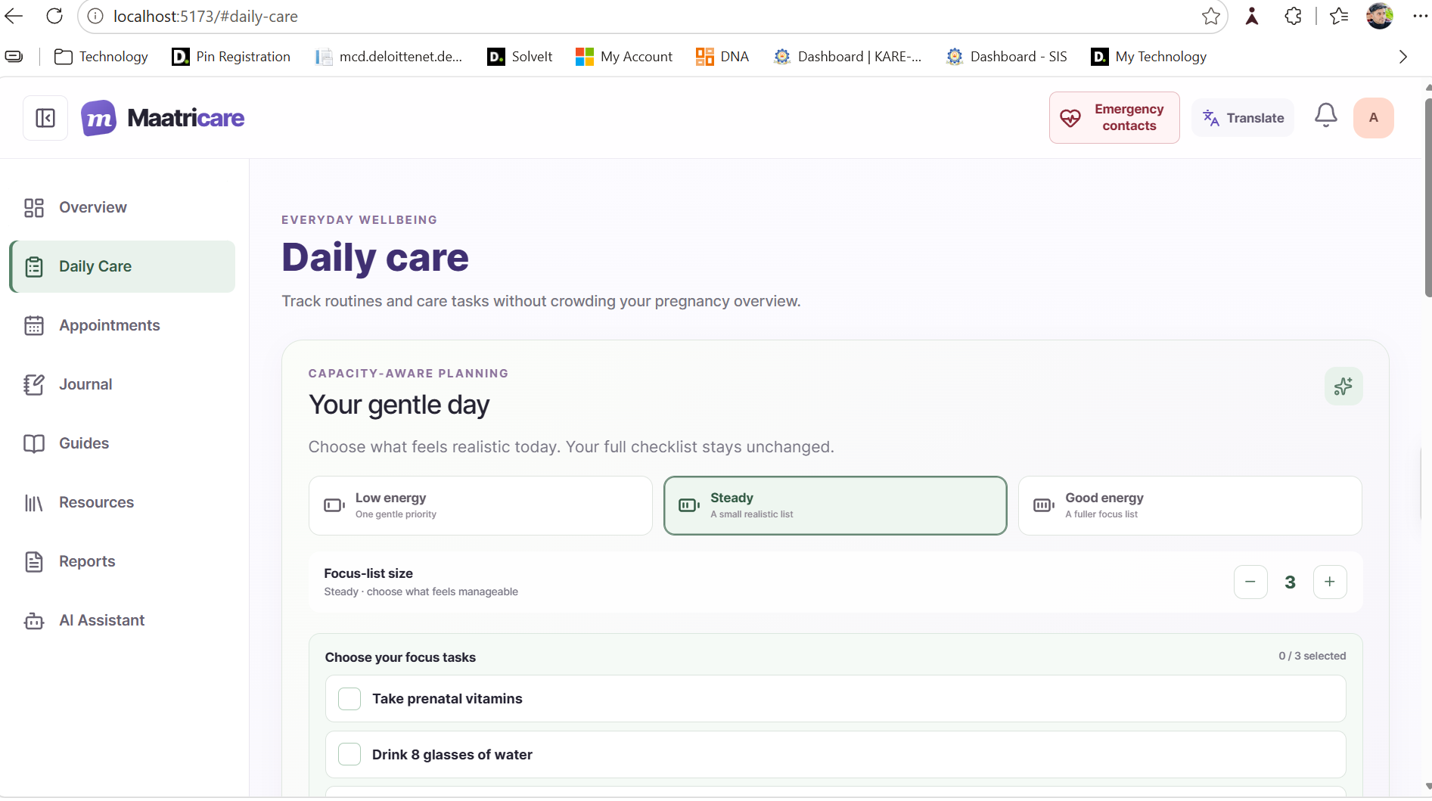
Daily Care and Gentle Day Planner
The daily care module tracks user-selected routines, including hydration, vitamins, activity, sleep, and mood. The Gentle Day Planner lets a user choose an energy level and a manageable focus list. Completion updates are saved to the account.
This module supports organization only; it does not prescribe a care plan.

Slide 10
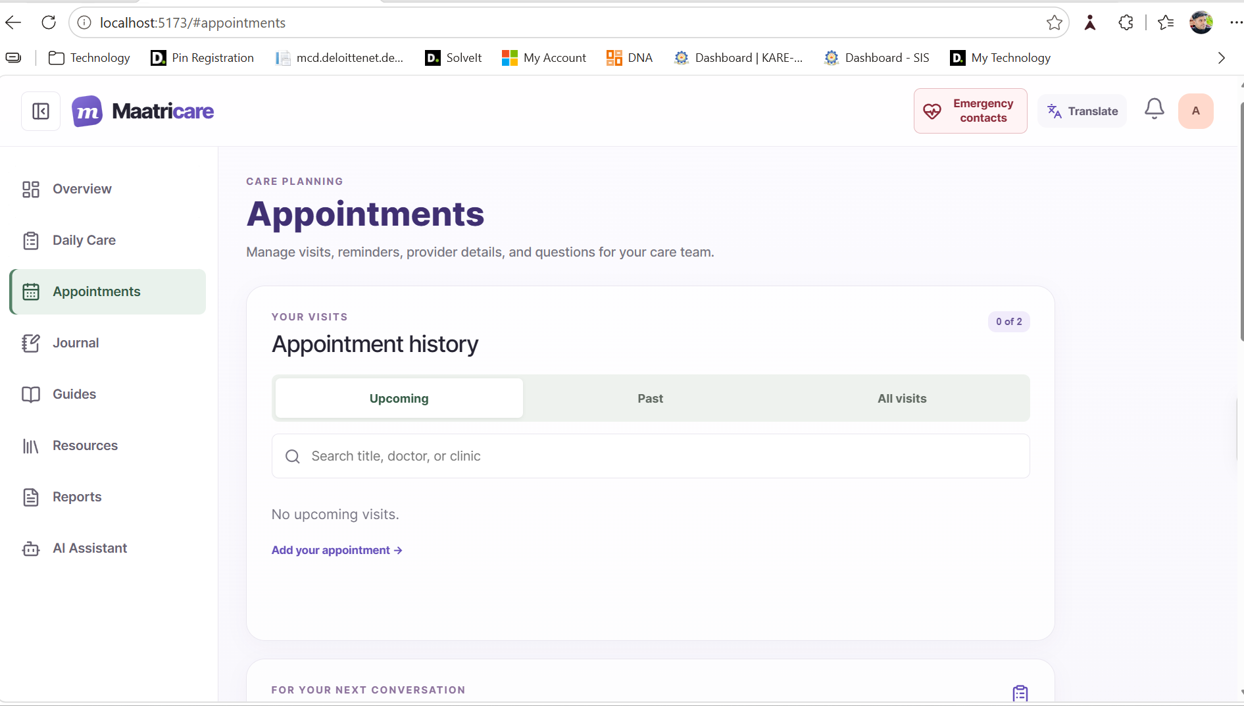
Appointment and Visit Brief Module
Users can create, search, and review upcoming or past appointments, record provider details, prepare questions, export calendar events, and generate a printable visit brief. The brief includes only information the user explicitly selects.

Slide 11
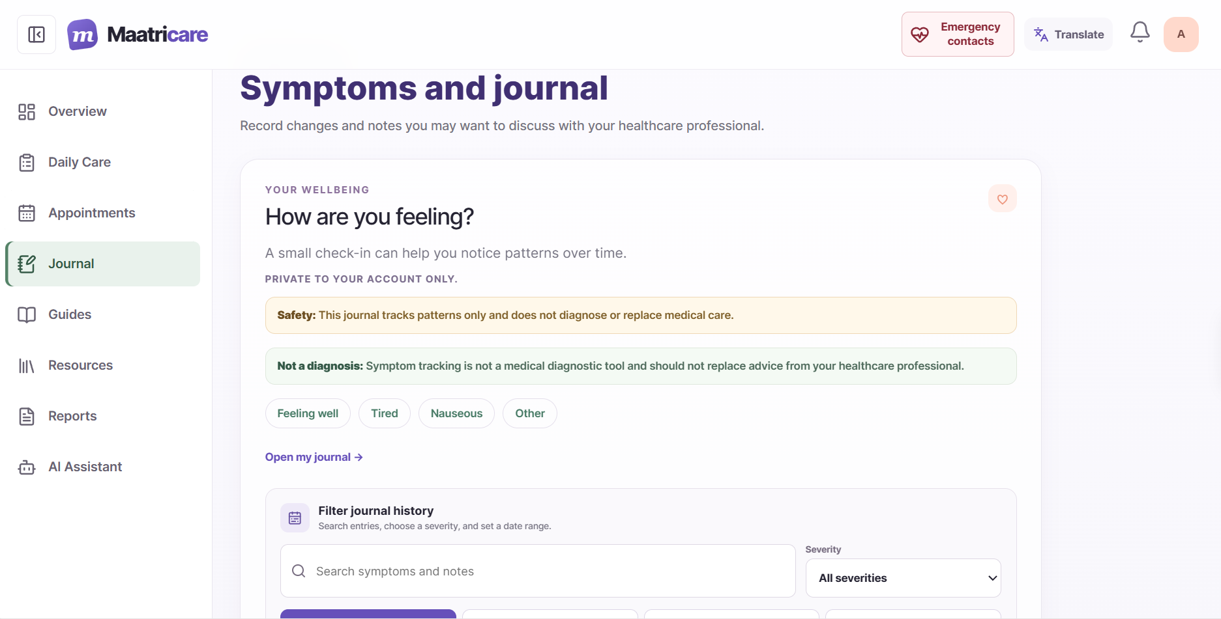
Private Journal and Learning Modules
Journal: record symptoms, severity, dates, and private notes; search and filter your entries.
Guides: review general, week-based information and searchable educational resources. Discuss personal questions with a healthcare professional.

Slide 12
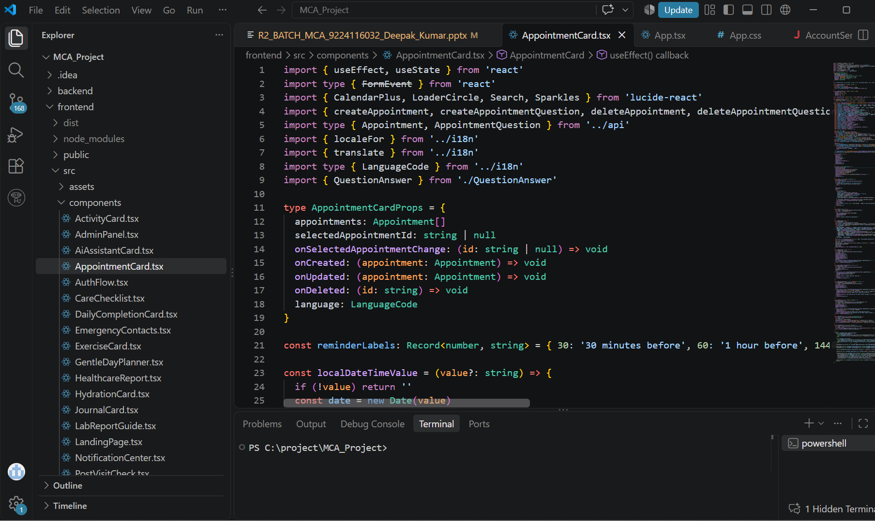
Sample Code : UI : TypeScript : AppointmentCard

Slide 13
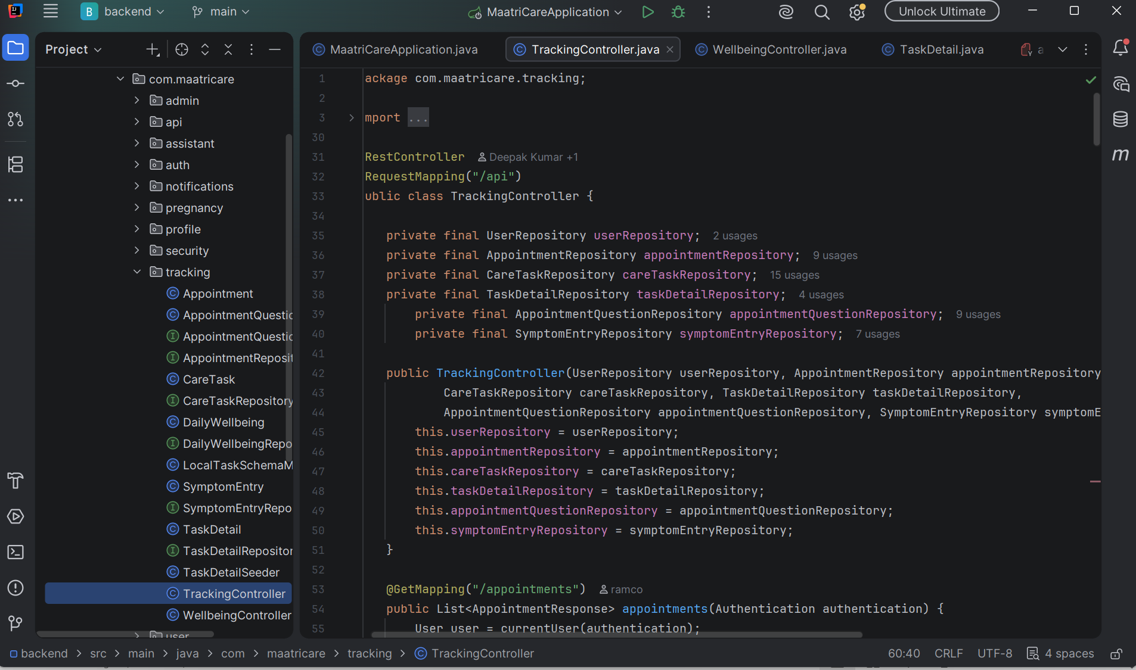
Sample Code : Backend : Spring Boot : TrackingController

Slide 14
Sample Data Set : MySQL / PostgreSQL
TABLE
SAMPLE FIELDS
PURPOSE
users
id, email, timezone_id
account
appointments
user_id, starts_at, reminder_minutes_before
visit schedule
care_tasks
user_id, task_date, completed
daily tasks
symptom_entries
user_id, symptom, severity
private journal
push_reminders
user_id, key, scheduled_at, status
scheduled delivery
push_subscriptions
user_id, endpoint_hash
opt-in device
All example records are synthetic and contain no real health information.

Slide 15
Testing Methods and Results
Backend: Spring Boot Test, MockMvc, JUnit, and H2 PostgreSQL mode. Four focused reminder tests passed.
Coverage: timezone default and validation; schedule preferences; deduplication; one-time expiring snooze; 90-day retention.
Frontend: TypeScript/Vite production build passed.
Privacy checks: JWT authentication, ownership checks, selective report sharing, generic push text.
Limitations: no live push delivery without VAPID keys and HTTPS; broader UI, accessibility, and MySQL integration tests remain future work.

Slide 16
Conclusion and Future Work
MaatriCare provides an authenticated workspace for pregnancy records, appointments, daily care, private journaling, educational resources, user-controlled reports, and reminders. The system focuses on organization and communication support.
Future work
- Configure VAPID and HTTPS, then test push on real devices
- Replace illustrative interface panels with live screenshots
- Extend frontend, database, migration, and accessibility tests
- Complete privacy/security review and production deployment
- Prepare the final report in the official institutional format

Slide 17
Reference Books and Websites
React Documentation. React.dev.
Spring Boot Reference Documentation. Spring.io.
Spring Security Reference Documentation. Spring.io.
PostgreSQL Documentation. PostgreSQL.org.
MySQL 8.0 Reference Manual. Oracle.
MDN Web Docs: Service Worker API and Push API.
Pressman and Maxim. Software Engineering: A Practitionerâ€™s Approach, 9th ed.
Sommerville. Software Engineering, 10th ed.
Verify publication details and retain only sources actually consulted.

Slide 18
Thank You

