Slide 1
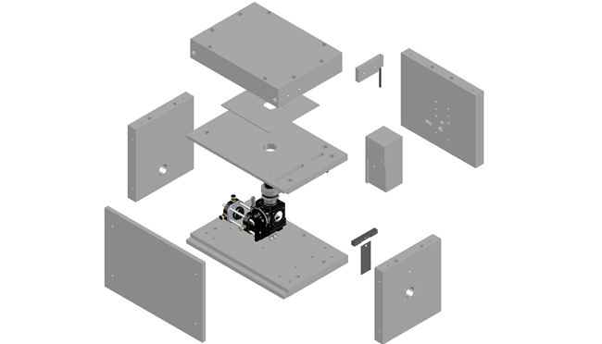
J
D
I
E
G
H
F
D
B
A
C

