Slide 1
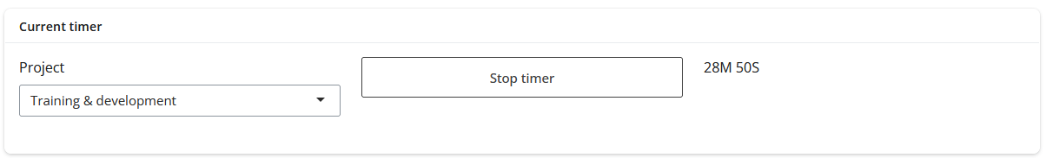
Time your work
Select the project you are working on
Start the timer
Click again to stop the timer
Keep track of the time spent

Slide 2
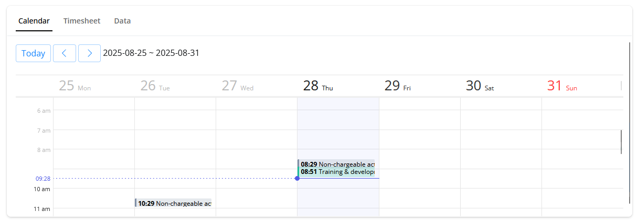
Calendar view
See all your project activity with a week-at-view calendar

Slide 3
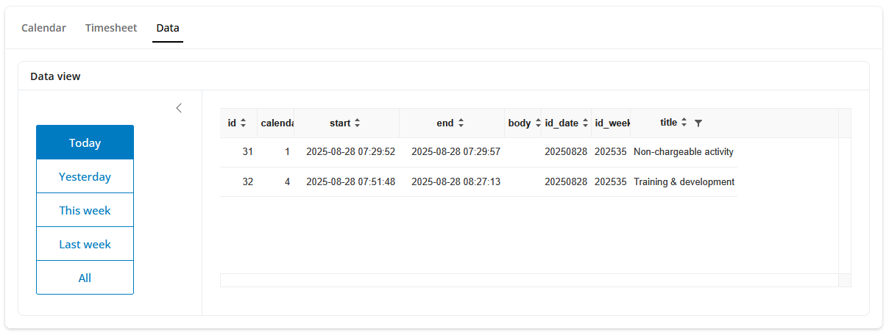
Data view
See your raw data

Slide 4


You’re in control
All data is stored on a SQL database kept on your computer.

