Slide 1
Stop targeting how big it gets.
Target where it starts.
Predicting Region-Season Wildfire Cause Patterns to Target Prevention and Mitigation
Craig Rudman · MSDS 696 Practicum II · Week 6
Notes:
SAY —
Stop targeting how big it gets. Target where it starts.
WATCH —
- A TARGETING claim, not an efficacy one. Nothing in this project measures what a treatment achieves; the ranking says where fire is most likely to arrive, which is a necessary condition for sited work to pay off and not a sufficient one.
- The deck closes on this same sentence at beat 19, so first and last statements match.

Slide 2
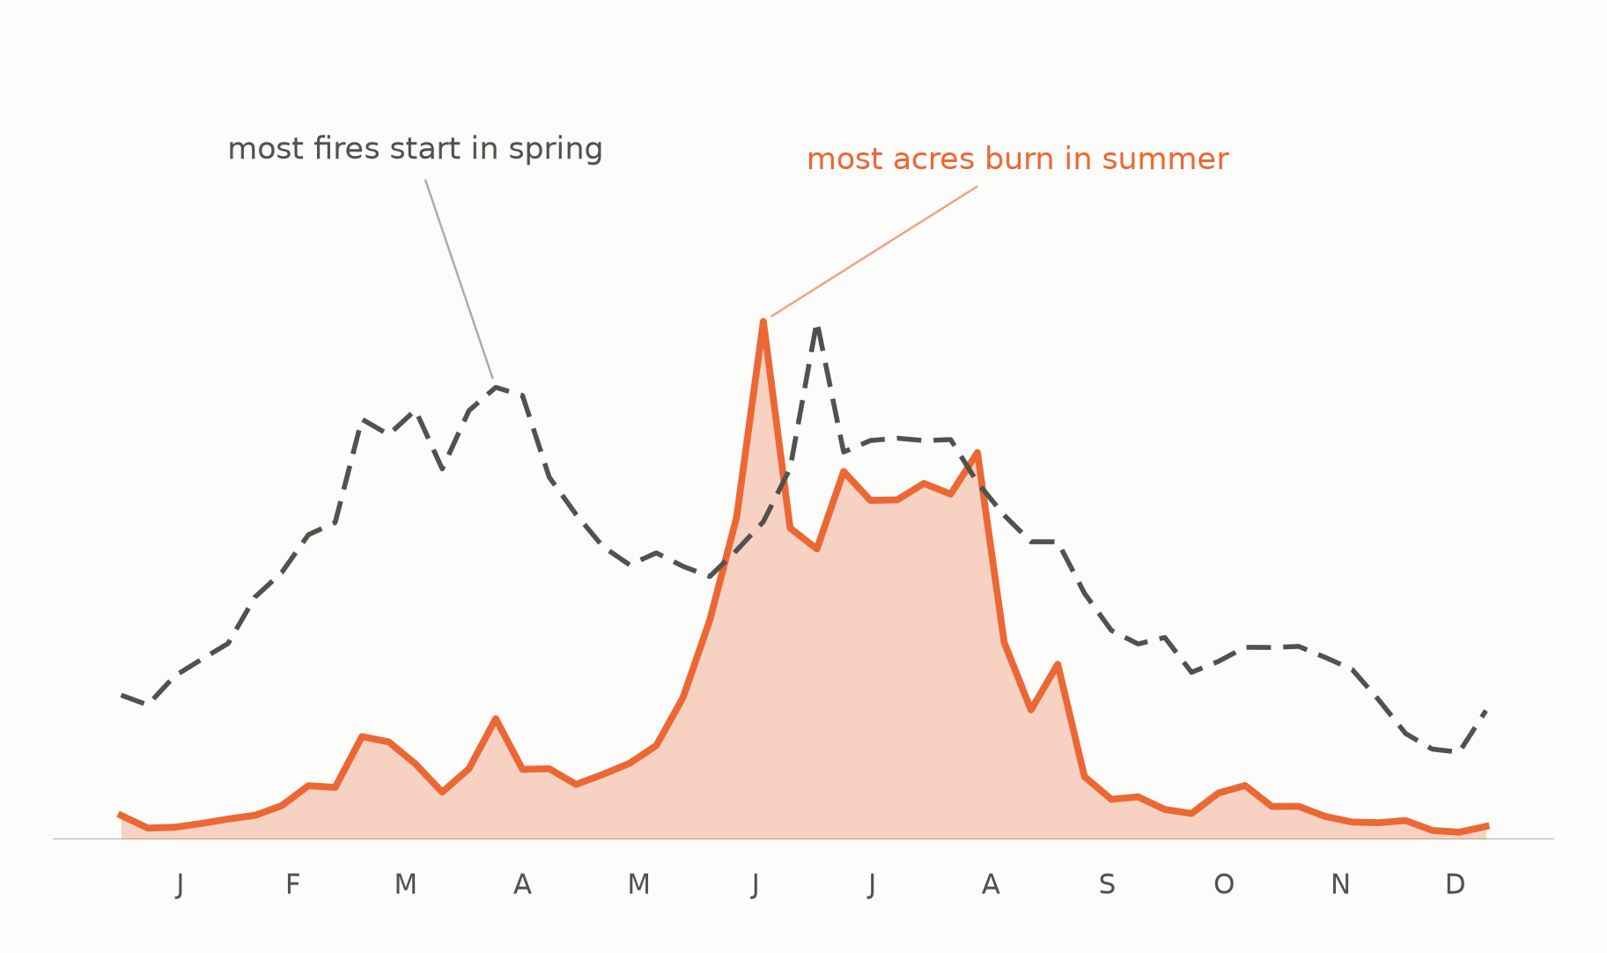
Wildfires are seasonal.
Notes:
EVIDENCE —
- Most fires start in spring; most acres burn in summer.
- MAM and JJA start nearly the same number of fires and differ 3.9x in acres.
WATCH —
- No axes and no magnitudes on this one — it is a calendar, not a chart.

Slide 3
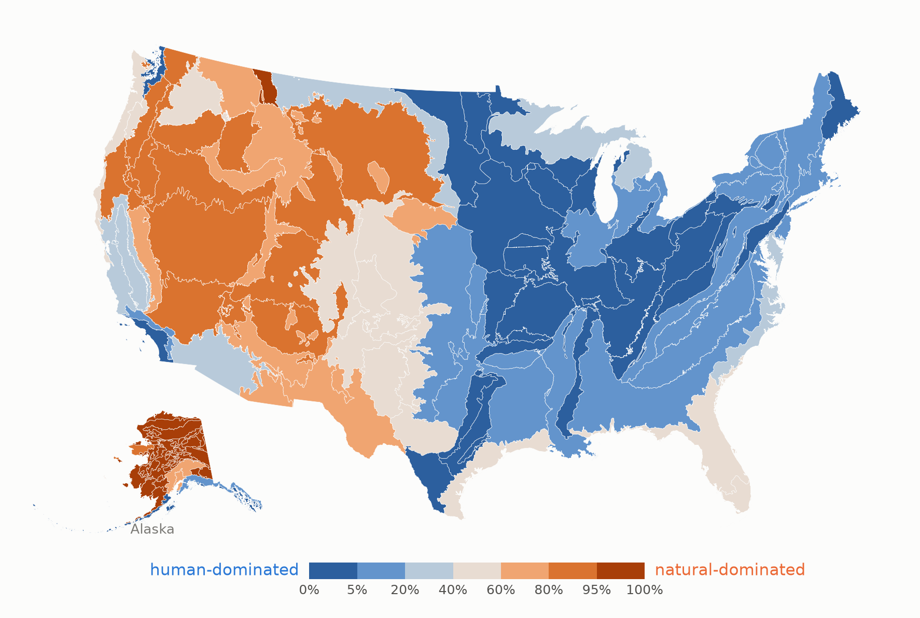
Cause is regional, not national.
Notes:
EVIDENCE —
- All 105 Level III ecoregions, shaded by natural share of attributed acres.
- A West/East split at roughly the 100th meridian; Alaska almost entirely natural.
- Bimodal: 50 regions below 20% natural, 28 above 80%, only 27 in between.

Slide 4
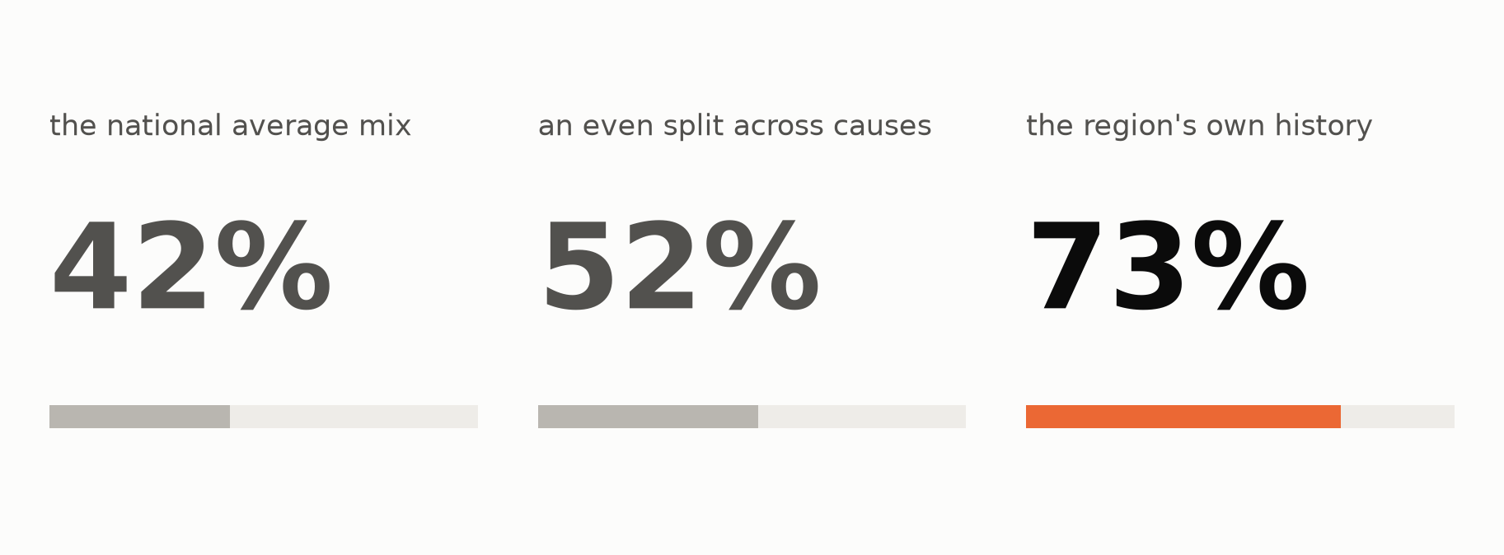
A region's cause mix is stable enough to forecast.
Notes:
SAY —
About three-quarters of the mix lands on the right cause.
EVIDENCE —
- Three tiles, worst to best: national average mix 42%, an even split 52%, the region's own history 73%.
- Acre-weighted TVD 0.580 / 0.485 / 0.266, forward-chained on 2010+, 3,949 held-out region-seasons.
WATCH —
- Do NOT say "right 73% of the time." 73% is an error magnitude (1 - TVD), not a hit rate — there is no "of the time" to attach it to.
- 72.7% top-1 agreement is a different number that DOES mean "of the time." Only use that phrasing if the slide on screen shows top-1.
- The middle tile carries the weight: the national mix at 42% is worse than guessing, which is beat 2 reappearing as forecast error.

Slide 5
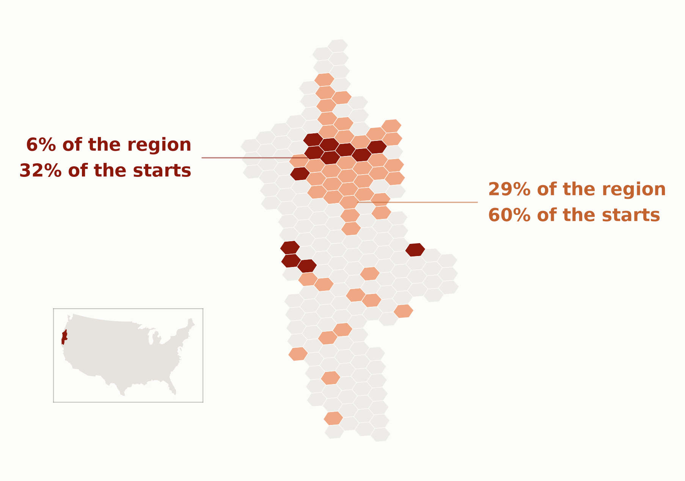
Where fires start is predictable, but not at ecoregion scale.
Notes:
SAY —
Everything so far has been a whole ecoregion — one number for an area the size of a small state. That is the right scale for deciding what to target, and the wrong one for deciding where to put anything. So from here the map breaks into cells of about sixty thousand acres, and the question changes with it: not how much will burn, but where fires start.
EVIDENCE —
- Klamath hexes in two bands: the deep band is 6% of the region catching 32% of next season's starts (5.2x); the light band 29% for 60% (2.1x).
- Held-out Spearman: Human +0.53, Natural +0.34.
WATCH —
- The deck's ONE grain change, and three things change at once: unit (105 ecoregions -> 36,234 hexes), target (acres -> ignition counts), answer (shares -> counts). The headline announces only the first; say the others.
- This is NOT an acres model. Unsaid, the audience reads the capture curve as "32% of the burn under 6% of the ground" — a much stronger claim than the one being made. It is 32% of the STARTS.
- The return decays fast: 90% of starts needs 77.8% of the ground at 1.16x. The ranking concentrates return; it does not eliminate the tail.
- Q&A companion: img/w6_capture_curve.png.

Slide 6
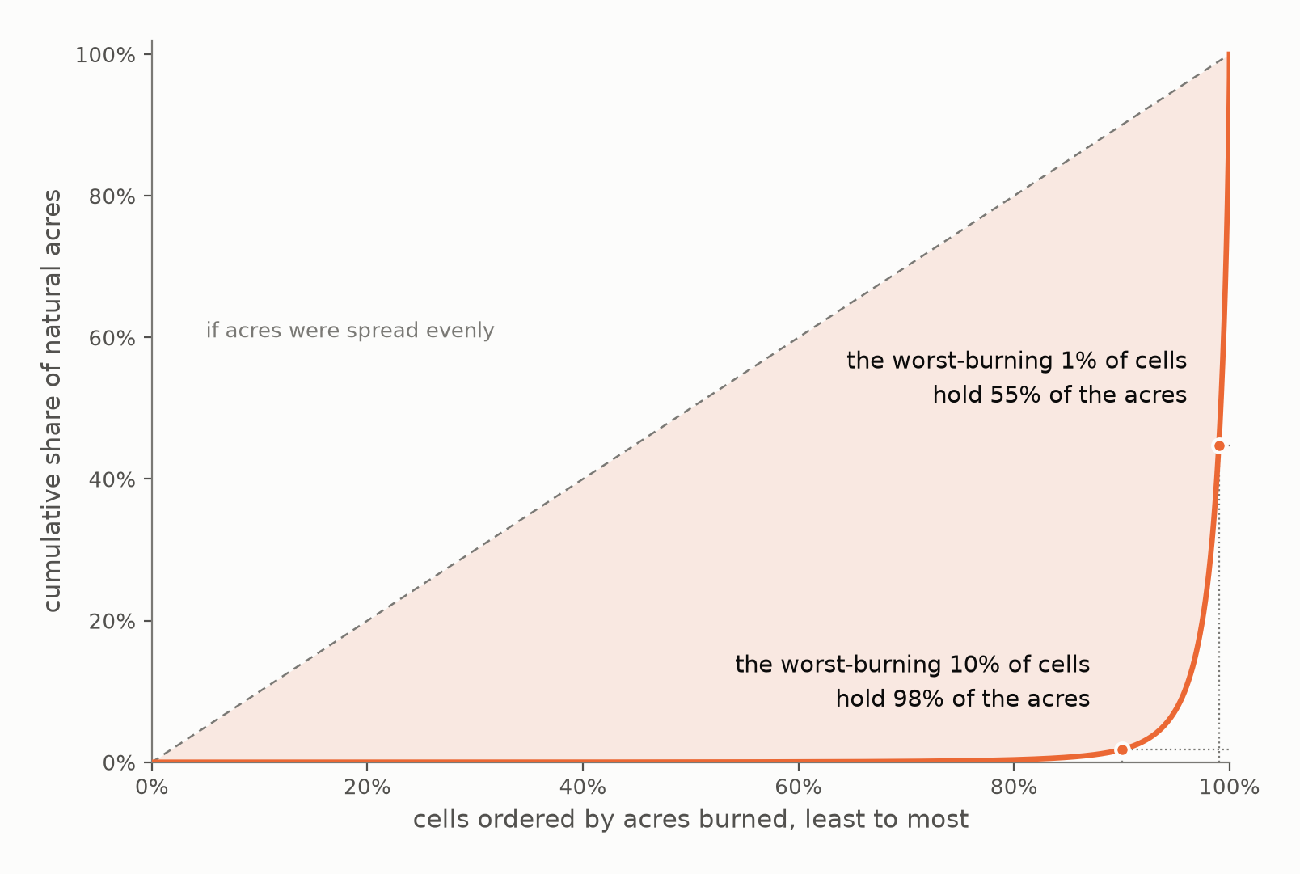
Almost all the acres are in almost none of the cells.
Notes:
EVIDENCE —
- Cumulative share of natural acres, cells ordered by acres burned, least to most.
- The worst-burning 10% of cells hold 98% of the acres; the worst-burning 1% hold 55%.
WATCH —
- This sets the stakes for beat 11 — it names which cells a forecast has to get right BEFORE any error is shown. Matched pair with 11; neither survives alone.

Slide 7
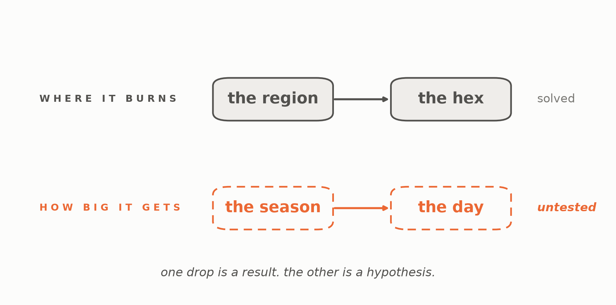
Siting needed a finer place. Size needs a finer moment.
Notes:
SAY —
Remember what we did to make siting work: the region was too coarse to put anything anywhere, so we dropped down to a hex. This is the same problem on the other axis. We asked how big a fire gets over a whole season, and a season is too coarse a unit to answer that — what makes a fire run is the wind on a particular afternoon, whether crews were already committed, what time of day it started. We could not test that here, because same-day data is a different project. But the shape of the failure tells you where to look.
EVIDENCE —
- The deck's only figure that plots no data, and its only one about the method rather than the fire. The solved row is closed, the untested row dashed.
- The fourth time the project has met the same lesson: W4's pooled climate null, beat 12's places-not-years, beat 7's grain drop, now this.
WATCH —
- Say "before the season" whenever the claim is stated as a null. "Megafire size is unpredictable" is a much bigger claim than anything measured here.
- Do not apologise for the null. Five ablations, a shuffled control at 26.6 SD, and a gain that landed in the wrong deciles is a thorough negative result.
- If asked "did you try hard enough?" — pre-season data was tried hard, same-day data was not tried at all. The second half is the open question, not a gap.
- If the room needs "stop targeting it" said aloud, say it as the last sentence rather than the headline.

Slide 8
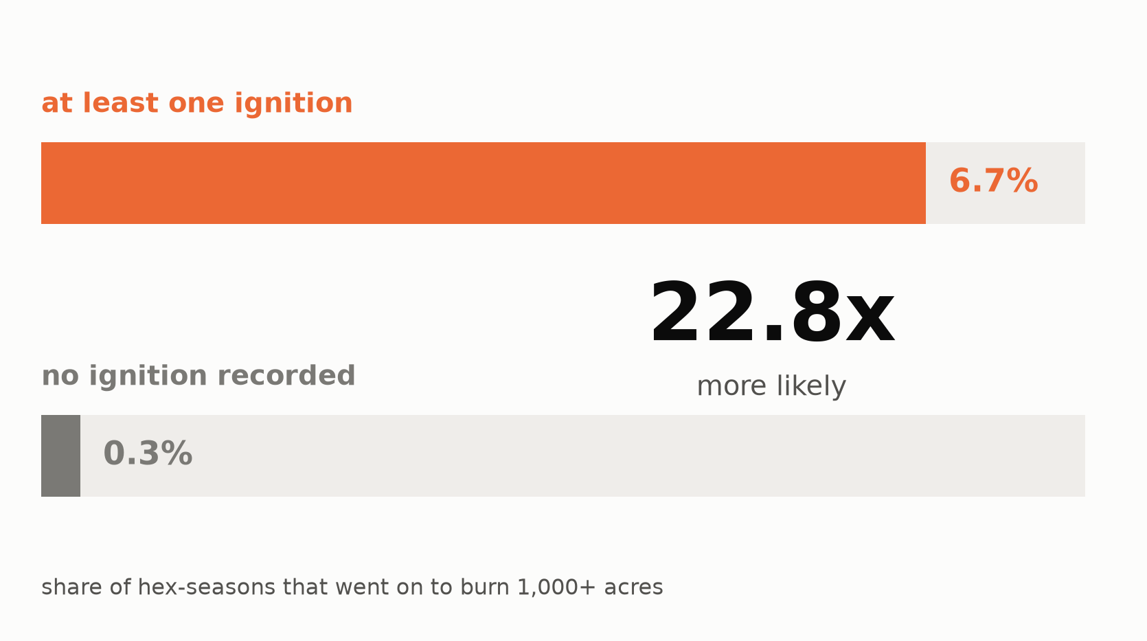
Every megafire was an ignition first.
Notes:
EVIDENCE —
- Two bars in a common frame, no axis: a hex-season that ignites at all produces a >=1,000-acre burn 6.7% of the time against 0.29% for one that does not — a 22.8x gate.
- JJA natural, held-out years. Percentages printed because at true scale the 0.29% bar is nearly invisible — which is itself the finding.
WATCH —
- Do not oversell the gate: it is necessary, not sufficient. 93% of igniting hex-seasons still produce nothing large. It narrows the field; it does not identify the fire.
- This is the door beat 15 left open — size is not forecastable, but the event upstream of it is.

Slide 9
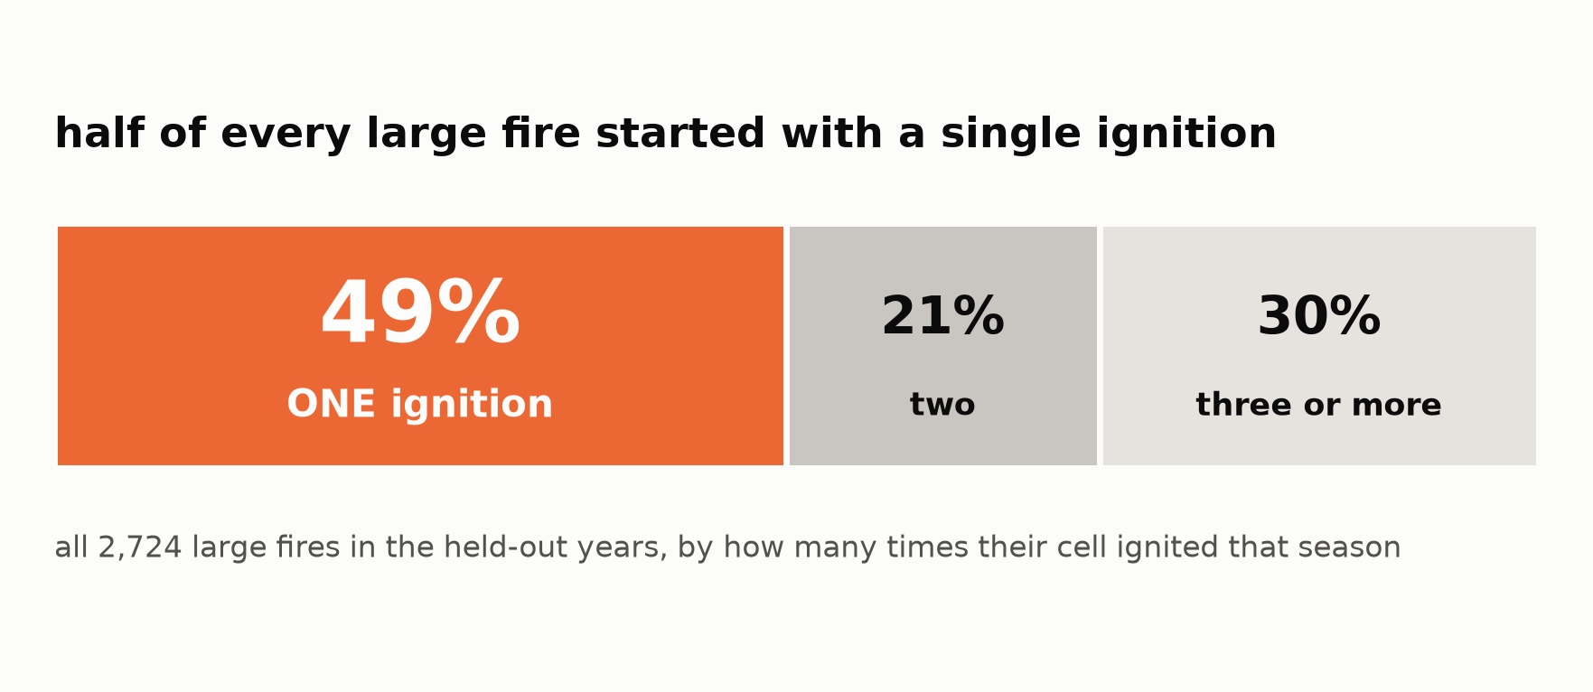
One ignition is enough.
Notes:
EVIDENCE —
- One stacked bar over all 2,724 large-fire cells in the held-out years, split by how many times their hex ignited that season: 49% had exactly one, 21% two, 30% three or more.
- Only the first segment carries color — it is the ground a planner would deprioritise by ranking on ignition count.
WATCH —
- The rule is binary: does this place ignite, not how often.
- If asked "doesn't a cell with more ignitions carry more risk?" — the rate does rise (19.1% at 11-20 ignitions vs 5.4% at one), but risk PER ignition falls 0.054 -> 0.014, and 49% of large-fire cells had exactly one ignition.
- Ignition count ranks burned area worse than the hex's own burn history does: Spearman +0.253 against +0.357.

Slide 10
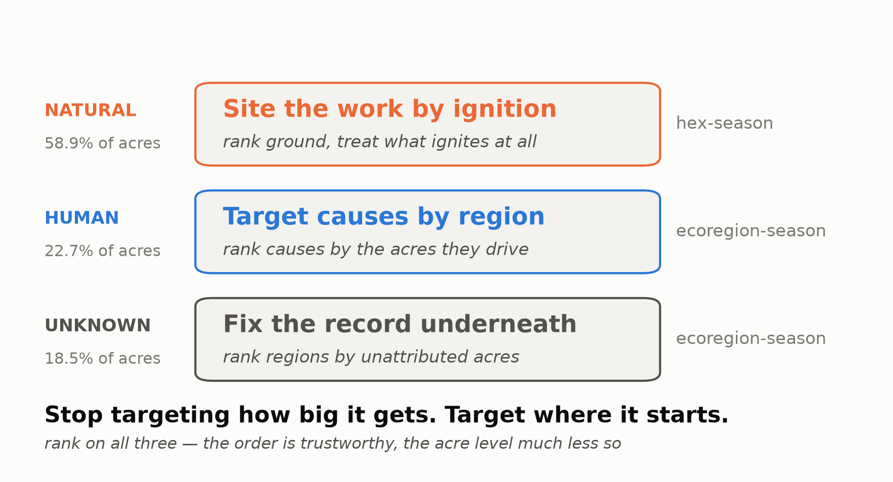
Target causes by region. Site the work by ignition. Fix the record where it says neither.
Notes:
SAY —
Stop targeting how big it gets. Target where it starts.
EVIDENCE —
- Three rows, one per Tier-1 class, ordered by share so the top row is where the acres are: Natural 58.9%, site by ignition, hex-season; Human 22.7%, rank causes by the acres they drive, ecoregion-season; Unknown 18.5%, fix the record underneath, ecoregion-season.
- The boundary, on the line beneath: rank on all three — the order is trustworthy and the acre level much less so.
WATCH —
- A TARGETING claim, not an efficacy one. Nothing here measures what a treatment achieves — no before/after, no control, no counterfactual.
- If asked "so if we treat those hexes, we cut the burn?" — say no, plainly. Davis et al. (2024) on severity reduction is separate evidence from someone else's study; cite it if asked, do not fold it in.
- If they remember one thing: site the work against where fires start, because that is the one stage of the escalation this data can see in advance.

