Slide 1
For pre-season planning:
Rank the ground, not the fire.
Predicting Region-Season Wildfire Cause Patterns to Target Prevention and Mitigation
Craig Rudman MSDS 696 Data Science Practicum II Regis University crudman@regis.edu
Source: FPA-FOD 6th ed., 2,271,343 fires, 1992–2020, 179.4M acres.
Notes:
This is for a state or regional fire planner deciding, before the season starts, where to concentrate a fixed prevention and mitigation budget.
It comes out of the federal record of U.S. wildfire occurrence — 2.3 million fires, 1992 through 2020, each with a date, a location, a size, and a cause. A quarter have no cause recorded.
The recommendation, up front: for pre-season planning, rank the ground — not the fire. Where fires start is predictable. How big they get, before the season, is not.

Slide 2
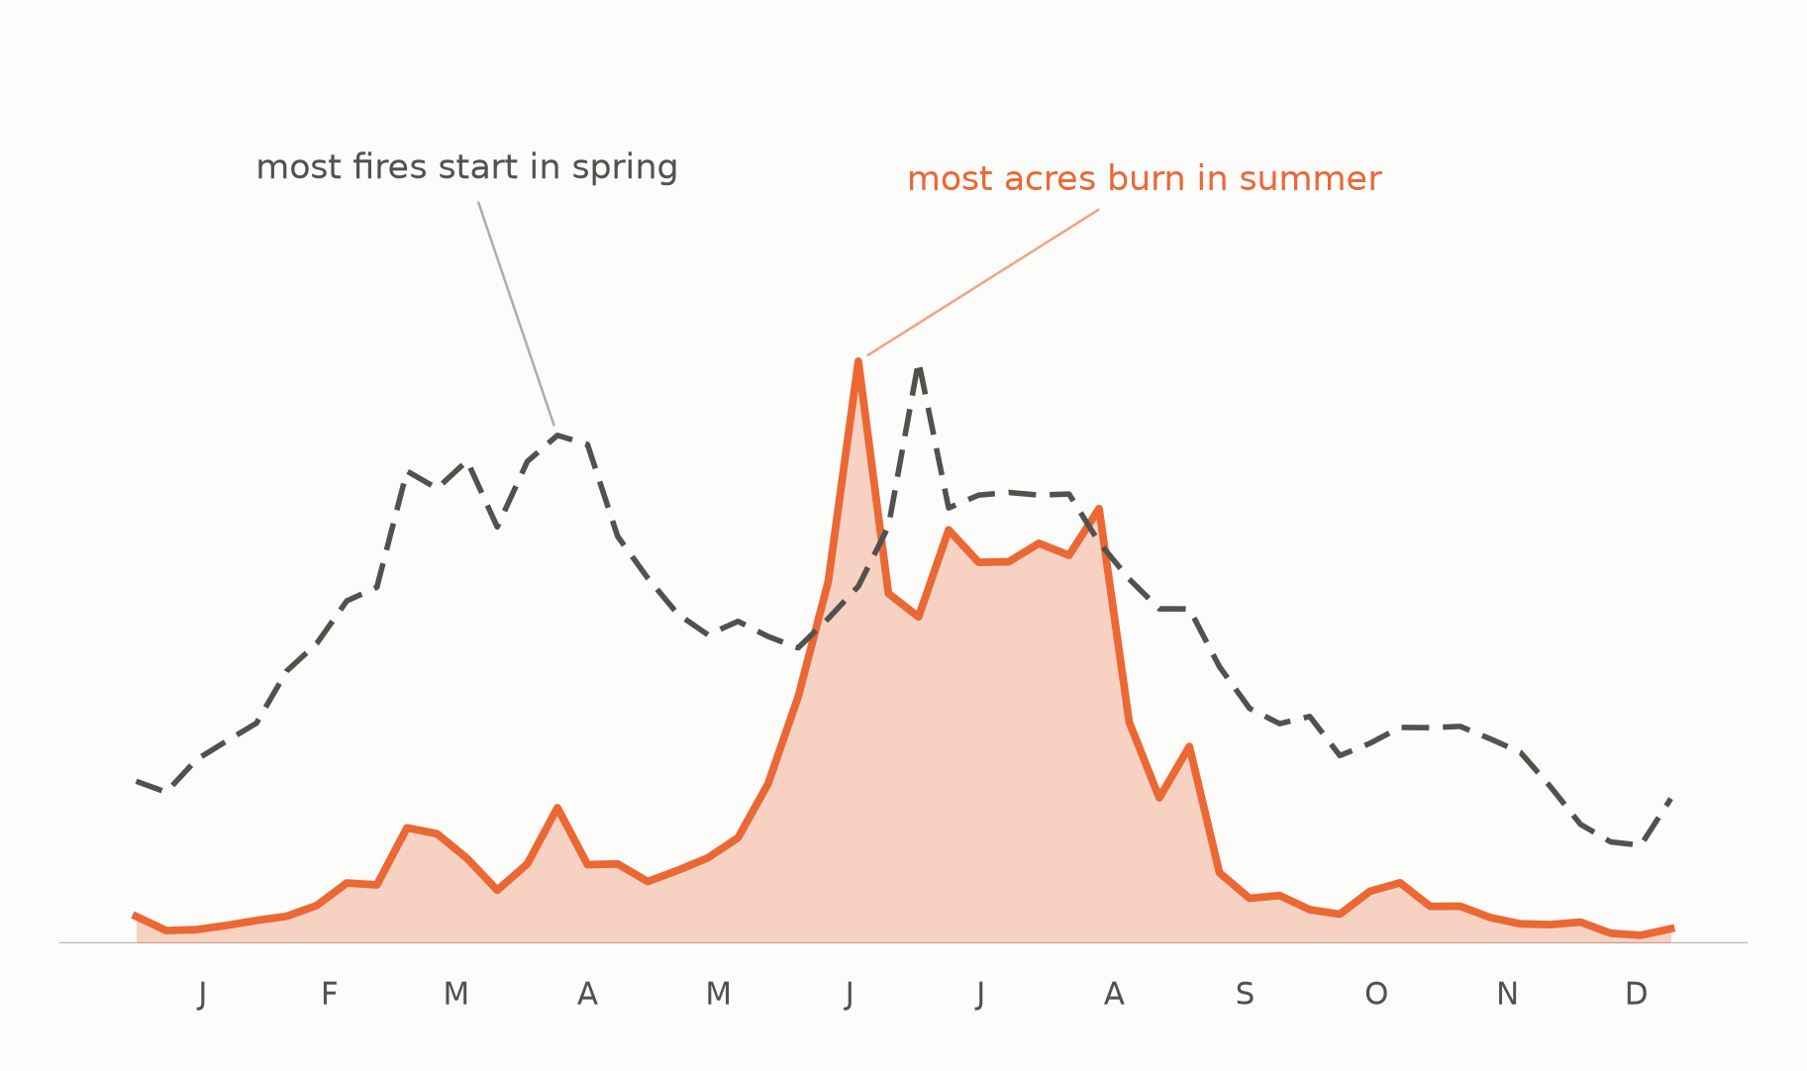
Wildfires are seasonal.
2.3M cleaned fires, 179.4M acres, 29 years; curves scaled to a typical year.
Notes:
Fire runs on a calendar, and the two peaks are months apart. The dashed line is when fires start, the solid one is how much burns. Spring and summer start about the same number of fires — summer burns almost four times the area.
Planners have to decide what to target, and where, before the season starts.

Slide 3
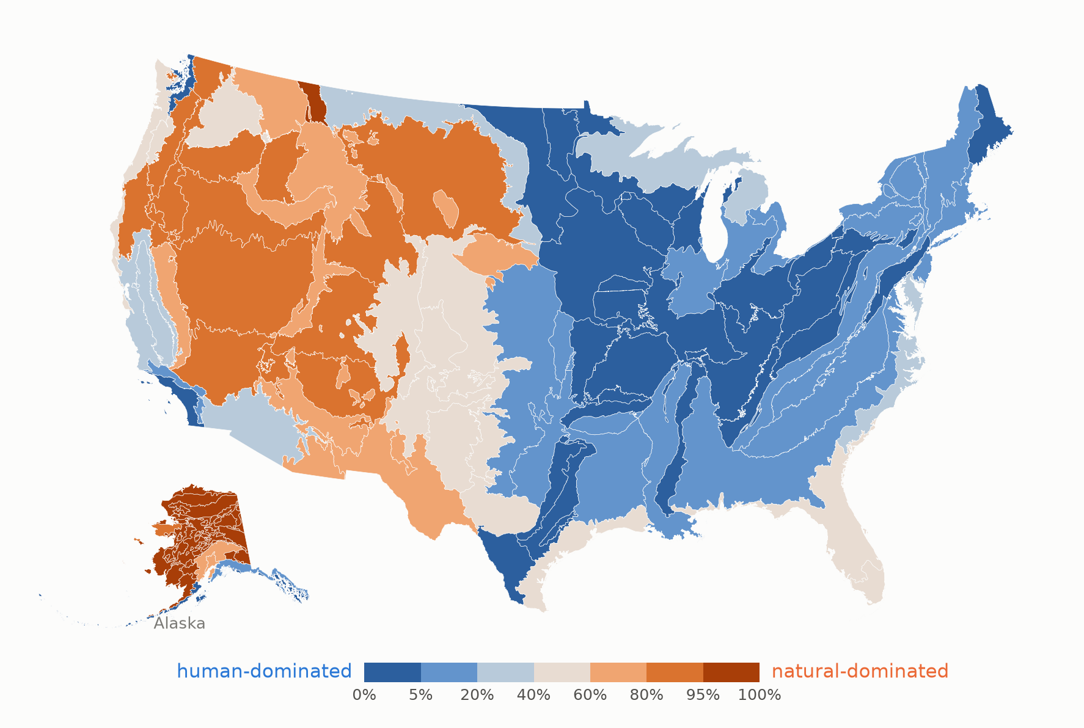
Cause is regional, not national.
105 Level III ecoregions; 146M resolved acres (missing-cause acres excluded from shading)
Notes:
Fire follows terrain, vegetation and climate, not state borders, so I’ve placed every fire into an EPA Level III ecoregion. A hundred and five cover the country.
If we shade each by how much of its burned area is of natural versus human causes, then the map splits at about the hundredth meridian… natural in the West, human in the East.
There's no national answer to what starts fires. There are regional ones.

Slide 4
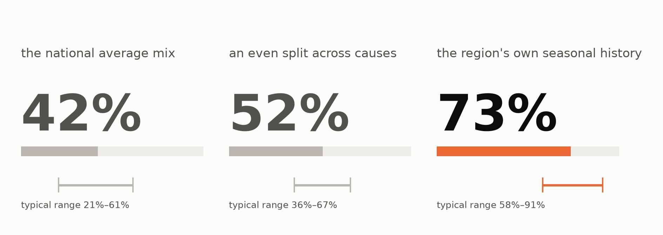
A region's cause mix is stable enough to forecast.
3.9k held-out region-seasons, 2010–2020; 80M held-out acres; trailing-mean k=7, forward-chained, acre-weighted TVD.
Notes:
The cause mix is three classes splitting a region-season's burned acres into natural, human, and unknown.
We're looking at three ways to predict that mix using a trailing mean of 7 years by region-season, acre-weighted, forward-chained. A region's own seasonal history beats the aggregate models shown here.

Slide 5
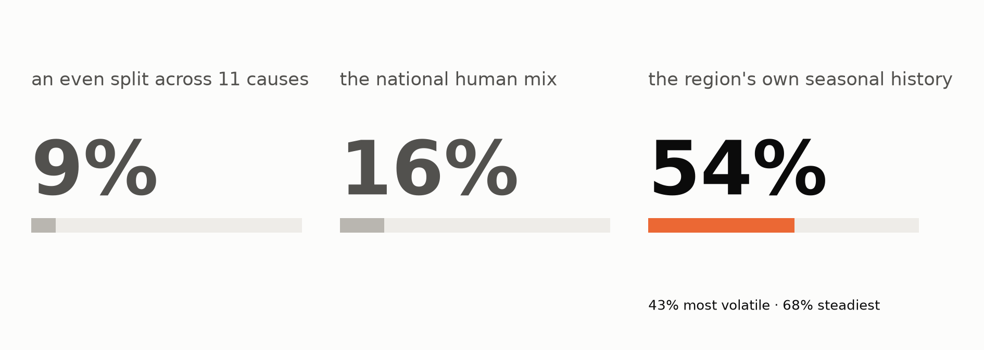
For human-cause wildfires, history names the lead cause more often than not.
3.9k held-out region-seasons (volatility split 3,844), 2010–2020; human-acres denominator; trailing-mean k=7, forward-chained, acre-weighted TVD.
Notes:
Human-caused fires break down to eleven sub-causes: arson, equipment, debris burning, powerlines, and so on. Rank them per region-season by the acres each drives, not by count.

Slide 6
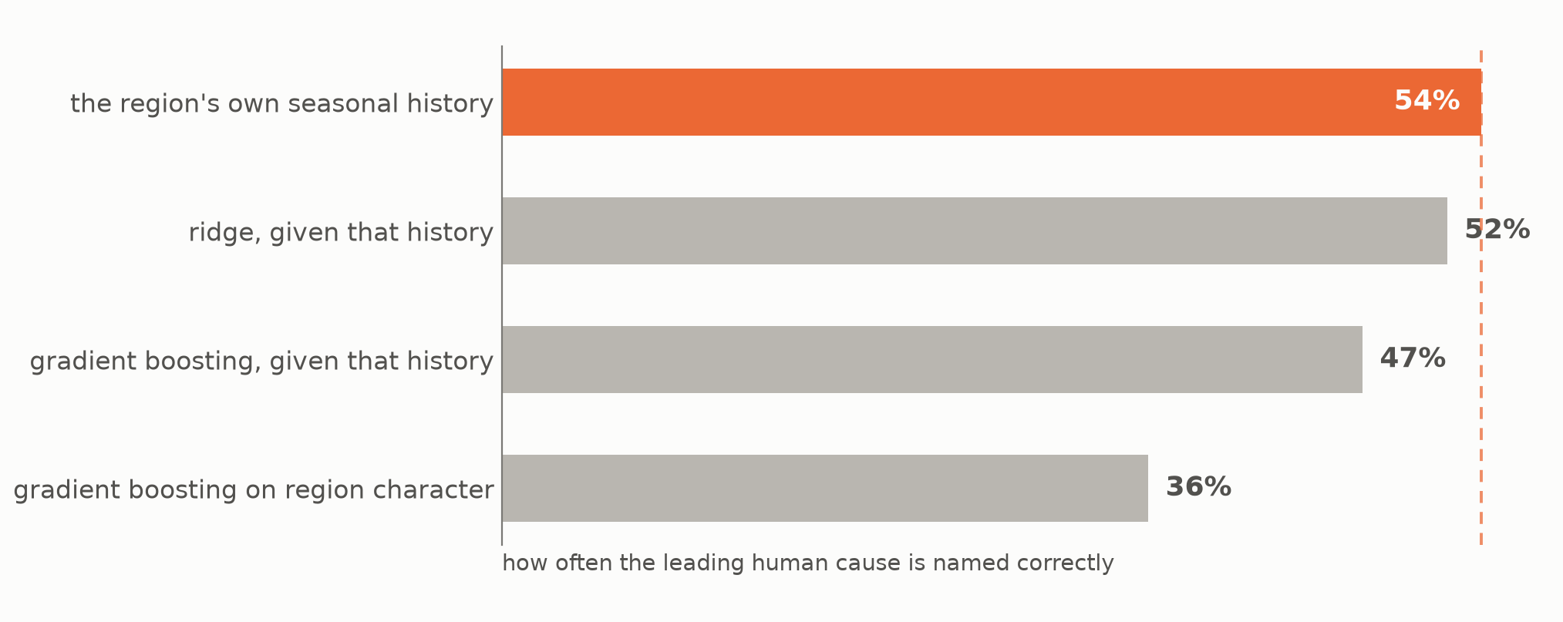
A learned model made naming the leading cause worse.
3.8k held-out region-seasons, 2010–2020; all rungs on identical cells, features and weights; ridge and gradient boosting vs. the k=7 floor, acre-weighted TVD and top-1.
Notes:
We tried training a few different models on a few different feature sets. None of them beat the region's own seasonal history — including the ones we handed that history to.

Slide 7
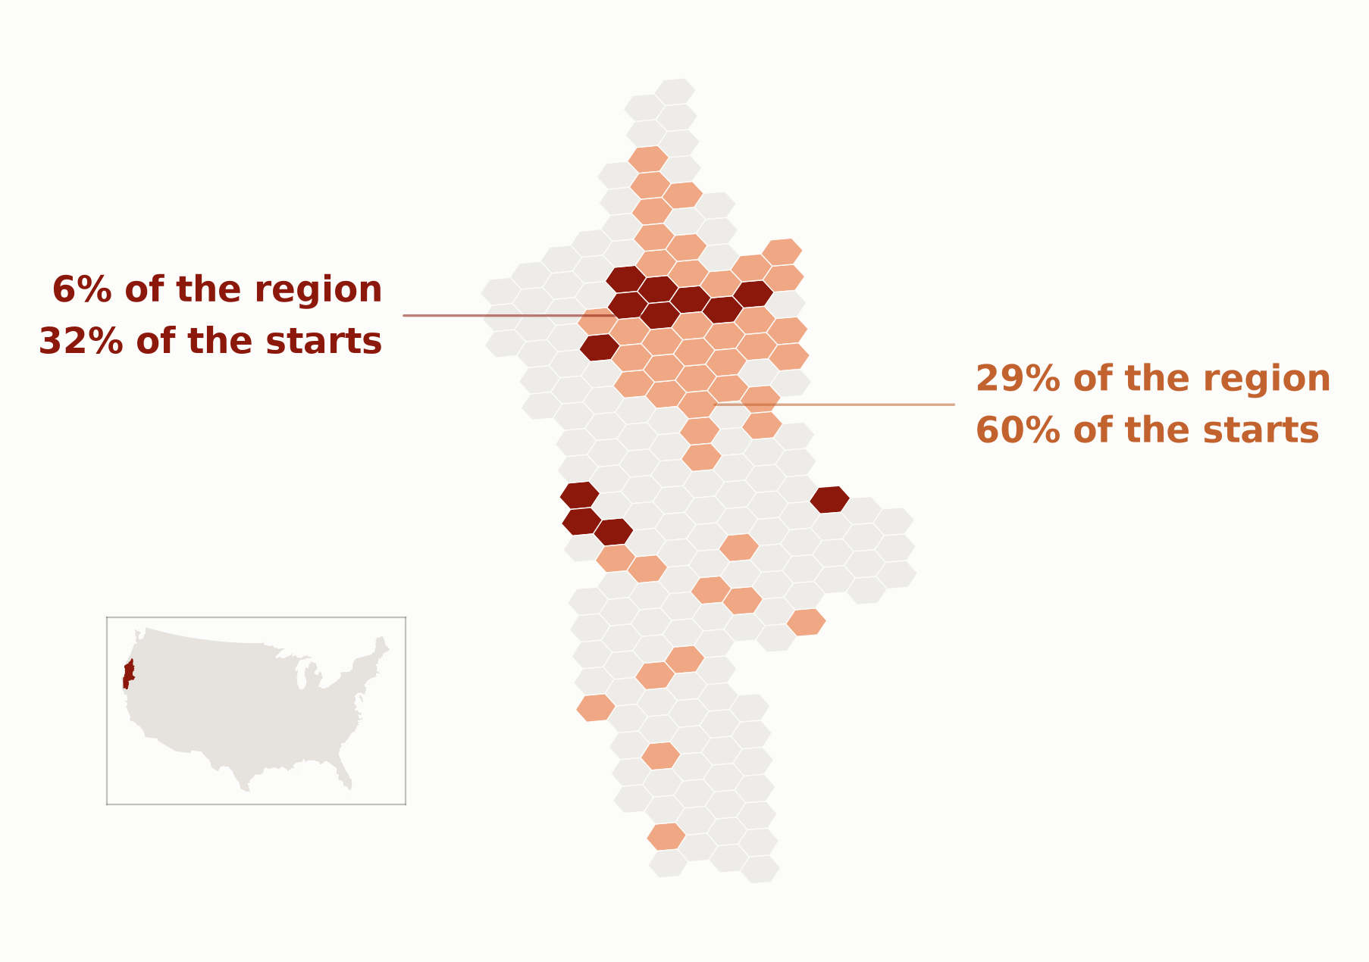
Where fires start is predictable, at the scale where you'd site the work.
198 res-5 hexes, Klamath Mountains, Summer 2020; 366 observed starts; persistence baseline, forward-chained; one season, not pooled.
Notes:
Ecoregion is the right scale for deciding what to target, but the wrong one for deciding where to focus resources. I layered in a hexmap of cells, about sixty thousand acres each, and the target changed with it: no longer shares of burned areas, it’s now counts of ignitions.
The region shown here is the Klamath Mountains in Western Oregon and Northern California; about two hundred cells. The darker cells show six percent of the ground catches a third of next season's starts; the lighter band, twenty-nine percent of cells for sixty percent of the fires started.

Slide 8
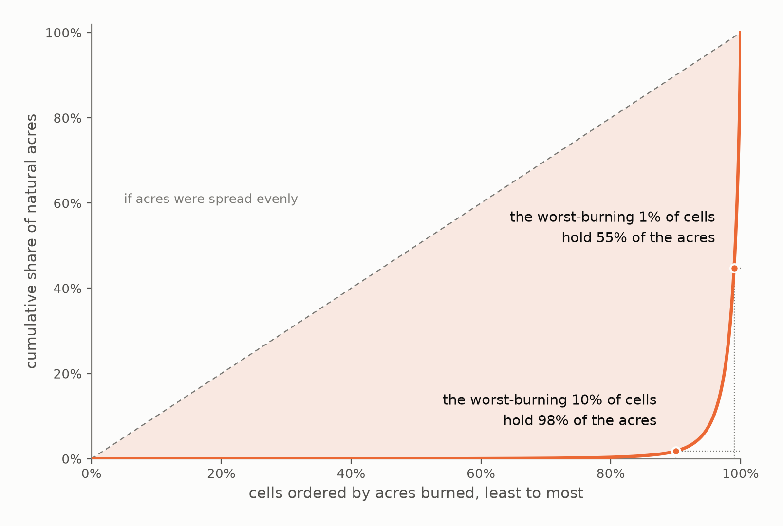
Almost all the area burned is in almost none of the cells.
167.8k burning hex-seasons; zero-burn cells excluded; perimeter-corrected acres; descriptive, no model.
Notes:
Same region, but now acres burned. Just one percent of the cells holds more than half of the burned area.
A forecast only matters at the top 10% of cells ranked by acres burned.

Slide 9
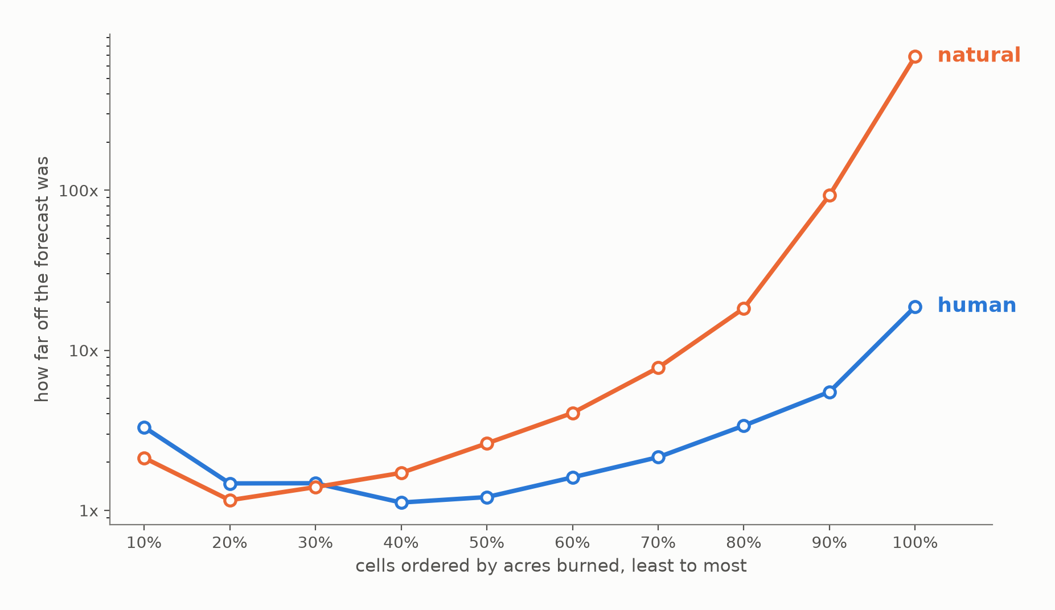
Up to a point, human and natural burned area is equally predictable. Past that point, natural is harder.
18.6k natural vs. 149.9k human burning hex-seasons, ≥1 acre, 2010–2020; persistence baseline, forward-chained; median log error by decile.
Notes:
Still on acres burned — same cells, same ordering. Across the left two thirds they track together more or less, then they split. At the right edge, on the cells that hold the acres, human fire is off by a factor of nineteen; natural fires off by nearly seven hundred.
So these ship as two different products. Human acres burned you can rank by expected acres. Nature fires you can't — which means for prioritizing natural fire mitigation resources, the answer is something other than fire size.

Slide 10
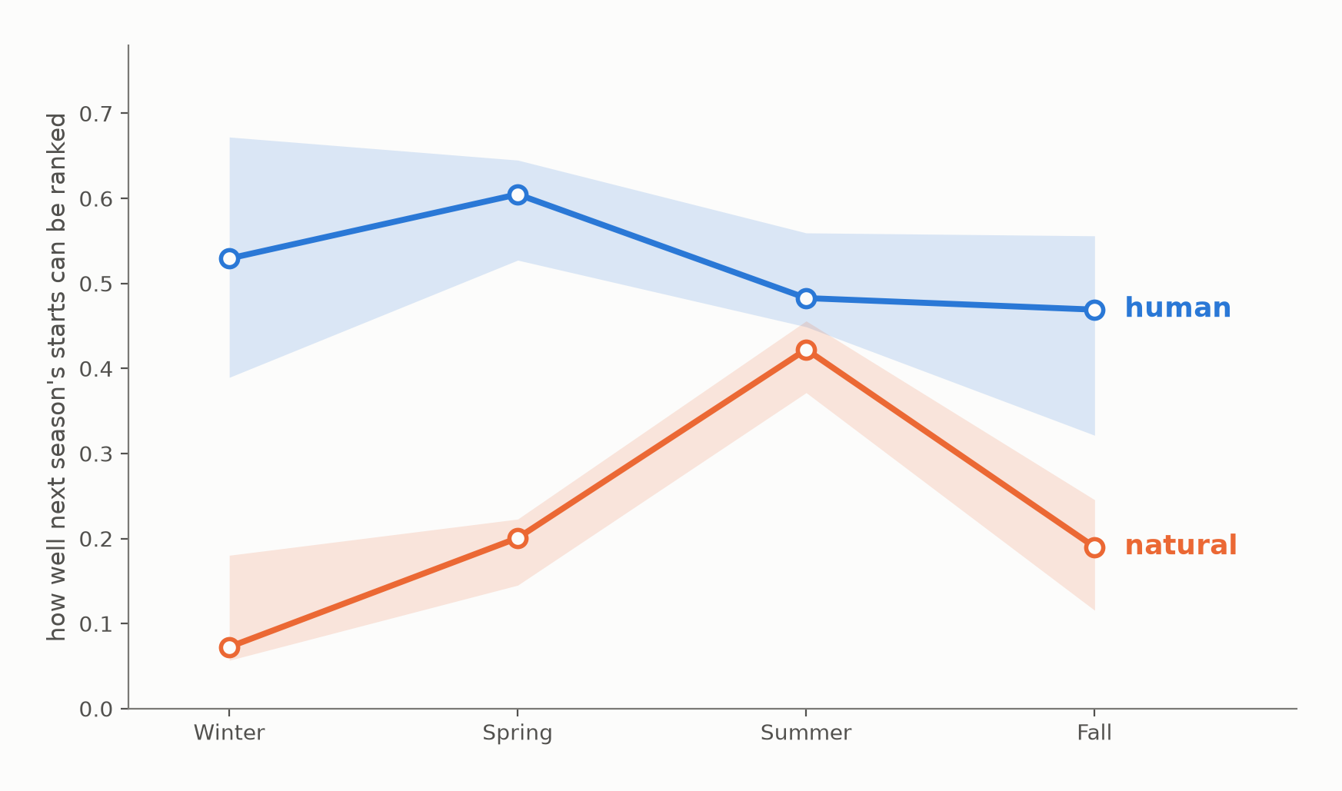
Where human fires start is predictable year-round; natural only in summer.
36.2k hexes per plotted point; 398.6k per season across 11 held-out years; persistence baseline, forward-chained; held-out Spearman, band is min–max.
Notes:
When we rank cells by where fires start it splits by season. Human in blue, natural in orange.
Human fire is rankable all year. It peaks in spring, but it never drops far. Natural fire is a summer phenomenon — good in July, and by winter it's essentially nothing.
That matters because they call for different work. Human ignition is a year-round program of prevention. Natural ignition is a seasonal program of mitigation, and its the one that burns the most.

Slide 11
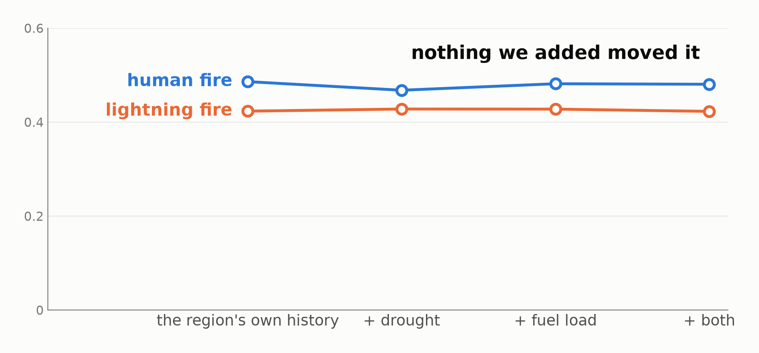
We tried to improve that with drought and fuel, but where fires start is a property of the place, not of the year.
29.3k held-out hex-seasons, six forest ecoregions, Summers 2010–2020; covariate ablation over the persistence floor, covariates lagged pre-season; held-out Spearman.
Notes:
I layered in data about drought and fuel density over time. Nothing moved. The axis starts at zero, so a real effect would show, and the best gain here is just four thousandths of a point.
Here's why. Greener cells with more fuel do get more fires than browner ones. But when a cell is greener than its own normal, it barely gets more fires than its own normal. These covariates find dry places which the history already knows. Where fires start is a property of the place, not of the year.

Slide 12
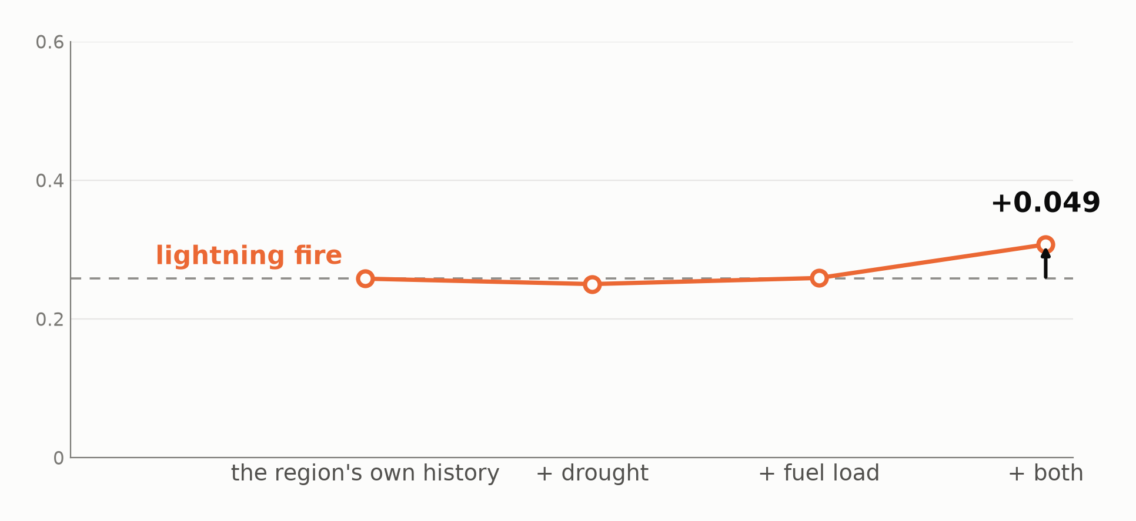
The same data does predict how much burns.
7.8k burning hex-seasons, Summers 2010–2020; burn-conditional baseline, covariate ablation, validated across five split years; held-out Spearman.
Notes:
However, the same data does help us predict how much fire will burn after it starts.
Drought alone does nothing. Fuel alone does nothing. Together they give a real gain — a fifth better than history, holding across every way we split the years. Which makes sense: wet heavy fuel won't carry fire, dry bare ground has nothing to burn. You need both.
So the data does know something about how much burns. The question is whether it knows it anywhere useful.

Slide 13
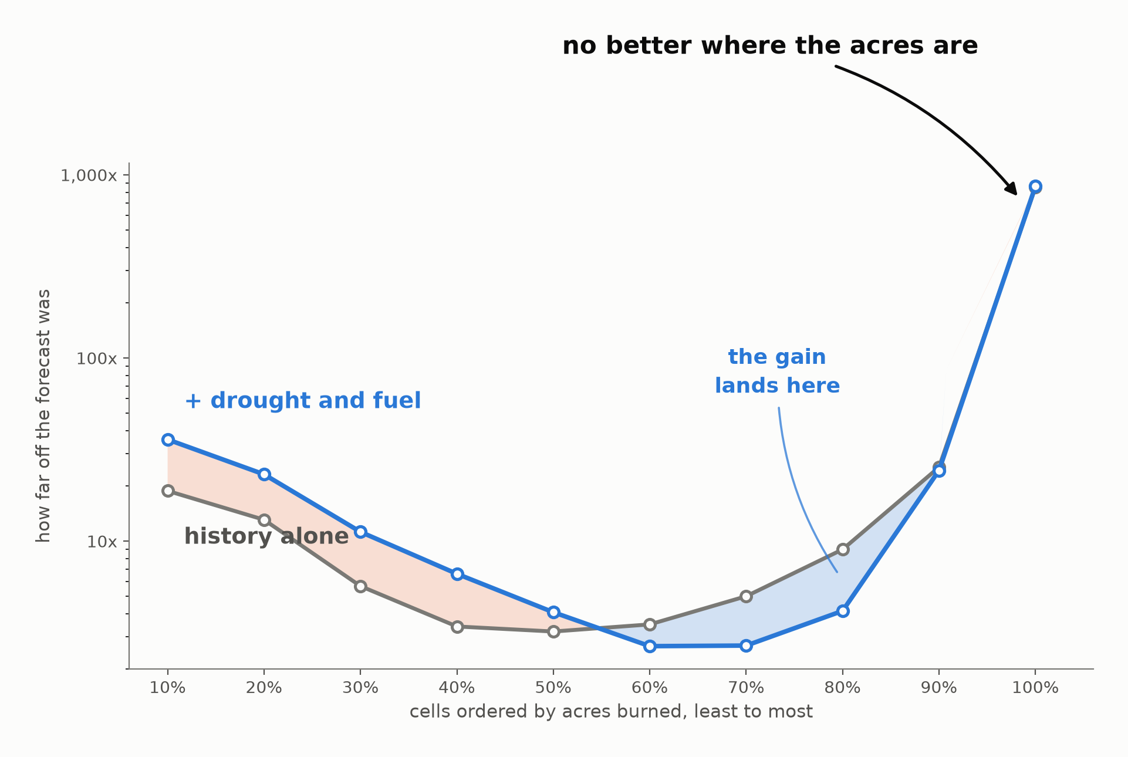
But the gain misses where we need it most.
7.8k held-out hex-seasons, 780 per decile; same cells and model as slide 11; median log error by decile.
Notes:
Look at where it lands. Same axis as before, with the covariate model laid over the baseline.
The blue lens is the gain. It's real, but it's on cells of one to two hundred acres. At the right-most edge, where almost all the burn is, the two lines finish together.
We improved the forecast exactly where it doesn’t much matter. And on the smallest cells it's actually worse. So a gain that survives every statistical test still doesn't buy a planner anything — which says the problem isn’t in the features.

Slide 14
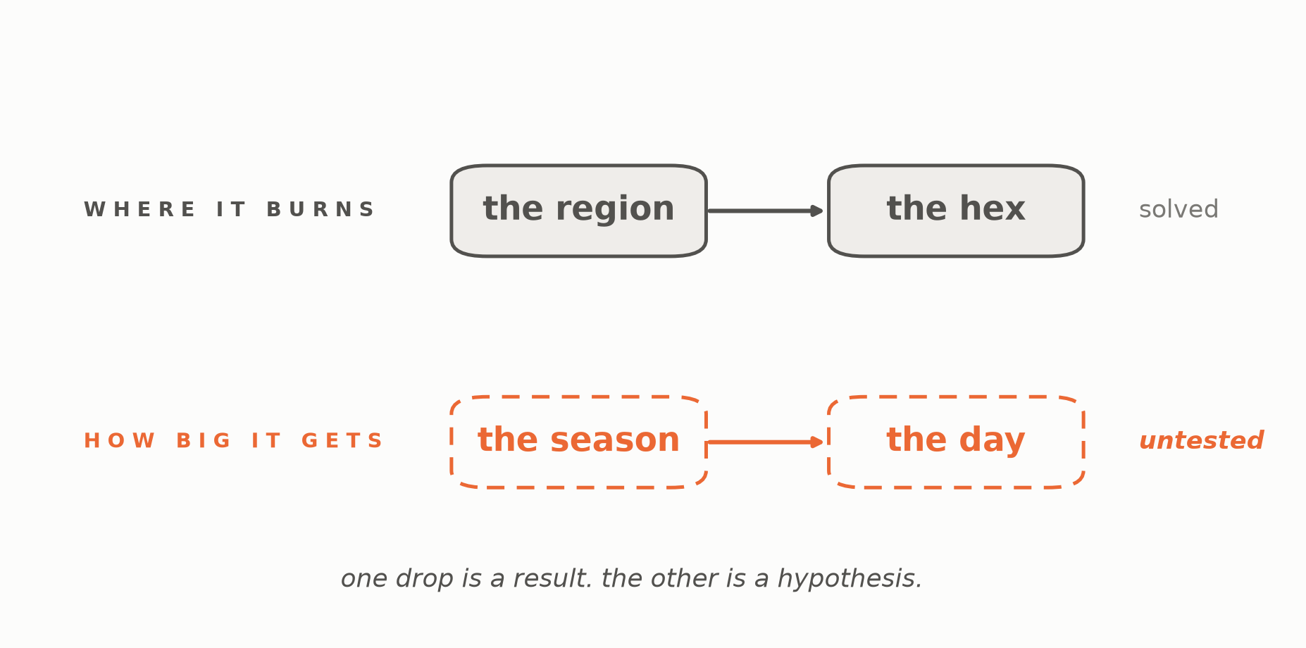
Predicting where fires start needed a finer spatial scale. Predicting size may need a shorter time scale.
Notes:
Siting worked once we stopped asking about a whole region and dropped to a hex. This is the same problem on the other axis. We asked how big a fire gets over a whole season, but what makes a fire run is temperature and wind on a particular afternoon, or whether crews were already committed elsewhere. A season is too coarse a unit to see that.
We couldn't test it here; same-day data is a different project. But the shape of the failure tells you where to look.

Slide 15
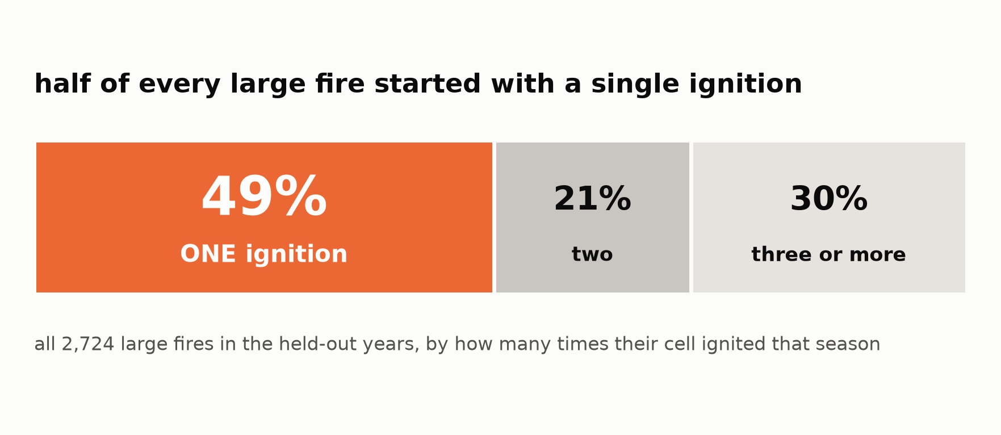
One ignition is enough.
2.8k large-fire cells (≥1k acres), held-out years, Summer, natural; descriptive, no model
Notes:
So our recommendation is to target ignition. A cell that ignites at all is about twenty times more likely to produce a thousand-acre fire than one that doesn’t. In other words, prediction ignition matters more than predicting combustion.

Slide 16
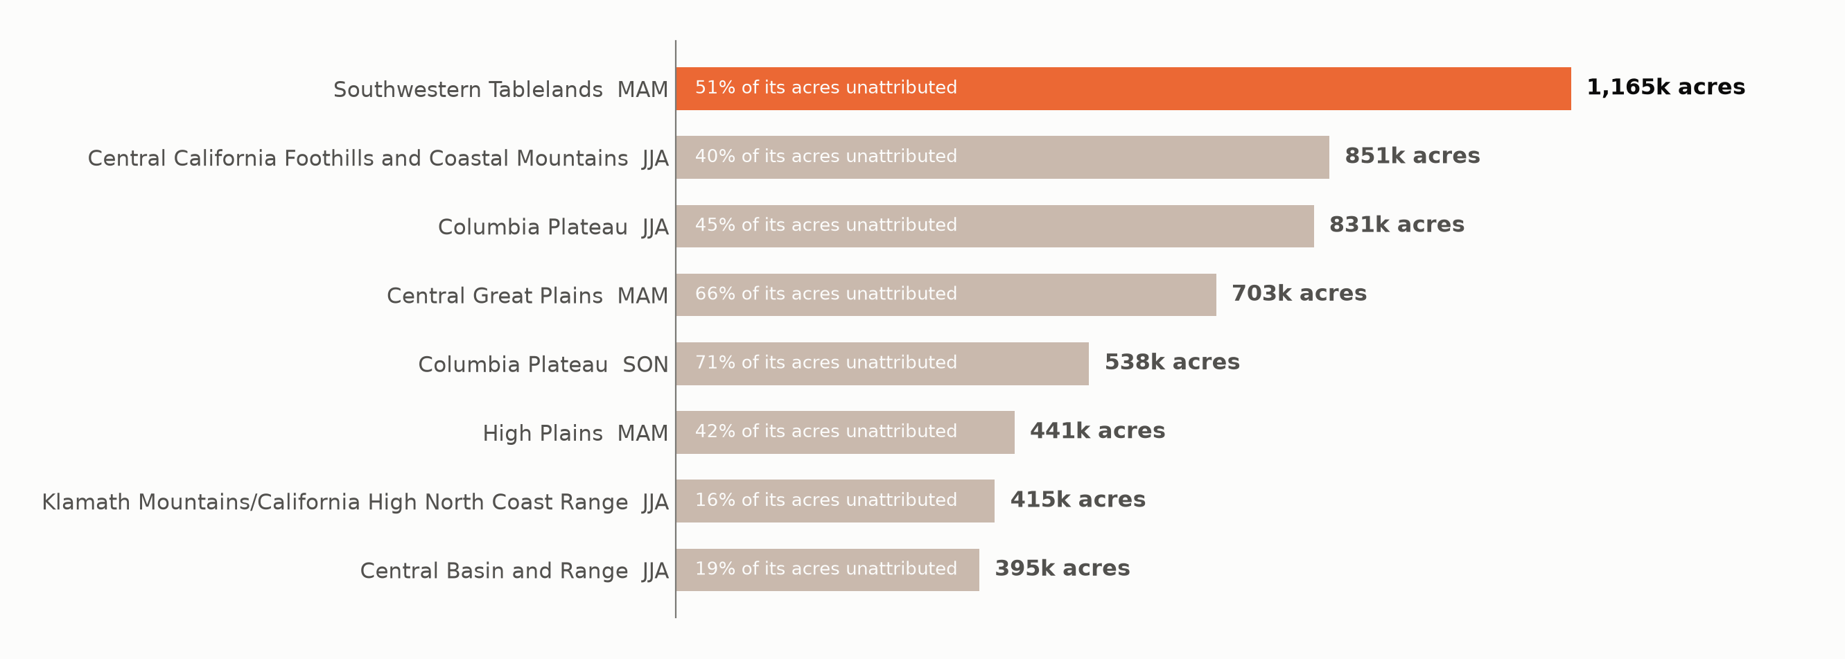
Nearly a fifth of burned acres have no specific cause — and that gap is itself forecastable.
393 region-season pairs from 3.9k held-out region-seasons, 2010–2020; trailing-mean k=7, forward-chained; acre-weighted MAE 0.167 vs. global mean 0.240; top 8 shown, ranked by predicted acres.
Notes:
One thing left… the quarter of fires with no cause on record. That's been a class to predict all along, not a gap.
Predicting where the record goes dark gives you a worklist for data quality improvement, and the recommendation is to address the region-seasons where the most acres will go unattributed.

Slide 17
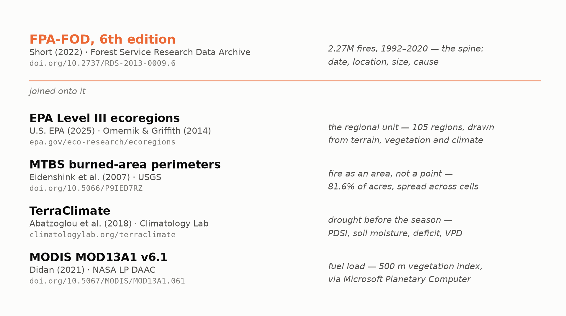
We started with one record of every U.S. wildfire, then layered on what it could not see.
Notes:
Everything here started with one federal record of 2.3M wildfires, from 1992 to 2020. It knows when and where a fire started, how big it got and what caused it.
Then we layered in ecoregions, fire perimeters, drought conditions, and fuel load.

Slide 18
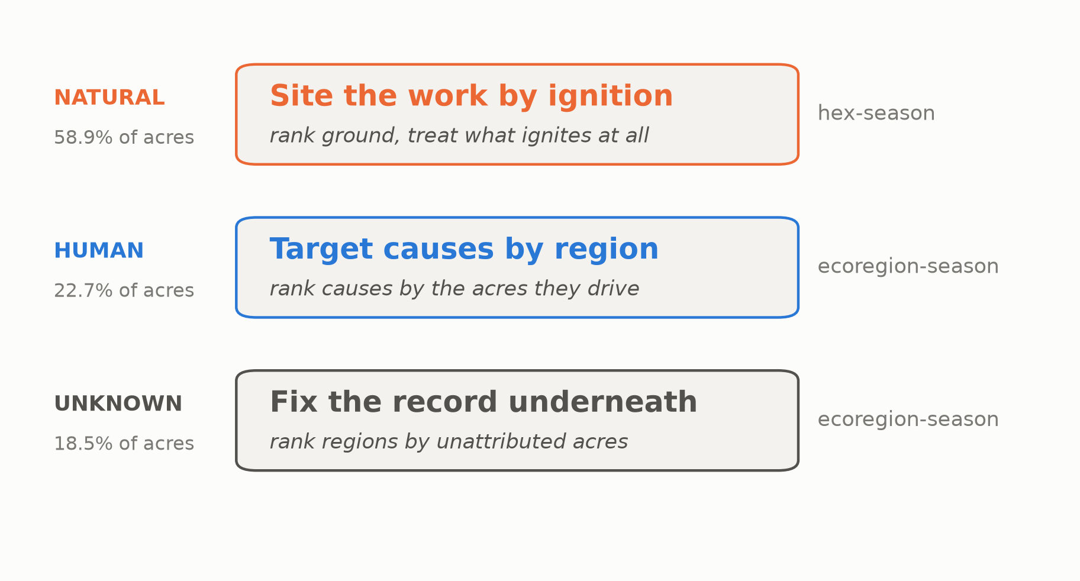
Target causes by region. Site the pre-season work by ignition. Fix the record where it says neither.
No new computation; composes three branch products. Tier 1 × Human, top-1 0.46 on 3.9k joined held-out cells.
Notes:
Three products, one per class, ordered by where the acres are. For lightning — the majority of the burn — rank the ground and treat what ignites. For human fire, rank the causes by the acres they drive. And where the record says neither, fix the record.
One boundary on all three: trust the order, not the number. These will tell you which region, which cause, which ground comes first. They won't tell you how many acres you'll save.

Slide 19
Rank the ground, not the fire.
Where fires start is predictable. How big they get, before the season, is not.
Notes:
Rank the ground, not the fire — and trust the order, not the number.

