Slide 1
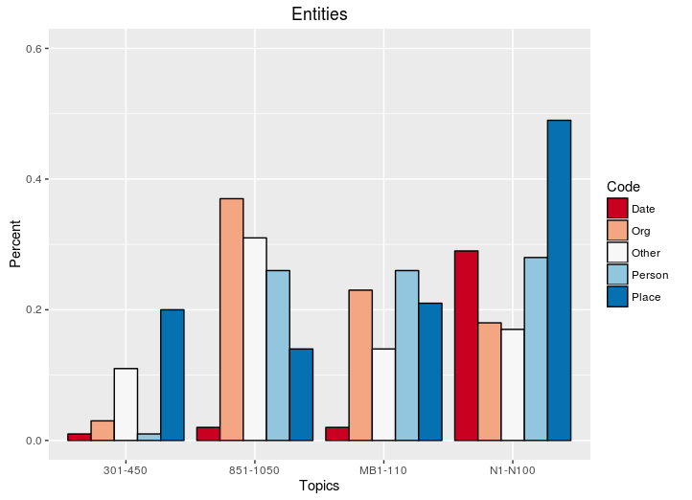
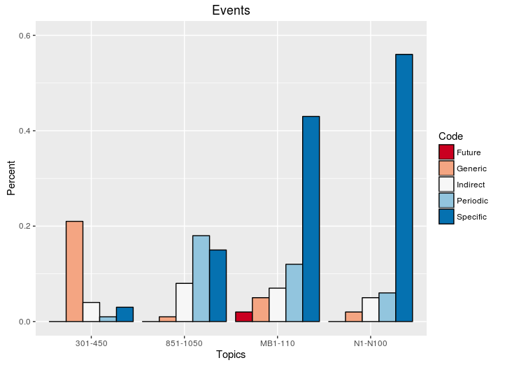



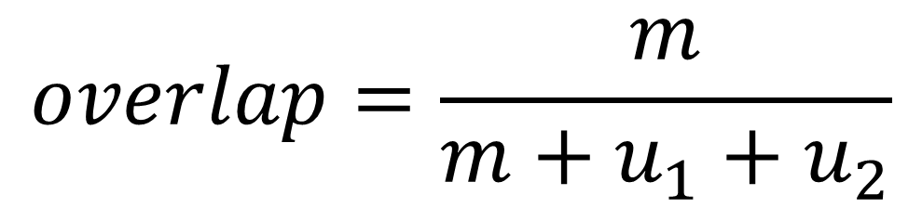
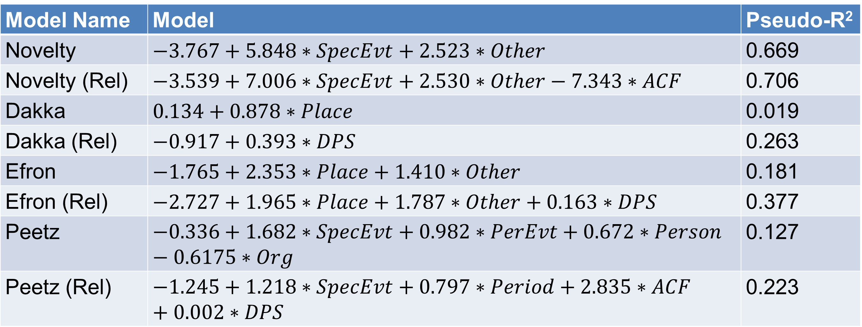
What Makes a Query Temporally Sensitive?
Craig Willis, Garrick Sherman, Miles Efron {willis8, gsherma2, mefron}@Illinois.edu
Motivation & Goals
A growing body of IR research argues that temporality should be modeled explicitly when scoring and ranking documents with respect to users' queries
For evaluation, past studies have manually classified topics as temporal or not temporal
We analyze 660 topics from TREC used in previous studies of temporal retrieval models to identify topic characteristics that might affect the manual assessment of temporal sensitivity
Figure 2: Percent of topics per collection assigned (a) entity and (b) events codes.
Methods
Content Analysis
We identify characteristics of TREC topics using codes defined based on characteristics of topics expected to be related to temporal sensitivity
Figure 1: Example topic annotation.
Title: [(East Timor)_{PlaceEntity} Independence]_{SpecificEvent}
Description: [(East Timor)_{PlaceEntity} vote for independence from
(Indonesia)_{PlaceName} in (August 1999)_{ExplicitDate}]_{SpecificEvent}
Relevant Document Distributions
Moderate to high inter-coder agreement in classifying document distributions
ACF and DPS effectively capture the temporally constraint of relevant document distributions
Table 2: Cohen’s κ for classification of true-relevant document distributions and Pearson correlation between manual classifications and ACF/DPS values.
Collection | Κ | ρ_{ACF} | ρ_{DPS}
AP | 0.743 | 0.518 | 0.356
LA/FT | 0.551 | 0.591 | 0.374
Blog | 0.857 | 0.728 | 0.498
Microblog | 0.806 | 0.692 | 0.354
Since coding is performed on arbitrary segments of text, we check inter-coder agreement using a variation of percent overlap:
$$overlap=\frac{m}{m+u_{1}+u_{2}}$$
Relevant Document Distributions
The coders also classified the distribution of relevant documents for each topic from low to high temporality
Coder agreement is measured using Cohen’s κ
Regression Analysis
We use logistic regression to predict the topic’s temporal/non-temporal classification assigned in four prior studies
The predictors are binary presence indicators for each of the qualitative codes along with the first-order time series autocorrelation (ACF) and dominant power spectrum (DPS) of the temporal distribution of true-relevant documents
Regression Analysis
Table 3: Logistic regression models predicting topic classifications with (Rel) and without ACF/DPS.
Model Name | Model | Pseudo-R²
Novelty | $$−3.767+5.848∗SpecEvt+2.523∗Other$$ | 0.669
Novelty (Rel) | $$−3.539+7.006∗SpecEvt+2.530∗Other−7.343∗ACF$$ | 0.706
Dakka | $$0.134+0.878∗Place$$ | 0.019
Dakka (Rel) | $$−0.917+0.393∗DPS$$ | 0.263
Efron | $$−1.765+2.353∗Place+1.410∗Other$$ | 0.181
Efron (Rel) | $$−2.727+1.965∗Place+1.787∗Other+0.163∗DPS$$ | 0.377
Peetz | $$−0.336+1.682∗SpecEvt+0.982∗PerEvt+0.672∗Person−0.6175∗Org$$ | 0.127
Peetz (Rel) | $$−1.245+1.218∗SpecEvt+0.797∗Period+2.835∗ACF+0.002∗DPS$$ | 0.223
Results
Content Analysis
Macro percent overlap: 0.71
Micro percent overlap: 0.83
Overlap and agreement indicate that overall our codes may be applied with good consistency
Table 1: Per-code agreement.
Code | % Agreement
PersonEntity | 0.94
PlaceEntity | 0.91
ExplicitDate | 0.89
PeriodicEvent | 0.85
OrganizationEntity | 0.76
SpecificEvent | 0.64
OtherEntity | 0.52
GenericEvent | 0.45
IndirectEventReference | 0.19
Conclusions
We were mostly unable to identify characteristics that fully explain prior manual classifications. They seem to conflate the temporal distribution of judged-relevant documents and common-sense notions of topic temporality.
We recommend using the ACF or other measure of distribution “burstiness” instead of manual assessment.
Acknowledgments
This work was supported in part by the US National Science Foundation under Grant No. 1217279. Any opinions, findings, conclusions, or recommendations expressed are those of the authors and do not necessarily reflect the views of the National Science Foundation.

Slide 2
Table 1: Topics analyzed here and used in prior studies.
Topics | Collections | Studies
51-200 (Ad-hoc) | TREC Disks 1-2 AP (1988-89) | Jones & Diaz (2007)
301-450 (Ad-hoc) | TREC Disks 4-5 FT (1991-94); LA Times (1988-89) | Efron & Golovchinksy (2011); Dakka, Gravano & Ipeirotis (2012)
N1-100 (Novelty) | AQUAINT Xinhua (1996-2000); NYT (1999-2000) | Jones & Diaz (2007)
851-1050 (Blog) | Blog06 (Dec 6, 2005 – Feb 21, 2006) | Peetz, Meij & de Rijke (2013)
MB1-110 (Microblog) | Tweets 2011 (Jan 24, 2011 – Feb 8, 2011) | Efron, Lin, de Vries (2014)

