Slide 1

My reading history:
an exercise in data analysis
This has been a personal project to explore new methodologies for data analysis and machine learning.
As a dataset, I am using the books I have read over the last few years, as exported from my Goodreads account (https://www.goodreads.com/craig0a)
The data exported includes ISBN, title, author, publisher, number of pages, year published, original publication year, the date I logged it on Goodreads, my overall rating, and whether I would recommend the book. I have also used web scraping to collect the Goodreads user shelves, book descriptions, and author biographies.
As of November 03, 2019 I have data on 610 books.

Slide 2
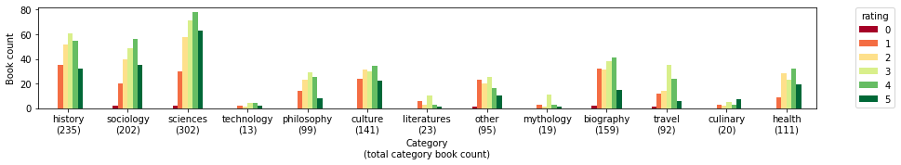
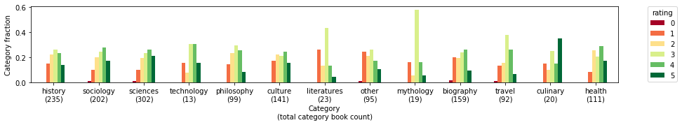
Distribution of ratings over 13 primary hand-curated categories
(based on user-reported shelves)
Most common categories: sciences, history, and sociology
Categories with highest proportions of above-average books: culinary, sciences, technology, health, sociology

Slide 3
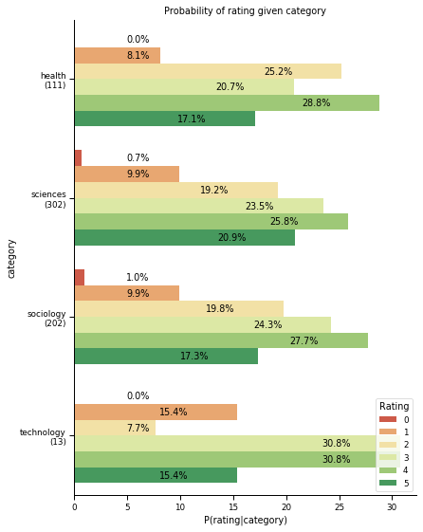
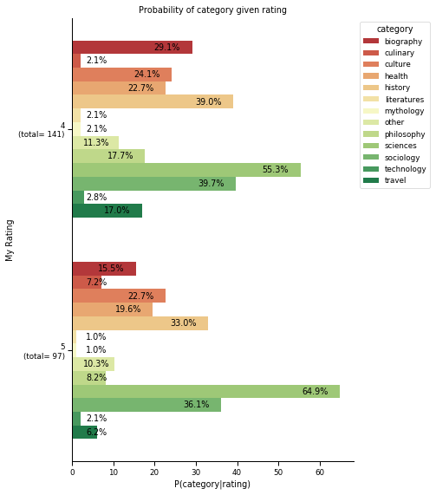
Naïve Bayes analysis (caveat: there is known correlation between categories)

Slide 4
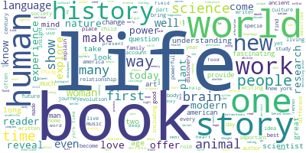
Topic modeling of book descriptions
Topics in NMF model (Frobenius norm):
Topic #0: life world book history human new time way story year
Topic #1: brain neuroscientist memory mind neural recovery mental information principle addiction
Topic #2: hanh nhat thich peace zen master mindfulness happiness leader spiritual
Topic #3: language word linguistic knowledge communication linguistics spread linguist use diversity
Topic #4: introduction short series subject topic analysis oxford area pocket readable
Topic #5: animal human specie communication intelligence emotion insect elephant autistic mind
Topic #6: woman men gender letter bad male power business young essay
Topic #7: bird isabella egg lady indian home travel settlement america adventure
Topic #8: plant human evolution flower specie insect earth climate color behaviour
Topic #9: black american america slave slavery white racial obama civil african
Topic #10: music musical sound theory cd song love listen taste culture

Slide 5
Future work:
Multi-label classification of books
Once I have the topic extractions reasonably refined, I am intending to build a multi-label classifier, which will be validated against the manually-curated categorizations based on Goodreads user shelves, but which will hopefully be somewhat more robust and extendable.
Book preference modeling
My hypothesis is that I tend to prefer books written by "professors" than "journalists" and books published by a "University Press" to books published by "Basic Books", regardless of topic. My goal is to explore the truth of these and other hypotheses by building prediction models for my rating based on extracted features.

