Slide 1
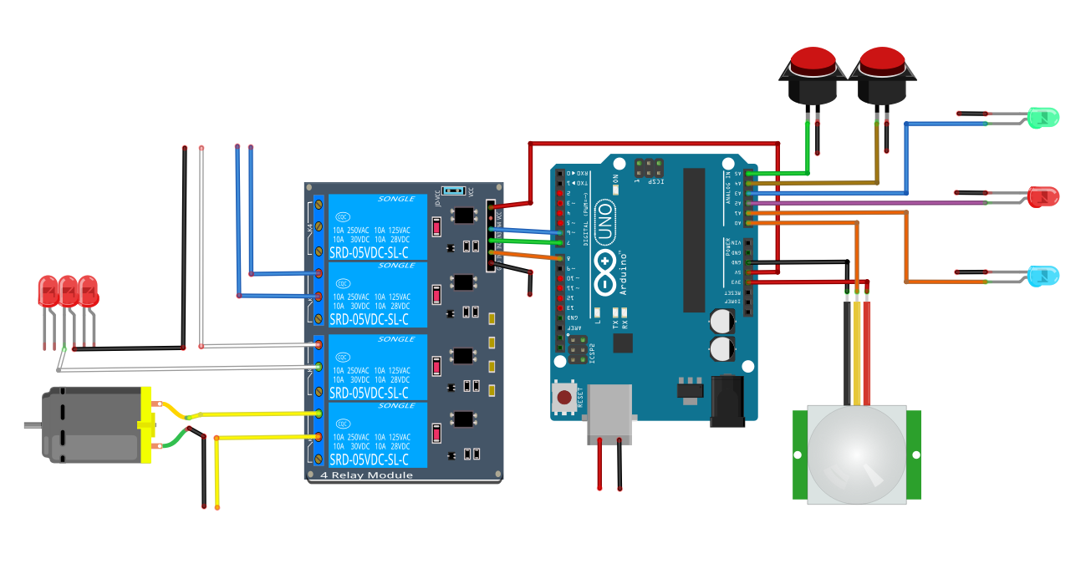







Debug
Pause
Wave Shield Uses
Arduino Pins:
2, 3, 4, 5, 10, 11, 12 & 13
Fog Machine
Ready to Wake
120v
Paused Indicator
Wave Shield
Not Shown
Motion Indicator
Red LED
mini lights
Lid Bouncer
Motor
PIR Motion
Sensor
12v
5v

Slide 2
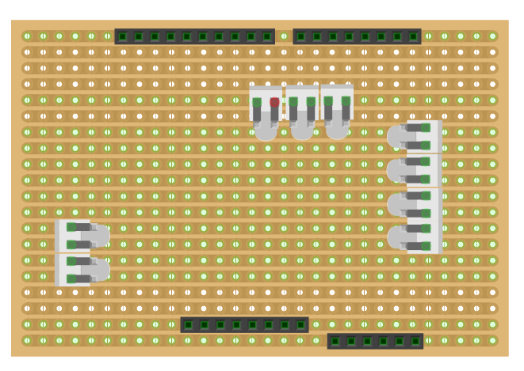
GND
Fog Machine (6)
Red Lights (7)
Lid Bouncer (8)
Unused (9)
+5v Vcc
Paused LED (A2)
GND
Ready to Wake LED (A3)
Motion LED (A1)
Pause Switch (A4)
PIR Signal (A0)
Debug Jumper (A5)
(close for debug)
+5v Vcc
Monster In A Box
Header Shield

Slide 3

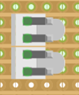
Remote PIR Wiring
Header
Shield
RJ11
Wall Plate
GND
RJ11
Connector
Motion LED
Motion LED (A1)
PIR Signal (A0)
+5v Vcc
Motion LED

