Slide 1
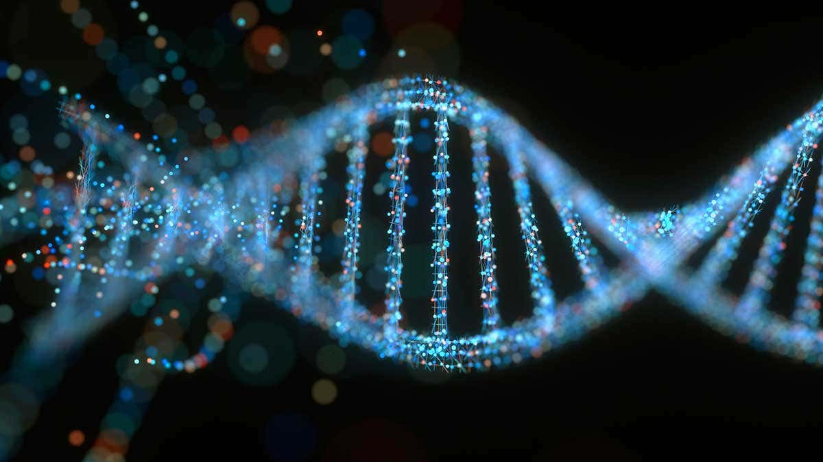
AMINO ACID TABLE
OUTER COLUMNS

Slide 2
AMINO ACIDS BY RELATIVE ATOMIC MASS
Amino Acid |  |  | Relative Atomic Mass Composition |  |  |  |  |  |  |  |  |  | Atomic Mass
Amino Acid Full Name | Amino Acid 3-Letter | Amino Acid 1-Letter | Hydrogen^{1,6,7} |  | Carbon^{2,6} |  | Nitrogen³ |  | Oxygen^{4,6,7} |  | Sulphur^{5,8} |  | Total Mass 4 Decimals | Total Mass 2 Decimals
 |  |  | 1.0079 |  | 12.0108 |  | 14.0065 |  | 15.9994 |  | 32.0645
Alanine | Ala | A | 7 | 7.0553 | 3 | 36.0324 | 1 | 14.0065 | 2 | 31.9988 | 0 | 0 | 89.0930 | 089.09
Arginine | Arg | R | 14 | 14.1106 | 6 | 72.0648 | 4 | 56.0260 | 2 | 31.9988 | 0 | 0 | 174.2002 | 174.20
Asparagine | Asn | N | 8 | 8.0632 | 4 | 48.0432 | 2 | 28.0130 | 3 | 47.9982 | 0 | 0 | 132.1176 | 132.12
Aspartic Acid | Asp | D | 7 | 7.0553 | 4 | 48.0432 | 1 | 14.0065 | 4 | 63.9976 | 0 | 0 | 133.1026 | 133.10
Cysteine | Cys | C | 7 | 7.0553 | 3 | 36.0324 | 1 | 14.0065 | 2 | 31.9988 | 1 | 32.0645 | 121.1575 | 121.16
Glutamic Acid | Glu | E | 9 | 9.0711 | 5 | 60.0540 | 1 | 14.0065 | 4 | 63.9976 | 0 | 0 | 147.1292 | 147.13
Glutamine | Gln | Q | 10 | 10.079 | 5 | 60.0540 | 2 | 28.0130 | 3 | 47.9982 | 0 | 0 | 146.1442 | 146.14
Glycine | Gly | G | 5 | 5.0395 | 2 | 24.0216 | 1 | 14.0065 | 2 | 31.9988 | 0 | 0 | 75.0664 | 075.07
Histidine | His | H | 9 | 9.0711 | 6 | 72.0648 | 3 | 42.0195 | 2 | 31.9988 | 0 | 0 | 155.1542 | 155.15
Isoleucine | Ile | I | 13 | 13.1027 | 6 | 72.0648 | 1 | 14.0065 | 2 | 31.9988 | 0 | 0 | 131.1728 | 131.17
Leucine | Leu | L | 13 | 13.1027 | 6 | 72.0648 | 1 | 14.0065 | 2 | 31.9988 | 0 | 0 | 131.1728 | 131.17
Lysine | Lys | K | 14 | 14.1106 | 6 | 72.0648 | 2 | 28.0130 | 2 | 31.9988 | 0 | 0 | 146.1872 | 146.19
Methionine | Met | M | 11 | 11.0869 | 5 | 60.0540 | 1 | 14.0065 | 2 | 31.9988 | 1 | 32.0645 | 149.2107 | 149.21
Phenylalanine | Phe | F | 11 | 11.0869 | 9 | 108.0972 | 1 | 14.0065 | 2 | 31.9988 | 0 | 0 | 165.1894 | 165.19
Proline | Pro | P | 9 | 9.0711 | 5 | 60.0540 | 1 | 14.0065 | 2 | 31.9988 | 0 | 0 | 115.1304 | 115.13
Serine | Ser | S | 7 | 7.0553 | 3 | 36.0324 | 1 | 14.0065 | 3 | 47.9982 | 0 | 0 | 105.0924 | 105.09
Threonine | Thr | T | 9 | 9.0711 | 4 | 48.0432 | 1 | 14.0065 | 3 | 47.9982 | 0 | 0 | 119.1190 | 119.12
Tryptophan | Trp | W | 12 | 12.0948 | 11 | 132.1188 | 2 | 28.0130 | 2 | 31.9988 | 0 | 0 | 204.2254 | 204.23
Tyrosine | Tyr | Y | 11 | 11.0869 | 9 | 108.0972 | 1 | 14.0065 | 3 | 47.9982 | 0 | 0 | 181.1888 | 181.19
Valine | Val | V | 11 | 11.0869 | 5 | 60.0540 | 1 | 14.0065 | 2 | 31.9988 | 0 | 0 | 117.1462 | 117.15
Totals |  |  | 197 | 198.5563 | 107 | 1285.1556 | 29 | 406.1885 | 49 | 783.9706 | 2 | 64.1290 | 2738.0000 | 2738.00

Slide 3
Aspartic acid
D
133.1026
Arginine
R
174.2002
Lysine
K
146.1872
Histidine
H
155.1542
Glutamic acid
E
147.1292
Asparagine
N
132.1176
Tryptophan
W
204.2254
Tyrosine
Y
181.1888
Phenylalanine
F
165.1894
Glutamine
Q
146.1442
Threonine
T
119.1190
Glycine
G
075.0664
Alanine
A
089.0930
Proline
P
115.1304
Serine
S
105.0924
Isoleucine
I
131.1728
Leucine
L
131.1728
Cysteine
C
121.1575
Methionine
M
149.2107
Valine
V
117.1462

Slide 4
Aspartic acid
D
133.1026
Glutamic acid
E
147.1292
133.1026 +
131.1728 =
264.2754
147.1292 +
117.1462 =
264.2754
Asparagine
N
132.1176
Glutamine
Q
146.1442
Threonine
T
119.1190
Serine
S
105.0924
132.1176 +
119.1190 =
251.2366
146.1442 +
105.0924 =
251.2366
Isoleucine
I
131.1728
Valine
V
117.1462

Slide 5
Aspartic acid
D
133.1026
Glutamic acid
E
147.1292
133.1026 +
119.1190 =
252.2216
147.1292 +
105.0924 =
252.2216
Asparagine
N
132.1176
Glutamine
Q
146.1442
Threonine
T
119.1190
Serine
S
105.0924
132.1176 +
131.1728 =
263.2904
146.1442 +
117.1462 =
263.2904
Isoleucine
I
131.1728
Valine
V
117.1462

Slide 6
Aspartic acid
D
133.1026
Glutamic acid
E
147.1292
133.1026 +
146.1442 =
279.2468
147.1292 +
132.1176 =
279.2468
Asparagine
N
132.1176
Glutamine
Q
146.1442
Threonine
T
119.1190
Serine
S
105.0924
119.1190 +
117.1462 =
236.2652
105.0924 +
131.1728 =
236.2652
Isoleucine
I
131.1728
Valine
V
117.1462

Slide 7
Aspartic acid
D
133.1026
Glutamic acid
E
147.1292
Asparagine
N
132.1176
133.1026 +
147.1292 +
Glutamine
Q
146.1442
132.1176 +
146.1442 +
119.1190 +
105.0924 +
Threonine
T
119.1190
Serine
S
105.0924
131.1728 =
117.1462 =
515.5120
515.5120
Isoleucine
I
131.1728
Valine
V
117.1462

Slide 8
Aspartic acid
D
133.1026
Glutamic acid
E
147.1292
Asparagine
N
132.1176
133.1026 +
147.1292 +
Glutamine
Q
146.1442
146.1442 +
132.1176 +
105.0924 +
119.1190 +
Threonine
T
119.1190
Serine
S
105.0924
131.1728 =
117.1462 =
515.5120
515.5120
Isoleucine
I
131.1728
Valine
V
117.1462

Slide 9
Aspartic acid
D
133.1026
Glutamic acid
E
147.1292
Asparagine
N
132.1176
133.1026 +
147.1292 +
Glutamine
Q
146.1442
146.1442 +
132.1176 +
119.1190 +
105.0924 +
Threonine
T
119.1190
Serine
S
105.0924
117.1462 =
131.1728 =
515.5120
515.5120
Isoleucine
I
131.1728
Valine
V
117.1462

Slide 10
AMINO ACIDS IN THE OUTER TWO COLUMNS
Amino Acid |  |  | Relative Atomic Mass Composition |  |  |  |  |  |  |  |  |  | Atomic Mass
Amino Acid Full Name | Amino Acid 3-Letter | Amino Acid 1-Letter | Hydrogen |  | Carbon |  | Nitrogen |  | Oxygen |  | Sulphur |  | Total Mass 4 Decimals | Total Mass 2 Decimals
 |  |  | 1.0079 |  | 12.0108 |  | 14.0065 |  | 15.9994 |  | 32.0645
Asparagine | Asn | N | 8 | 8.0632 | 4 | 48.0432 | 2 | 28.0130 | 3 | 47.9982 | 0 | 0 | 132.1176 | 132.12
Aspartic Acid | Asp | D | 7 | 7.0553 | 4 | 48.0432 | 1 | 14.0065 | 4 | 63.9976 | 0 | 0 | 133.1026 | 133.10
Glutamic Acid | Glu | E | 9 | 9.0711 | 5 | 60.0540 | 1 | 14.0065 | 4 | 63.9976 | 0 | 0 | 147.1292 | 147.13
Glutamine | Gln | Q | 10 | 10.079 | 5 | 60.0540 | 2 | 28.0130 | 3 | 47.9982 | 0 | 0 | 146.1442 | 146.14
Isoleucine | Ile | I | 13 | 13.1027 | 6 | 72.0648 | 1 | 14.0065 | 2 | 31.9988 | 0 | 0 | 131.1728 | 131.17
Serine | Ser | S | 7 | 7.0553 | 3 | 36.0324 | 1 | 14.0065 | 3 | 47.9982 | 0 | 0 | 105.0924 | 105.09
Threonine | Thr | T | 9 | 9.0711 | 4 | 48.0432 | 1 | 14.0065 | 3 | 47.9982 | 0 | 0 | 119.1190 | 119.12
Valine | Val | V | 11 | 11.0869 | 5 | 60.0540 | 1 | 14.0065 | 2 | 31.9988 | 0 | 0 | 117.1462 | 117.15
Totals |  |  | 74 | 74.5846 | 36 | 432.3888 | 10 | 140.0650 | 24 | 383.9856 | 0 | 0 | 1031.0240 | 1031.02
AMINO ACID COMBINATIONS BY ATOM NUMBERS
AAs | H | C | N | O
D + I | 20 | 10 | 2 | 6
E + V | 20 | 10 | 2 | 6
N + T | 17 | 8 | 3 | 6
Q + S | 17 | 8 | 3 | 6
TOTAL | 74 | 36 | 10 | 24
AAs | H | C | N | O
D + T | 16 | 8 | 2 | 7
E + S | 16 | 8 | 2 | 7
N + I | 21 | 10 | 3 | 5
Q + V | 21 | 10 | 3 | 5
TOTAL | 74 | 36 | 10 | 24
AAs | H | C | N | O
D + Q | 17 | 9 | 3 | 7
E + N | 17 | 9 | 3 | 7
T + V | 20 | 9 | 2 | 5
S + I | 20 | 9 | 2 | 5
TOTAL | 74 | 36 | 10 | 24

Slide 11
Sources for the Relative Atomic Mass Figures
1. Hydrogen 1.0079 at:
http://www.elementsdatabase.com/el.php?id=4
2 Carbon 12.0108 at: https://books.google.co.nz/books?id=9l3o1K2B26QC&pg=PA12&lpg=PA12&dq=carbon+12.0108&source=bl&ots=FjjBYMWKTP&sig=ACfU3U31kb5kzirzrue0aY6FrQTZgy0VPQ&hl=en&sa=X&ved=2ahUKEwjb3Oyvzs7tAhWFyzgGHcYsDcsQ6AEwCHoECAUQAg#v=onepage&q=carbon%2012.0108&f=false
In Arthur E. Morris, Gordon Geiger, H. Alan Fine: Handbook on Material and Energy Balance Calculations in Material Processing. John Wiley & Sons, Hoboken, New Jersey: 2011, page 12.
3. Nitrogen 14.0065 at:
https://moen.tistory.com/14429
https://core.ac.uk/download/pdf/322968441.pdf Page 32
EUCASS2019-0091.pdf Valentina König, Siegfried Müller and Michael Rom: Numerical investigation of transpiration cooling in supersonic nozzles. Page 9
4. Oxygen 15.9994 at:
http://www.elementsdatabase.com/el.php?id=11
Sulphur 32.0645 at:
https://qualifications.pearson.com/content/dam/pdf/A%20Level/Physics/2013/Exam%20materials/6PH04_01_que_20110621.pdf See Page 17, Question 17, Section (c), Part (ii)
Hydrogen 1.0079; Carbon 12.0108; Oxygen 15.9994 at:
https://en.intl.chemicalaid.com/tools/empiricalformula.php?composition=C%3D12.0108%25+H%3D1.0079%25+N%3D14.0067%25+O%3D15.9994%25
7. Hydrogen 1.0079; Oxygen 15.9994 at:
https://www.lenntech.com/periodic-chart-elements/atomic-mass.htm
8. Some sources give a relative atomic mass figure of 32.064 for sulphur, and others give a figure of 32.065.
We have taken the middle ground figure of 32.0645 in extending it to the fourth decimal.
Sulphur 32.064 at:
https://webbook.nist.gov/cgi/formula?ID=C14701123&Mask=40
https://www.accessscience.com/content/sulfur/667200
https://memory-beta.fandom.com/wiki/Sulfur
https://radiopaedia.org/articles/sulfur
https://www.britannica.com/science/equivalent-weight
Sulphur 32.065 at:
http://www.boulderdan.com/elementfile.php?action=Sulfur
https://www.livescience.com/28939-sulfur.html
https://energyeducation.ca/encyclopedia/Sulfur
https://webbook.nist.gov/cgi/cbook.cgi?ID=C7704349&Units=CAL&Mask=FFFFFF&Type=JANAFG&Plot=on
https://www.chemeurope.com/en/encyclopedia/Isotopes_of_sulfur.html

