Slide 1

Experiences on teaching version control
Craig Alexander, University of Glasgow
craig.alexander.2@glasgow.ac.uk

Slide 2

Introduction - Why Version Control in statistics education?
Many degree programmes in Statistics consist of courses with a high volume of theory, lacking exposure to technical skills key for the workplace.
It is important that we equip our graduates with such skills, so they are prepared for the job market.
Version control is becoming an ever-increasing feature within roles across academia and industry in statistics and data science.
How do we integrate teaching version control into our learning and teaching practice?

Slide 3
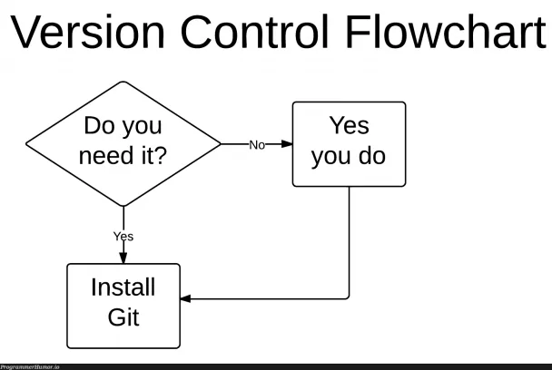
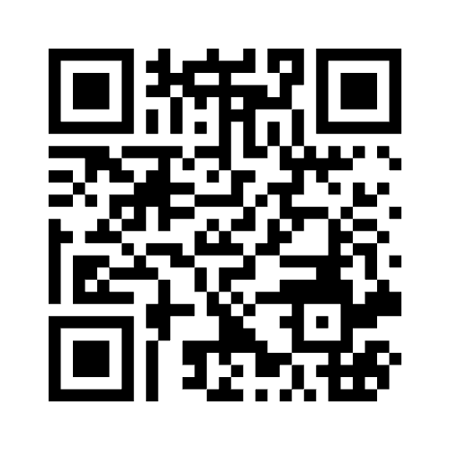
Your views on version control
Are you currently using version control in your practice?
Go to menti.com with the code 6646 6100

Slide 4
Introduction – Incorporating Version Control into Teaching
To help integrate version control knowledge into our teaching practices, we have:
Created a short Version Control course
Developed by David McArthur, Andrew Elliott, Craig Alexander & Vinny Davies.
Designed for use for UG/PG students, PG researchers & staff.
Designed assessment strategies using Version Control
Promoting use within group-based assessments.
Incorporating short course notes, promoting a flipped classroom strategy.

Slide 5
Incorporating version control
In what ways have you incorporated version control in your practice?
Go to menti.com with the code 6646 6100

Slide 6

Developing a Version Control Course – Case Study
An ‘Innovation in Teaching’ project to develop short course on version control as part of the school’s AI3 Initiative².
Comprised of seven units building from basics to advanced concepts.
Tailored exercises which can be used for stand-alone learning or as part of a course.
Course notes use bespoke accessible features as discussed in Jack et al. (2023)³.
2. https://www.gla.ac.uk/schools/mathematicsstatistics/research/stats/teaching/versioncontrolforteachingandresearch/
3. Jack, E., Alexander, C., McArthur, D. and Mair, C. (2023) Reflections on designing and delivering an online distance learning programme in the mathematical sciences. MSOR Connections, 21(2), pp. 25-33. (doi: 10.21100/msor.v21i2.1397)

Slide 7
Developing a version control course – Considerations
When designing the course, several considerations had to be made.
There are an abundance of online resources for using version control – aim is to create a tailored course that is accessible to a host of users.
Users have different areas of expertise – need a course which covers multiple usage scenarios.
For example, UG students and PG researchers will have different levels of exposure to programming and project-based work – course content & structure should reflect this.

Slide 8
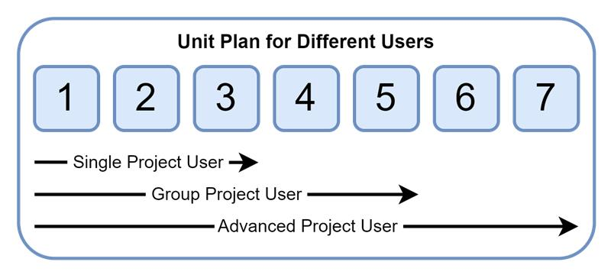
Considerations – Example Structure
Learners will all have different desired outcomes in terms of what they would like to get out of the course.
Course has been designed in structured units to meet the needs for each users' requirements.

Slide 9
Developing a Version Control Course – Course Structure
Unit 1 – Up and Running
Unit 2 – Basic workflow for single user
Unit 3 – Consuming & contributing to open-source projects
Unit 4 – Solid foundations for users
Unit 5 – Branching and branching strategies
Unit 6 – Using GitHub Flow in a team
Unit 7 – Foundations for advanced users

Slide 10
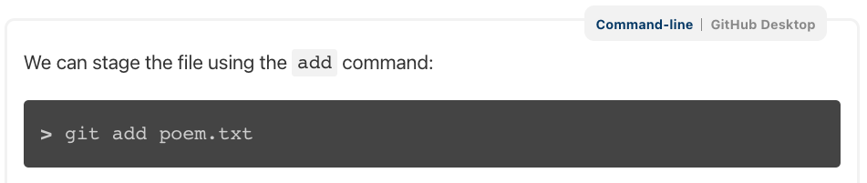
Considerations – Command line vs. GitHub Desktop
Git commands can be carried out using command line operations or via a GUI such as GitHub Desktop.
To cater to the different needs of users, the notes include examples for both command line and GitHub Desktop use.
We have provided details on using either format for the full course, providing a “switcher” within the notes to allow users to choose their preference.

Slide 11
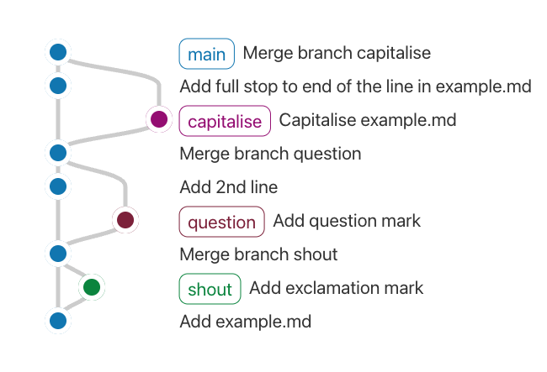
Considerations – Visualising Branches
To illustrate the concepts behind git and GitHub, we have included a graphical visualisation of a repository using gitgraph⁴.
This allows us to give a graphical representation of a repository workflow and are particularly useful when discussing branching.
4. https://github.com/nicoespeon/gitgraph.js/

Slide 12

Implementing Version Control in Courses
Within the curriculum at your institution, which courses do you feel would be best place to teach version control?
Go to menti.com with the code 6646 6100

Slide 13
Implementing Version Control in Courses
This academic year, the course has been shared as a resource to all staff and students, and implemented in the following courses:
Semester 2 MSc (on-campus) course on Data Analysis Skills
Semester 2 UG course on Data Analysis
ODL MSc final project students
Staff/PhD students – 1.5h presentation and course release

Slide 14
Feedback on Version Control Course
Early feedback on the course has been positive, though there are some differences between the learning cohorts:
Students primarily focus on the first 5 units. They would like more examples and video tutorials included in the materials.
PhD students and staff focussed mainly on all units. They found the materials easier to follow than taught students and have a generally positive view of version control.
Taught students did highlight the importance of knowing version control from a career perspective, but did highlight they would like more exposure to version control on the programme.

Slide 15

Incorporating version control in assessment
In terms of assessment, what assessments do you currently offer that could incorporate version control?
Go to menti.com with the code 6646 6100

Slide 16
Using Version Control in Assessment – Case Study
Semester 2 MSc Data Analysis Skills course – focus on graduate attributes for careers in statistics and data science.
Version control covered for 2 weeks of the course, using short course delivered in a flipped classroom format.
Group project using version control for data analysis
Groups create repository for R analysis
Promoting working in a collaborative environment
Assessment focus on general good practice, successful use of pull requests and code review.

Slide 17
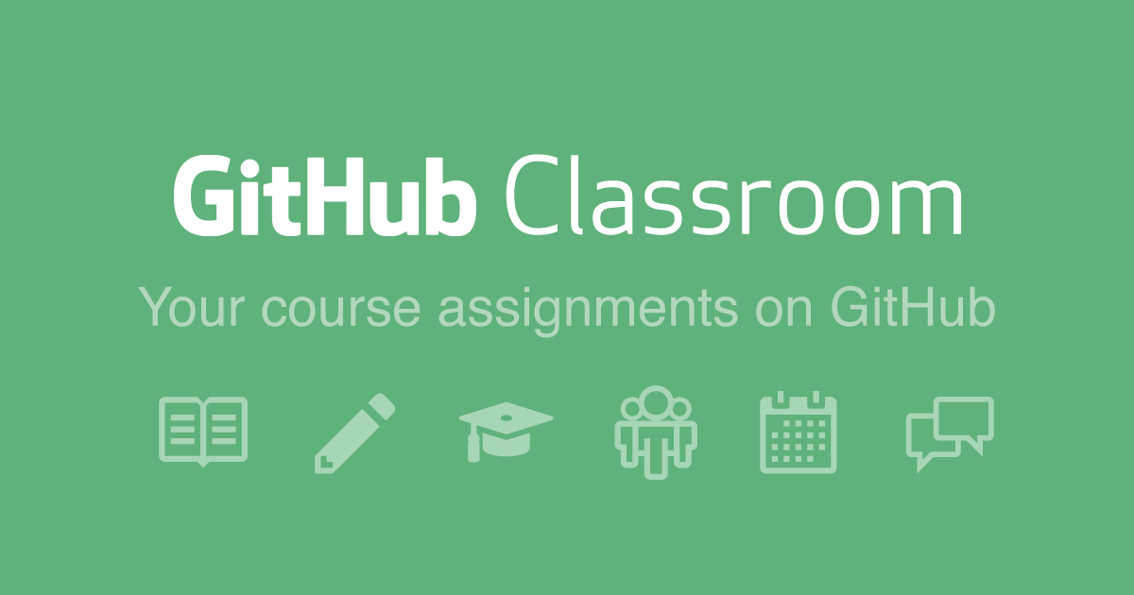
Using Version Control in Assessment – Case Study
Student feedback very positive on using version control.
Enjoy practical exposure to group-based projects.
For next year:
Potential extension to use GitHub Classroom⁵ to assist with administrative processes and assess version control use more.
5. https://classroom.github.com/

Slide 18



Thank you for listening! If you have any questions, feel free to contact me at: Craig.Alexander.2@Glasgow.ac.uk Slides available at:
#UofGWorldChangers
@UofGlasgow

