Slide 1
template
By Author

Slide 2
Key Messages

Slide 4
Summary

Slide 5

Additional Resources
Documentation
Project Management
Example
Using a Simulink Project
Tutorials
Try Simulink Project Tools with the Airframe Project
Create a New Project to Manage Existing Files
Training
Simulink Model Management and Architecture
Consulting
Proven Solutions from MathWorks Consulting Services

Slide 6
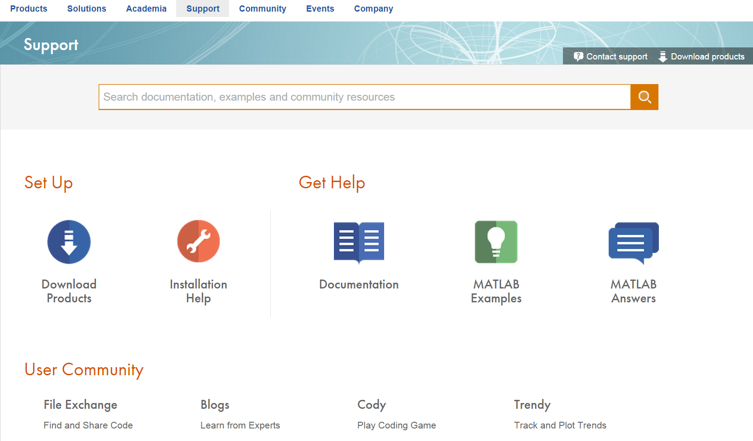
Support

Slide 7

Contact Us
Monday - Friday
08:30-17:30 ET
08:30-20:00 ET
508-647-7000
Sales / Customer Support ......
Technical Support ......

Slide 8

Contact Us
Account Manager:
MathWorks:
Jon Lewis
310-819-4998
Jon.Lewis@MathWorks.com
Monday - Friday
08:30-17:30 ET
08:30-20:00 ET
508-647-7000
Sales / Customer Support ......
Technical Support ......

Slide 9
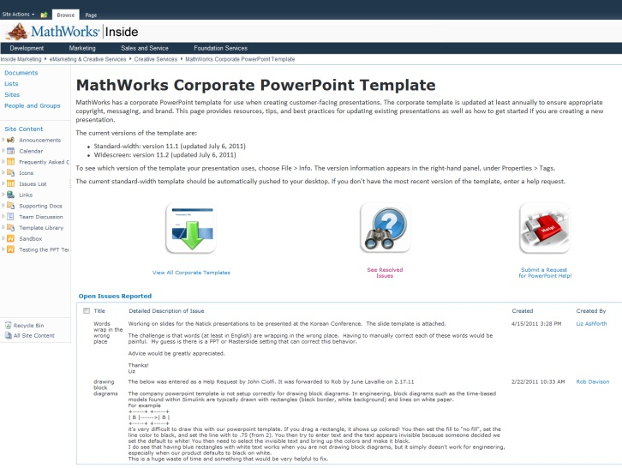
PowerPoint Resources
Corporate PowerPoint Template Resource Page This page provides resources, tips, and best practices for updating existing presentations as well as how to get started if you are creating a new presentation.
Existing Presentations
CRE - Customer event Resource Exchange The CRE contains customer-facing content, including release and product-related presentations, as well as event content (e.g., seminars, webinars, master classes).
User Story and Technical Article Summary Slides Searchable library with metadata filters featuring more than 300 current user story technical article and summary slides
Workflow Diagrams
Technical Diagram Toolkit The toolkit is a single source for technical diagrams created by MathWorks that relate to technical computing, computational finance, physical modeling, parallel computing, and Model-Based Design. The toolkit includes full diagrams, some animations, and individual editable elements you can use to customize your presentation.
Guidelines These guidelines explain how to keep your presentation visually up-to-date, when to use the confidential and nonconfidential templates, how to design visually compelling slides, and other best practices.
MathWorks Visual Design Standards If your presentation is customer-facing, you can request from Creative Services via AtTask.
MathWorks Image Gallery This library is a large repository of MathWorks copyright-owned images grouped by content type.
Questions concerning presentation design? Contact Chris Roth, x4467.
V15.2 Delete this slide before finalizing your presentation.

Slide 10
Using the Corporate Template
Avoid manually formatting whenever possible. Instead, use built-in styles, templates, layouts, and colors.
When creating new presentations, select the slide layout that best suits your needs from the built-in theme, then add content.
When creating custom shapes, text boxes, and other elements, start from scratch rather than reformatting template shapes.
When applying the new template to existing presentations, review your presentation carefully and manually adjust any formatting issues that have occurred. For additional help, contact Creative Services.
V15.2 Delete this slide before finalizing your presentation.

Slide 11
Sample Additional Colors
R: 255
G: 204
B: 0
R: 153
G: 50
B: 0
R: 93
G: 70
B: 95
R: 27
G: 48
B: 73
R: 171
G: 200
B: 209
R: 23
G: 140
B: 100
R: 77
G: 78
B: 68
Apply the built-in theme palette to add color to presentations. Should you require additional colors, please select them from the sample palette above. (Use the Format Painter to copy the color, then select the new object to apply the color.)
V15.2 Delete this slide before finalizing your presentation.

