Slide 1
Presentation Title
By Author

Slide 2
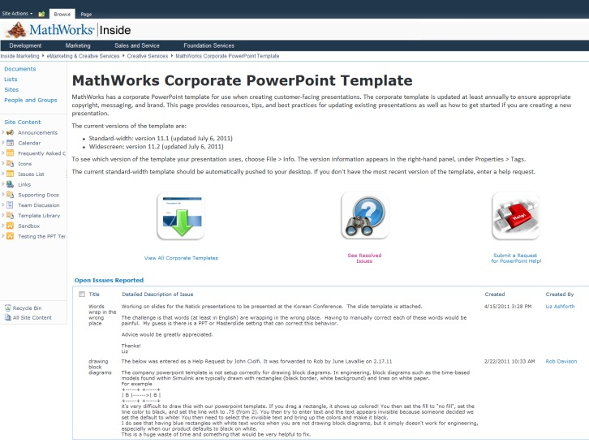
PowerPoint Resources
Corporate PowerPoint Template Resource Page This page provides resources, tips, and best practices for updating existing presentations as well as how to get started if you are creating a new presentation.
Guidelines These guidelines explain how to keep your presentation visually up-to-date, when to use the confidential and nonconfidential templates, how to design visually compelling slides, and other best practices.
MathWorks Visual Design Standards If your presentation is customer-facing, you can request from Creative Services via Project Tracker.
MathWorks Image Gallery This library is a large repository of images grouped by industry and content type.
Questions concerning presentation design? Contact Chris Roth, x4467.
V14.0 Delete this slide before finalizing your presentation.

Slide 3
PowerPoint Resources
Existing Presentations
CRE - Customer event Resource Exchange The CRE contains customer-facing content, including release and product-related presentations, as well as event content (e.g., seminars, webinars, master classes).
User Story Slides Searchable presentation of more than 190 current user story summary slides
Questions concerning presentation design? Contact Chris Roth, x4467.
V14.0 Delete this slide before finalizing your presentation.

Slide 4
Using the Corporate Template
Avoid manually formatting whenever possible. Instead, use built-in styles, templates, layouts, and colors.
When creating new presentations, select the slide layout that best suits your needs from the built-in theme, then add content.
When creating custom shapes, text boxes, and other elements, start from scratch rather than reformatting template shapes.
When applying the new template to existing presentations, review your presentation carefully and manually adjust any formatting issues that have occurred. For additional help, contact Creative Services.
V14.0 Delete this slide before finalizing your presentation.

Slide 5
Sample Additional Colors
R: 255
G: 204
B: 0
R: 153
G: 50
B: 0
R: 93
G: 70
B: 95
R: 27
G: 48
B: 73
R: 171
G: 200
B: 209
R: 23
G: 140
B: 100
R: 77
G: 78
B: 68
Apply the built-in theme palette to add color to presentations. Should you require additional colors, please select them from the sample palette above. (Use the Format Painter to copy the color, then select the new object to apply the color.)
V14.0 Delete this slide before finalizing your presentation.

