Slide 1
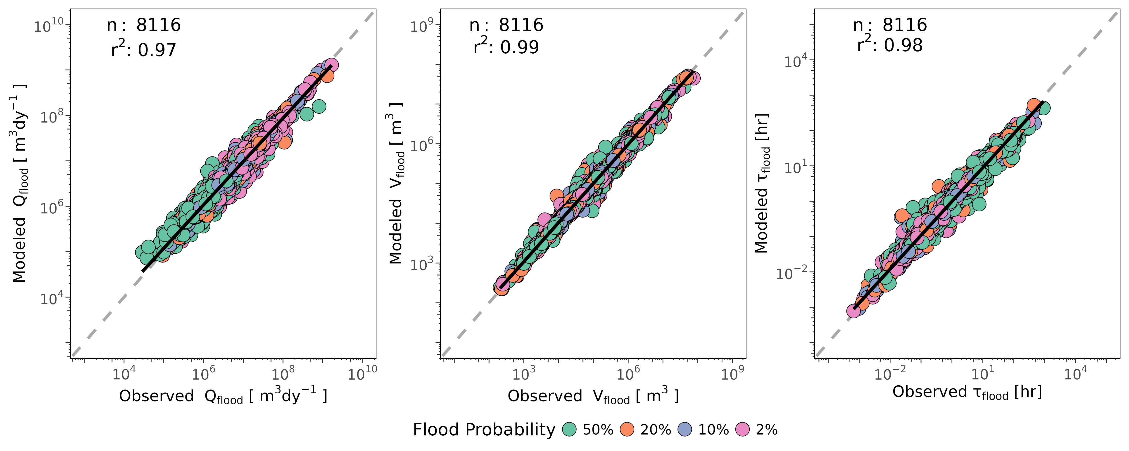
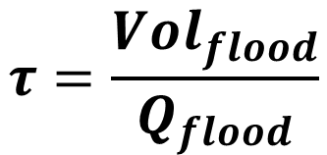
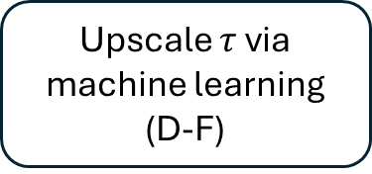
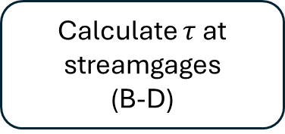
(A)
Calculate $τ$ at streamgages
(B-D)
Upscale $τ$ via machine learning
(D-F)
Pair with DOM flux model
(Fig. 4)
(B)
(C)
(D)
River discharge
$$τ=\frac{Vol_{flood}}{Q_{flood}}$$
(E)
Flood event
(F)
(G)

Slide 2
Calculate $τ$ at streamgages
(B-D)
Upscale $τ$ via machine learning
(D-F)
Pair with DOM flux model
(Fig. 4)
River discharge
$$τ=\frac{Vol_{flood}}{Q_{flood}}$$
Flood event

Slide 3
Floodplain
Channel
Floodplain
Floodplain
Bankfull excess
Floodplain
Bankfull
channel

Slide 4
Contributing catchment
River channel
HAND grid
Depth grid
Flood map
Flood volume map
 |  |  | 1 | 0 | 3
 |  |  | 0 | 1 | 3
 | 5 | 1 | 0 | 2 | 3 | 5 | 8
6 | 2 | 1 | 0 | 2 | 2 | 4 | 6
3 | 2 | 1 | 0 | 2 | 6
4 | 3 | 1 | 0 | 5 | 7
3 | 0 | 0 | 0 | 3 | 6
1 | 0 | 1
0
 |  |  | 3 | 3 | 3
 |  |  | 3 | 3 | 3
 | 3 | 3 | 3 | 3 | 3 | 3 | 3
3 | 3 | 3 | 3 | 3 | 3 | 3 | 3
3 | 3 | 3 | 3 | 3 | 3
3 | 3 | 3 | 3 | 3 | 3
3 | 3 | 3 | 3 | 3 | 3
3 | 3 | 3
3
 |  |  | 4 | 6
 |  |  | 6 | 4
 |  | 4 | 6 | 2
 | 2 | 4 | 6 | 2 | 2
 | 2 | 4 | 6 | 2
 |  | 4 | 6
 | 6 | 6 | 6
4 | 6 | 4
6

