Slide 1
Gas exchange in large rivers controlled by largest turbulent eddies: implications for remotely sensing gas exchange via SWOT

Slide 2
Key points
In big rivers, turbulence production and dissipation must reduce to stream power and are equal
This means that energy produced by depth-scale eddies is equal to energy dissipated by Kolmogorov-scale eddies
This allows for scaling of k via either turbulence scale, so long as the river is sufficiently large
This can all be exploited and measured from SWOT satellite, where near-daily sampling should allow for novel mapping of river gas exchange

Slide 3

Turbulent energy budget at free surface
$G+T_{d}+V_{d}=ε$ [Nezu & Nagawaka 1993]
G
Bulk TKE production rate [J/kg*s]
Depth-scale diffusion rate of TKE [J/kg*s]
TKE viscous diffusion rate [J/kg*s]
TKE dissipation rate [J/kg*s]
$$ε$$
“Energy
Produced”
“Energy Transported from bed”
“Energy Transported viscously”
“Energy
Dissipated”
Td

Slide 4
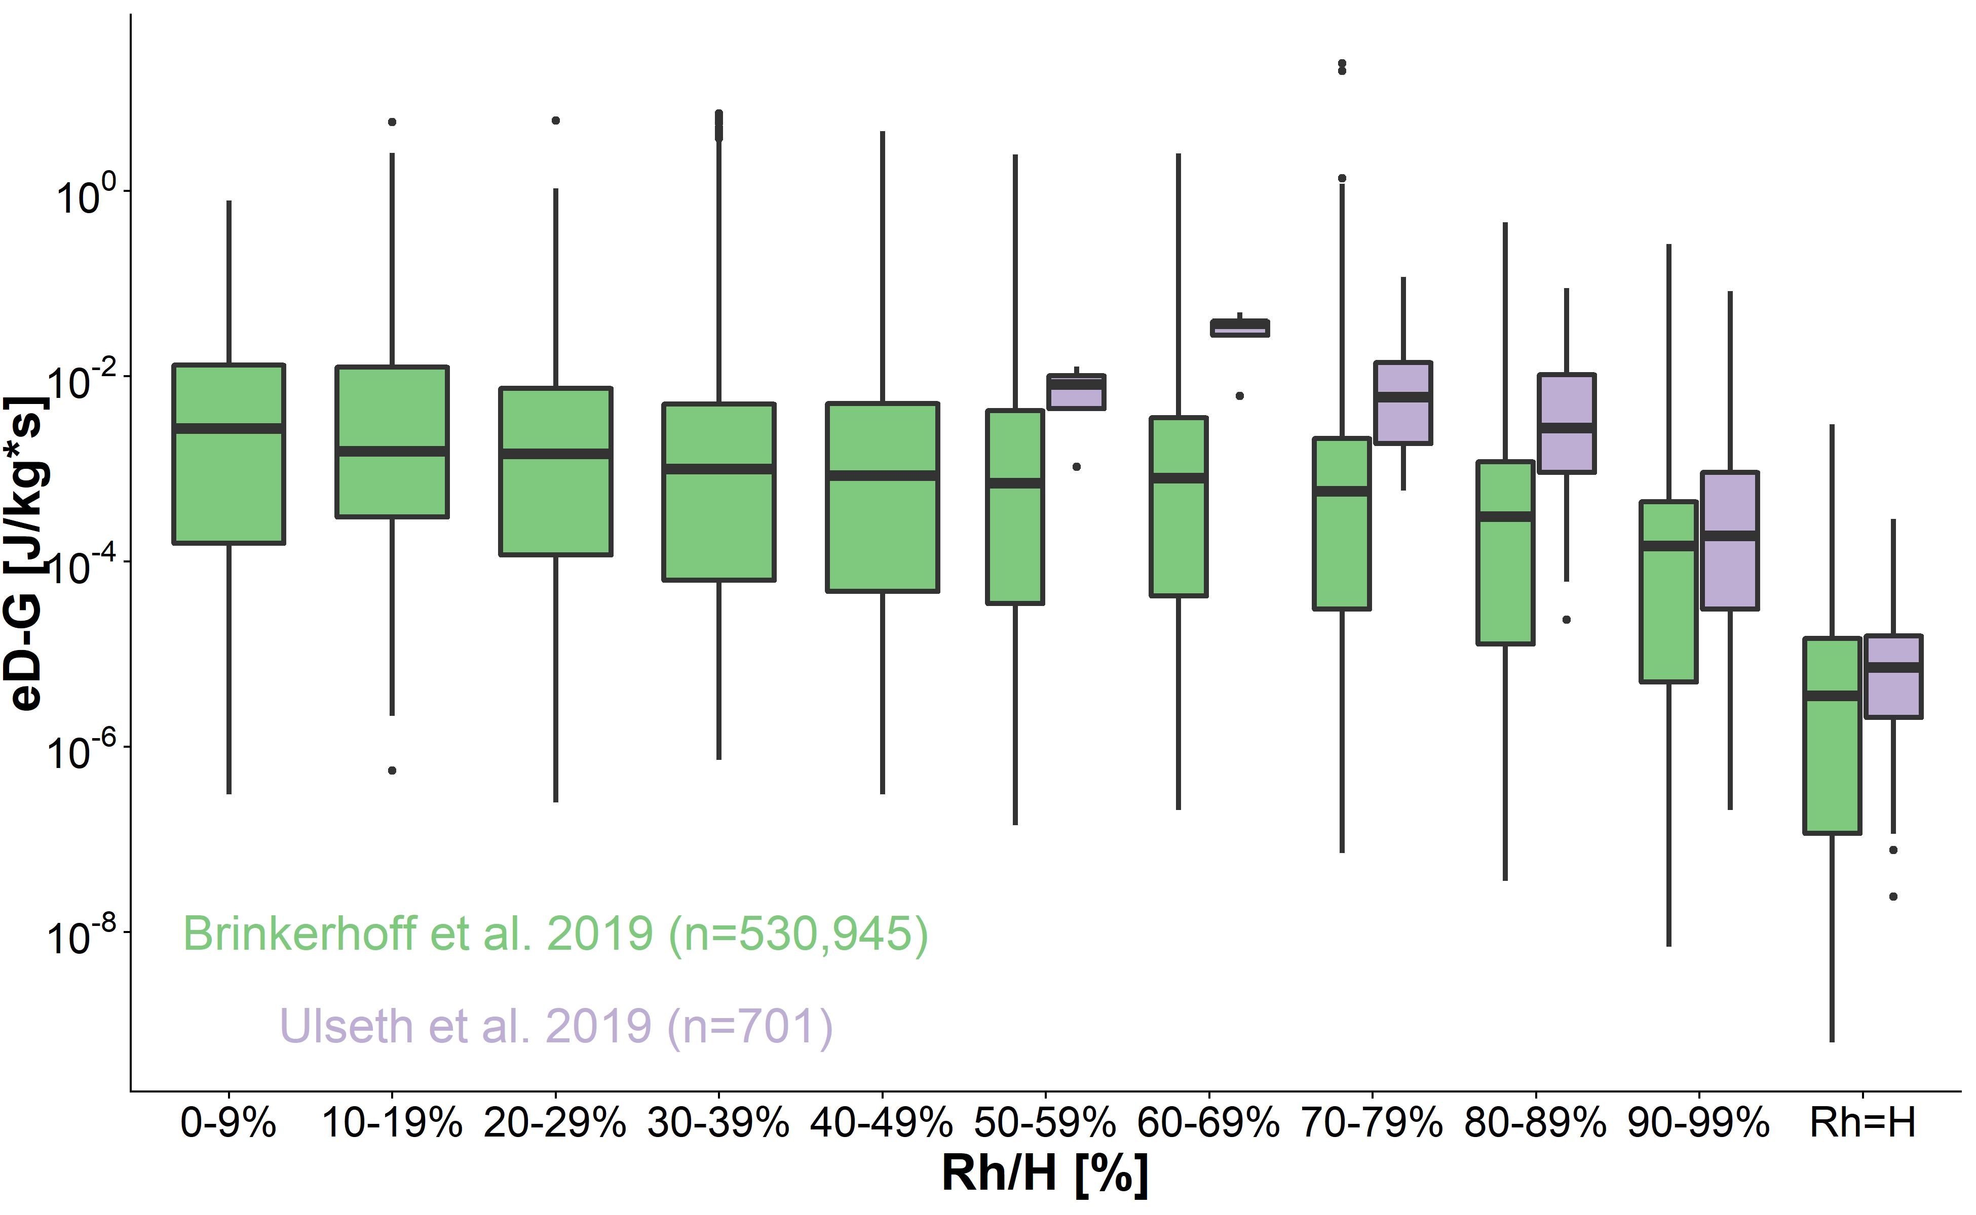
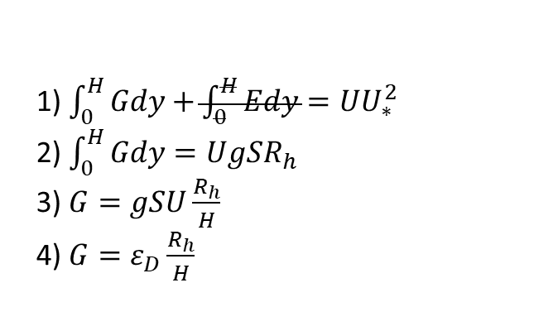
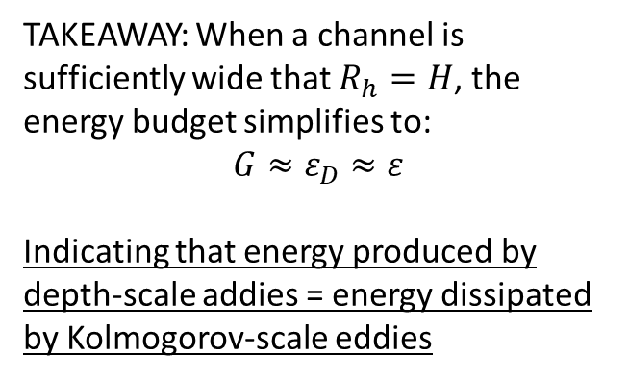
Turbulent energy budget at free surface
Empirical confirmation for over 531,000 unique measurements of river channel hydraulics
1) $\int_{0}^{H}{Gdy}+\int_{0}^{H}{Edy}=UU_{∗}^{2}$
2) $\int_{0}^{H}{Gdy}=UgSR_{h}$
3) $G=gSU\frac{R_{h}}{H}$
4) $G=ε_{D}\frac{R_{h}}{H}$
[Nezu & Nagawaka 1993]
TAKEAWAY: When a channel is sufficiently wide that $R_{h}=H$, the energy budget simplifies to:
$$G≈ε_{D}≈ε$$
Indicating that energy produced by depth-scale addies = energy dissipated by Kolmogorov-scale eddies

Slide 5
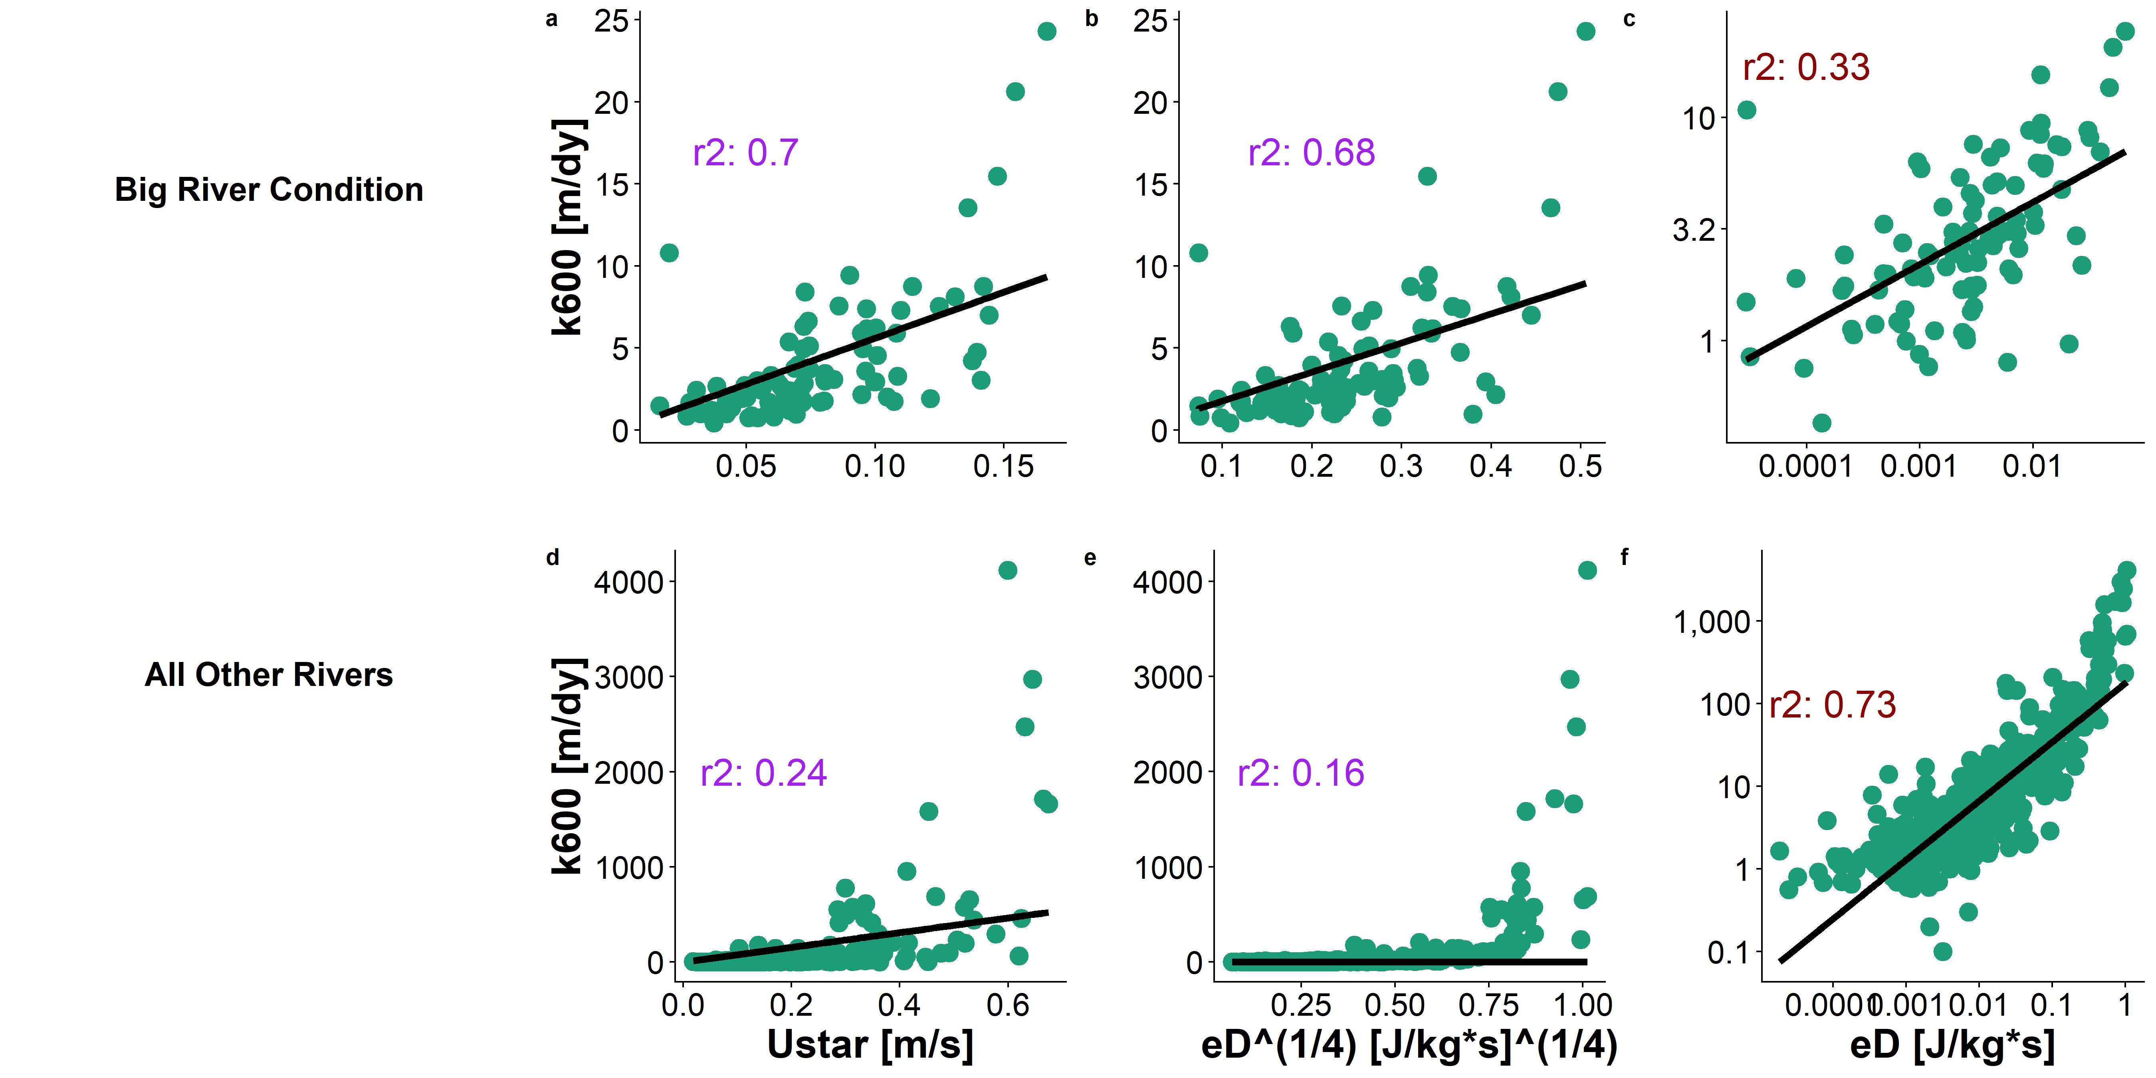
Implications for k scaling in large rivers
Functionally equal
Slope is still ¼ here!!
It follows then that scaling k600 via either turbulence scale should yield the same model when Rh=H (and not when Rh=/=H)
This matters because U* is pretty easy to remotely sense, while eD is not…
Rh=H
Not equal
Slope is steeper, but good fit
Rh=/=H
These models are fit using the Ulseth etal (2019) dataset

Slide 6
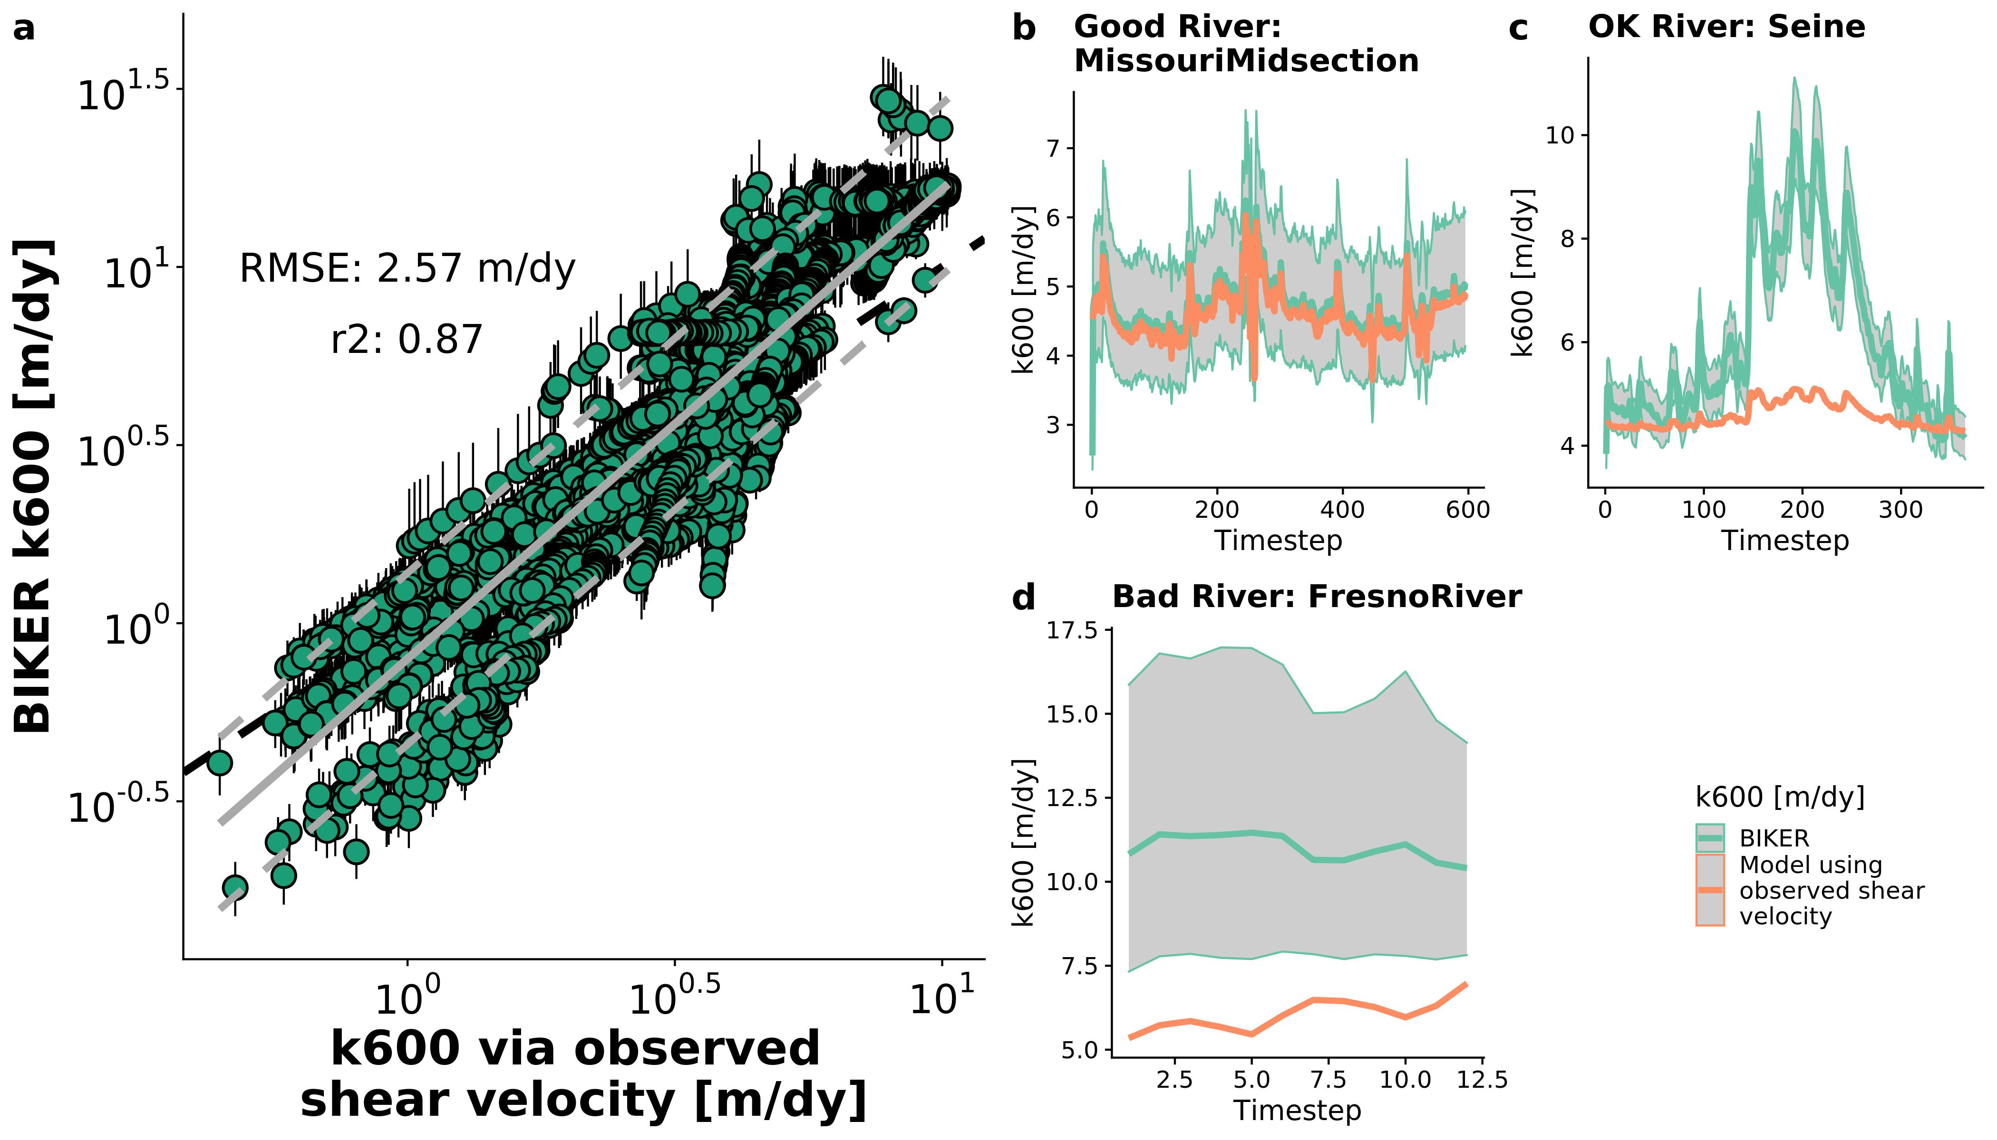
BIKER algorithm validated on 47 SWOT rivers
Bayesian algorithm solves for only 2 unknowns: k600 and median channel area

Slide 7
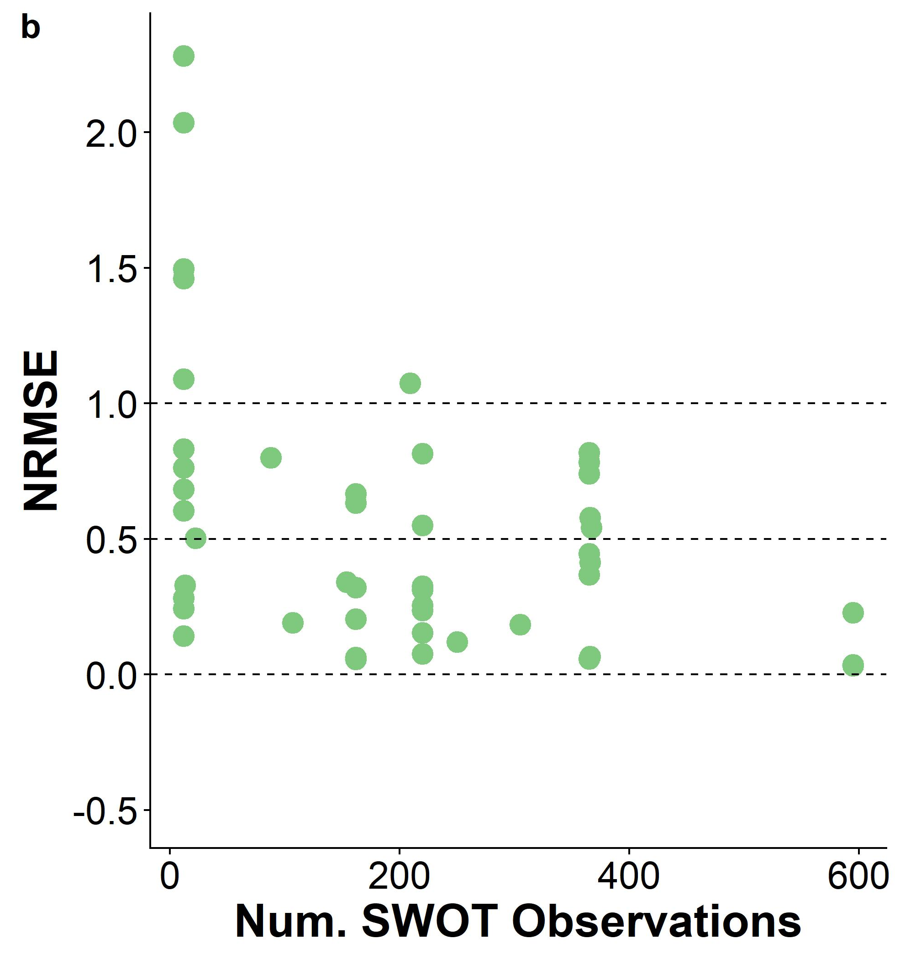
Performance improves with more data
RMSE normalized by mean k to compare across rivers
Especially since SWOT will have a 3-year lifespan…

Slide 8
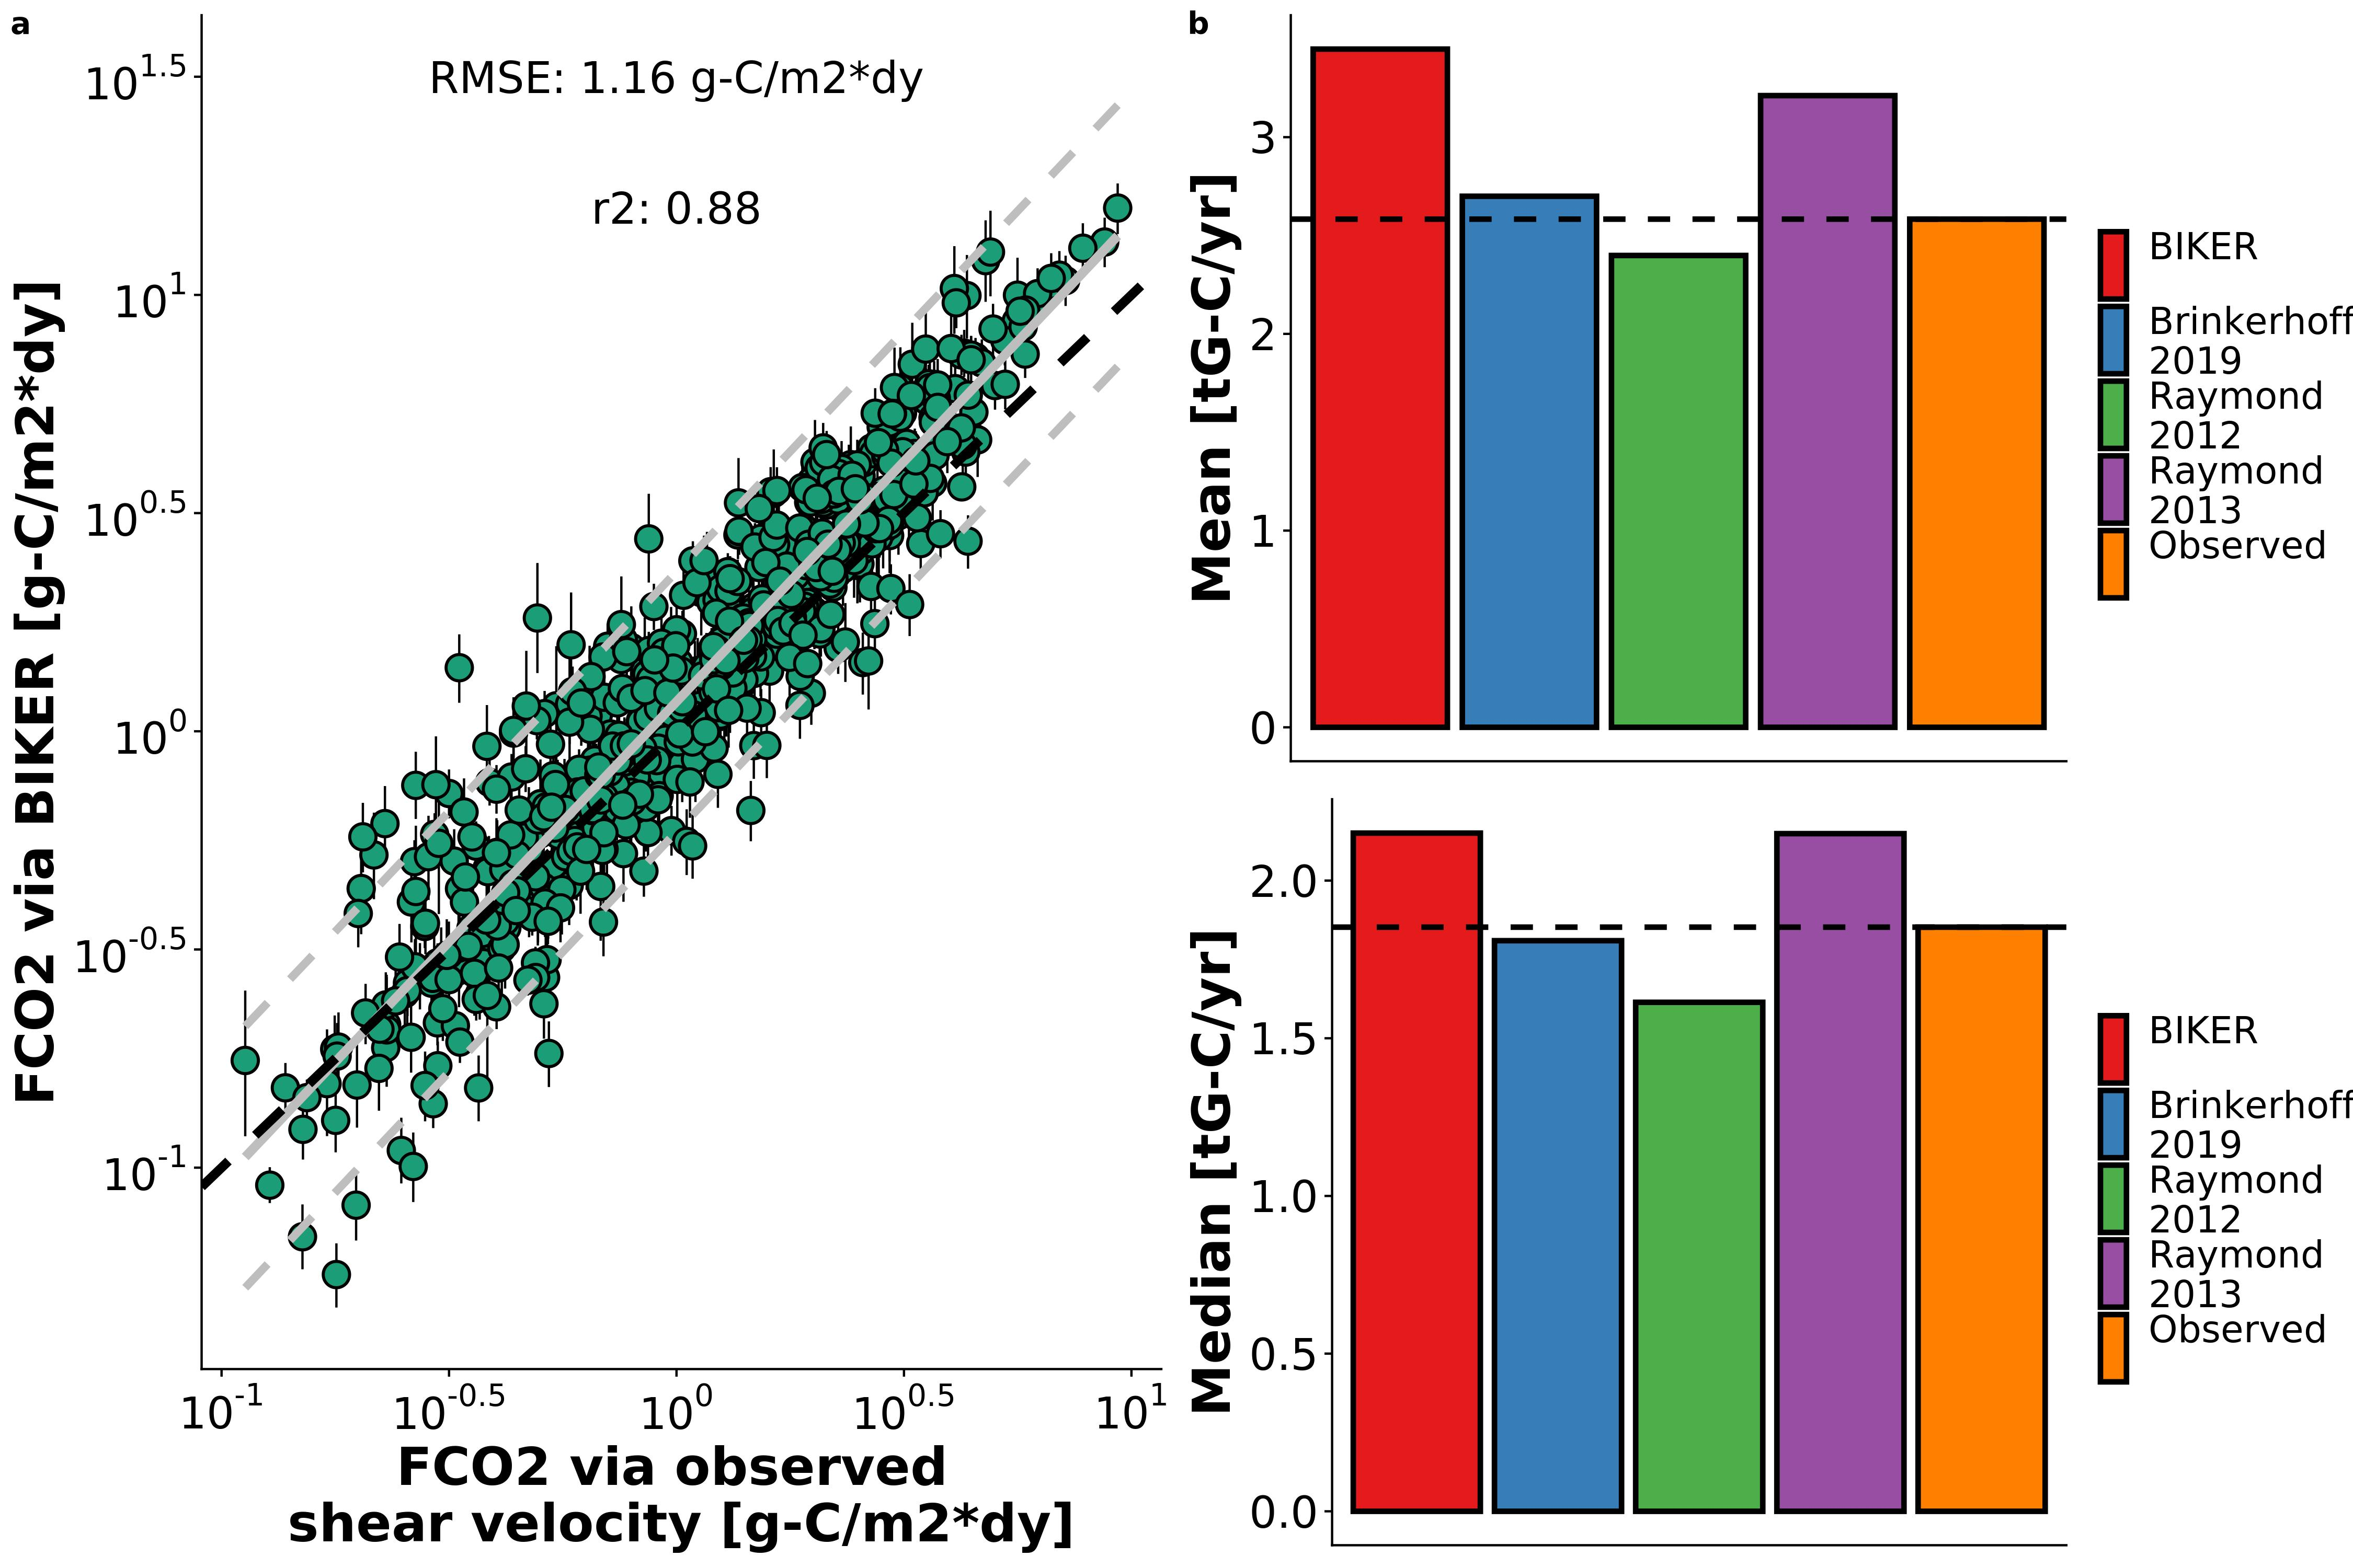
Coupled with an in situ CO2 sensor
No Q required
Needs Q
Needs Q
Needs Q
N=530,945
N=1,026
N=9,811

