Slide 1
Efficient Channel

Slide 2
Inefficient Channel

Slide 4
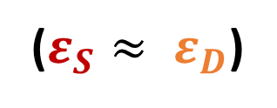
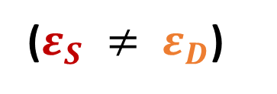
Efficient Channel
($ε_{S} ≠ ε_{D}$)
Inefficient Channel
($ε_{S}≈ ε_{D}$)

Slide 5
slope
slope
slope
slope

