Slide 1
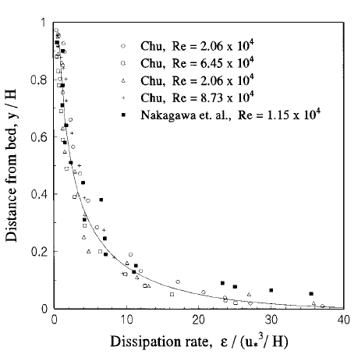
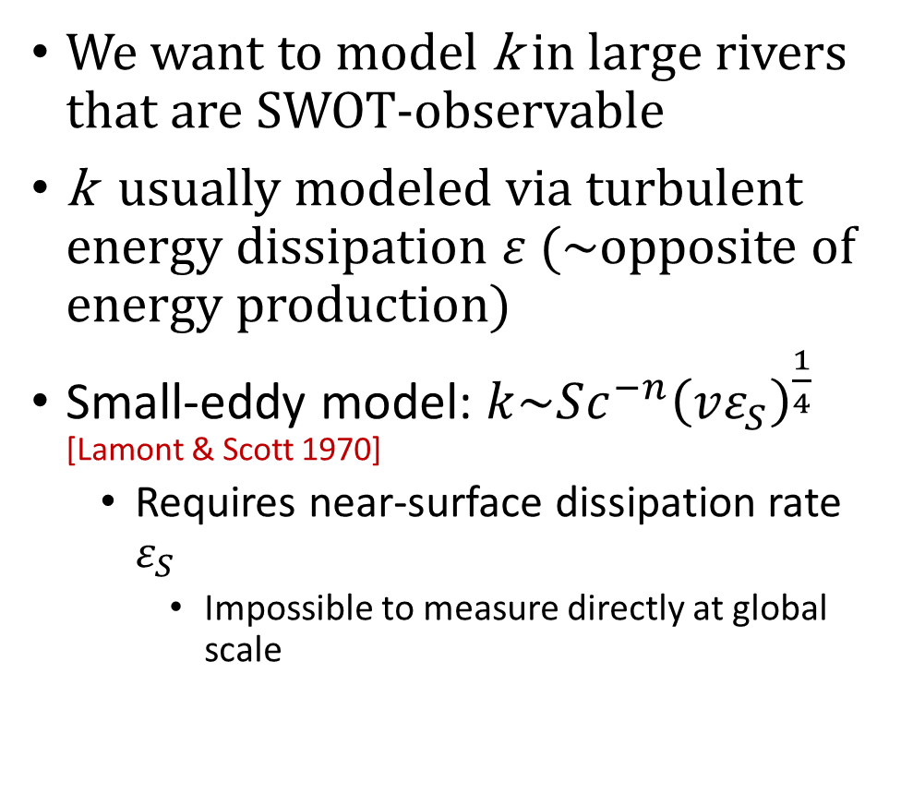

Intro
We want to model k in large rivers that are SWOT-observable
k usually modeled via turbulent energy dissipation $ε$ (~opposite of energy production)
Small-eddy model: $k\sim Sc^{−n}{\left(vε_{S}\right)}^{\frac{1}{4}}$ [Lamont & Scott 1970]
Requires near-surface dissipation rate $ε_{S}$
Impossible to measure directly at global scale
$$ε_{S}$$

Slide 2
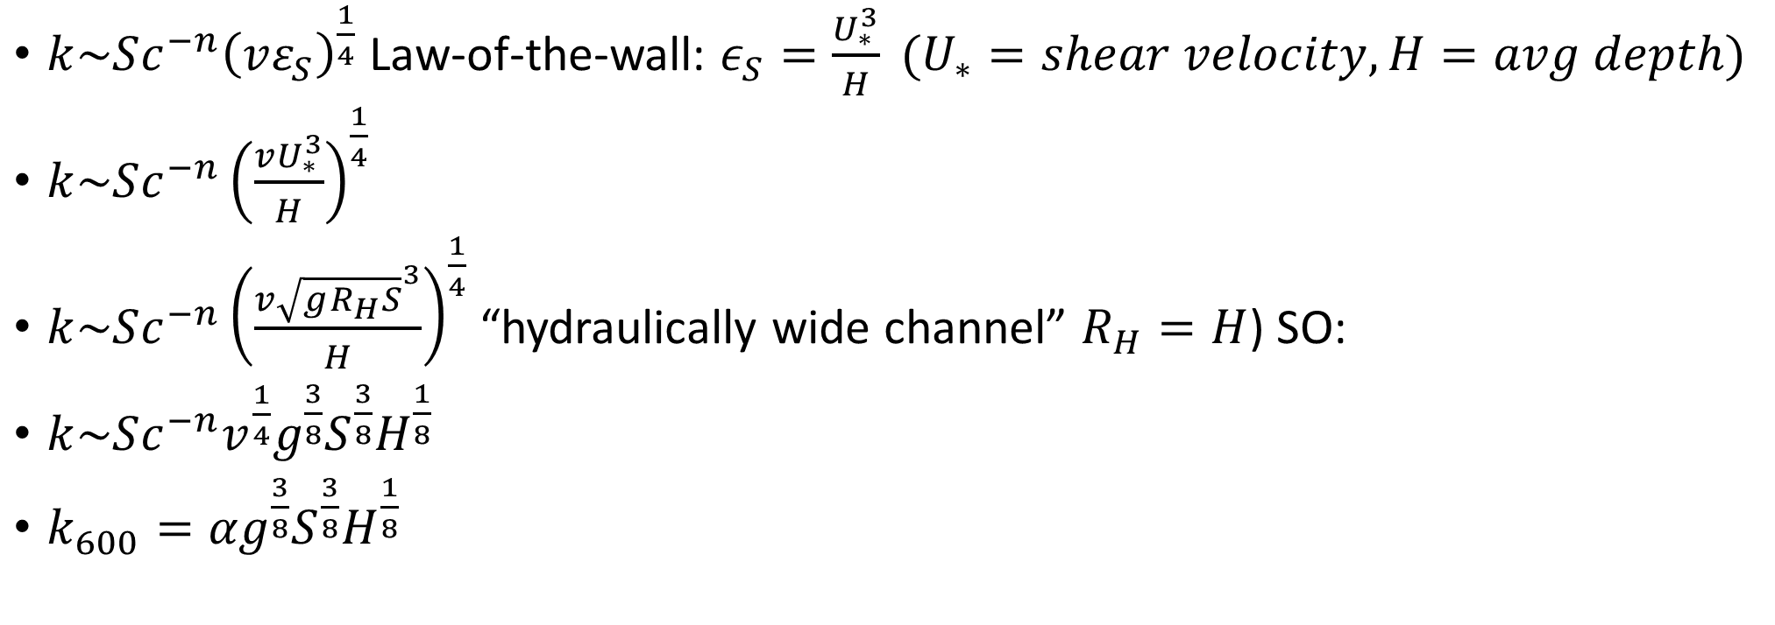
The hydraulically wide channel
$k\sim Sc^{−n}{\left(vε_{S}\right)}^{\frac{1}{4}}$ Law-of-the-wall: $ε_{S}=\frac{U_{∗}^{3}}{H} (U_{∗}=shear velocity, H=avg depth)$
$k\sim Sc^{−n}{\left(\frac{vU_{∗}^{3}}{H}\right)}^{\frac{1}{4}}$
$k\sim Sc^{−n}{\left(\frac{v{\sqrt{gR_{H}S}}^{3}}{H}\right)}^{\frac{1}{4}}$ “hydraulically wide channel” $R_{H}=H$) SO:
$k\sim Sc^{−n}v^{\frac{1}{4}}g^{\frac{3}{8}}S^{\frac{3}{8}}H^{\frac{1}{8}}$
$k_{600}={αg}^{\frac{3}{8}}S^{\frac{3}{8}}H^{\frac{1}{8}}$

Slide 3
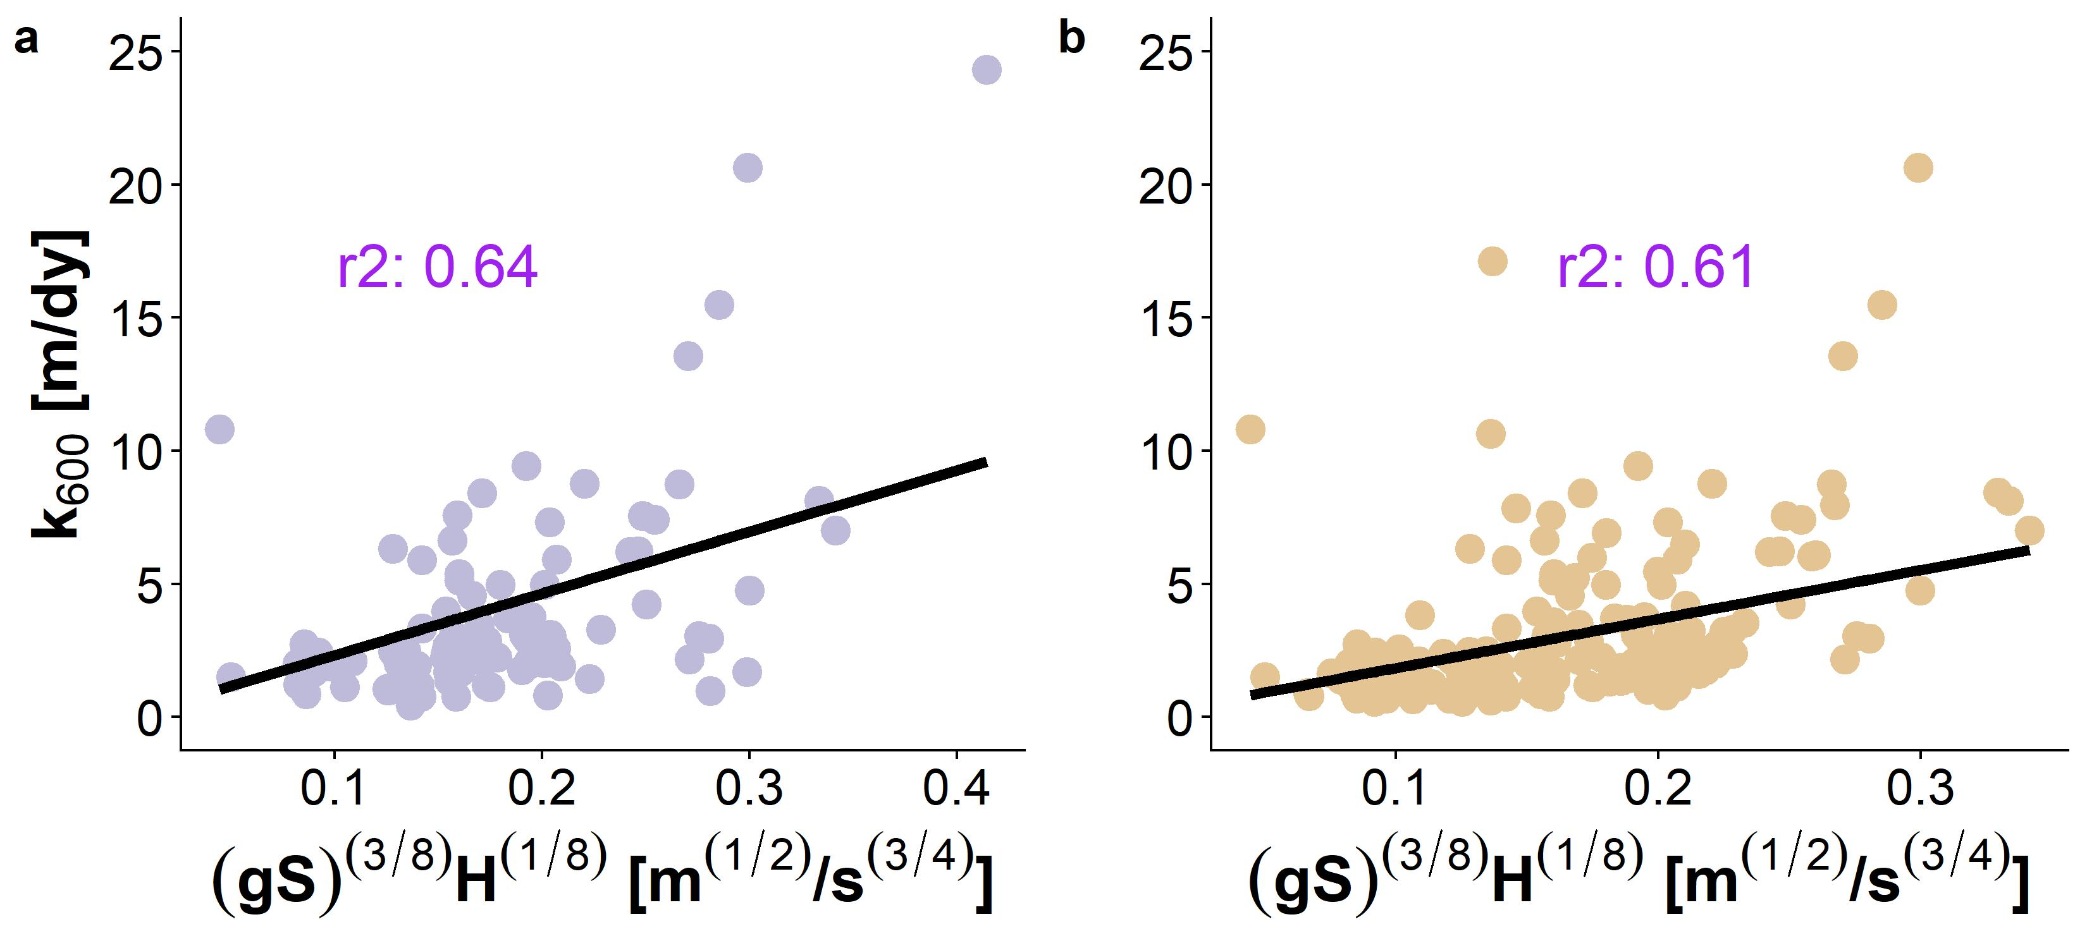
Results
Hydraulically Wide
SWOT-Observable

Slide 4

What does this mean for SWOT?
Using Brinkerhoff et al (2019) dataset (n=171,553), 95% of SWOT-observable river measurements had Rh within 5% of H
This theoretical model for k ($k\sim U_{∗}\sim ε_{D}^{\frac{1}{4}}$) is therefore generally valid in SWOT-observable rivers and we can exploit this physical model to build a parsimonious BIKER algorithm with minimal unknowns

