Slide 1
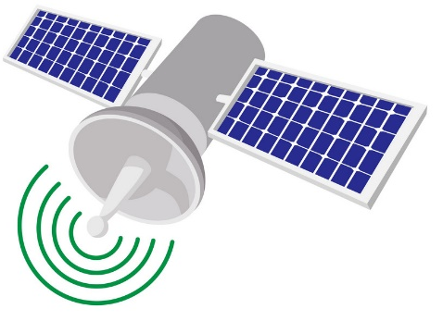

$CO_{2}$ concentration
Boundary layer (turbulence driven)

