Slide 1
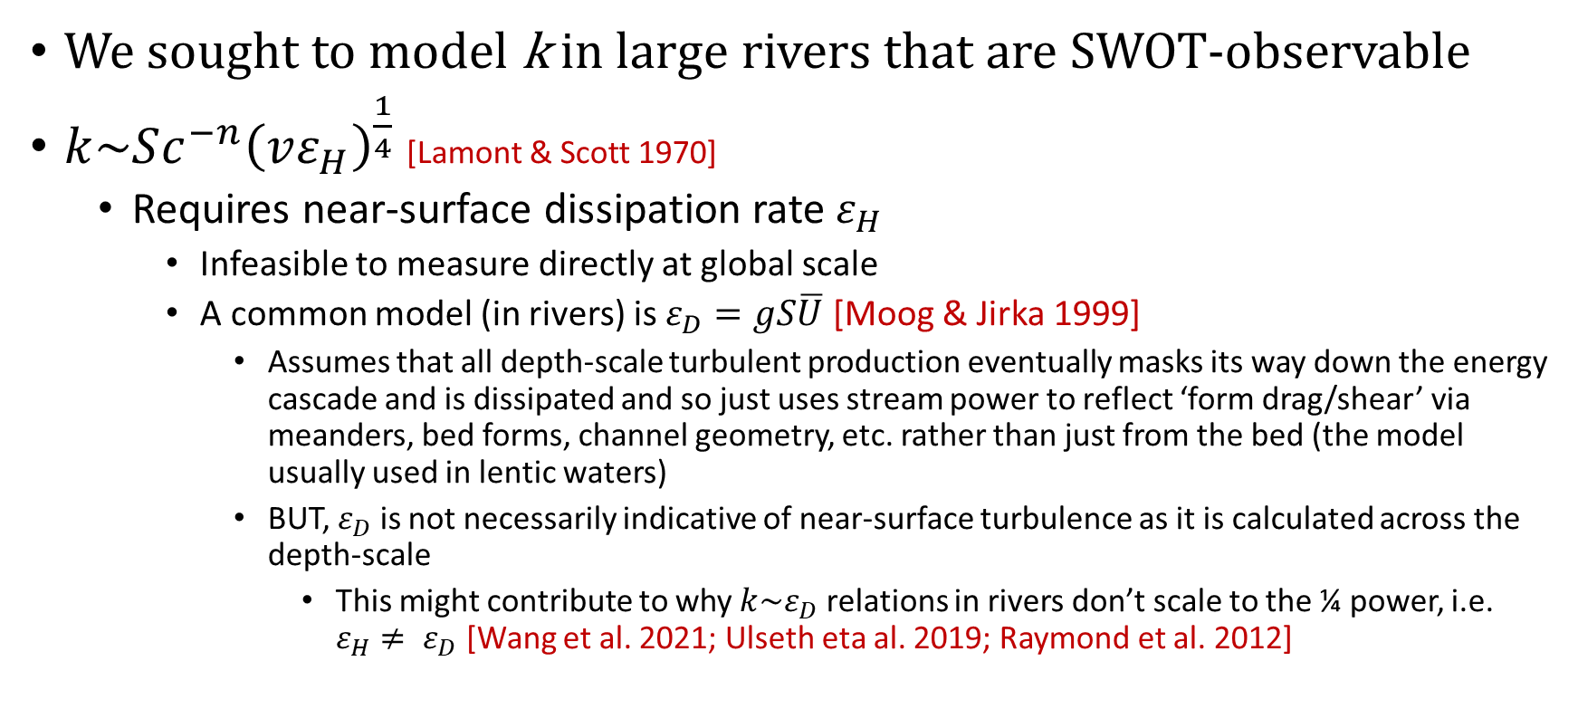
Intro
We sought to model k in large rivers that are SWOT-observable
$k\sim Sc^{−n}{\left(vε_{H}\right)}^{\frac{1}{4}}$ [Lamont & Scott 1970]
Requires near-surface dissipation rate $ε_{H}$
Infeasible to measure directly at global scale
A common model (in rivers) is $ε_{D}=gS\overline{U}$ [Moog & Jirka 1999]
Assumes that all depth-scale turbulent production eventually masks its way down the energy cascade and is dissipated and so just uses stream power to reflect ‘form drag/shear’ via meanders, bed forms, channel geometry, etc. rather than just from the bed (the model usually used in lentic waters)
BUT, $ε_{D}$ is not necessarily indicative of near-surface turbulence as it is calculated across the depth-scale
This might contribute to why $k\sim ε_{D}$ relations in rivers don’t scale to the ¼ power, i.e. $ε_{H}≠ ε_{D}$ [Wang et al. 2021; Ulseth eta al. 2019; Raymond et al. 2012]

Slide 2
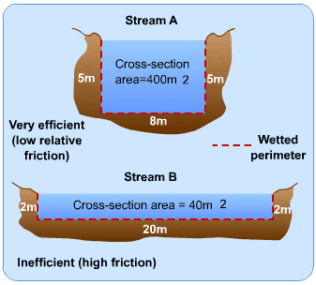
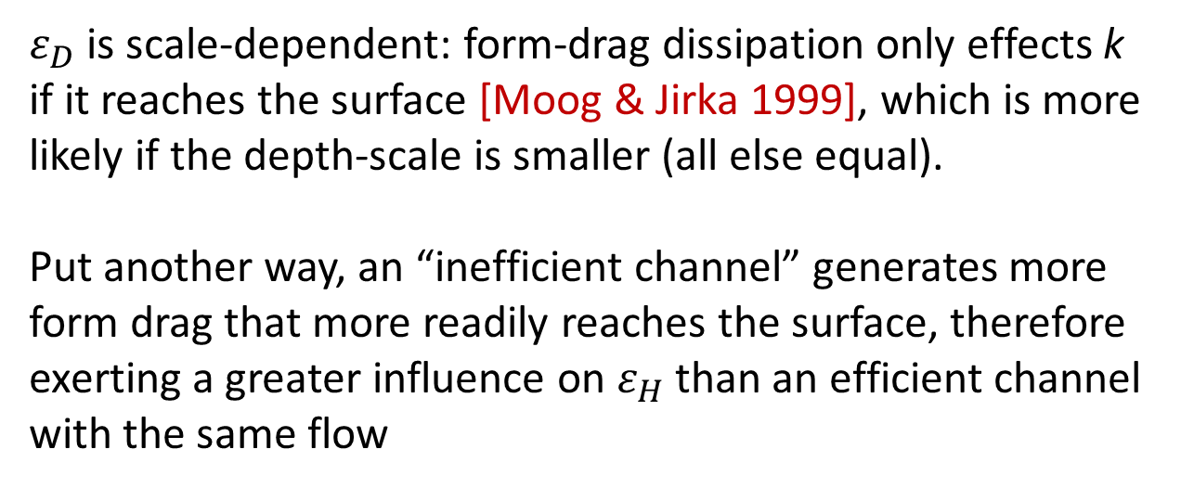
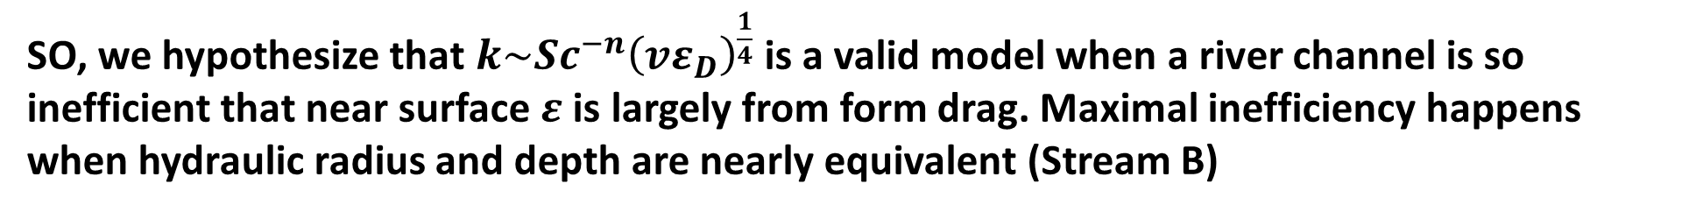
River channel geometry influences form-drag production and dissipation
$ε_{D}$ is scale-dependent: form-drag dissipation only effects k if it reaches the surface [Moog & Jirka 1999], which is more likely if the depth-scale is smaller (all else equal).
Put another way, an “inefficient channel” generates more form drag that more readily reaches the surface, therefore exerting a greater influence on $ε_{H}$ than an efficient channel with the same flow
SO, we hypothesize that $k\sim Sc^{−n}{\left(vε_{D}\right)}^{\frac{1}{4}}$ is a valid model when a river channel is so inefficient that near surface $ε$ is largely from form drag. Maximal inefficiency happens when hydraulic radius and depth are nearly equivalent (Stream B)
Further, if this is true, then we likely don’t need the small-eddy model and can predict k directly using depth-scale turbulence (i.e. $k\sim U_{∗}$) in inefficient rivers

Slide 3
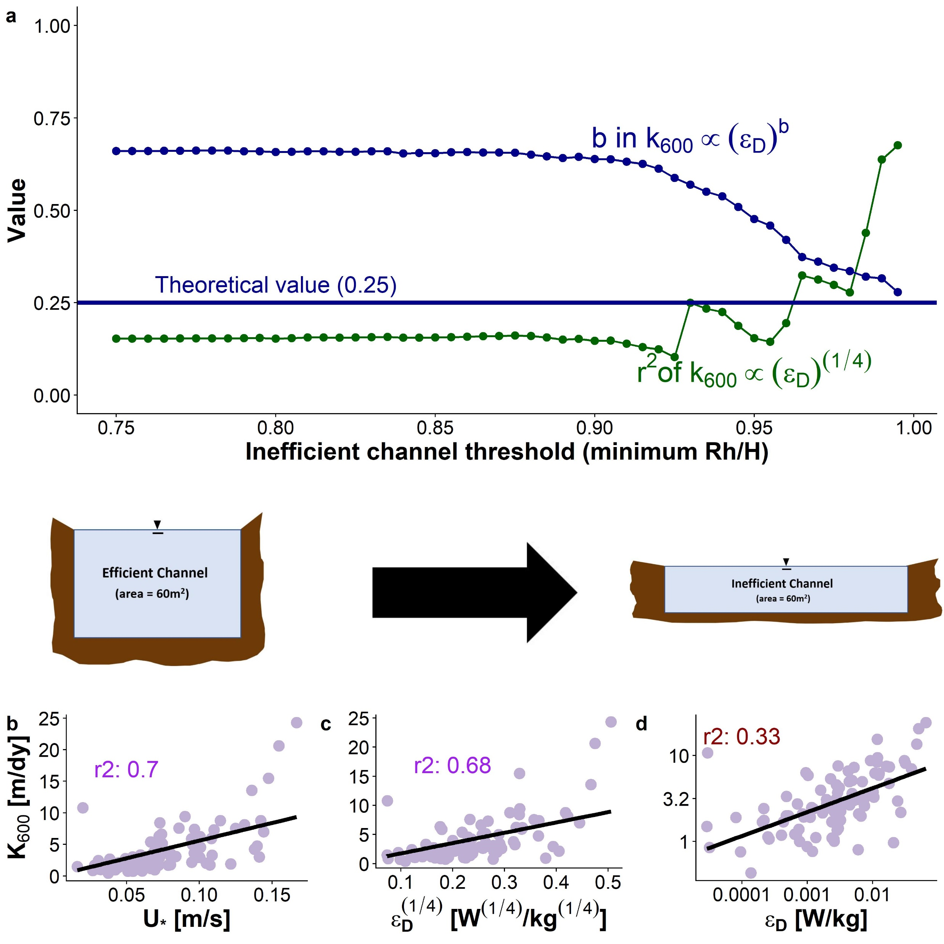
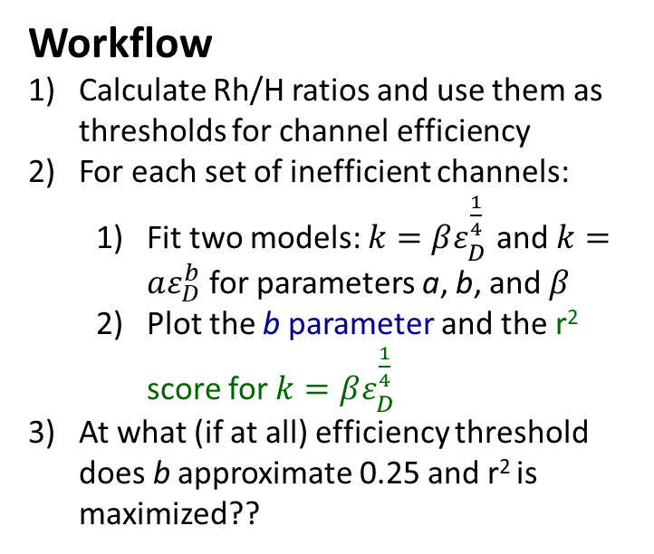
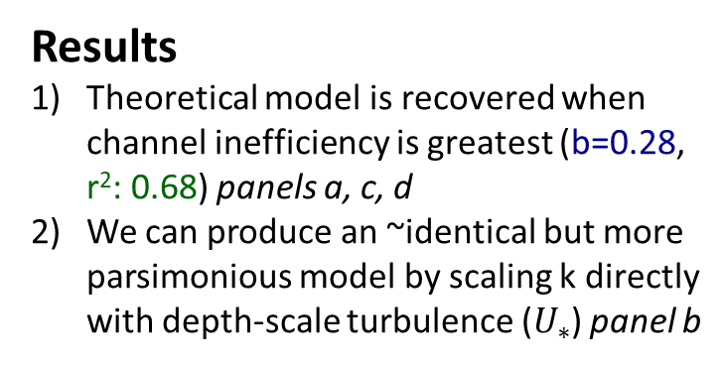
Workflow
Calculate Rh/H ratios and use them as thresholds for channel efficiency
For each set of inefficient channels:
Fit two models: $k=βε_{D}^{\frac{1}{4}}$ and $k=aε_{D}^{b}$ for parameters a, b, and $β$
Plot the b parameter and the r² score for $k=βε_{D}^{\frac{1}{4}}$
At what (if at all) efficiency threshold does b approximate 0.25 and r² is maximized??
Results
Theoretical model is recovered when channel inefficiency is greatest (b=0.28, r²: 0.68) panels a, c, d
We can produce an ~identical but more parsimonious model by scaling k directly with depth-scale turbulence ($U_{∗}$) panel b

