Slide 1
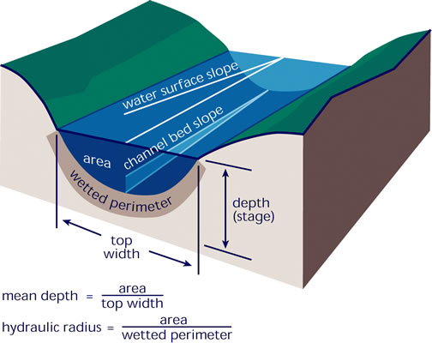
Background/updated goal
We want to model gas transfer velocity k in large rivers that are SWOT-observable
SWOT-observable rivers are generally ‘hydraulically wide’
Hydraulic radius Rh = mean depth H
As we talked about last time
Goal: completely streamline the presentation I showed previously
Simply impose the hydraulically-wide condition on established models for k and confirm whether the models work
I’ve tested two models

Slide 2
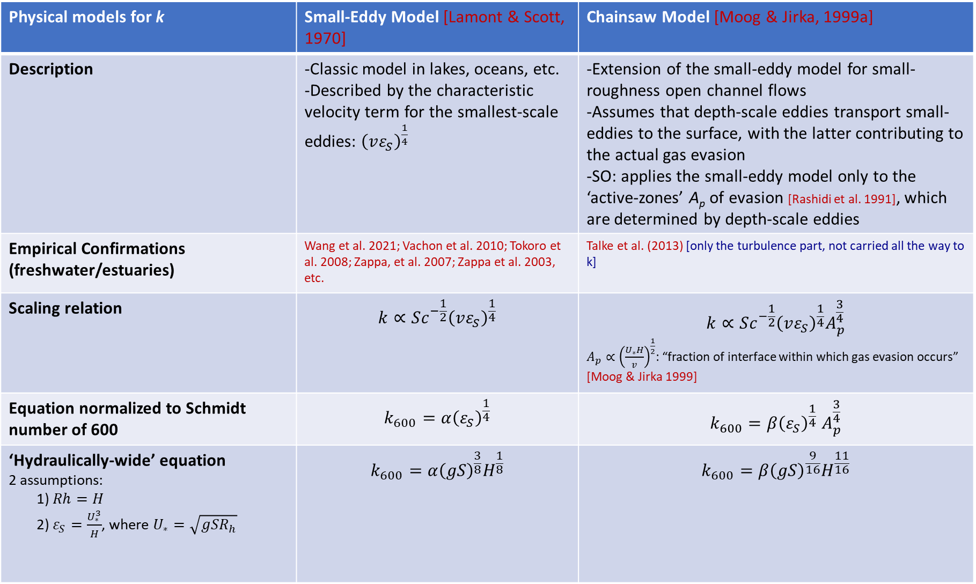
Physical models for k | Small-Eddy Model [Lamont & Scott, 1970] | Chainsaw Model [Moog & Jirka, 1999a]
Description | -Classic model in lakes, oceans, etc. -Described by the characteristic velocity term for the smallest-scale eddies: ${\left(vε_{S}\right)}^{\frac{1}{4}}$ | -Extension of the small-eddy model for small-roughness open channel flows -Assumes that depth-scale eddies transport small-eddies to the surface, with the latter contributing to the actual gas evasion -SO: applies the small-eddy model only to the ‘active-zones’ A_{p} of evasion [Rashidi et al. 1991], which are determined by depth-scale eddies
Empirical Confirmations (freshwater/estuaries) | Wang et al. 2021; Vachon et al. 2010; Tokoro et al. 2008; Zappa, et al. 2007; Zappa et al. 2003, etc. | Talke et al. (2013) [only the turbulence part, not carried all the way to k]
Scaling relation | $$k∝Sc^{−\frac{1}{2}}{\left(vε_{S}\right)}^{\frac{1}{4}}$$ | $$k∝Sc^{−\frac{1}{2}}{\left(vε_{S}\right)}^{\frac{1}{4}}A_{p}^{\frac{3}{4}}$$ $A_{p}∝{\left(\frac{U_{∗}H}{v}\right)}^{\frac{1}{2}}$: “fraction of interface within which gas evasion occurs” [Moog & Jirka 1999]
Equation normalized to Schmidt number of 600 | $$k_{600}=α{\left(ε_{S}\right)}^{\frac{1}{4}}$$ | $$k_{600}{=β\left(ε_{S}\right)}^{\frac{1}{4}}A_{p}^{\frac{3}{4}}$$
‘Hydraulically-wide’ equation 2 assumptions: 1) $Rh=H$ 2) $ε_{S}=\frac{U_{∗}^{3}}{H}$, where $U_{∗}=\sqrt{gSR_{h}}$ | $$k_{600}=α{\left(gS\right)}^{\frac{3}{8}}H^{\frac{1}{8}}$$ | $$k_{600}={β\left(gS\right)}^{\frac{9}{16}}H^{\frac{11}{16}}$$

Slide 3
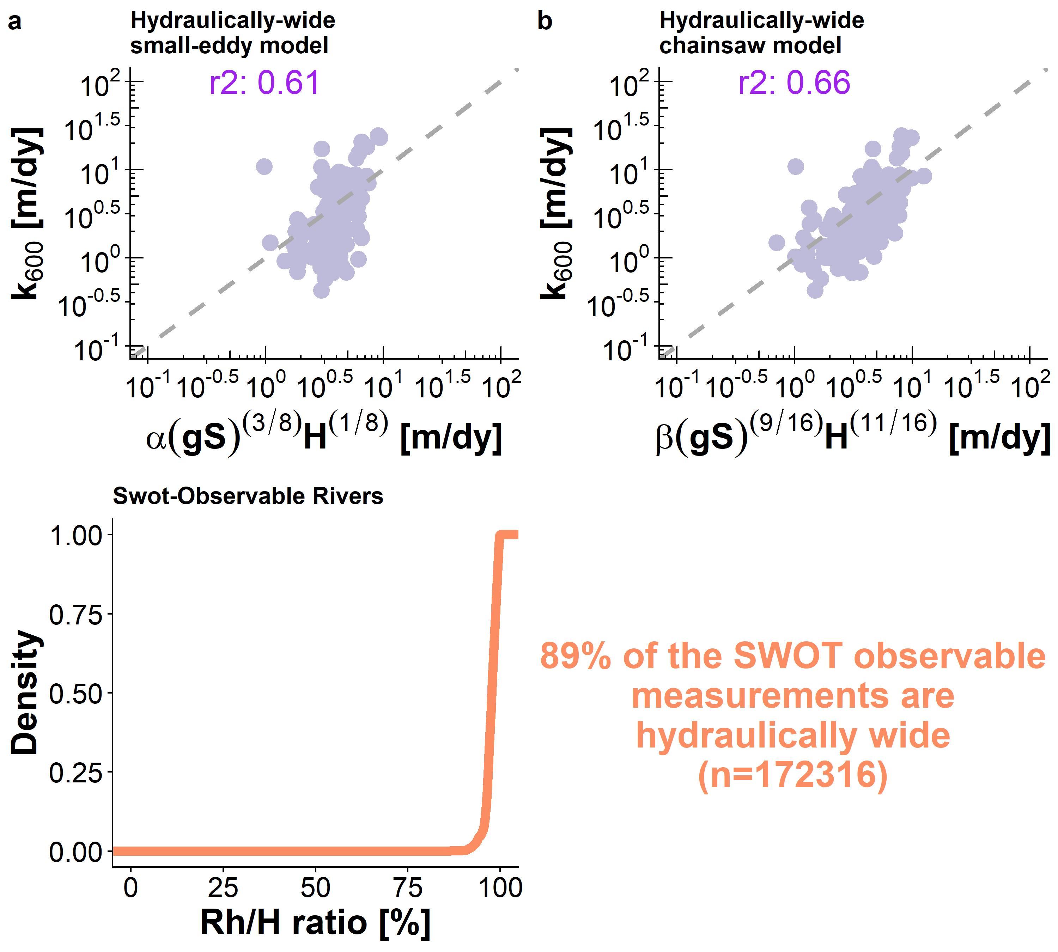
I’ve implemented the chainsaw model within the algorithm because it appears to get the scaling dynamics more correctly.
This would also be (I think) the first empirical confirmation of the chainsaw model predicting k.

Slide 4
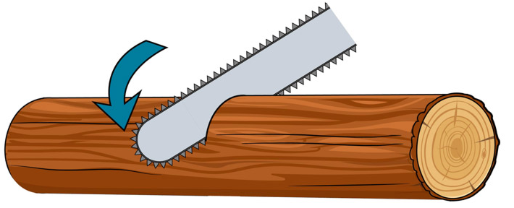
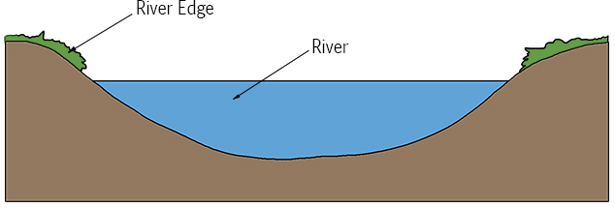
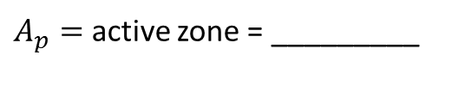
How I interpret the chainsaw model
Small eddies
Large eddies
Entire interface
$A_{p}=$ active zone = _________
Active zone of gas evasion
Gas evasion
Entire interface

Slide 5

Questions
I’m currently avoiding the other Moog & Jirka (1999) model which relies on depth-scale form drag
$k∝ε_{D}$ where $ε_{D}=gS\overline{U}$ and is stream power per unit mass water
Avoiding it for two reasons

