Slide 1
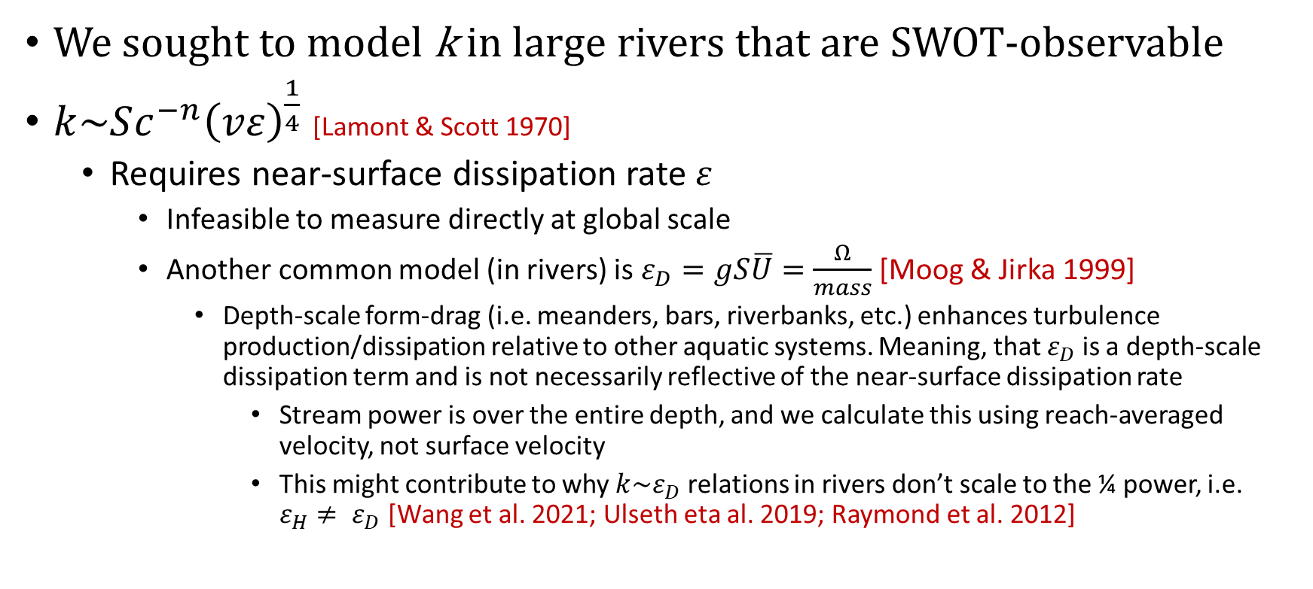
Intro
We sought to model k in large rivers that are SWOT-observable
$k\sim Sc^{−n}{\left(vε\right)}^{\frac{1}{4}}$ [Lamont & Scott 1970]
Requires near-surface dissipation rate $ε$
Infeasible to measure directly at global scale
Another common model (in rivers) is $ε_{D}=gS\overline{U}=\frac{Ω}{mass}$ [Moog & Jirka 1999]
Depth-scale form-drag (i.e. meanders, bars, riverbanks, etc.) enhances turbulence production/dissipation relative to other aquatic systems. Meaning, that $ε_{D}$ is a depth-scale dissipation term and is not necessarily reflective of the near-surface dissipation rate
Stream power is over the entire depth, and we calculate this using reach-averaged velocity, not surface velocity
This might contribute to why $k\sim ε_{D}$ relations in rivers don’t scale to the ¼ power, i.e. $ε_{H}≠ ε_{D}$ [Wang et al. 2021; Ulseth eta al. 2019; Raymond et al. 2012]

Slide 2
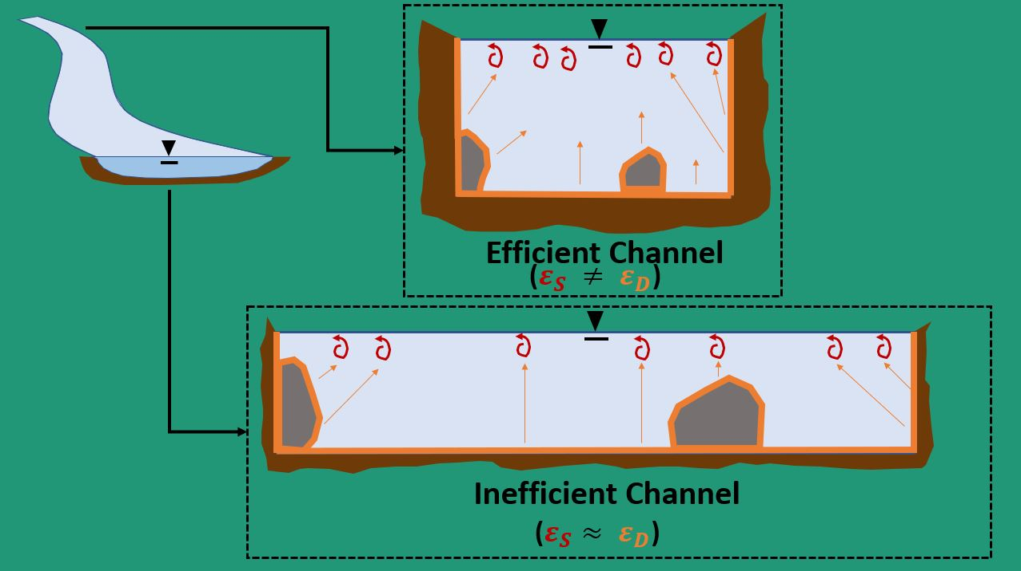
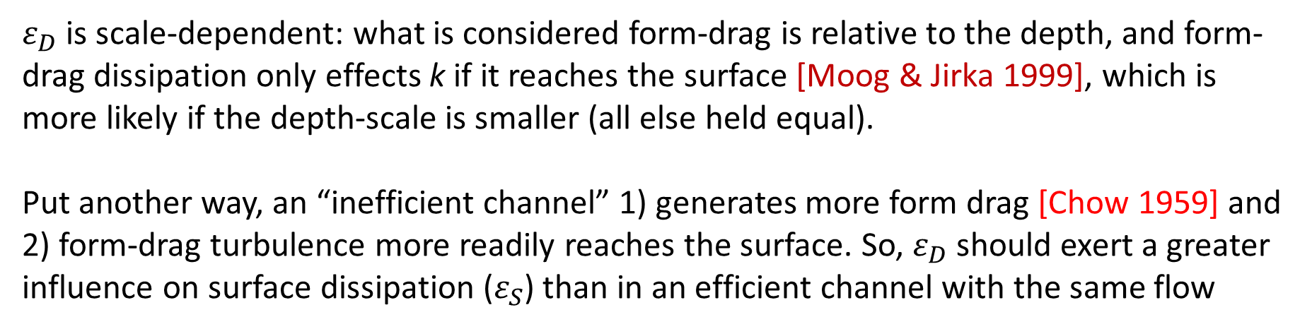
$ε_{D}$ is scale-dependent: what is considered form-drag is relative to the depth, and form-drag dissipation only effects k if it reaches the surface [Moog & Jirka 1999], which is more likely if the depth-scale is smaller (all else held equal).
Put another way, an “inefficient channel” 1) generates more form drag [Chow 1959] and 2) form-drag turbulence more readily reaches the surface. So, $ε_{D}$ should exert a greater influence on surface dissipation ($ε_{S}$) than in an efficient channel with the same flow

Slide 3
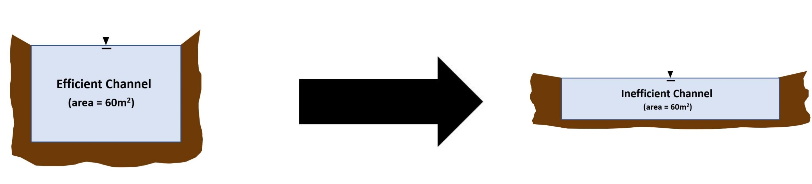
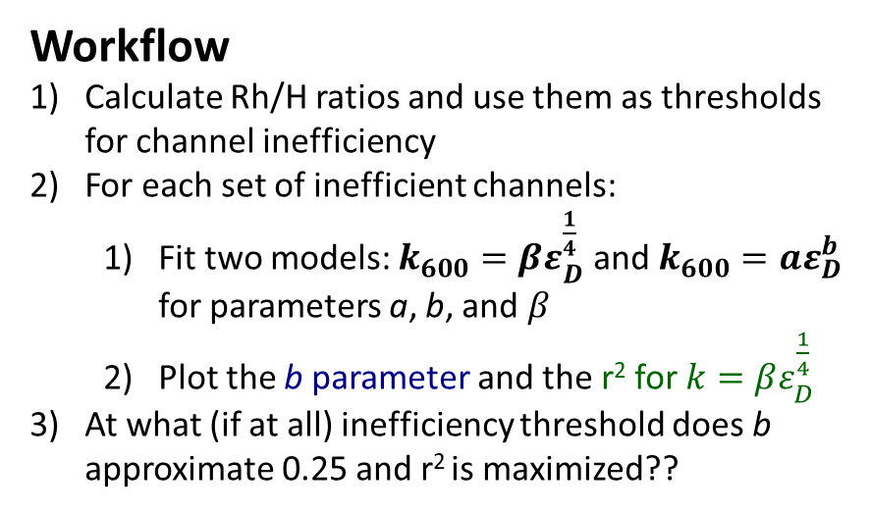
SO, I hypothesize that $k\sim Sc^{−n}{\left(vε_{D}\right)}^{\frac{1}{4}}$ is a valid model when a river channel is so inefficient that near surface $ε$ is largely from form drag (i.e. $ε≈ε_{D}$).
Further, if this is true, then we likely don’t need the small-eddy model and can predict k directly using depth-scale turbulence (i.e. $k\sim U_{∗}$) in inefficient rivers
Rh/H is low
Rh/H is near 1
Workflow
Calculate Rh/H ratios and use them as thresholds for channel inefficiency
For each set of inefficient channels:
Fit two models: $k_{600}=βε_{D}^{\frac{1}{4}}$ and $k_{600}=aε_{D}^{b}$ for parameters a, b, and $β$
Plot the b parameter and the r² for $k=βε_{D}^{\frac{1}{4}}$
At what (if at all) inefficiency threshold does b approximate 0.25 and r² is maximized??

Slide 4
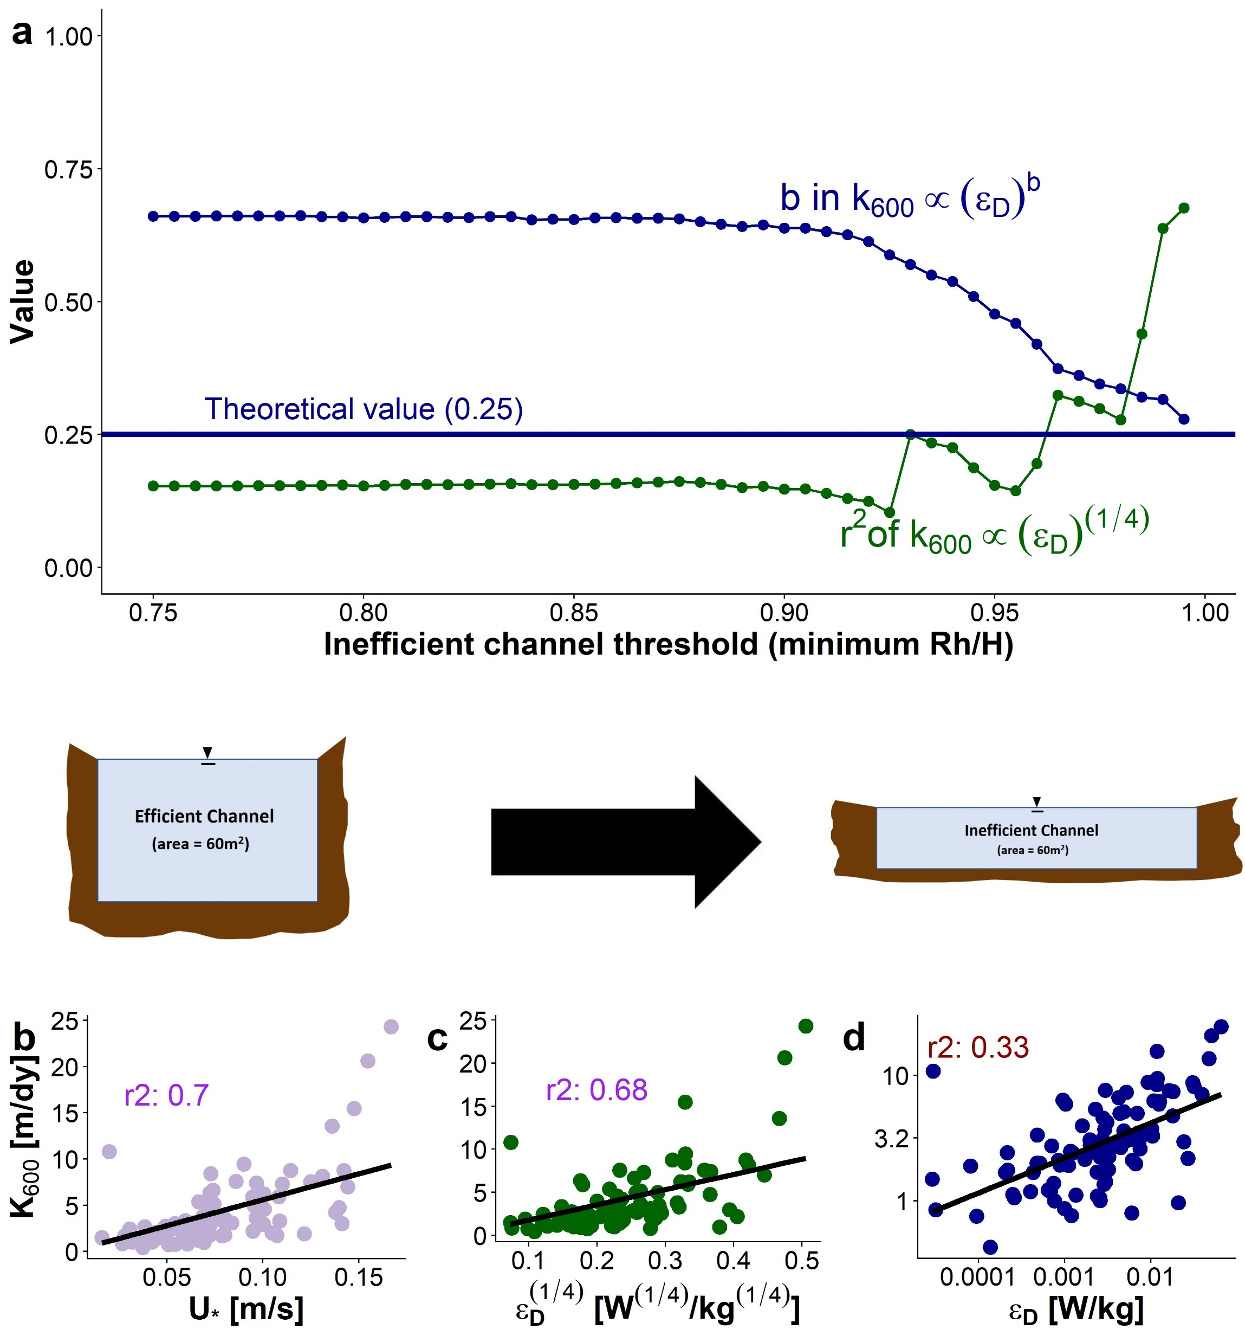
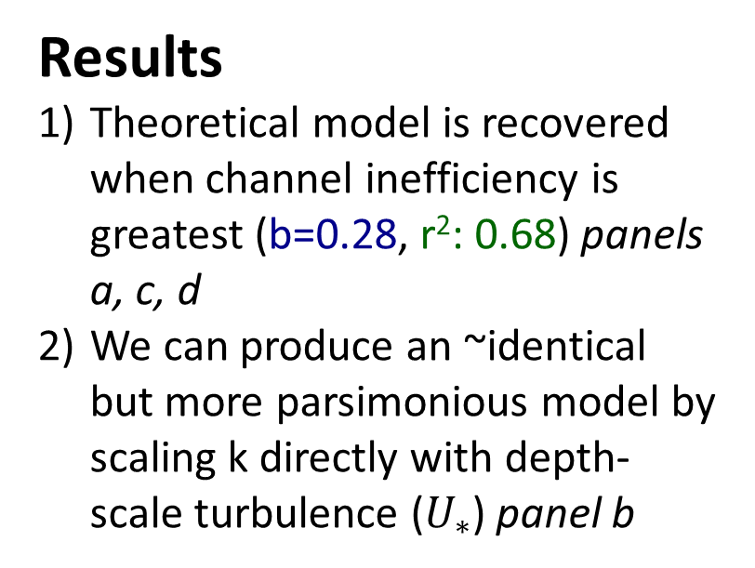
Results
Theoretical model is recovered when channel inefficiency is greatest (b=0.28, r²: 0.68) panels a, c, d
We can produce an ~identical but more parsimonious model by scaling k directly with depth-scale turbulence ($U_{∗}$) panel b

Slide 5

What does this mean for SWOT?
Using Brinkerhoff et al (2019) dataset (n=171,553), I found that 95% of SWOT-observable river measurements had Rh within 5% of H
This theoretical model for k ($k\sim U_{∗}\sim ε_{D}^{\frac{1}{4}}$) is therefore generally valid in SWOT-observable rivers and we can exploit this physical model to build a parsimonious BIKER algorithm with minimal unknowns

