Slide 1
Efficient Channel
(area = 60m²)

Slide 2
Inefficient Channel
(area = 60m²)

Slide 4
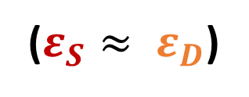
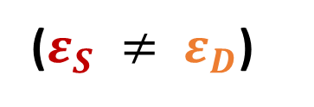
Efficient Channel
($ε_{S} ≠ ε_{D}$)
Inefficient Channel
($ε_{S}≈ ε_{D}$)

