Slide 1
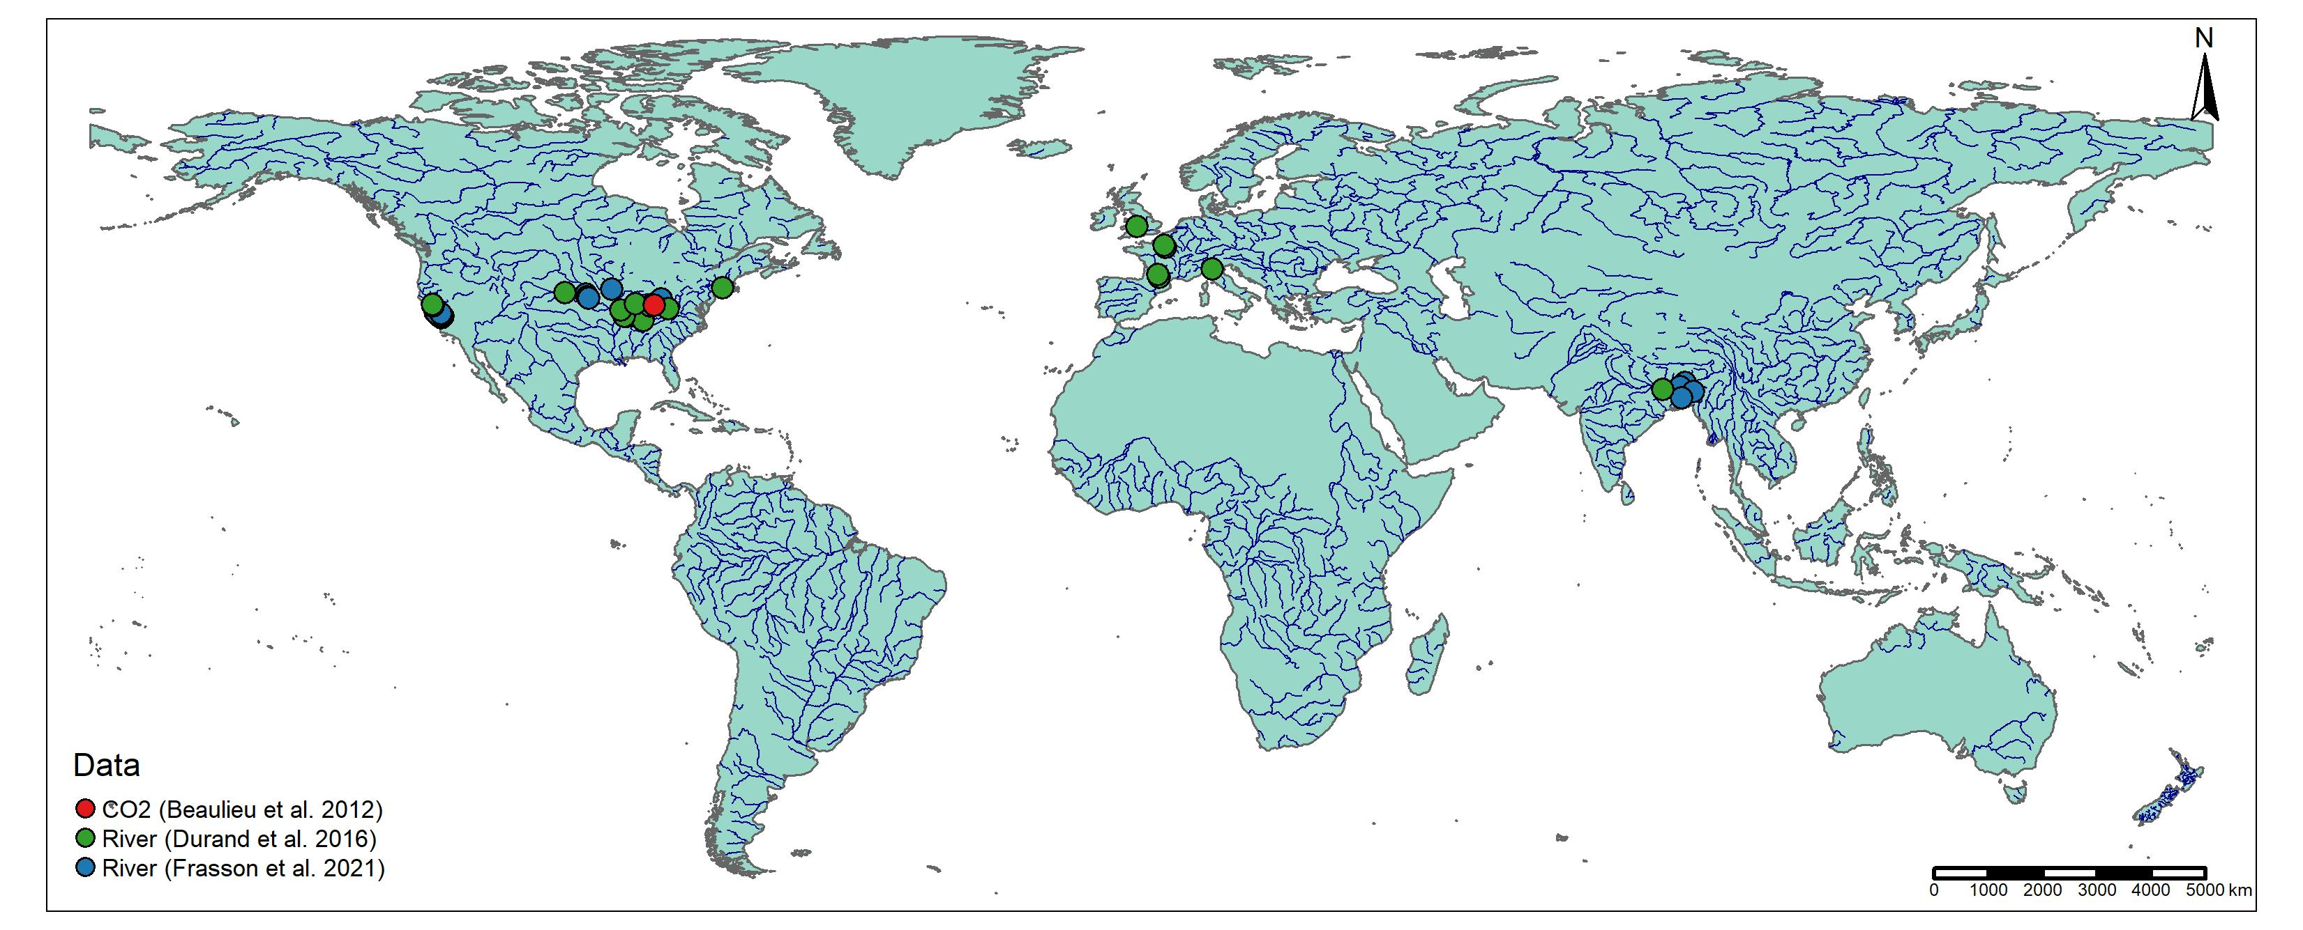
Europe (n=7)
California, US (n=14)
Bangladesh (n=5)
Eastern US (n=21)
Notes:
Padma not working, I don’t know why
Kushiyara not really lining up with hydrography

Slide 2
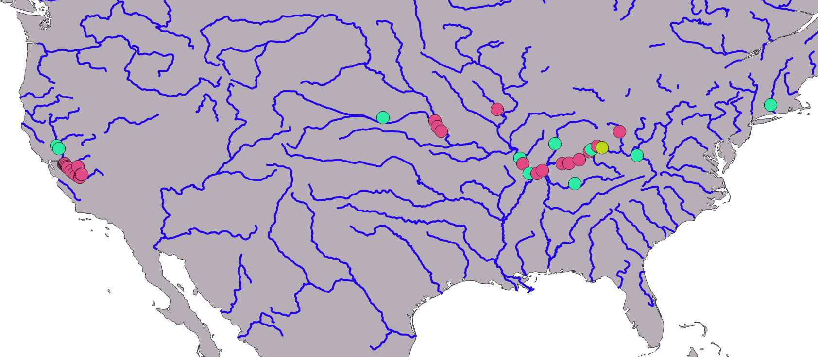
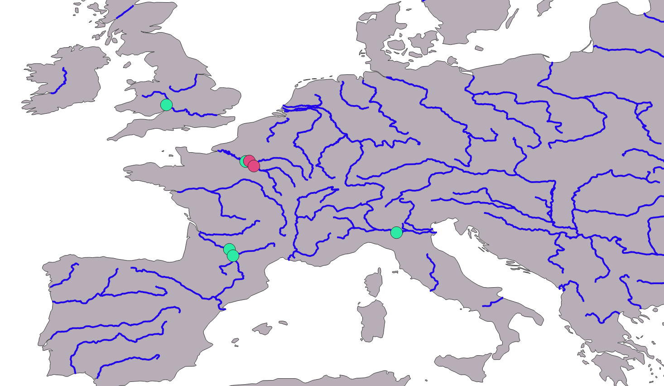
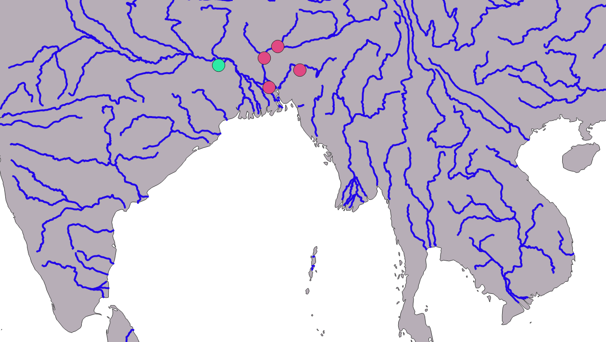
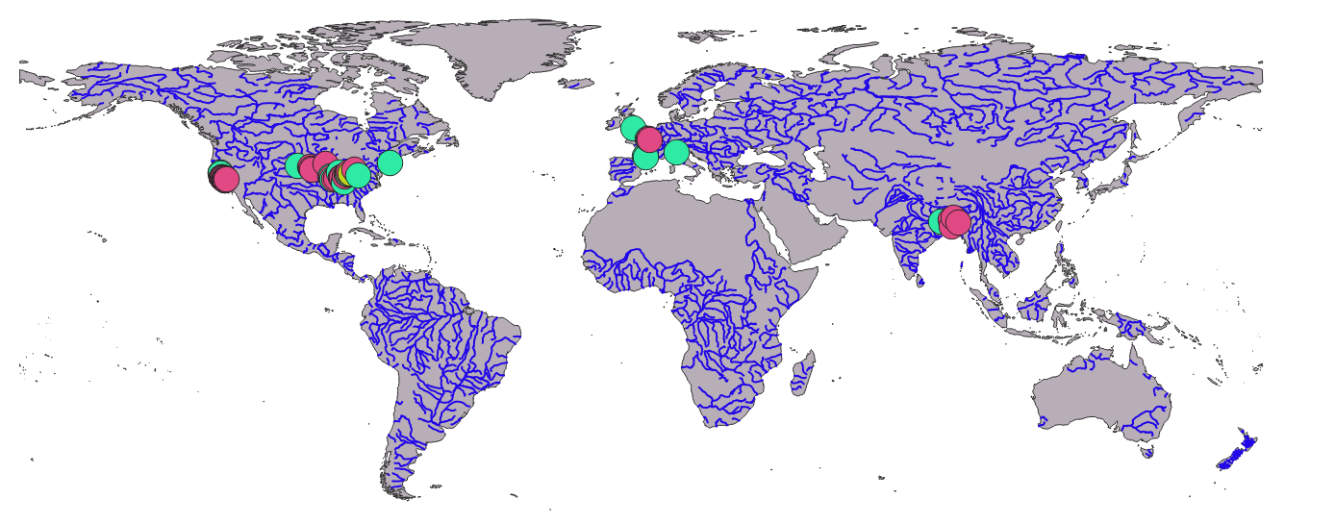
United States
Europe
1:8,000,000
1:5,000,000
Bangladesh
1:100,000,000
Durand et al. (2016)
Frasson et al. (2021)
Beaulieu et al. (2012)
1:10,000,000

