Slide 1
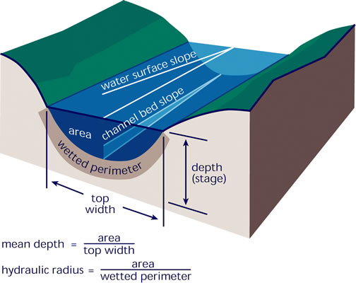
Background/updated goal
We want to remotely sense gas transfer velocity k in large rivers that are SWOT-observable
But first, need to choose a physical model for k
SWOT-observable rivers are generally ‘hydraulically wide’
Hydraulic radius Rh = mean depth H
As we talked about last time
Goal: completely streamline the presentation I showed previously
Reduce k equations to base hydraulic terms
Test 4 total equations for k
2 k models
2 turbulent dissipation rate models

Slide 2
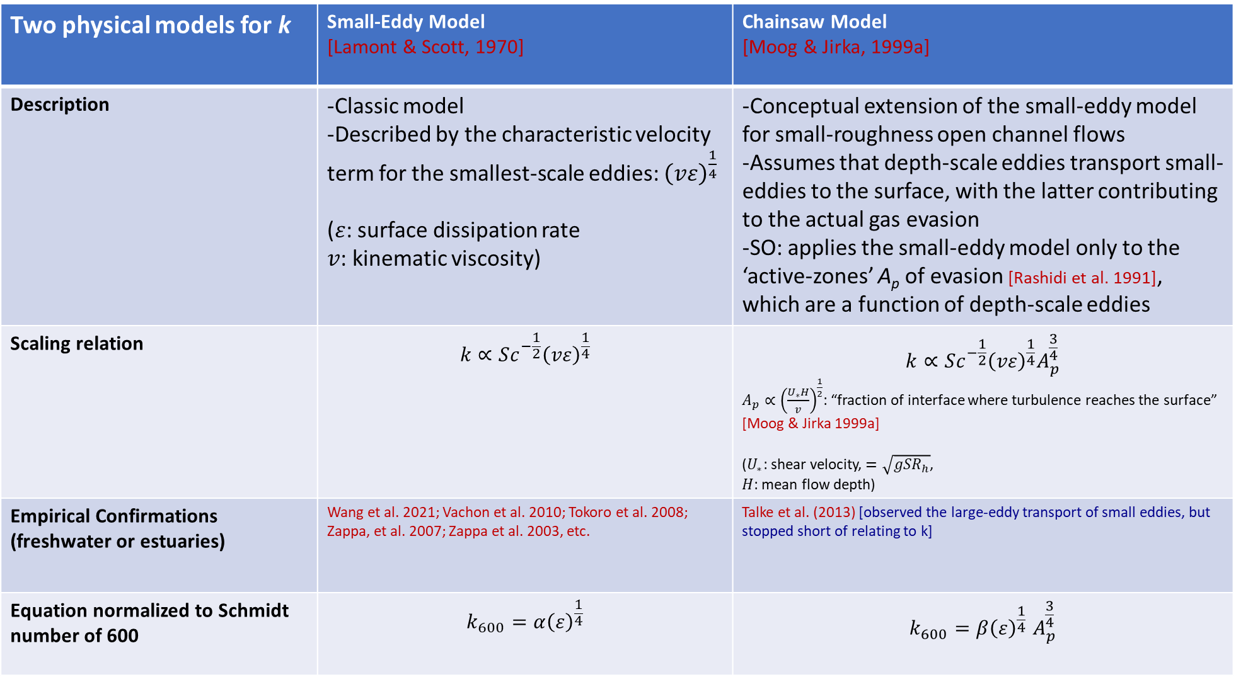
Two physical models for k | Small-Eddy Model [Lamont & Scott, 1970] | Chainsaw Model [Moog & Jirka, 1999a]
Description | -Classic model -Described by the characteristic velocity term for the smallest-scale eddies: ${\left(vε\right)}^{\frac{1}{4}}$ ($ε$: surface dissipation rate $v$: kinematic viscosity) | -Conceptual extension of the small-eddy model for small-roughness open channel flows -Assumes that depth-scale eddies transport small-eddies to the surface, with the latter contributing to the actual gas evasion -SO: applies the small-eddy model only to the ‘active-zones’ A_{p} of evasion [Rashidi et al. 1991], which are a function of depth-scale eddies
Scaling relation | $$k∝Sc^{−\frac{1}{2}}{\left(vε\right)}^{\frac{1}{4}}$$ | $$k∝Sc^{−\frac{1}{2}}{\left(vε\right)}^{\frac{1}{4}}A_{p}^{\frac{3}{4}}$$ $A_{p}∝{\left(\frac{U_{∗}H}{v}\right)}^{\frac{1}{2}}$: “fraction of interface where turbulence reaches the surface” [Moog & Jirka 1999a] ($U_{∗}$: shear velocity, $=\sqrt{gSR_{h}}$, $H$: mean flow depth)
Empirical Confirmations (freshwater or estuaries) | Wang et al. 2021; Vachon et al. 2010; Tokoro et al. 2008; Zappa, et al. 2007; Zappa et al. 2003, etc. | Talke et al. (2013) [observed the large-eddy transport of small eddies, but stopped short of relating to k]
Equation normalized to Schmidt number of 600 | $$k_{600}=α{\left(ε\right)}^{\frac{1}{4}}$$ | $$k_{600}{=β\left(ε\right)}^{\frac{1}{4}}A_{p}^{\frac{3}{4}}$$
These two models are then parameterized using two different dissipation equations (next slide)

Slide 3
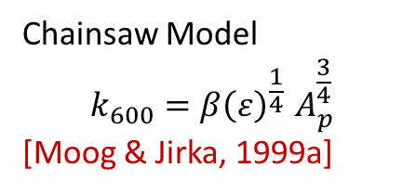
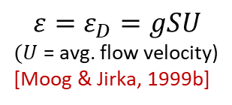

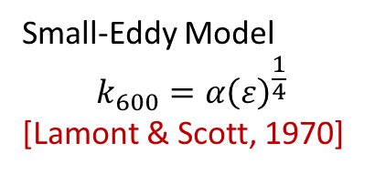
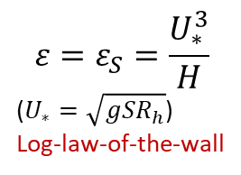
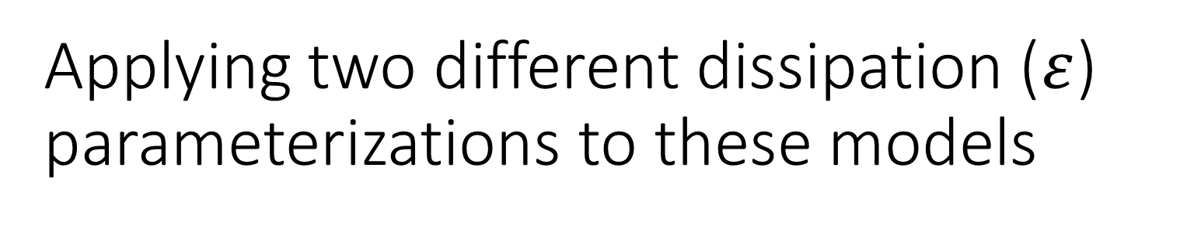


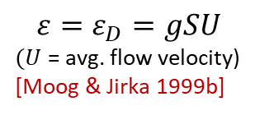


Applying two different dissipation ($ε$) parameterizations to these models
Small-Eddy Model
$$k_{600}=α{\left(ε\right)}^{\frac{1}{4}}$$
[Lamont & Scott, 1970]
Chainsaw Model
$$k_{600}{=β\left(ε\right)}^{\frac{1}{4}}A_{p}^{\frac{3}{4}}$$
[Moog & Jirka, 1999a]
$$ε=ε_{S}=\frac{U_{∗}^{3}}{H}$$
($U_{∗}=\sqrt{gSR_{h}}$)
Log-law-of-the-wall
$$ε=ε_{S}=\frac{U_{∗}^{3}}{H}$$
($U_{∗}=\sqrt{gSR_{h}}$)
Log-law-of-the-wall
$$ε=ε_{D}=gSU$$
$(U$ = avg. flow velocity)
[Moog & Jirka 1999b]
$$ε=ε_{D}=gSU$$
$(U$ = avg. flow velocity)
[Moog & Jirka, 1999b]
Assume hydraulically wide channel ($R_{h}=H$) and simply equations
$$k_{{600}_{ε_{S}}}=α{\left(gS\right)}^{\frac{3}{8}}H^{\frac{1}{8}}$$
$$k_{{600}_{ε_{D}}}=α_{1}{\left(gSU\right)}^{\frac{1}{4}}$$
$$k_{{600}_{ε_{S}}}={β\left(gS\right)}^{\frac{9}{16}}H^{\frac{11}{16}}$$
$$k_{{600}_{ε_{D}}}=β_{1}{\left(gS\right)}^{\frac{7}{16}}U^{\frac{1}{4}}H^{\frac{9}{16}}$$
Which works the best?

Slide 4
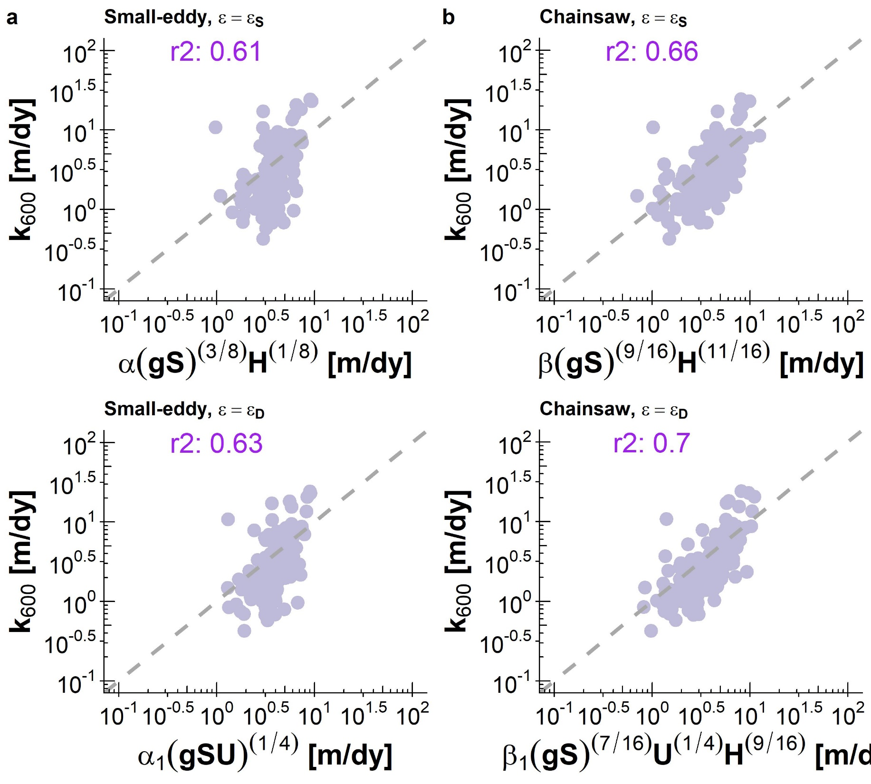
The four models empirically tested on ‘hydraulically-wide flows’
I’ve implemented this equation within the algorithm because it appears to get the scaling dynamics most correct.
(This would also be- I think- the first empirical confirmation of the chainsaw model predicting river k)

Slide 5
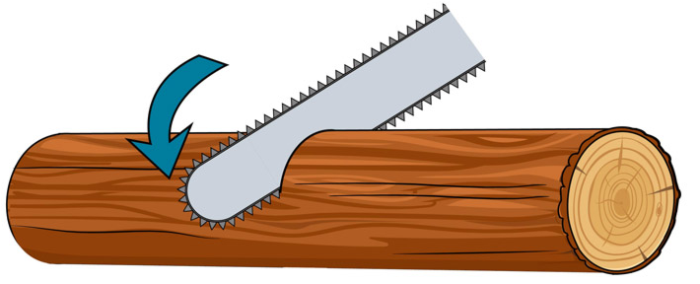
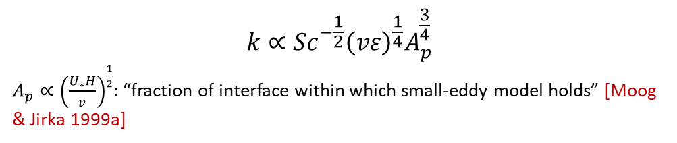
Small eddies
Large eddies
$$k∝Sc^{−\frac{1}{2}}{\left(vε\right)}^{\frac{1}{4}}A_{p}^{\frac{3}{4}}$$
$A_{p}∝{\left(\frac{U_{∗}H}{v}\right)}^{\frac{1}{2}}$: “fraction of interface within which small-eddy model holds” [Moog & Jirka 1999a]
Entire interface
Active zone of gas evasion
$Re^{∗}=\left(\frac{U_{∗}H}{v}\right)$, ratio of shear force to viscous force
If smooth flow (i.e. Re* < 1) → k is decreased relative to small-eddy model

