Slide 1
River surface turbulence in large rivers driven by stream power: implications for remotely sensing gas exchange

Slide 2
Intro
River gas evasion models are limited by poor temporal resolution estimates of k due to mechanistic and methodological uncertainties in gas exchange
Mechanistic: Many existing scaling relationships for river k perform appreciably worse in large rivers [Raymond etal 2012; Ulseth et al 2019]
This has been attributed to wind effects [Beauileu etal 2012; Alin et al something] and decreasing bed roughness in flatter channels [Ulseth etal 2019]. K~Q relationships also break down in big rivers [Wang eta 2021]
Methodological: Current tools to predict k are fundamentally limited by the resolution and uncertainty in their hydrology inputs, especially in ungauged settings
DO inverse models require super high-resolution in situ datasets [Appling etal 2018]
Predictive models require in situ discharge OR hydrology models with their own uncertainties [Liu et al in review]
Moving towards process-based modeling of river gas evasion requires a stronger mechanistic understanding of gas exchange and ways to measure this at high temporal resolution and across huge domains

Slide 3
Key points
Using a simple energy balance, we show in big rivers that turbulence production and dissipation must reduce to stream power and are equal
This means there is no additional diffusion of turbulent energy from the bed to the surface and the bed is effectively decoupled from the surface (turbulence-wise)
This allows for scaling of k via shear velocity (production = dissipation). We show that once a river is big enough, these models outperform those based on turbulent dissipation.
Finally, we show that this can all be measured from satellite, where near-daily sampling will allow for unprecedented mapping of river gas exchange

Slide 4


Two turbulence regimes at the river’s surface: background
$G+T_{d}+V_{d}=ε$ [Nezu & Nagawaka 1993]
G
Bulk TKE production rate [J/kg*s]
Depth-scale diffusion rate of TKE [J/kg*s]
TKE viscous diffusion rate [J/kg*s]
TKE dissipation rate [J/kg*s]
$$ε$$
“Energy
Produced”
“Energy Transported from bed”
“Energy Transported viscously”
“Energy
Dissipated”
Td
Rivers are unique among aquatic environments in that stream power/downslope flow dissipates energy in far greater quantities than from bottom friction alone [Moog & Jirka 1999; Raymond etal 2012], which is the classical model in lakes and oceans [Lorke & Peeters, 2006] which don’t have classical advection.
TAKEAWAY:
This means that G < $ε$ (at the free surface)

Slide 5
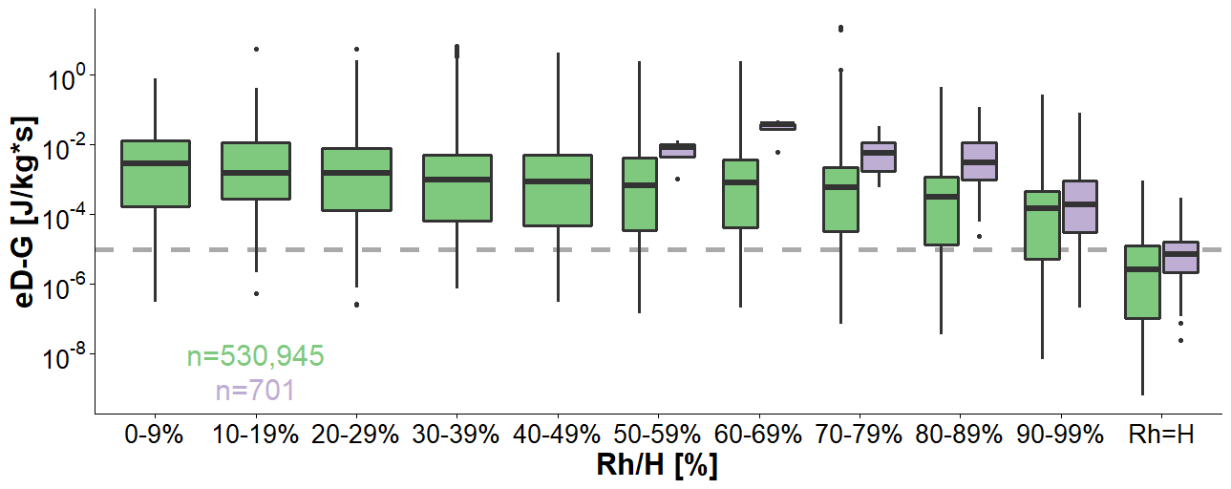
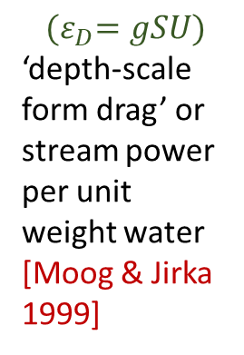
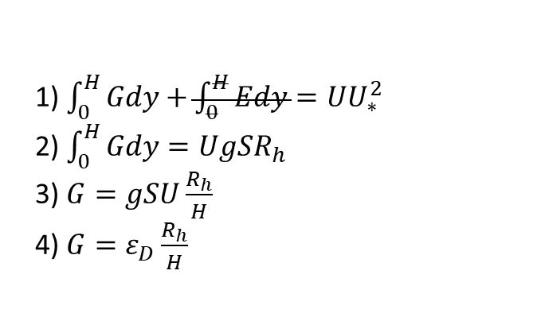
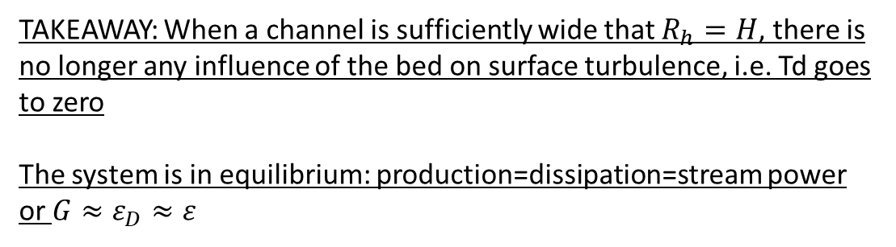
Two turbulence regimes at the river surface
TAKEAWAY: When a channel is sufficiently wide that $R_{h}=H$, there is no longer any influence of the bed on surface turbulence, i.e. Td goes to zero
The system is in equilibrium: production=dissipation=stream power or $G≈ε_{D}≈ε$
1) $\int_{0}^{H}{Gdy}+\int_{0}^{H}{Edy}=UU_{∗}^{2}$
2) $\int_{0}^{H}{Gdy}=UgSR_{h}$
3) $G=gSU\frac{R_{h}}{H}$
4) $G=ε_{D}\frac{R_{h}}{H}$
[Nezu & Nagawaka 1993]
$${(ε}_{D}=gSU)$$
‘depth-scale form drag’ or stream power per unit weight water [Moog & Jirka 1999]
Brinkerhoff etal 2019
Ulseth etal 2019

Slide 6
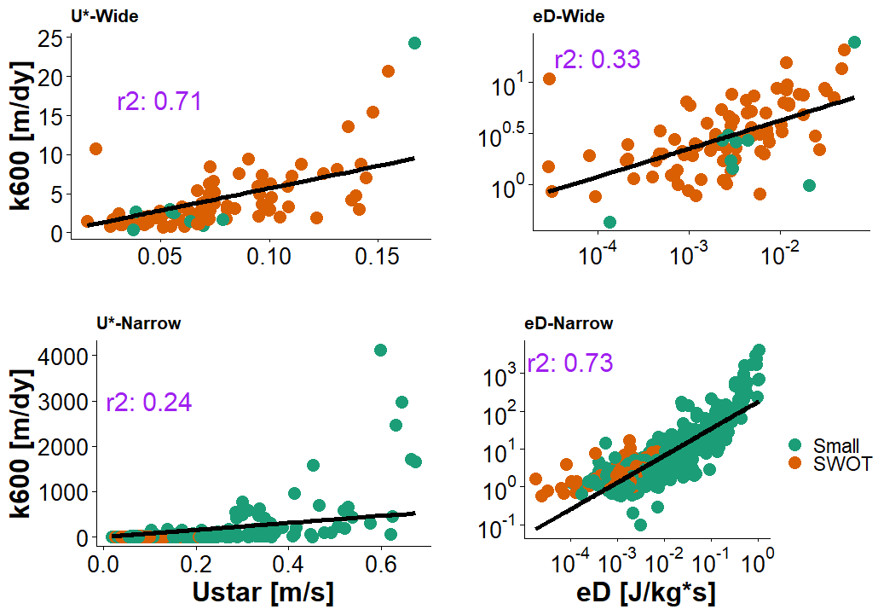
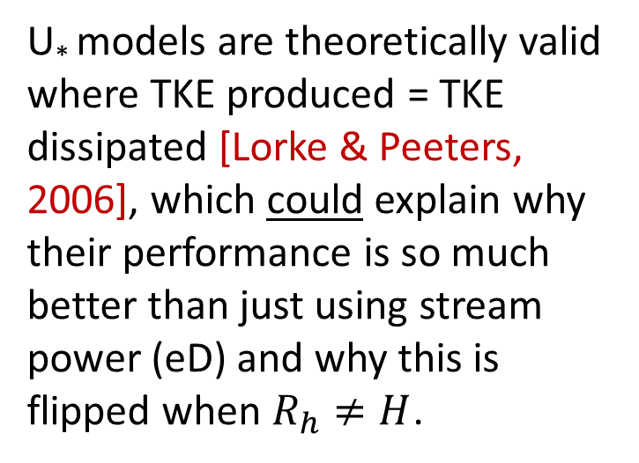




Implications for k scaling in large rivers
$$R_{h}=H$$
$$R_{h}=H$$
U* models are theoretically valid where TKE produced = TKE dissipated [Lorke & Peeters, 2006], which could explain why their performance is so much better than just using stream power (eD) and why this is flipped when $R_{h}≠H$.
$$R_{h}≠H$$
$$R_{h}≠H$$
These models are fit using the Ulseth etal (2019) dataset

Slide 7
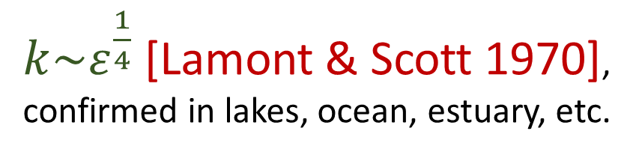
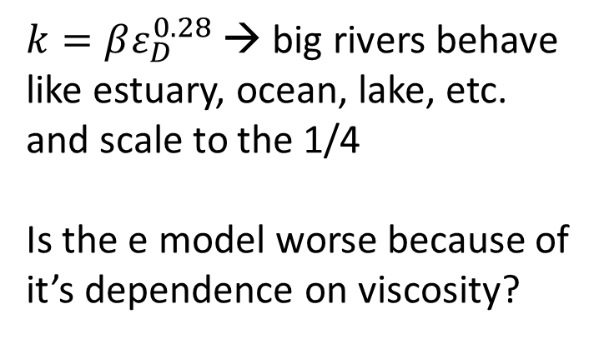





Sidenote on scaling theory
$k\sim ε^{\frac{1}{4}}$ [Lamont & Scott 1970], confirmed in lakes, ocean, estuary, etc.
$$R_{h}=H$$
$$R_{h}=H$$
$k=βε_{D}^{0.28}$ → big rivers behave like estuary, ocean, lake, etc. and scale to the 1/4
Is the e model worse because of it’s dependence on viscosity?
$$R_{h}≠H$$
$$R_{h}≠H$$
$$k=βε_{D}^{0.73}$$
[Ulseth et al. 2019] already showed empirically this doesn’t scale to the ¼ in steep rivers
These models are fit using the Ulseth etal (2019) dataset

Slide 8
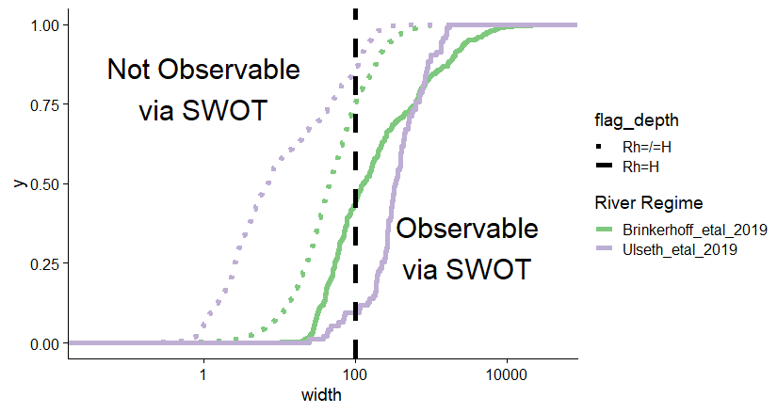
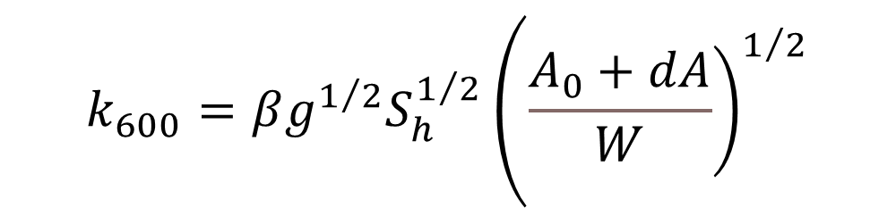
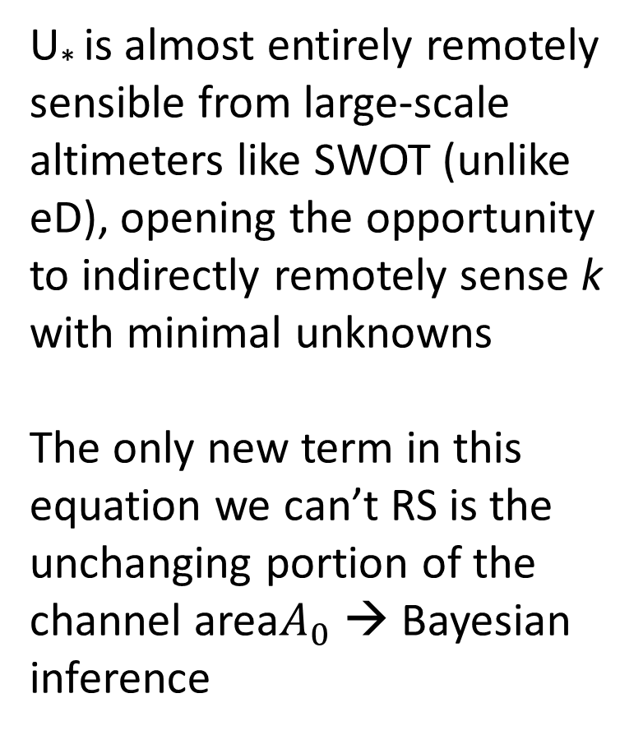
Exploiting this new theory for remote sensing
$$\begin{matrix}k_{600}=βg^{1/2}S_{h}^{1/2}\left({\left.\frac{A_{0}+dA}{W}\right)}^{1/2}\right.\end{matrix}$$
U* is almost entirely remotely sensible from large-scale altimeters like SWOT (unlike eD), opening the opportunity to indirectly remotely sense k with minimal unknowns
The only new term in this equation we can’t RS is the unchanging portion of the channel area$A_{0}$ → Bayesian inference

