Slide 1
RSK600 Upscaling

Slide 2
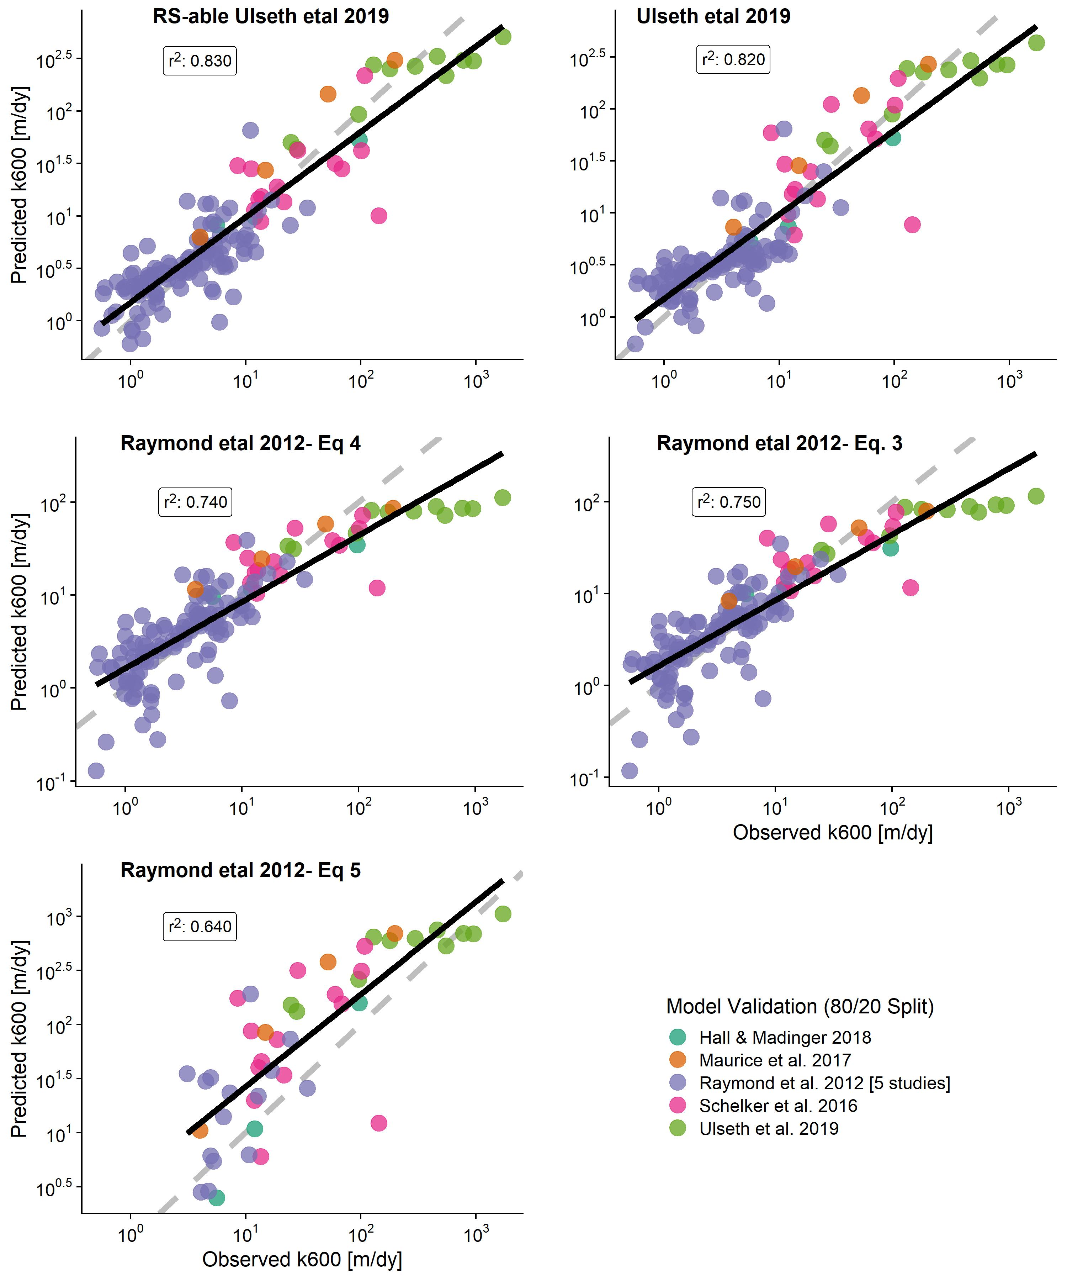
First, I wanted to confirm the scaling model choice
Refit Raymond 2012 models to this expanded dataset
Compare against Ulseth 2019 model and our ‘RS-able’ extension of that model
Note that Raymond eq. 5 is linear and predicts negative values (not plotted) b/c this is not a linear relationship…

Slide 3
SO: for validation, any deviations from 1:1 are caused by RS of velocity and/or the k600 prior
I found the bias from last week is due to the k600 prior.
I’m now going to show tandem results
A geoBAM style k600 prior
i.e. bin by river size and directly use those PDFs
A Mark style k600 prior
i.e. build simple linear regression using slope + model error

Slide 4
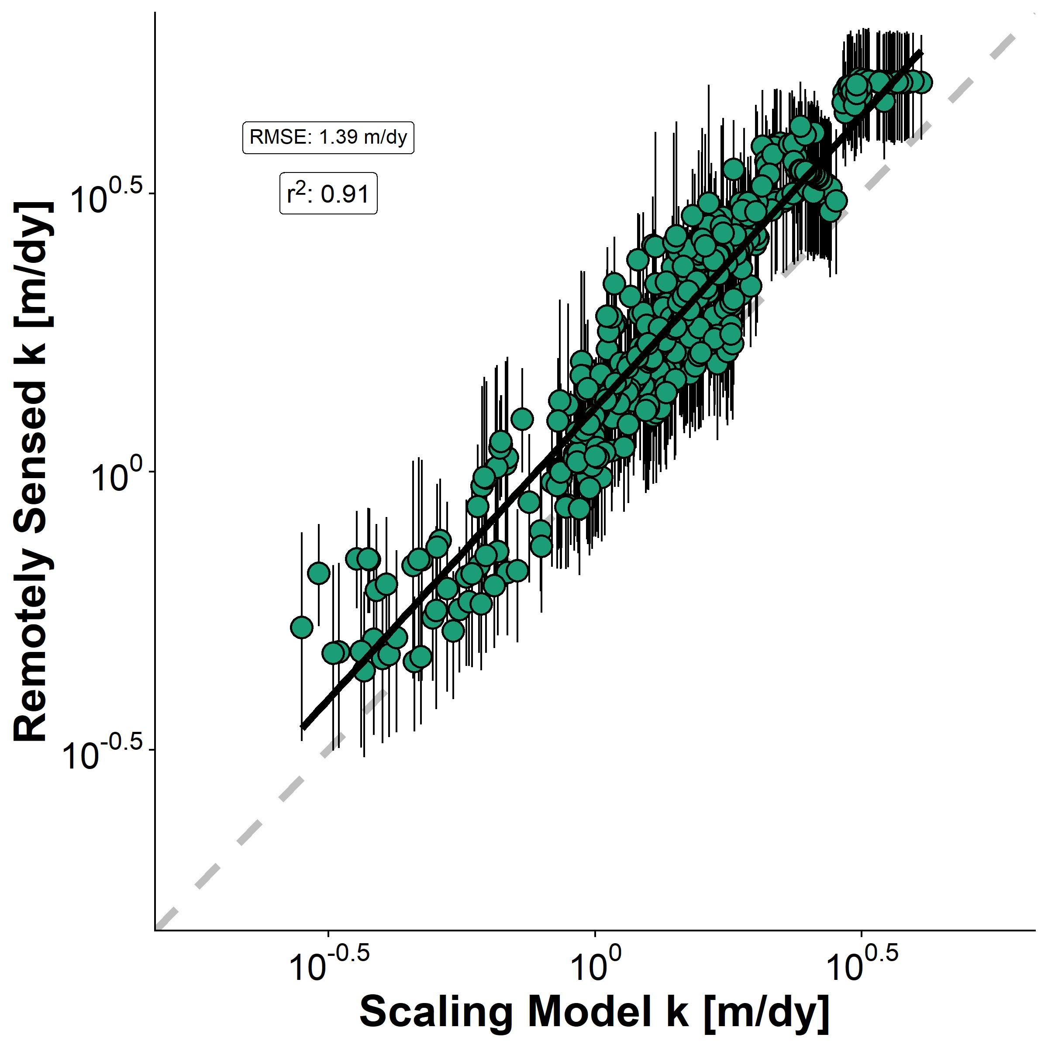
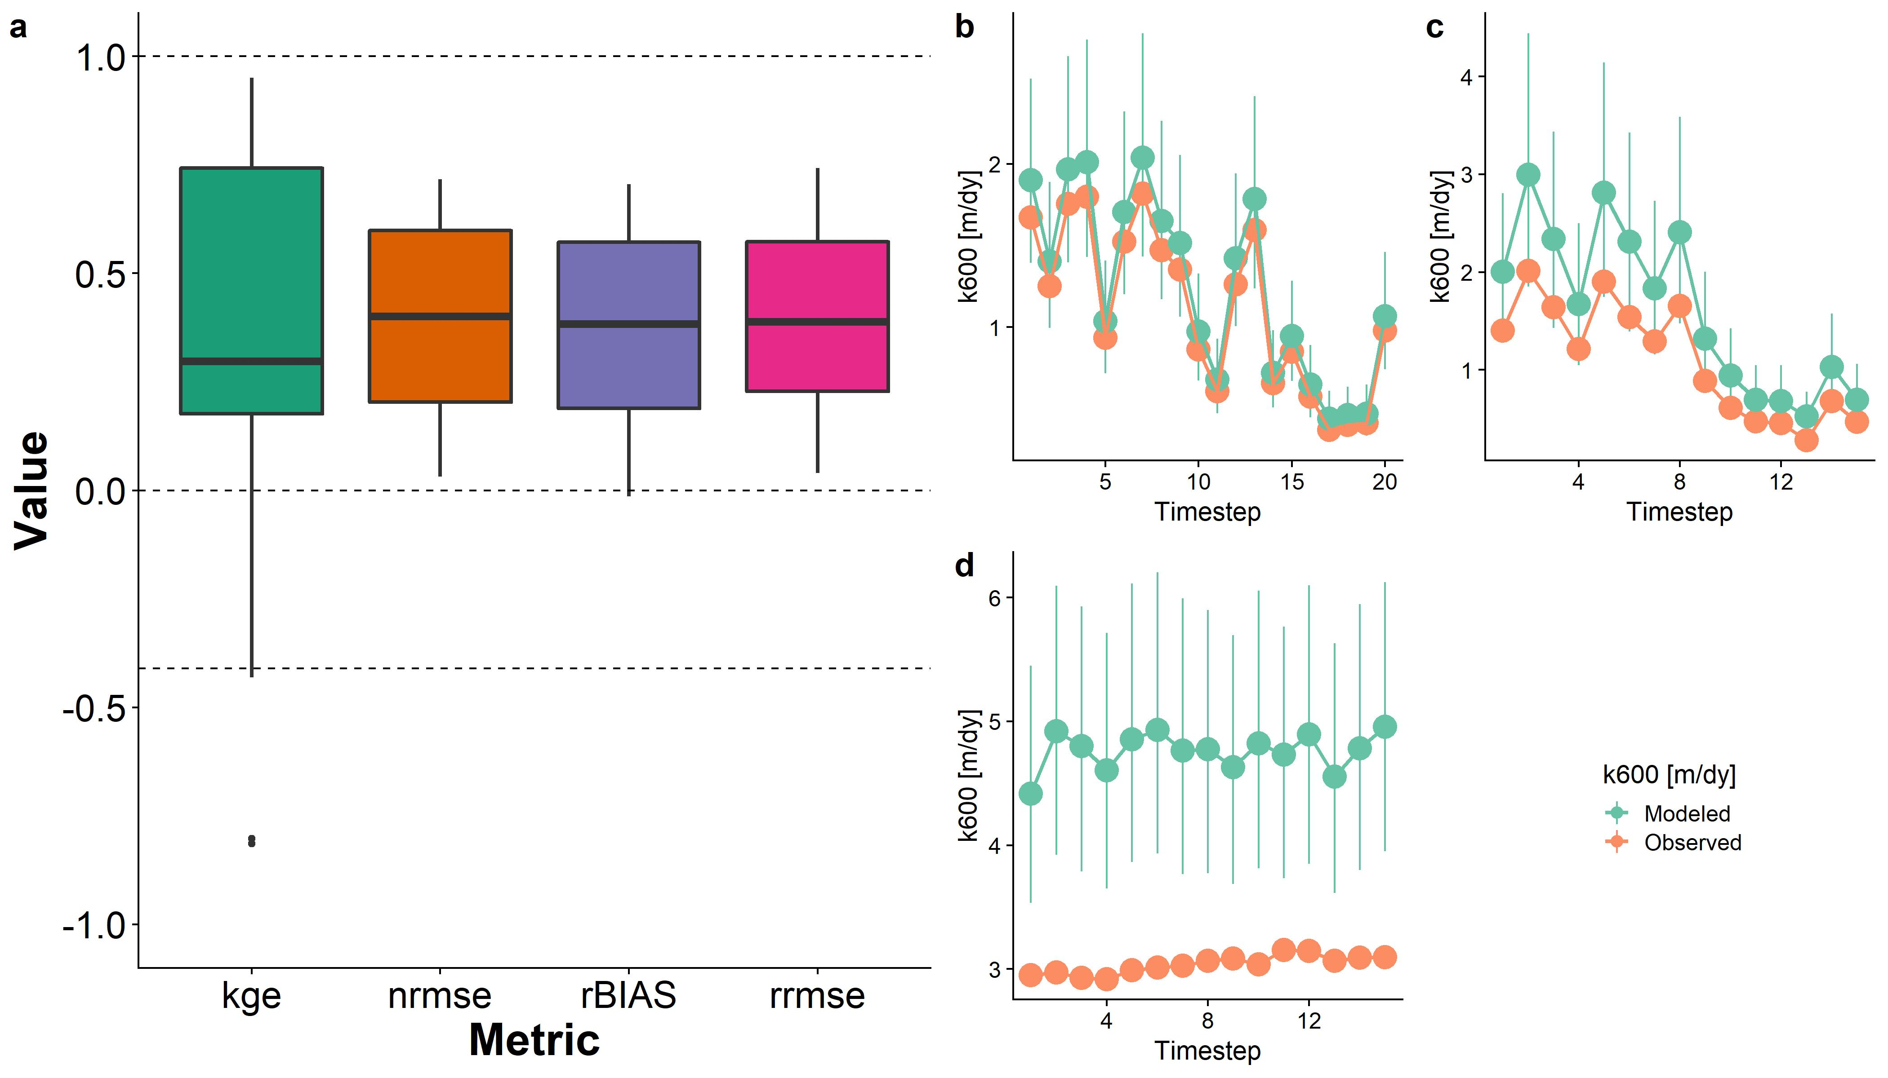
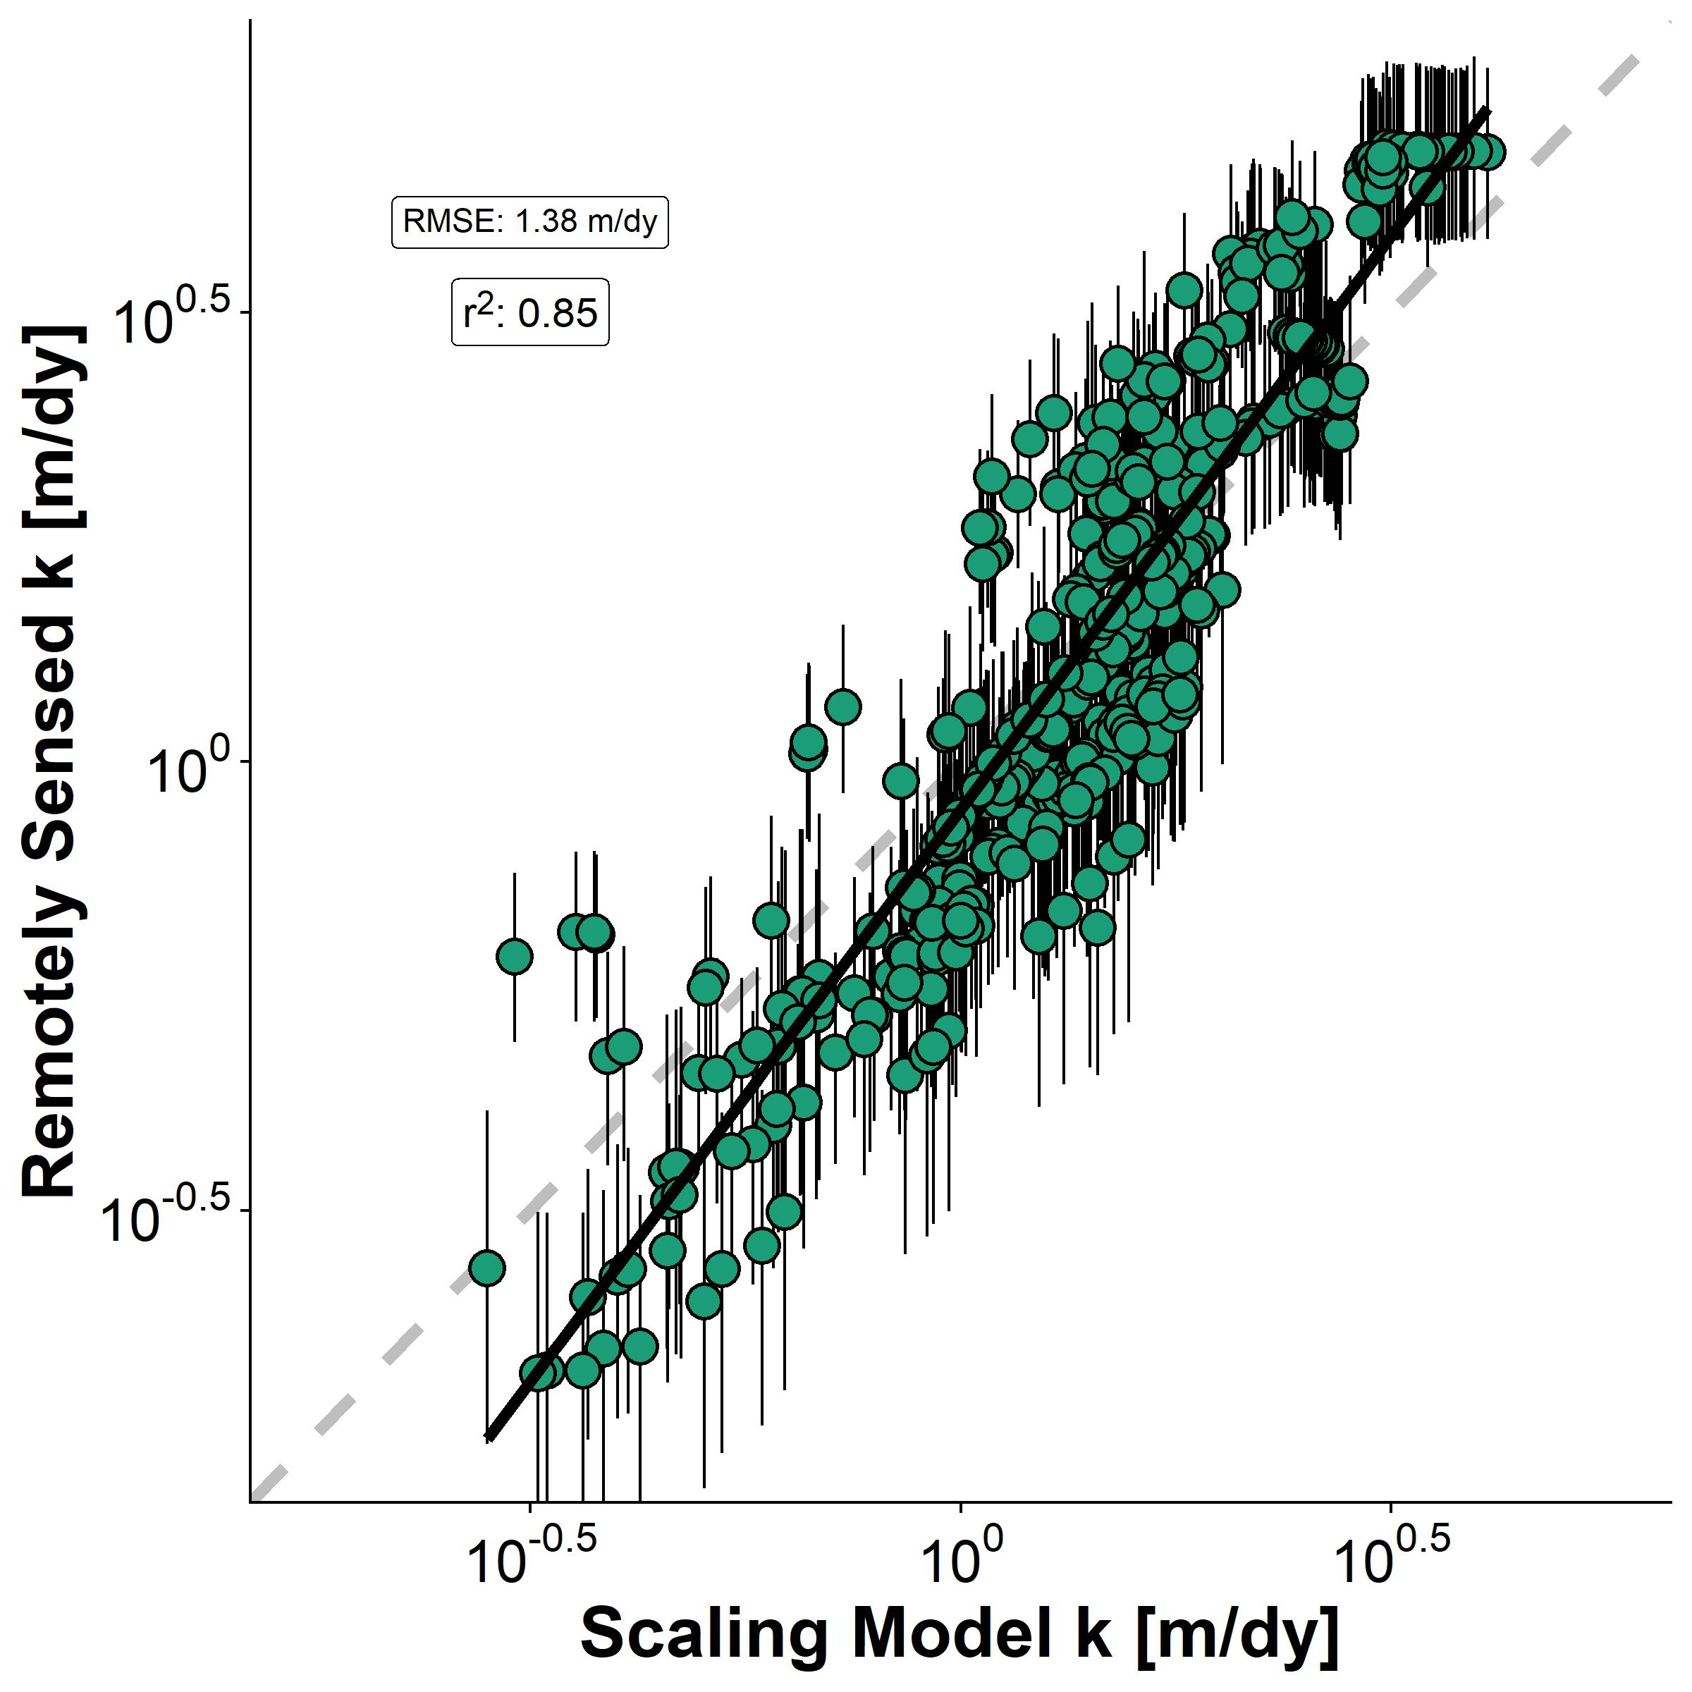
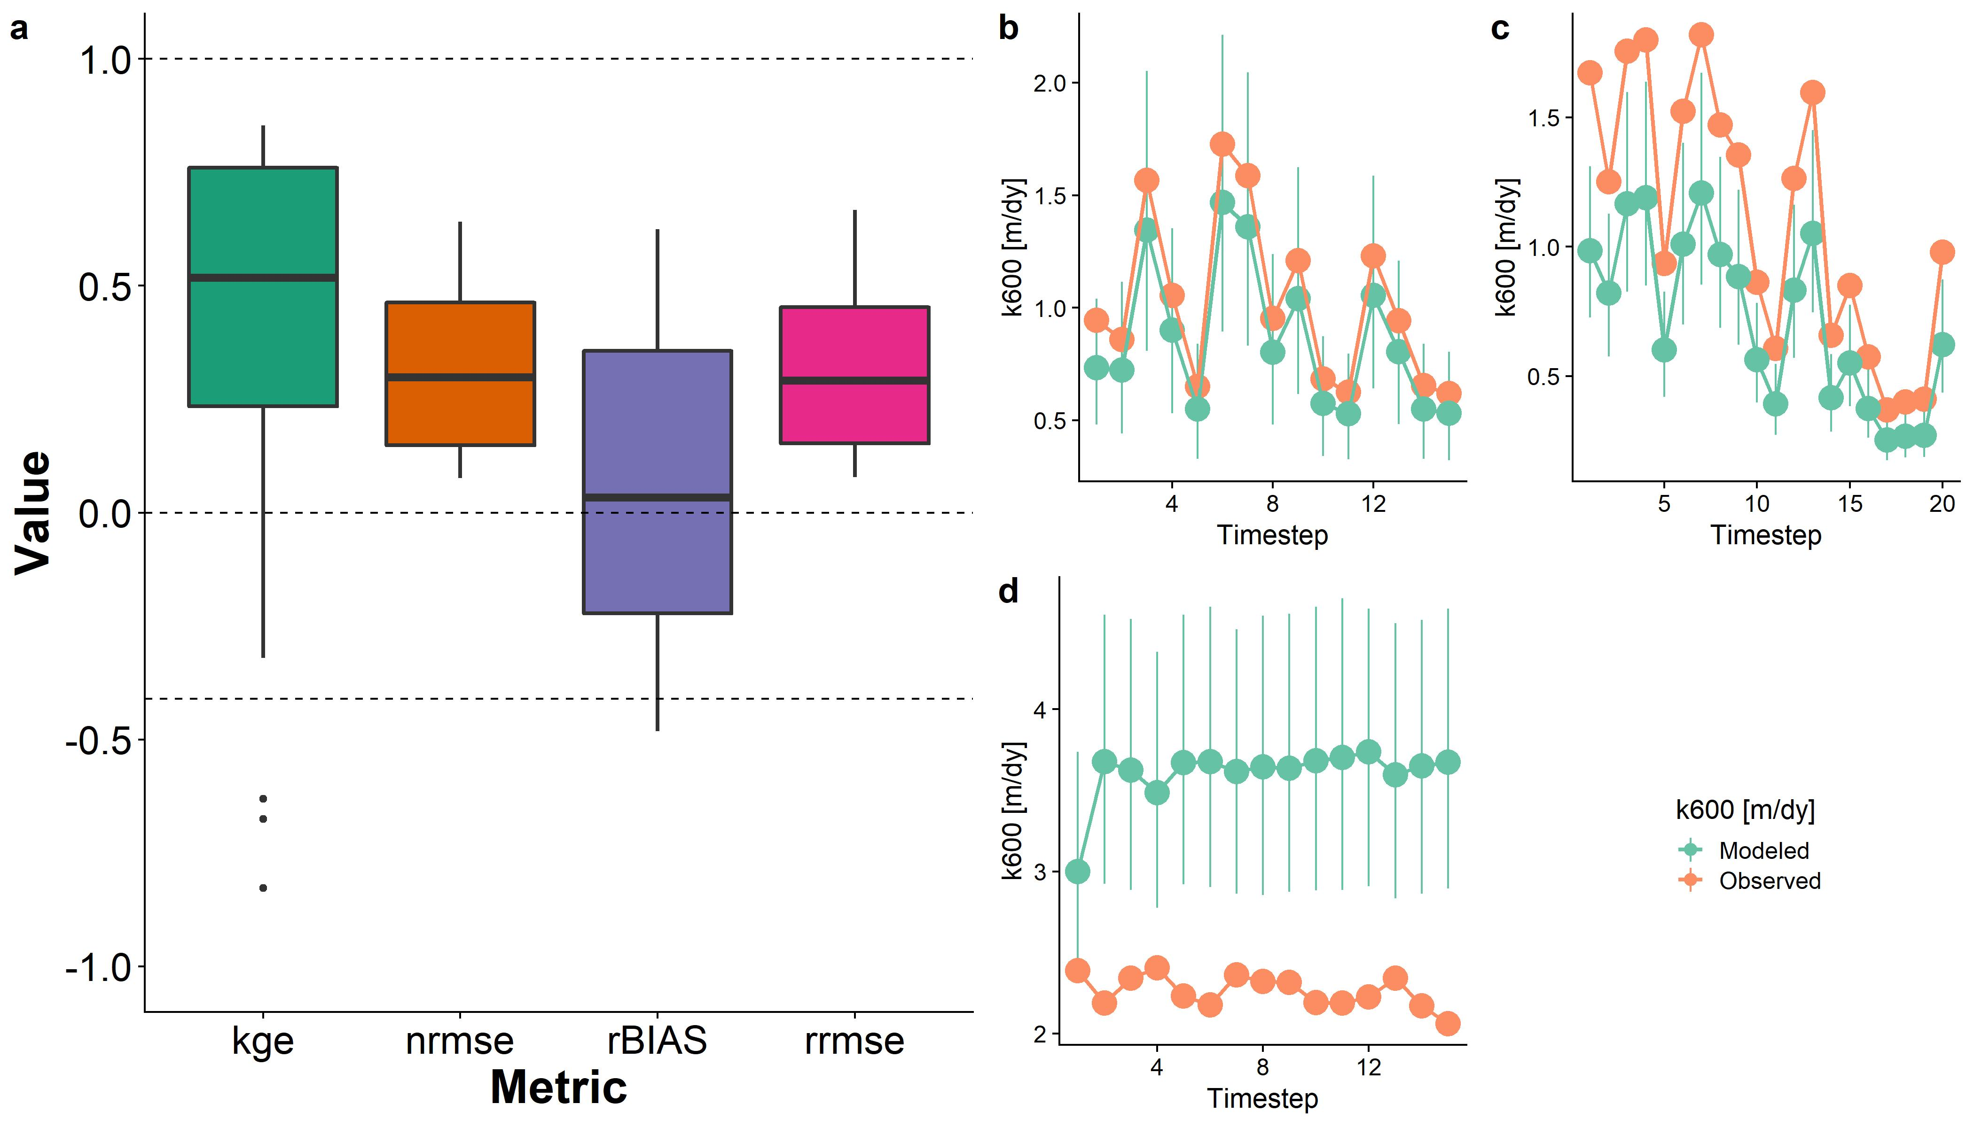
geoBAM style
Mark-style

Slide 5
Upscaling Implications for 22 SWOT rivers
Took bi-weekly CO2 data for the Ohio River (Beauliu etal 2012) and used it on all rivers as dummy values for a reasonable timeseries
Ignoring the timesteps > 29 for a few rivers as CO2 data is only 29 samples
Calculate k_{co2} (and then FCO2) using:
1) Observed average velocity
2) BIKER posterior means
3) Shaoda’s in review approach
4) Raymond 2012/2013 approach
Basically, how does our ungauged approach compare to gauge-based methods?
Also lets me explicitly validate against using obs. V

Slide 6
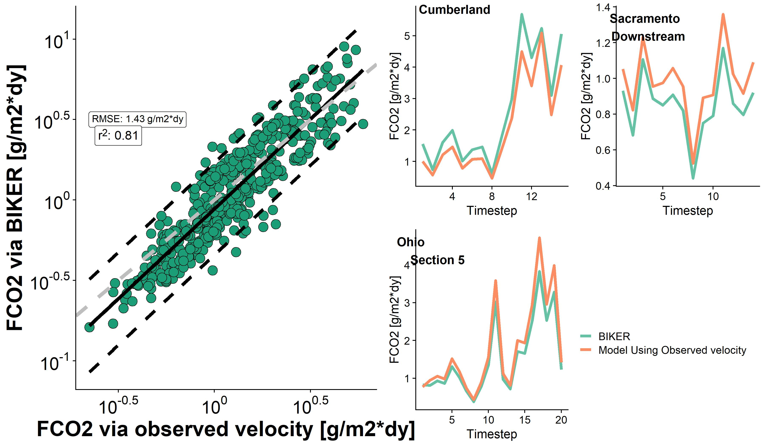
95% prediction
interval is ~1.9 g/m2*dy

Slide 7
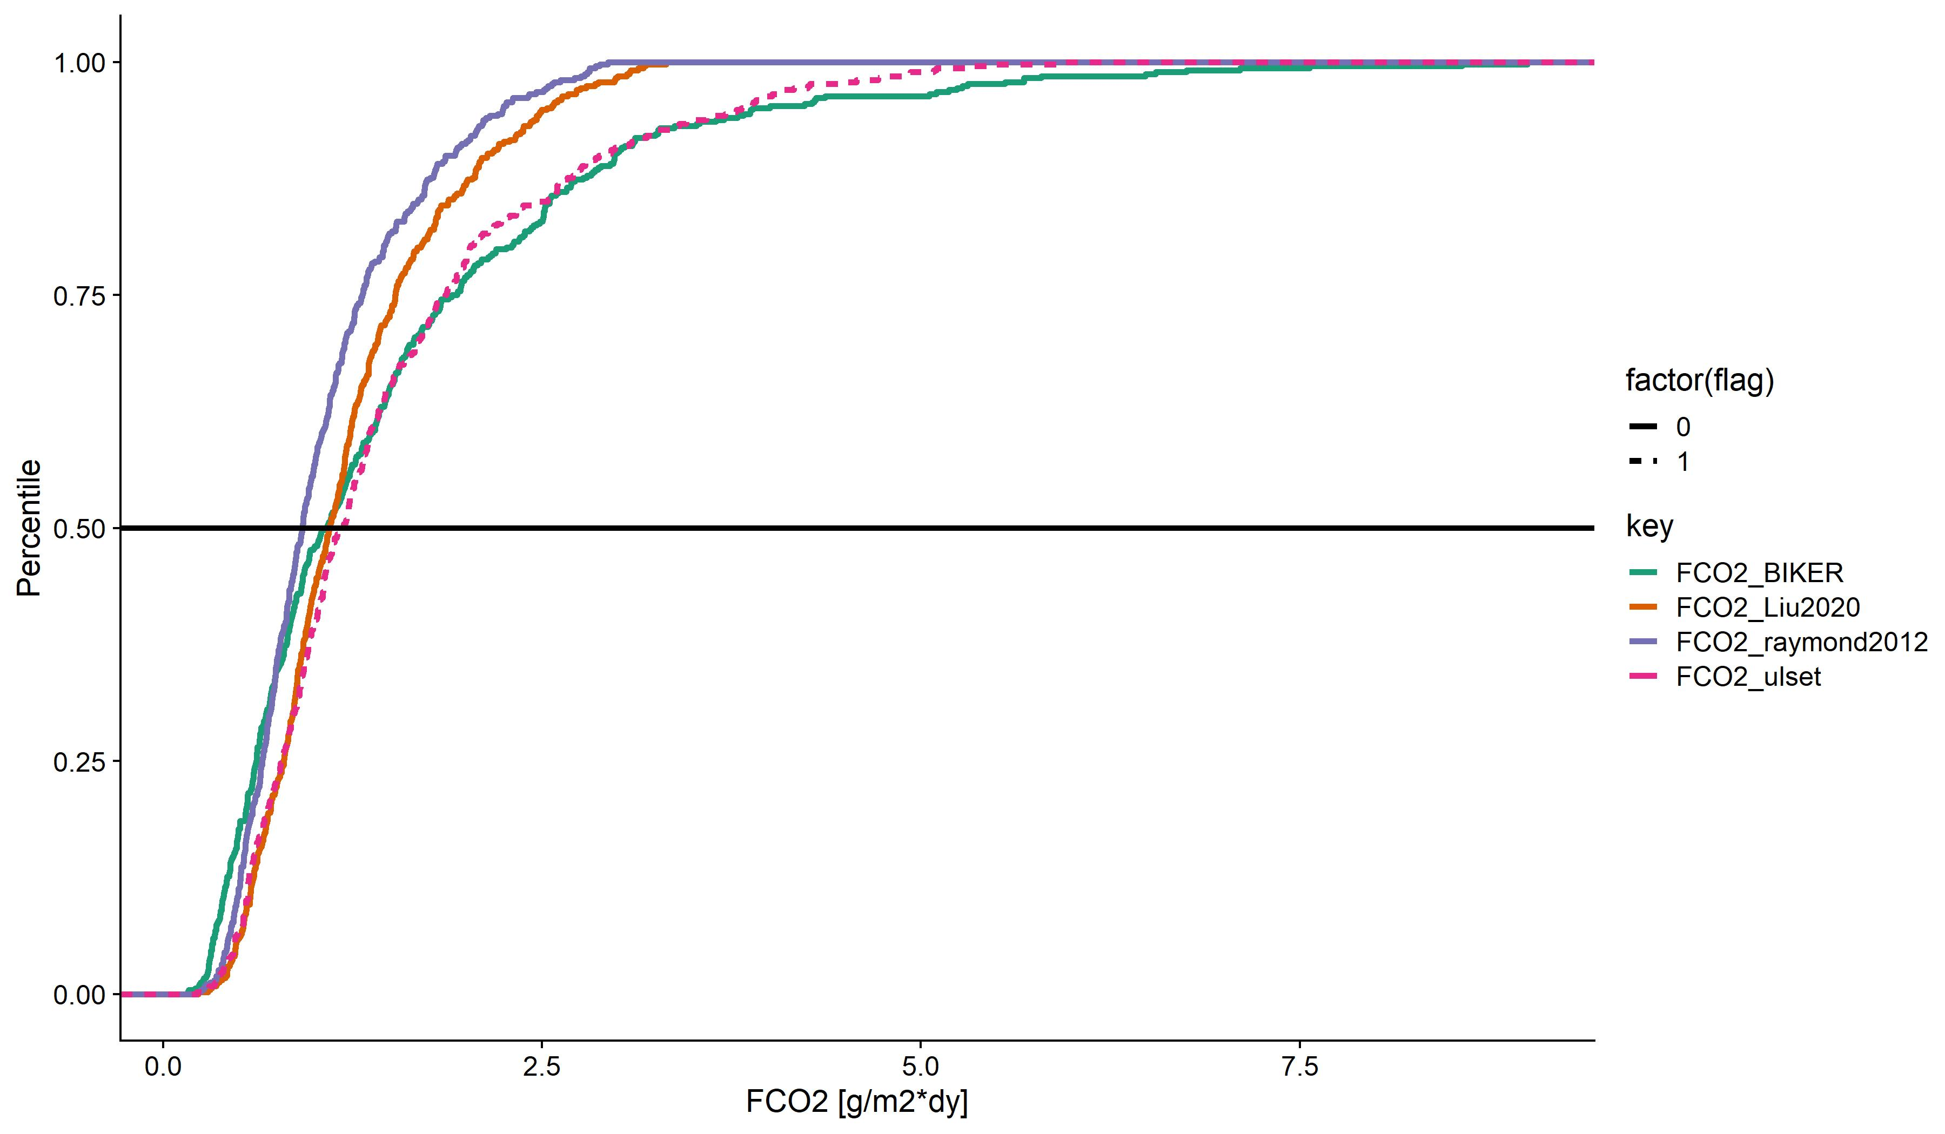
Both velocity models are of form v=kQ^m and use the observed Q record.
K and m are global-scope
Observed Velocity

Slide 8
One more thing
Tamlin, Ethan, and Pete have now all suggested running this on AirSWOT or somehow simulating slope errors…

