Slide 1
Some crunchy Bayes stuff + a cool result

Slide 2
STATS course project
Build Bayesian model using some dataset
I’m building a regression model for the gas transfer dataset I have
To then use as the ‘flow law’ within my McFLI-style model
‘Bayesian Hierarchal Linear Regression Model’
Runs linear regressions for different groups, but weights these parameters differentially to account for sample size and sampling biases…
w/in group coefficients are also a f(global coefficients)
Maybe overkill for this, but a good course project!

Slide 3
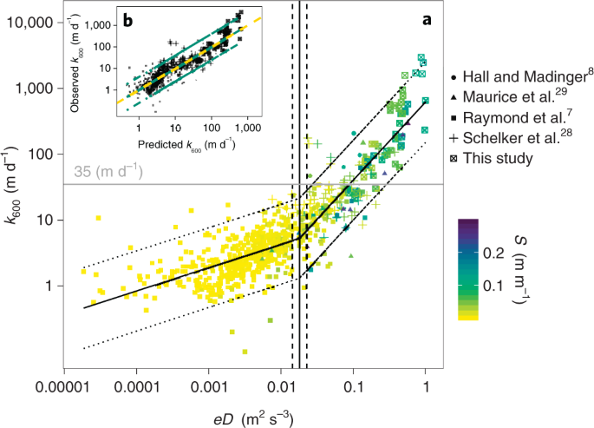
Dataset: Ulseth etal. 2019
2 distinct ‘regimes’, where the physical driver behind k₆₀₀ is speculated to be different.
Manifests as two distinct linear models

Slide 4
What I’ve done
Build two Bayesian hierarchal linear regression models
Use river width as grouping variable, informed by dataset quartiles
Tiny (0-5m)
Small (5-10m)
Larger (10-50m)
SWOT-observable (50+m)
Confirm model fits the data
‘posterior predictive checks’
Compare regression lines across groups and against Ulseth etal 2019
For class
For us

Slide 5
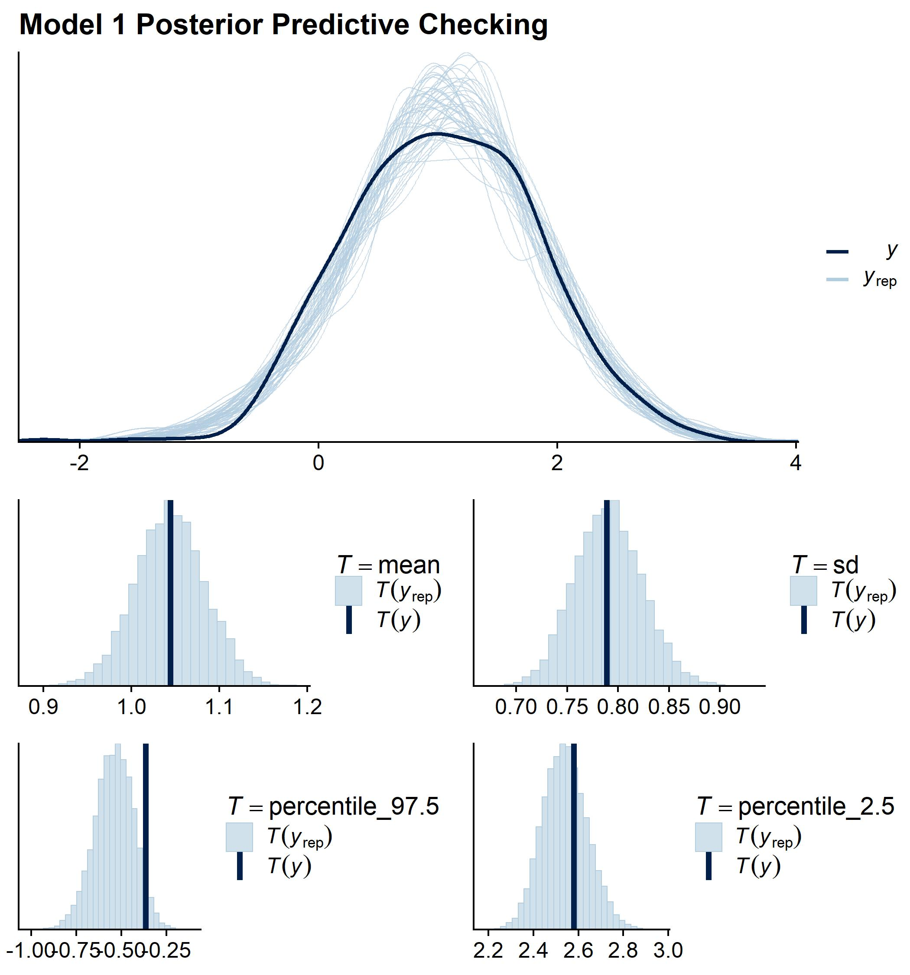
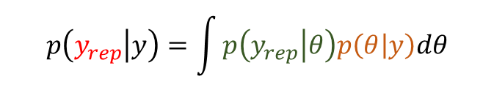
Posterior Predictive Checks
$$p\left(y_{rep} | y\right)=\int{p\left(y_{rep} | θ\right)p\left(θ | y\right)dθ}$$
Simulated data
Likelihood
Posterior
Obtain posterior
Sample a set of parameters from the posterior
Use those values to sample ‘data’ from the likelihood
Do this 100s of times
Compare against actual data
Don’t think this is too relevant to a McFLI but neat if you are ever building a more traditional Bayesian model

Slide 6
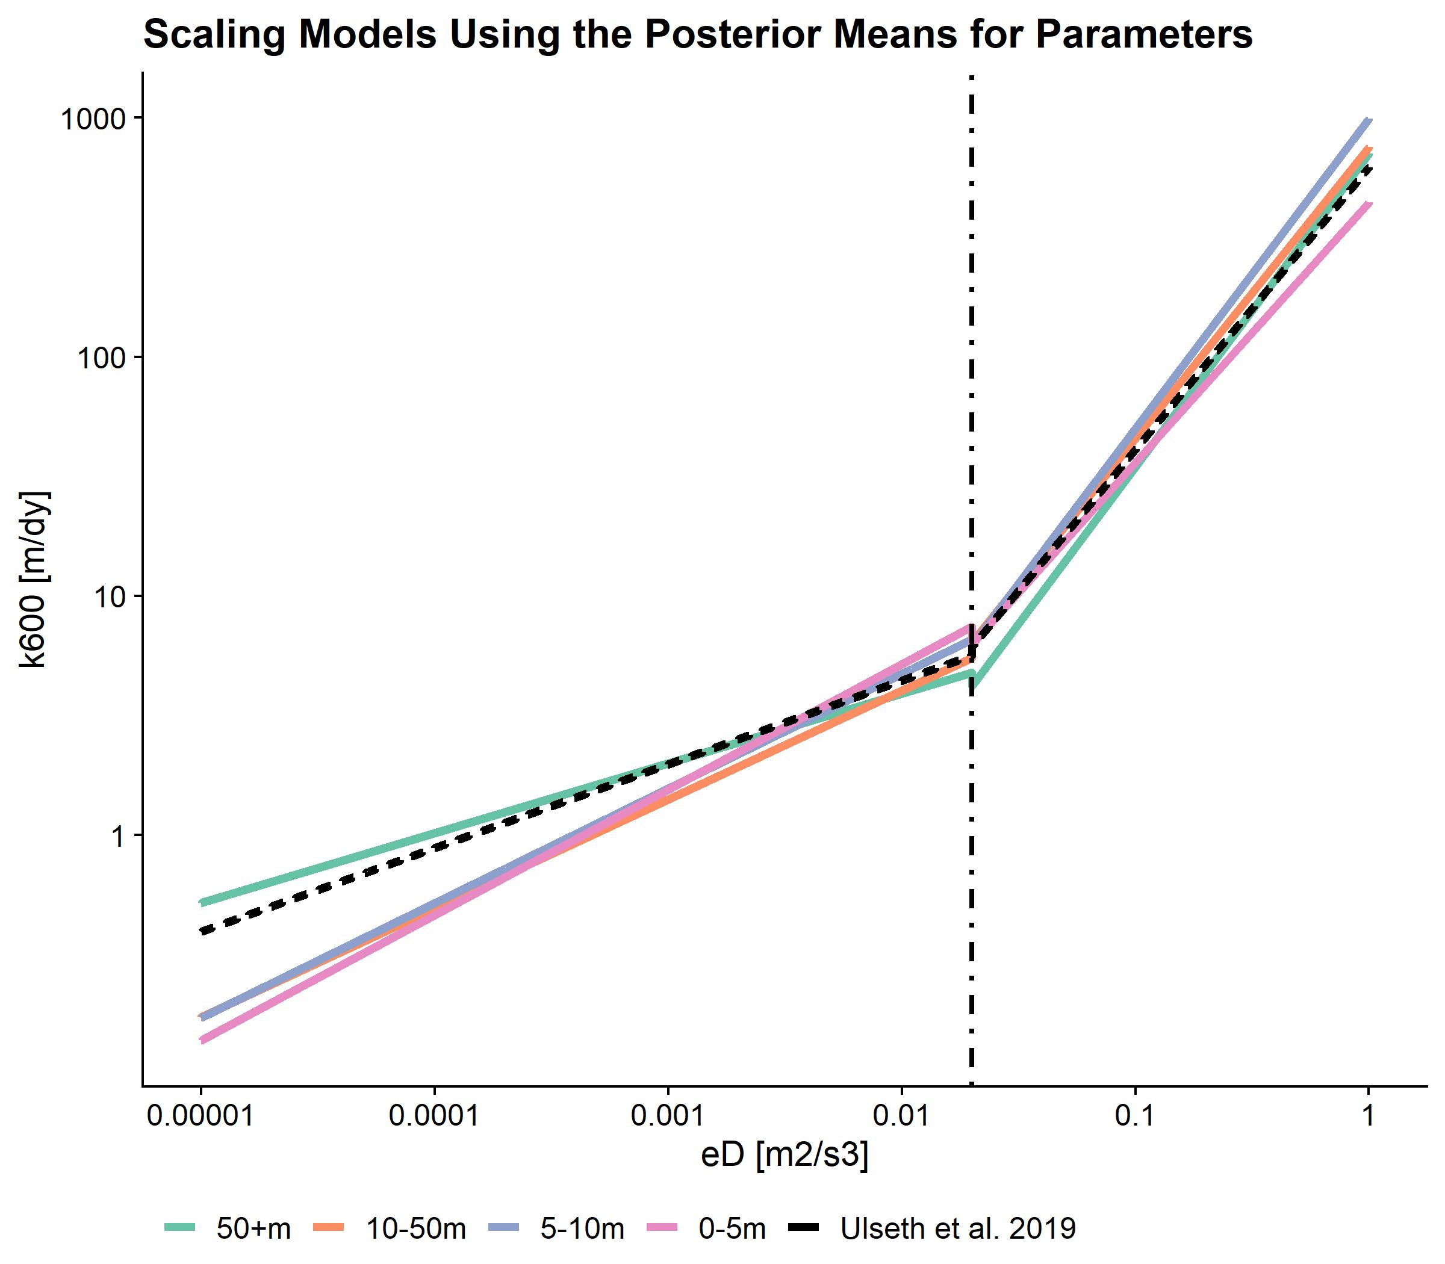
Ultimately
SWOT-observable rivers have a fundamentally different scaling relationship than smaller ones
Implicates the model I use in my McFLI method…
A set of regression coefficients for each river size group, ~regularized to account for small group sizes/ high in-group variability

Slide 7
This week
AGU presentation submitted by the 11/20…
Keep fleshing out this model
Other coursework

Slide 8
Group Sizes
Group | Model | n
0-5m | Model 1 | 136
5-10m | Model 1 | 44
10-50m | Model 1 | 99
50+m | Model 1 | 226
0-5m | Model 2 | 128
5-10m | Model 2 | 35
10-50m | Model 2 | 24
50+m | Model 2 | 9
Only two groups have smaller samples, and 24 really isn’t that bad…

