Slide 1
More Gas Transfer
Late night/early morning idea

Slide 2
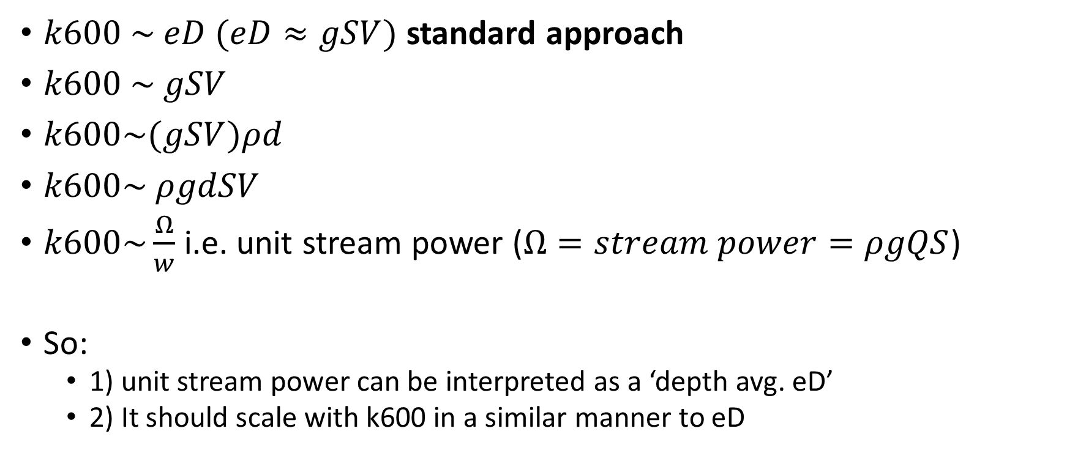
$k600 \sim eD (eD≈gSV)$ standard approach
$k600 \sim gSV$
$k600\sim (gSV)ρd$
$k600\sim ρgdSV$
$k600\sim \frac{Ω}{w}$ i.e. unit stream power ($Ω=stream power=ρgQS$)
So:
1) unit stream power can be interpreted as a ‘depth avg. eD’
2) It should scale with k600 in a similar manner to eD

Slide 3
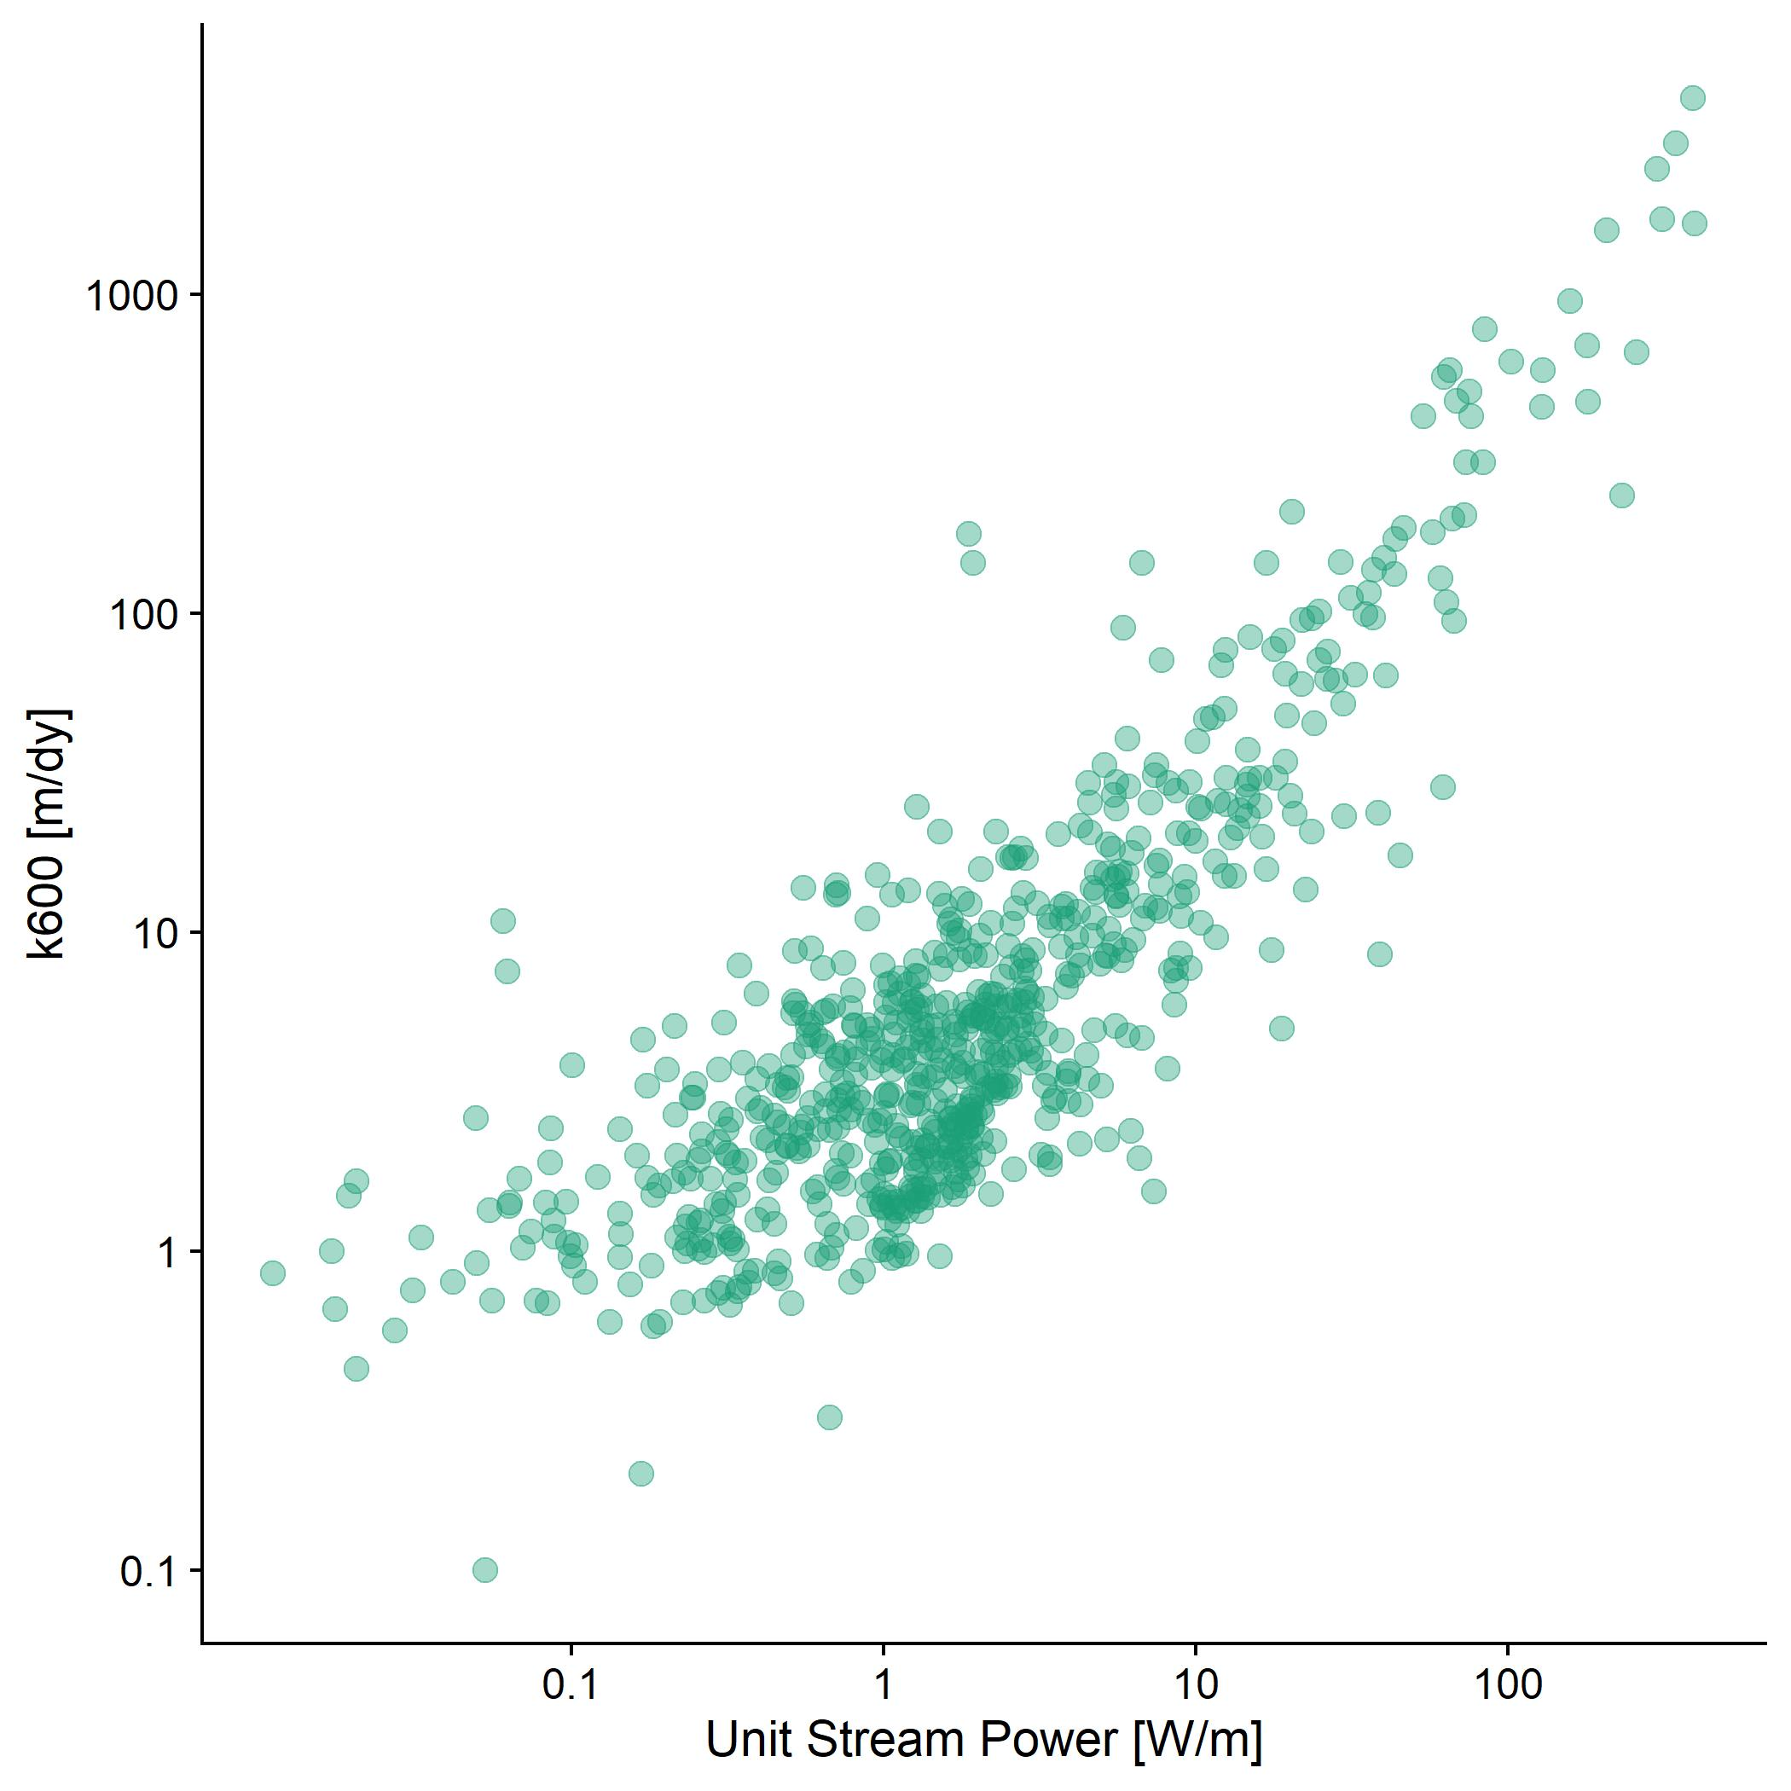
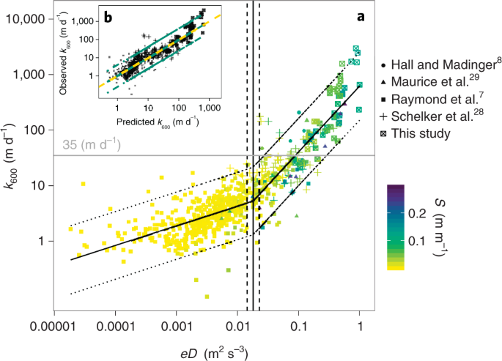
It does!
R² 0.78
Team Gleason
Ulseth et al 2019

Slide 4
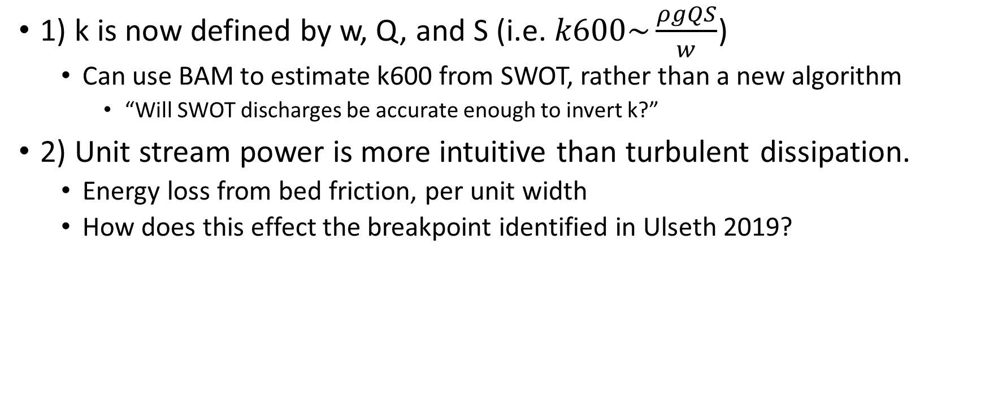
Two implications (I think)
1) k is now defined by w, Q, and S (i.e. $k600\sim \frac{ρgQS}{w}$)
Can use BAM to estimate k600 from SWOT, rather than a new algorithm
“Will SWOT discharges be accurate enough to invert k?”
2) Unit stream power is more intuitive than turbulent dissipation.
Energy loss from bed friction, per unit width
How does this effect the breakpoint identified in Ulseth 2019?

Slide 5
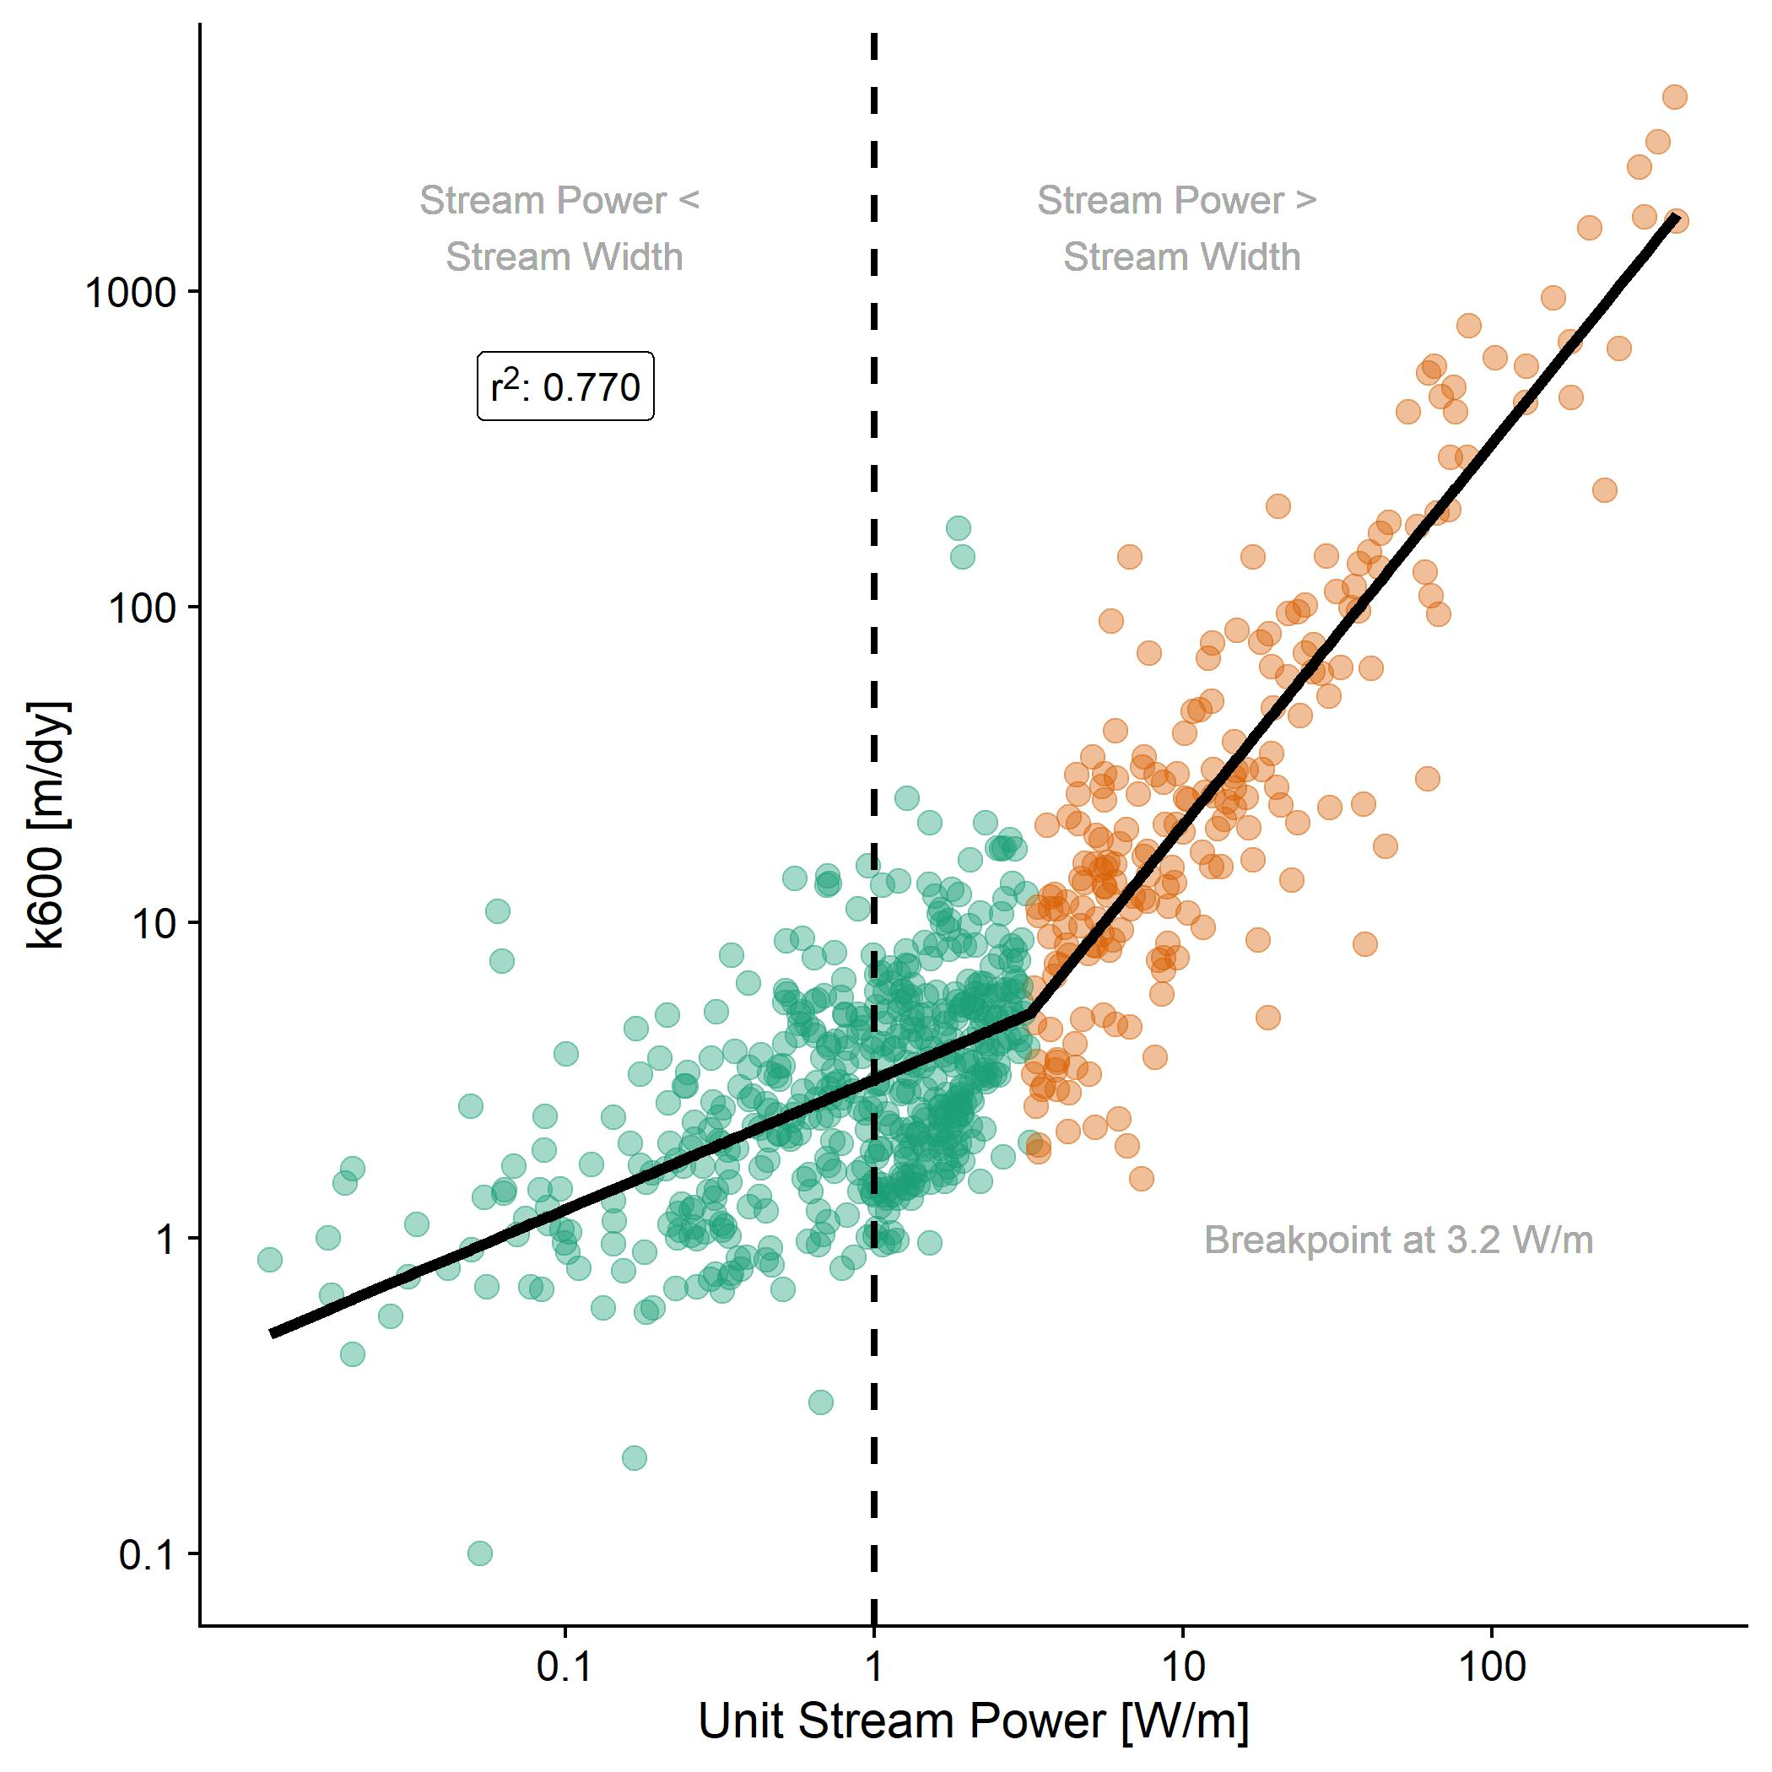
The ‘regime shift’ outlined in Ulseth etal 2019 occurs when stream power is ~3x greater than channel width
Total energy >>> river size → regime shift in relation to k600

Slide 6
Questions
Should I explore using BAM discharges to estimate k?
Do you think the breakpoint of stream power is interesting?
Could link with bed roughness, which Pete was interested in

