Slide 1
RS of River CO2
!!

Slide 2
Current concerns
Quantifying uncertainty for CO2 evasion model
Validating the posterior
Found a typo in model too!

Slide 3
Quantifying evasion model uncertainty
Sigma_man and sigma_amhg (in BAM) represent flow law error and manifest in the model as the posterior SD
I know sigma_amhg was defined empirically w/ hydroSWOT, and believe sigma_man was too
I lack training data for CO2 fluxes + hydraulics to do the same thing
So I used Monte Carlo simulations to explore propagation of uncertainty through model

Slide 4
Quantifying CO2 evasion model uncertainty
I ran Monte Carlo simulations for 10,000 random sets of realistic hydraulic measurements.
For each MC simulation: Assuming no measurement error, 10,000 sets of model parameters were randomly sampled from parameter distributions (via mean and sigmas from Raymond et al 2012)
Manning’s equation uncertainty defined by Hagemann et al. (2017)

Slide 5
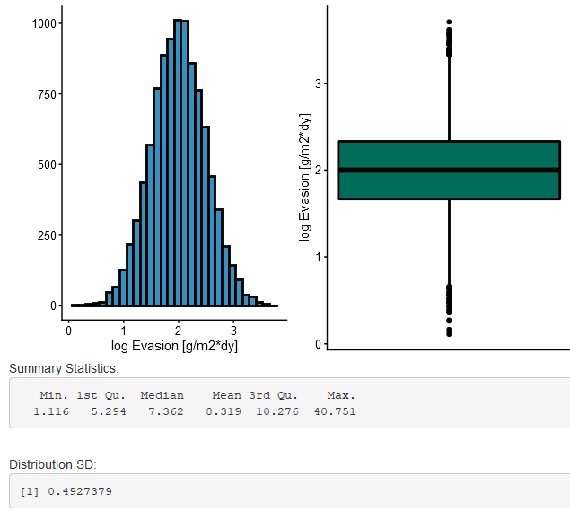
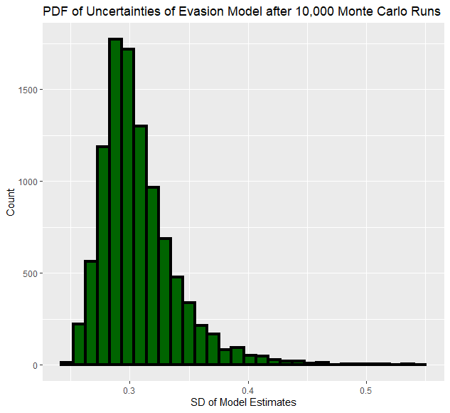
Quantifying CO2 evasion model uncertainty
1 example simulation output
Mean model uncertainty of 0.31
Little higher than Manning’s uncertainty in BAM (0.22), as expected
Makes sense given the relatively poor performance of gas transfer models

Slide 6
‘Validating’ the posterior
Recall there (only) 4 priors in the model: A0, n, CO2 flux, and CO2 concentration difference
With new model error, I ran model on 5 reaches of Ohio River Pepsi 2 data
Using 10 day sampling (phase 2 of pepsi 2)
Field measurements were every 14 days
Have ‘validation’ data for all priors but the CO2 flux
The one we actually care about!!!!

Slide 7
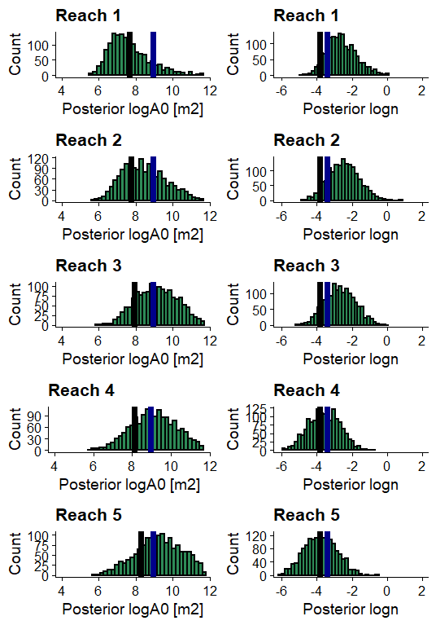
‘Validating’ the posterior- Hydraulics
Black is truth
Blue is geoBAM prior
Green is posterior
A0 and Manning’s n priors are reasonably
recovered in the posterior
Note that ‘observed n’ is invariant b/c this is HEC-RAS
4/10: Posterior is ‘improved’ from prior
3/10: Posterior and prior are ~same
3/10: Posterior is ‘worse’ than prior (but still in PDF)

Slide 8
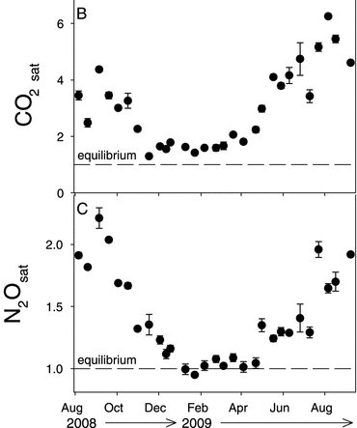
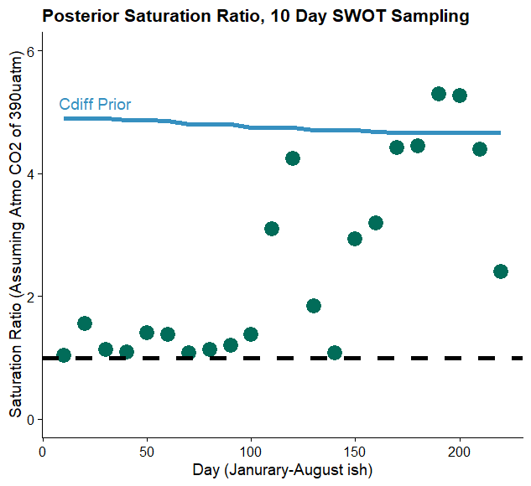
‘Validating’ the posterior- biogeochemistry
Beauliu et al. 2012
Using field data from a few kms upstream, there is strong agreement b/w posterior and field measurements
VERY different from prior

Slide 9
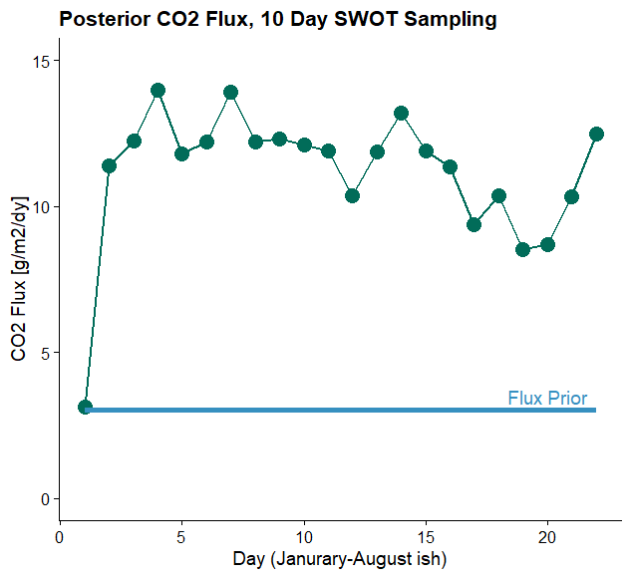
CO2 Flux (posterior)
If I had the raw data from Beauliu 2012, I could actually validate this and the previous slide
Significant difference from prior

Slide 10
Next
Actual validation
Use Shaoda’s monthly CO2 data as priors (instead of Lauerwald et al. 2015’s time-invariant, gridded data)
Future:
Compare outputs across pepsi 2/SWOT sampling schemes

