Slide 1
RS of River CO2
!!!!

Slide 2
Lots of stuff!
Weird coincidence- I now have ‘almost’ validation data from Beaulieu et al. (2012) (~10 miles upstream of pepsi2 data and 3 years earlier)
Fixed typo in model
Identified some weird behavior

Slide 3
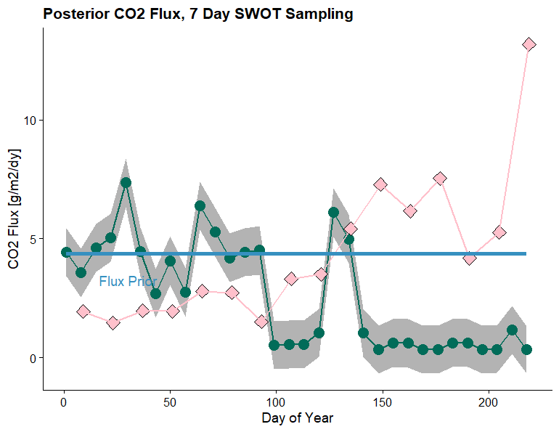
Pepsi2 Ohio River Results (flux prior is set to average observed flux)
Pink is observed ~10mi upstream
Uncertainty is standard error of posterior
Why so bad??
Flux drops to ~0 when slope is ~0, but in-stream CO2 goes really high. This doesn’t make sense.

Slide 4
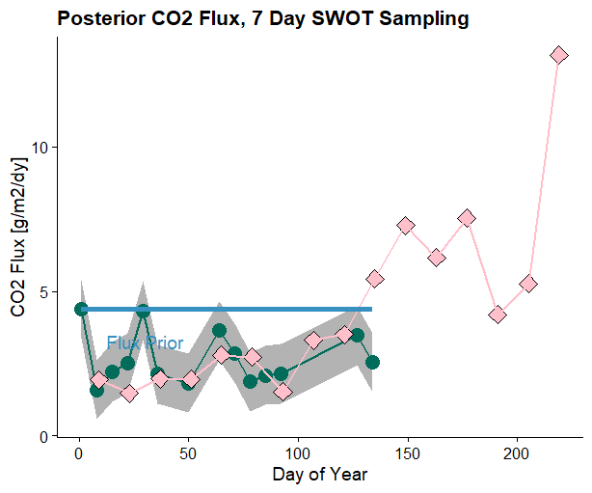
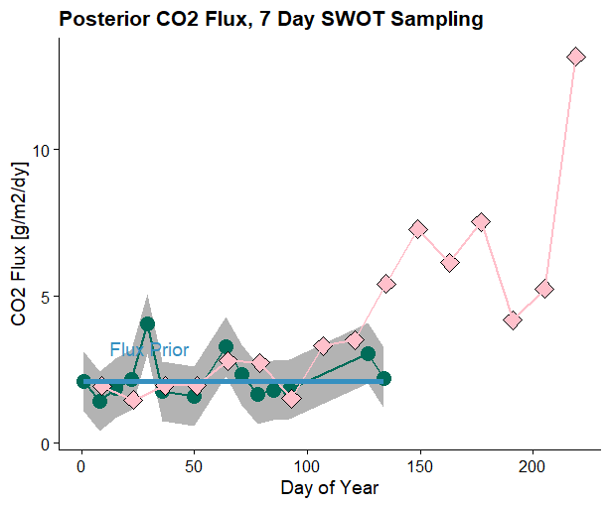
Filtering out ‘flat’ timesteps (slope < 0.00005)
Same prior as last slide
Wicked good prior

Slide 5
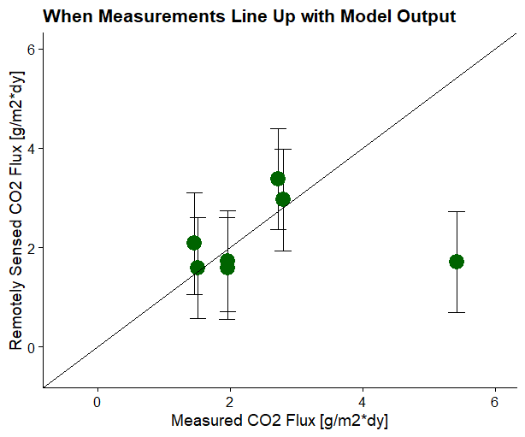
Explicit validation using daily SWOT sampling, filtering out flat timesteps
6/7 are quite good

Slide 6
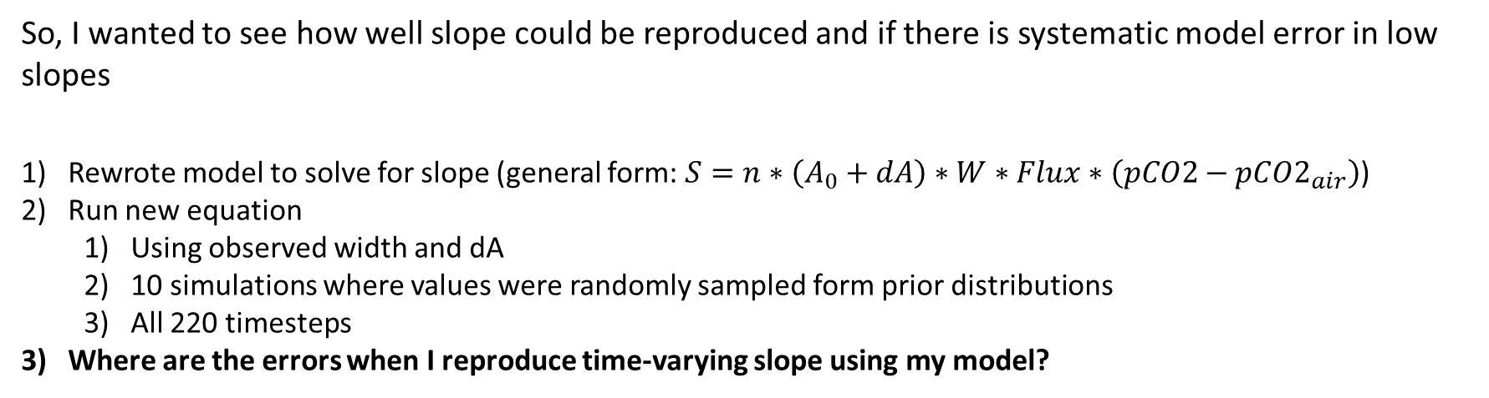
What Gives?
So, I wanted to see how well slope could be reproduced and if there is systematic model error in low slopes
Rewrote model to solve for slope (general form: $S=n∗\left(A_{0}+dA\right)∗W∗Flux∗\left(pCO2−pCO2_{air}\right)$)
Run new equation
Using observed width and dA
10 simulations where values were randomly sampled form prior distributions
All 220 timesteps
Where are the errors when I reproduce time-varying slope using my model?

Slide 7
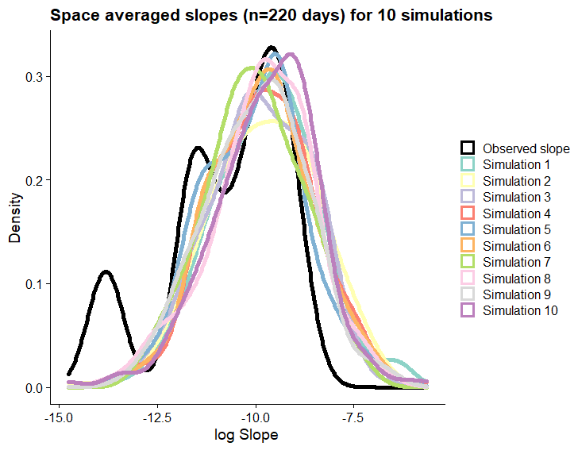
What Gives?
1) Model works fine for ‘not super low slopes’
2) Model can’t reproduce weird 2nd and 3rd peaks at super low slopes in observed distribution.
I don’t know if this is a limitation of my model or a quirk of the pepsi2 data b/c it clearly works if I remove the ‘non-normal’ part of the observed record

