Slide 1
July 20th
!?

Slide 2
three Updates
Courses: biogeochemistry course has no one enrolled and he will likely cancel it this fall…
Wetland/Forest hydrology (taking)
Water resources management (maybe)
Aquatic ecology (maybe)
Fixed Manning’s n issue
Trying to build reasonable simulated FCO2 timeseries

Slide 3
1) Manning’s n
I realized that pepsi observed n values are stage-and-time invariant
Now, I should just solve for n using Q, W, and A
Fixed those issues from last week

Slide 4
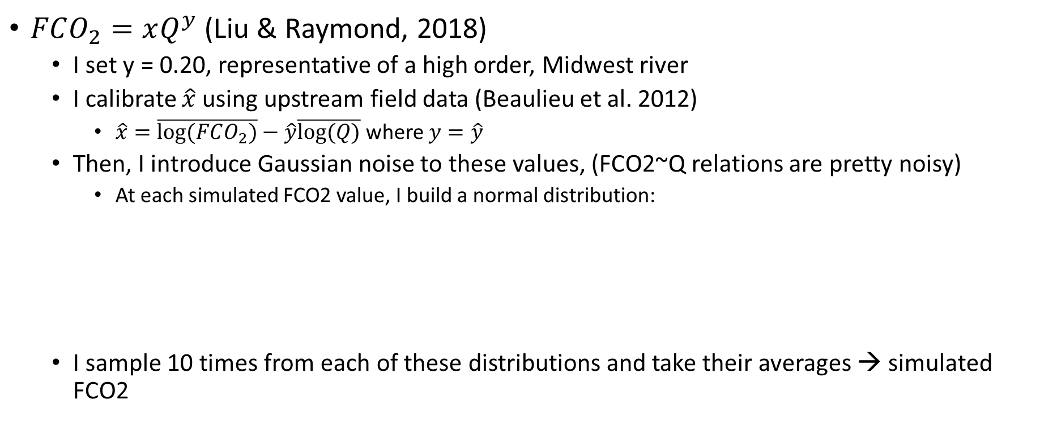


2) Reasonable simulated timeseries of FCO2
$FCO_{2}=xQ^{y}$ (Liu & Raymond, 2018)
I set y = 0.20, representative of a high order, Midwest river
I calibrate $\hat{x}$ using upstream field data (Beaulieu et al. 2012)
$\hat{x}=\overline{log⁡(FCO_{2})}−\hat{y}\overline{log⁡(Q)}$ where $y=\hat{y}$
Then, I introduce Gaussian noise to these values, (FCO2~Q relations are pretty noisy)
At each simulated FCO2 value, I build a normal distribution:
I sample 10 times from each of these distributions and take their averages → simulated FCO2
Mean = simulated FCO2
sigma = C.V. of 30% (arbitrary... I might get avg. model error from Shaoda…)

Slide 5
5 tests
 | N prior | A0 prior | Flux prior | pCO2 prior | Expected Performance | Required In situ data
Test 1 |  |  |  |  | Perfect | All
Test 2 | geoBAMr | geoBAMr |  |  | Good | CO2
Test 3 (great CO2 priors) | geoBAMr | geoBAMr | Shaoda | Shaoda | Acceptable | None
Test 4 (eh CO2 priors) | geoBAMr | geoBAMr | Shaoda | Shaoda | Biased | None
Test 5 (Mark-style CO2 bounds) | geoBAMr | geoBAMr | Shaoda | Shaoda | Terrible | None
In the weeds:
When pCO2 prior is known (), it is held constant b/c of the way priors must be defined within stan models. But in test 3-5, we actually validate against a simulated timeseries of FCO2 fluxes that are not constant, as would be expected

Slide 6
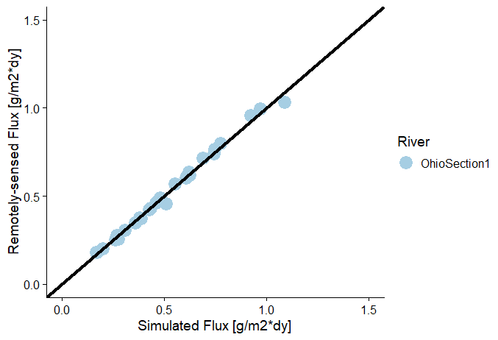
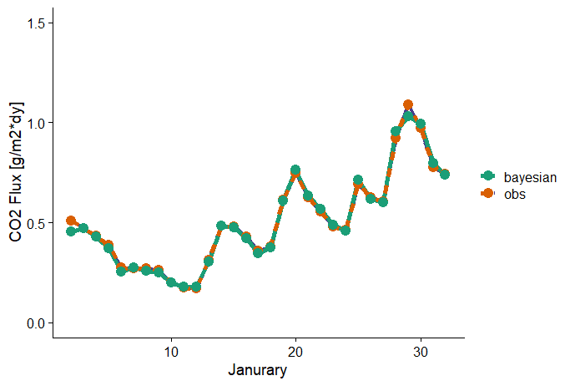
Test 1: ~perfect priors
pCO2 prior: 700 uatm
pCO2 observed: 700 uatm (informed by Beaulieu et al 2012)
This is good these should be functionally identical! Gut check is approved.

Slide 7
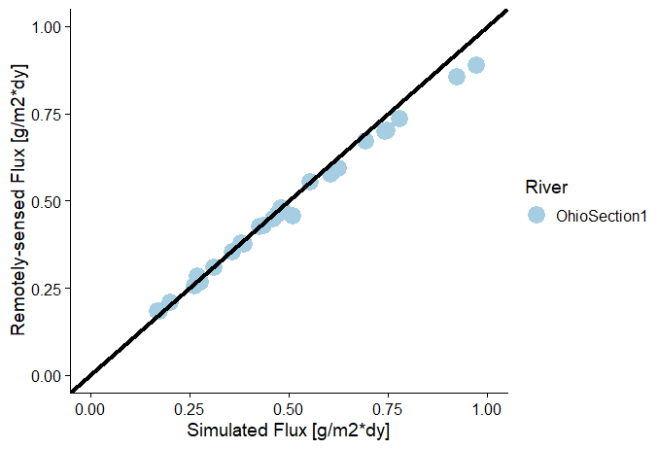
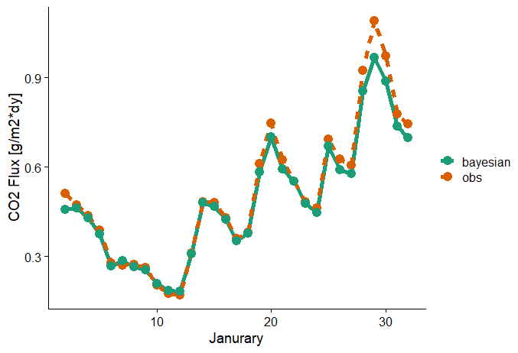
Test 2: ~perfect CO2 priors, global channel priors
pCO2 prior: 700 uatm
pCO2 observed: 700 uatm (informed by Beaulieu et al 2012)
Granted, geoBAMr works great on the Ohio…

Slide 8
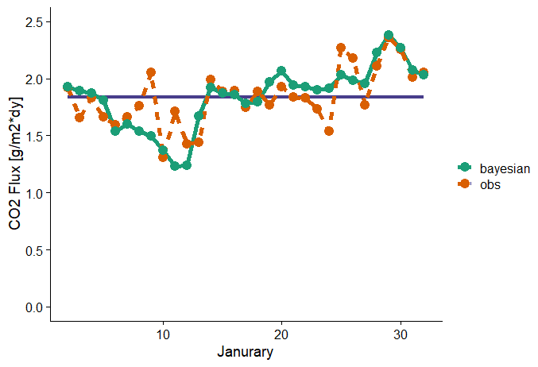
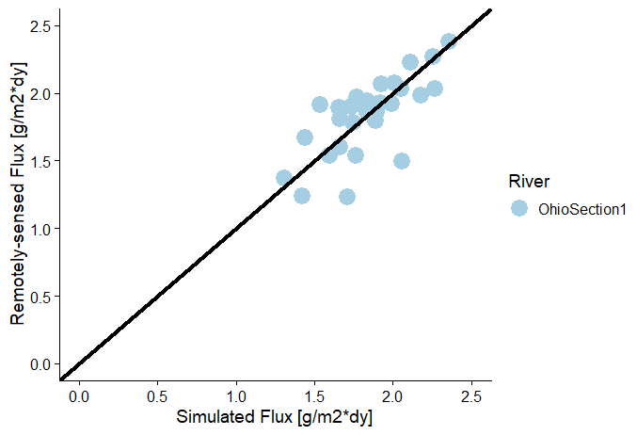
Test 3: all remotely-sensed/global priors (good priors)
F prior (Shaoda
monthly value)

Slide 9
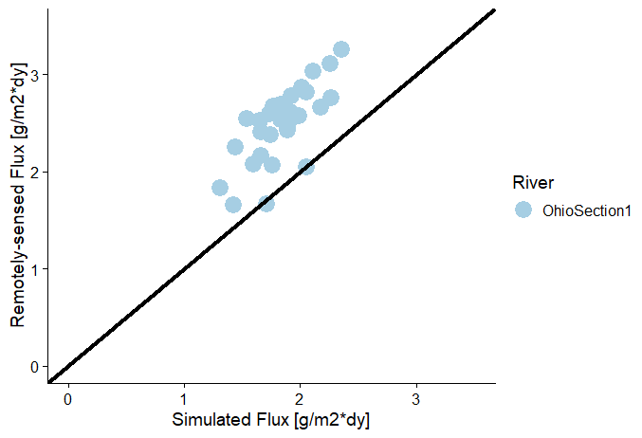
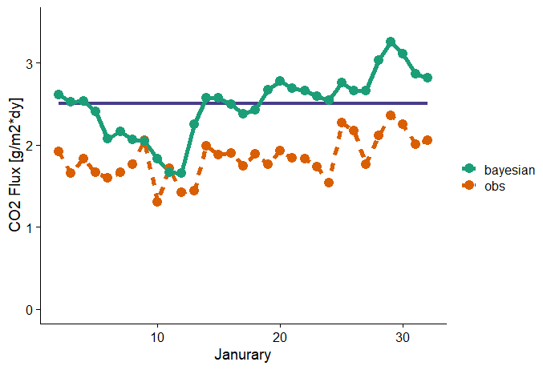
Test 4: all remotely-sensed/global priors (eh priors)
F prior (Shaoda
monthly value)

Slide 10
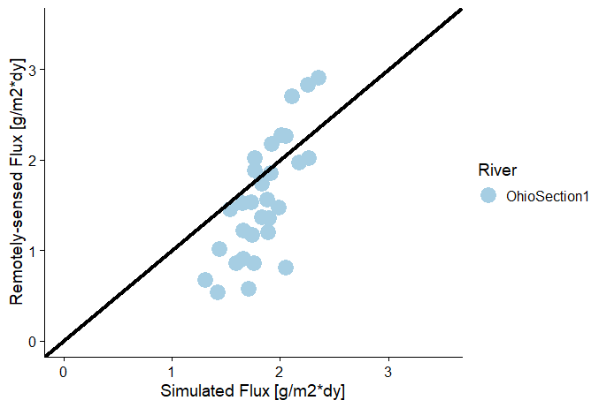
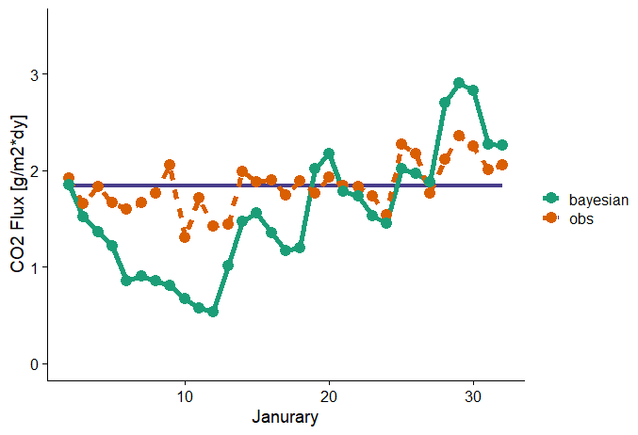
Test 5: all remotely-sensed/global priors (good priors, but wide bounds on CO2)
F prior (Shaoda
monthly value)

