Slide 1
CT Paper
Submit to GRL this afternoon
Send Colin AGU abstract today too

Slide 2
RS of CO2 in the Connecticut
Specifically, RS of potential flux of laterally-transferred, headwater-sourced CO2……

Slide 3
Updates
Reparametrized model to address problems w/ observed CO2 in air
Apparently, stan models ‘don’t behave’ when observables are used within transformed parameters
Simpler algebra
Model diagnostics
Does model adequately approximate the posterior?
Do chains sufficiently converge?
Autocorrelation of MCMC samples
“MCMC samples are dependent. This does not effect the validity of inference on the posterior if the samplers has time to explore the posterior distribution, but it does affect the efficiency of the sampler. In other words, highly correlated MCMC samplers requires more samples to produce the same level of Monte Carlo error for an estimate.”
Model fit
Preliminary CT runs

Slide 4
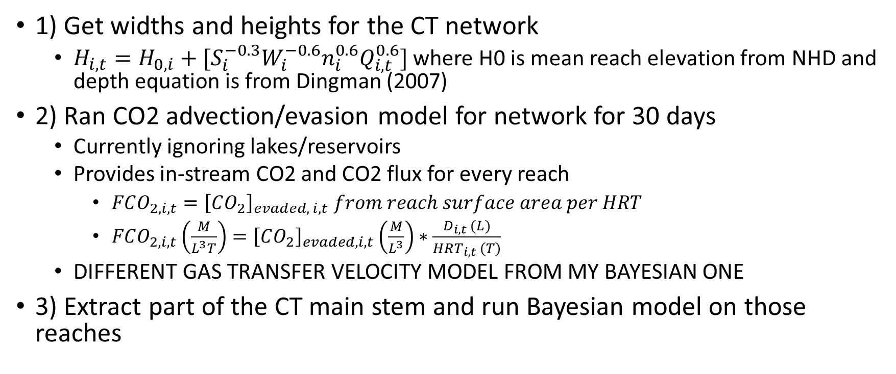
What I’ve Done in CT
1) Get widths and heights for the CT network
$H_{i,t}=H_{0, i}+[S_{i}^{−0.3}W_{i}^{−0.6}n_{i}^{0.6}Q_{i,t}^{0.6}]$ where H0 is mean reach elevation from NHD and depth equation is from Dingman (2007)
2) Ran CO2 advection/evasion model for network for 30 days
Currently ignoring lakes/reservoirs
Provides in-stream CO2 and CO2 flux for every reach
$FCO_{2, i, t}={\left[CO_{2}\right]}_{evaded, i, t} from reach surface area per HRT$
$FCO_{2, i, t}\left(\frac{M}{L^{3}T}\right)={\left[CO_{2}\right]}_{evaded, i, t}\left(\frac{M}{L^{3}}\right)∗\frac{D_{i,t} (L)}{HRT_{i,t} (T)}$
DIFFERENT GAS TRANSFER VELOCITY MODEL FROM MY BAYESIAN ONE
3) Extract part of the CT main stem and run Bayesian model on those reaches

Slide 5
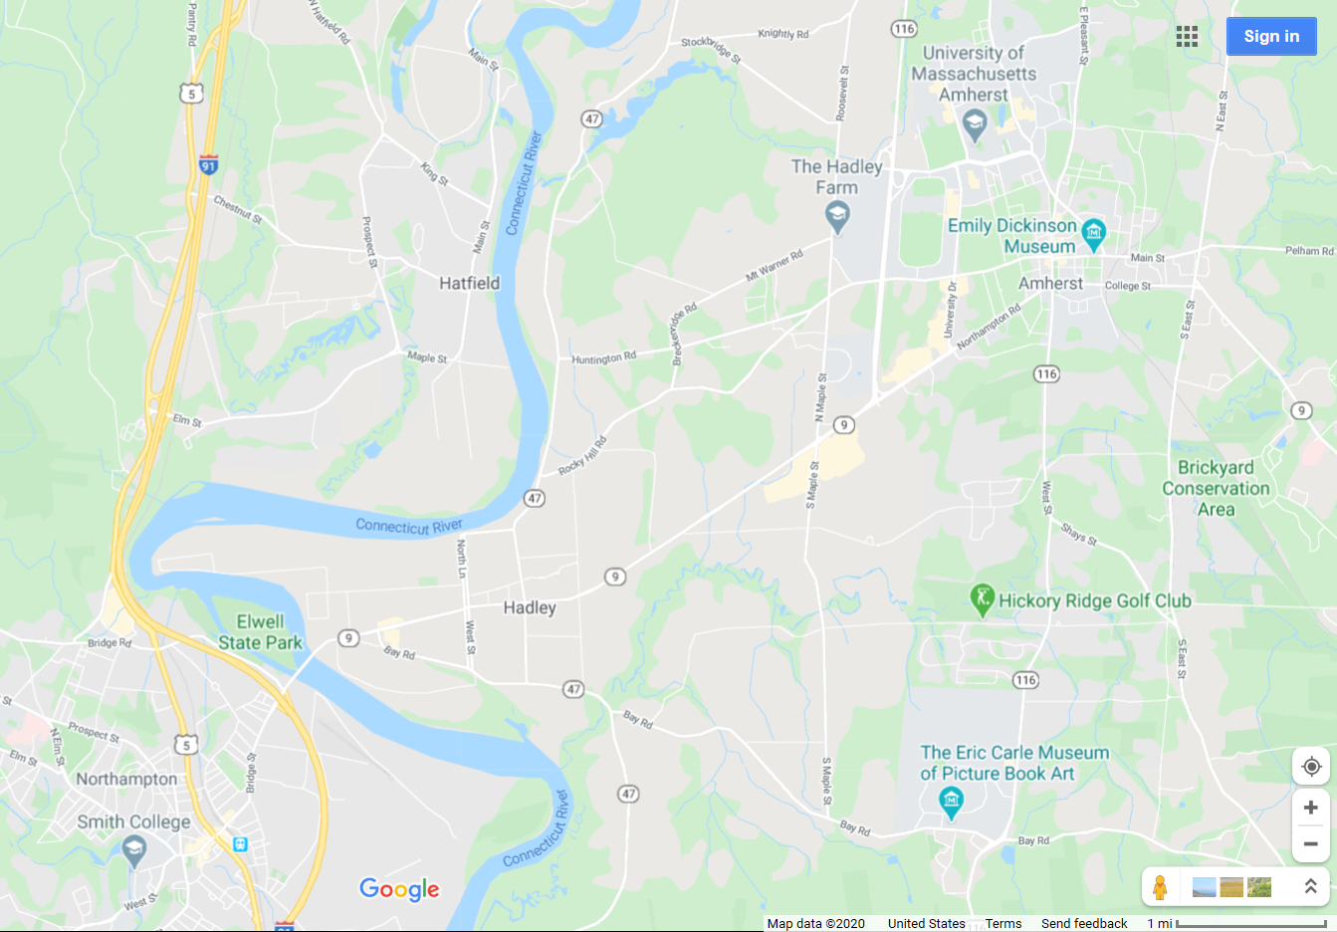
I used the five reaches separating Hadley and Northampton/Hatfield!!
Ish

Slide 6
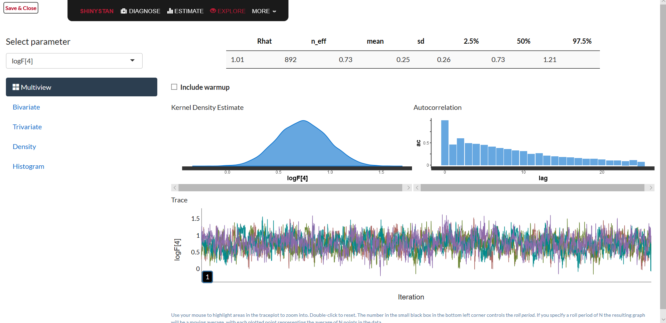
Model diagnostics using ‘shinystan’
Autocorrelation not a problem, as n_eff < 1/100th of # iterations (here: 50)
Posterior logFCO2, 4th time step
Chains are converging nicely! (Rhat <= ~1.01)

Slide 7
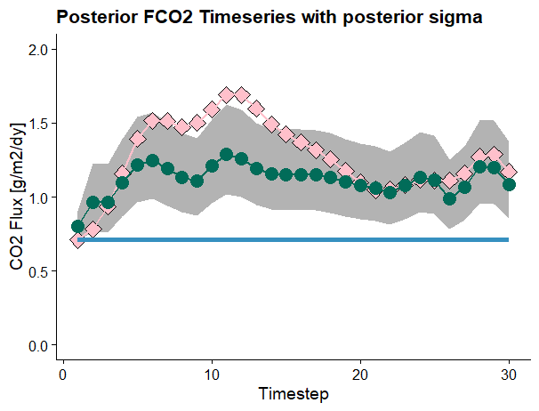
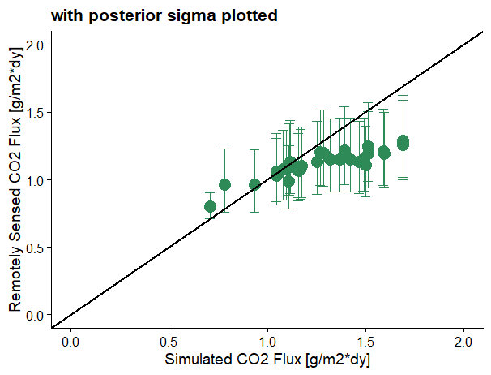
Reasonable prior
Remember that widths are static, so dynamics are achieved using just water surface heights
R2: 0.71
RMSE: 0.23 g/m2*dy

Slide 8
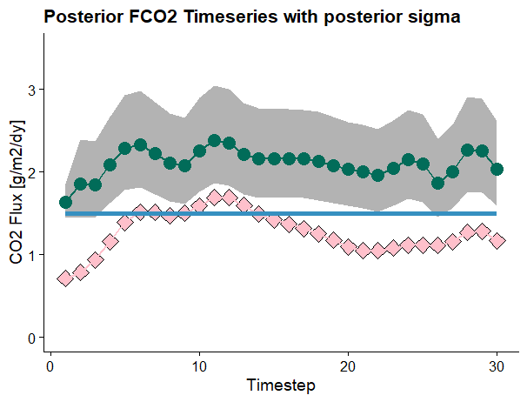
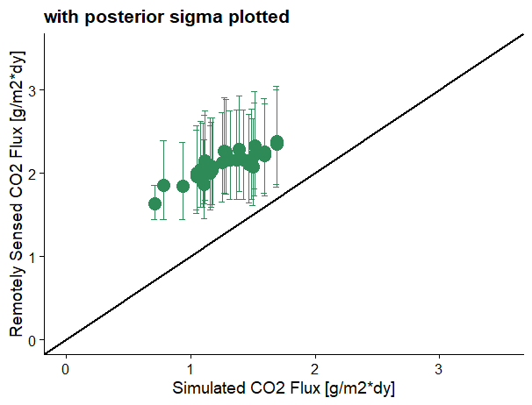
Worse CO2 priors
R2: 0.69
RMSE: 0.85 g/m2*dy

Slide 9
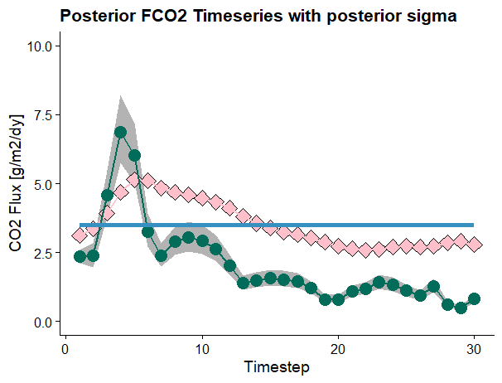
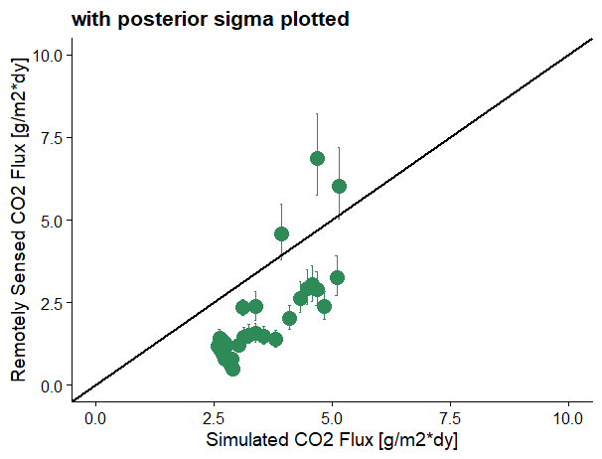
Northern CT river, ~100m wide
R2: 0.58
RMSE: 1.75 g/m2*dy

Slide 10
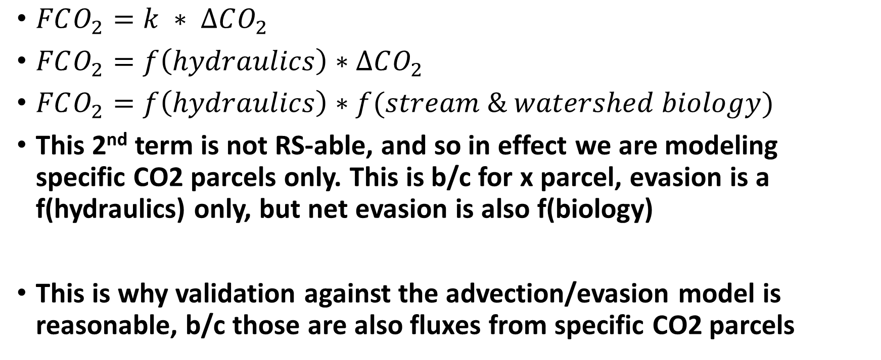
In the weeds: RS of CO2 parcels
$FCO_{2}=k ∗ ∆CO_{2}$
$FCO_{2}=f\left(hydraulics\right)∗∆CO_{2}$
$FCO_{2}=f\left(hydraulics\right)∗f(stream \& watershed biology)$
This 2nd term is not RS-able, and so in effect we are modeling specific CO2 parcels only. This is b/c for x parcel, evasion is a f(hydraulics) only, but net evasion is also f(biology)
This is why validation against the advection/evasion model is reasonable, b/c those are also fluxes from specific CO2 parcels

Slide 11
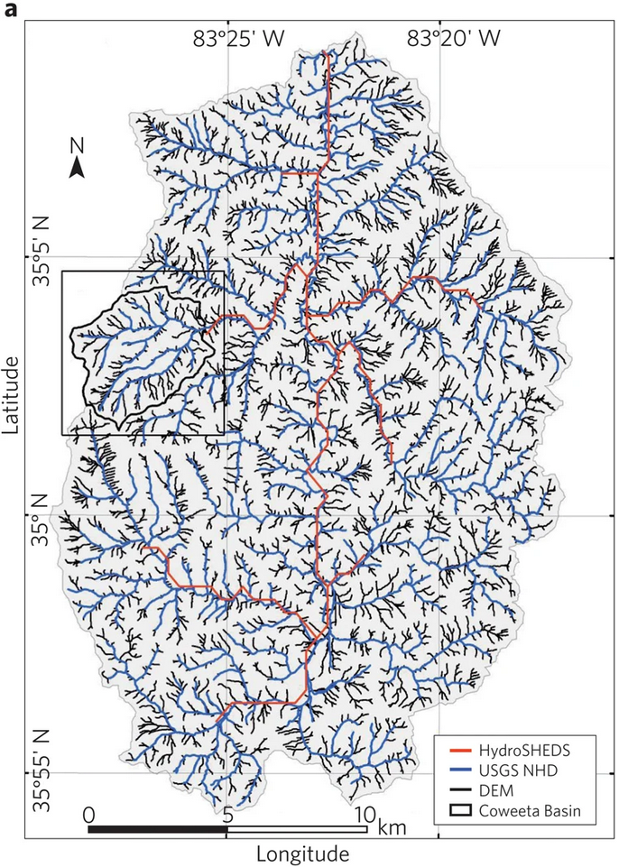
Eventually…
Benstead & Leigh
(2012)
Given SWOT’s limits on observing rivers (and the overwhelming biogeochemical influence of small streams), can we merge SWOT remote sensing with modeling to estimate fluxes in small streams?
Remotely sense evasion of CO2 parcels in SWOT rivers
Push those parcels upstream via inverse advection/evasion modeling (from the CT project)
Estimate how much CO2 must have entered the 1st order streams (i.e. initial size of parcel)
All told, this would be a way to remotely sense average terrestrial CO2 inputs
Assuming I can run the model in reverse……
Initial CO2 concentration
RS
CO2
SWOT Observable
GRADES
USGS NHD

