Slide 1
More SWOT biogeochemsitry

Slide 2
Updates
Set up CT so I can test across dozens of reaches
Ran some BAM tests
Inspired by BAM results, ran similar tests on CO2 model

Slide 3
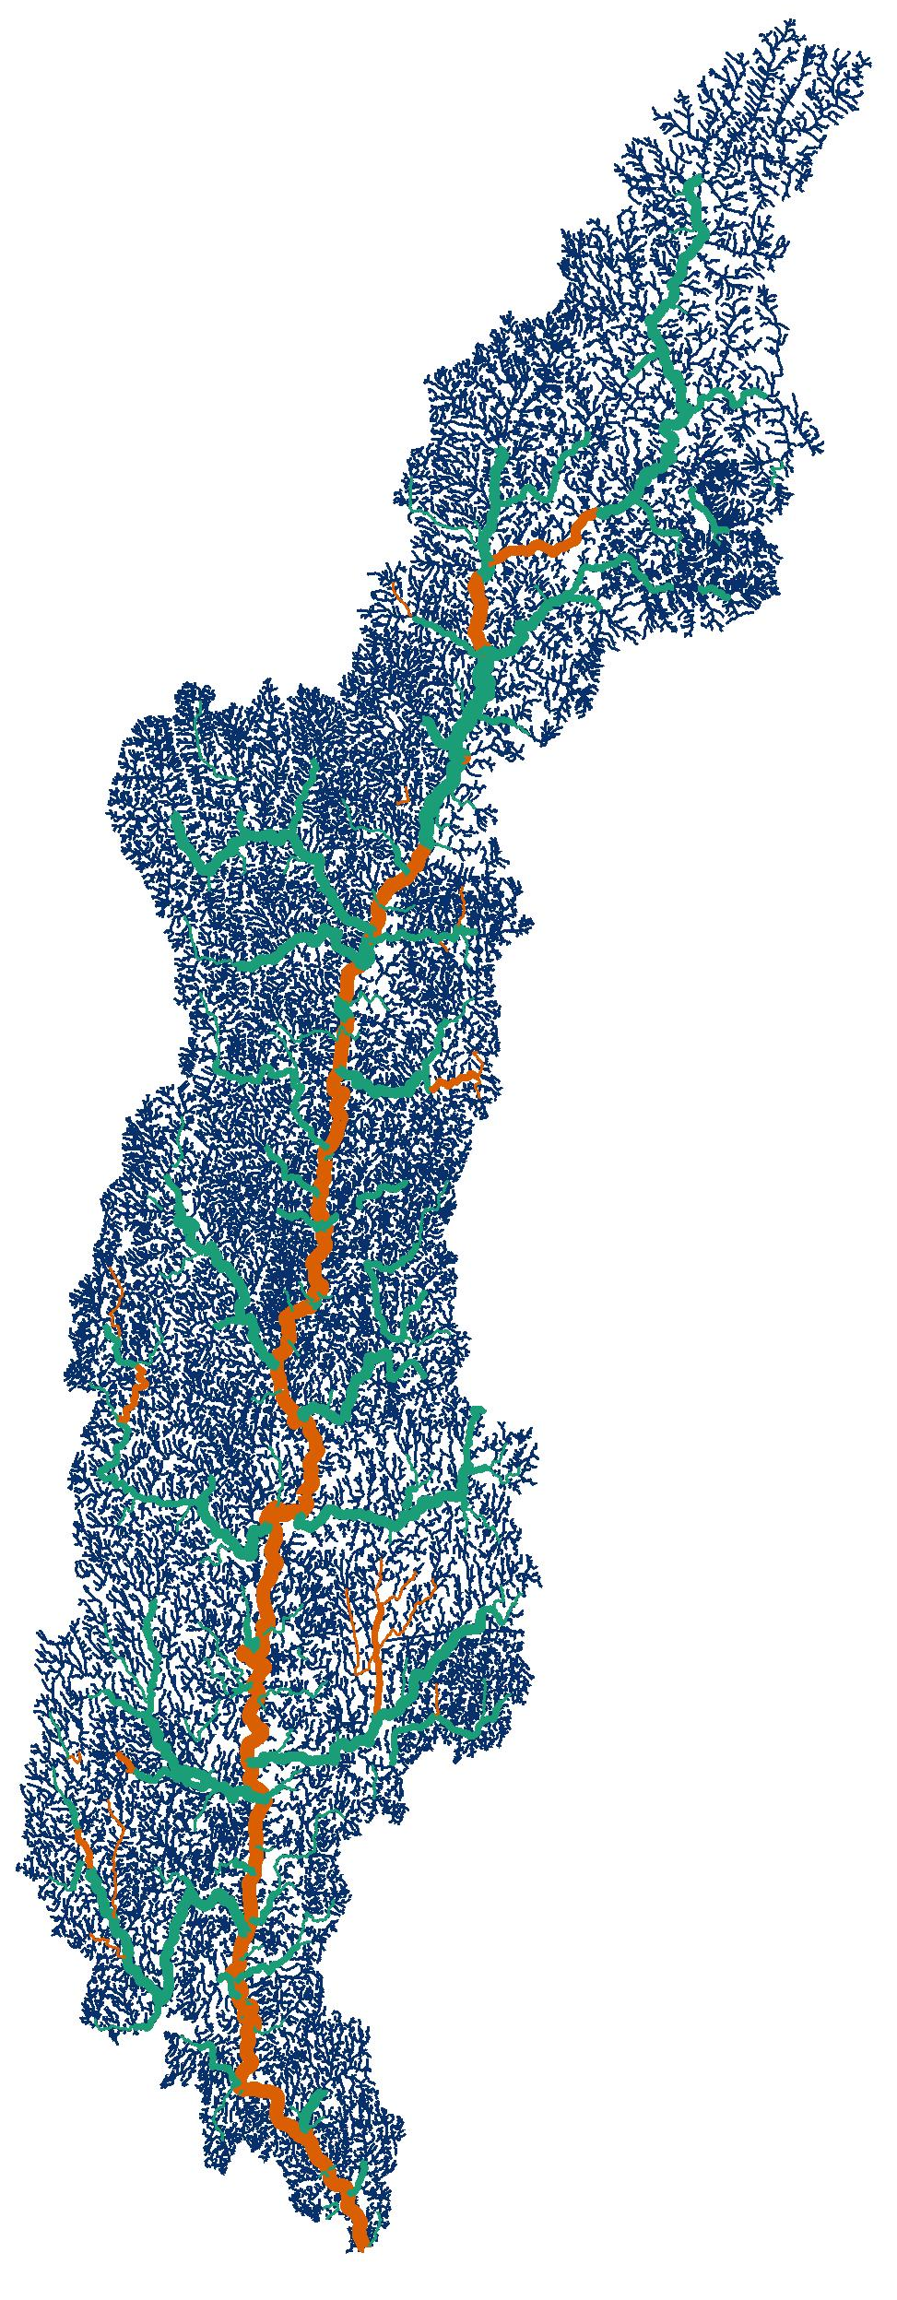
Set up CT so I can test across dozens of reaches
NHD reaches
Where all the biogeochem happens!!
According to the internet, SWOT will observe ~10km reaches of rivers > 100m wide
This conveniently ~aligns with the 8th order of this system (most of CT main stem)
I broke the 8th order of the NHD into ~10km segments
-NHD reaches are ~0.5km in length, so I treat them as xs w/in these SWOT reaches
Ultimately, 39 SWOT reaches each w/ 10+ xs to validate BEES
Non-SWOT-observable GRADES
SWOT-observable GRADES

Slide 4
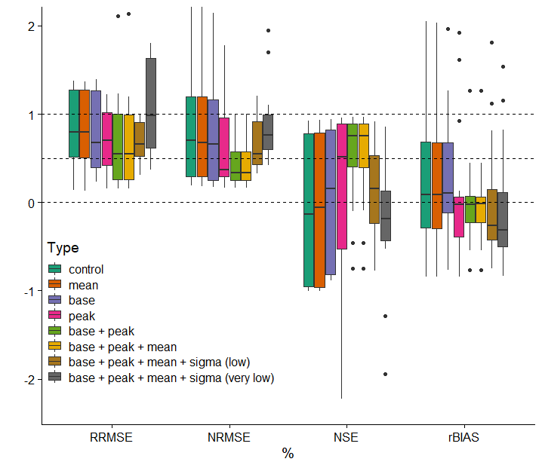
Ran some BAM tests
Colin wants to know how improved BAM would be if single discharge measurements are made
I ran 6 tests on Pepsi 2 data, increasingly constrained by a priori info
i.e. baseflow/lowerbound_Q is known or mean flow/Q_hat is known
Long story short
Knowing the upper/lower bounds of Q prior improves BAM accuracy tremendously. Knowing Q_hat a priori does very little.

Slide 5
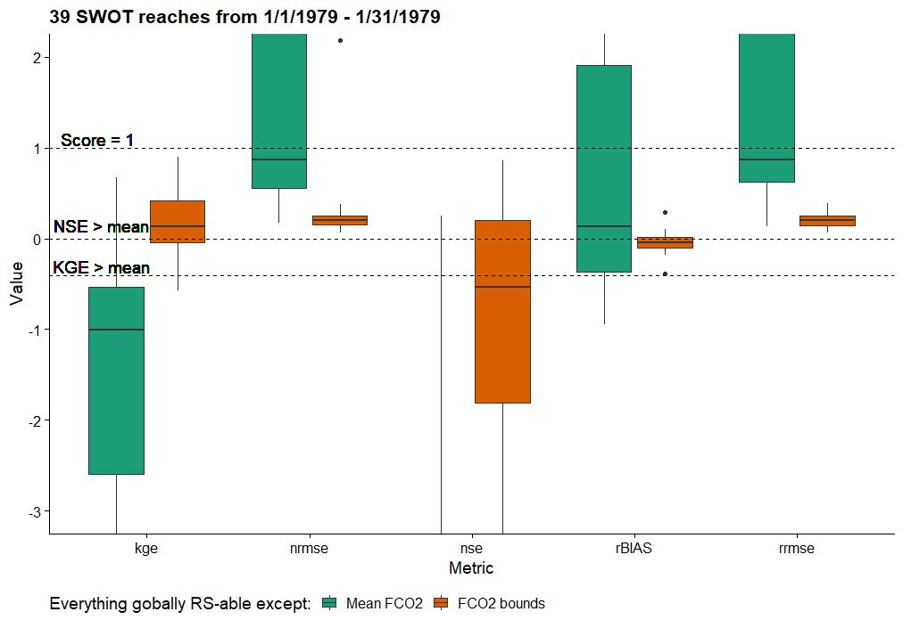
So, what if I a ran similar test on CT main stem? With hydrology metrics…
Clearly, the same pattern holds for CO2 but even more extreme…
Potential FCO2 is also a much wider range than actual FCO2, which might be highlighting the problem of global bounds
To figure out:
1) why KGE is so much better than NSE…
2) Maybe there is someway to guesstimate reasonable bounds using RS?
Or maybe this influence is less pronounced at SWOT sampling frequencies
https://core.ac.uk/reader/242721772
Section 2

Slide 6
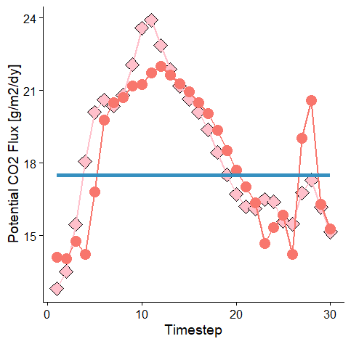
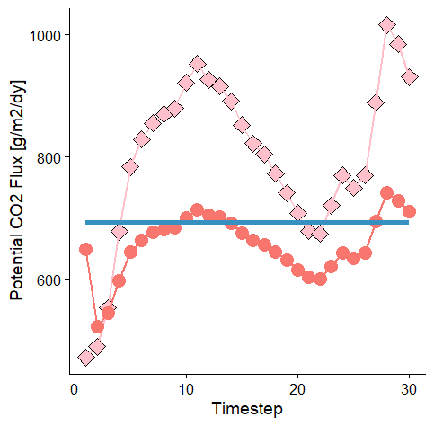
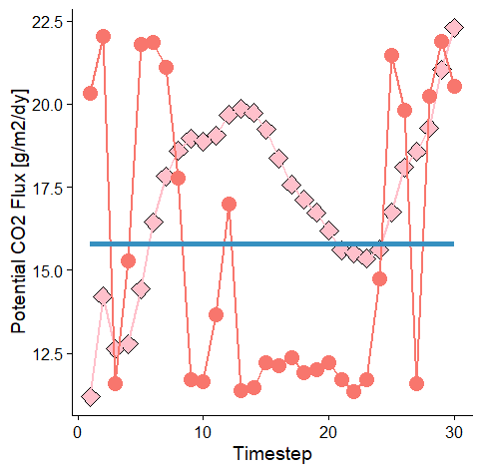
KGE > 0.35
-0.02 < KGE < 0.35
KGE < -0.02
(Randomly sampled from tertiles of KGE)

