Slide 1
Dynamic widths
HRR + Dingman in the Farmington

Slide 2
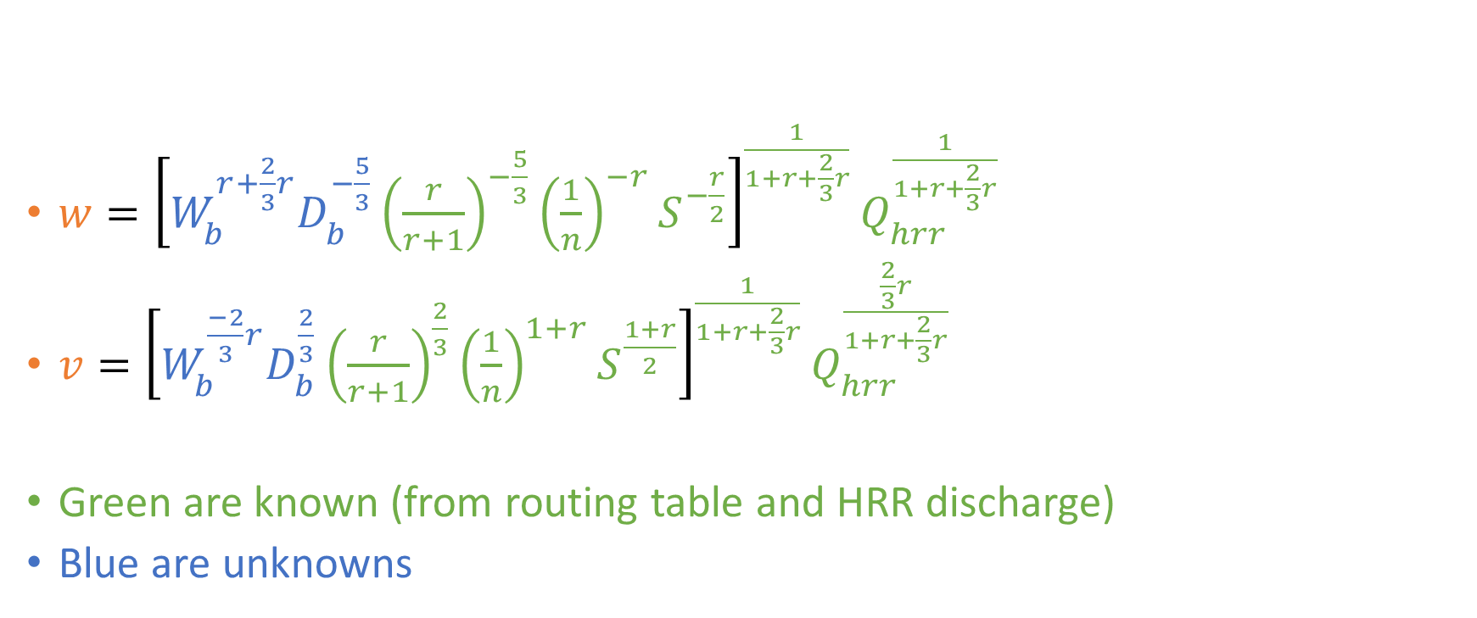
Dingman models after imposing Manning’s equation (and assuming r is known)
$w={\left[W_{b}^{r+\frac{2}{3}r}D_{b}^{−\frac{5}{3}}{\left(\frac{r}{r+1}\right)}^{−\frac{5}{3}}{\left(\frac{1}{n}\right)}^{−r}S^{−\frac{r}{2}}\right]}^{\frac{1}{1+r+\frac{2}{3}r}}Q_{hrr }^{\frac{1}{1+r+\frac{2}{3}r}}$
$v={\left[W_{b}^{\frac{−2}{3}r}D_{b}^{\frac{2}{3}}{\left(\frac{r}{r+1}\right)}^{\frac{2}{3}}{\left(\frac{1}{n}\right)}^{1+r}S^{\frac{1+r}{2}}\right]}^{\frac{1}{1+r+\frac{2}{3}r}}Q_{hrr}^{\frac{\frac{2}{3}r}{1+r+\frac{2}{3}r}}$
Green are known (from routing table and HRR discharge)
Blue are unknowns

Slide 3
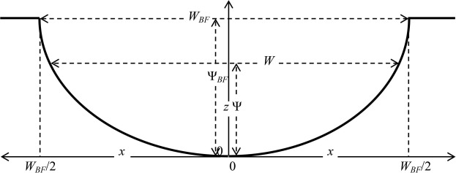
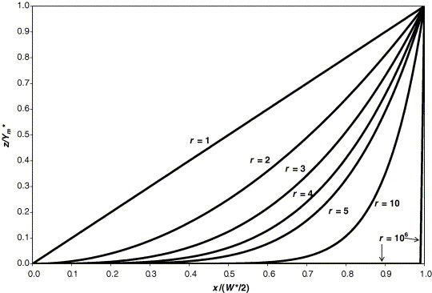
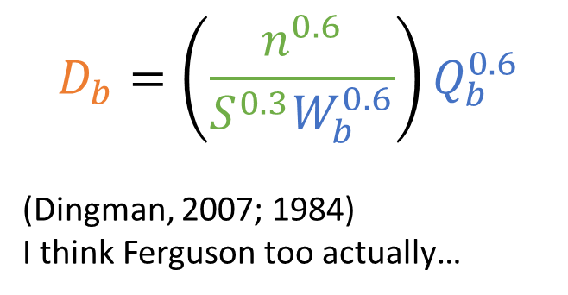
In this case, Wb and Db are static. If r changes from 10⁶ to 2, all that will happen is w*d decreases and v increases
Thus, D_{b} can be found assuming a rectangular channel
$$D_{b}=\left(\frac{n^{0.6}}{S^{0.3}W_{b}^{0.6}}\right)Q_{b}^{0.6}$$
(Dingman, 2007; 1984)
I think Ferguson too actually…

Slide 4
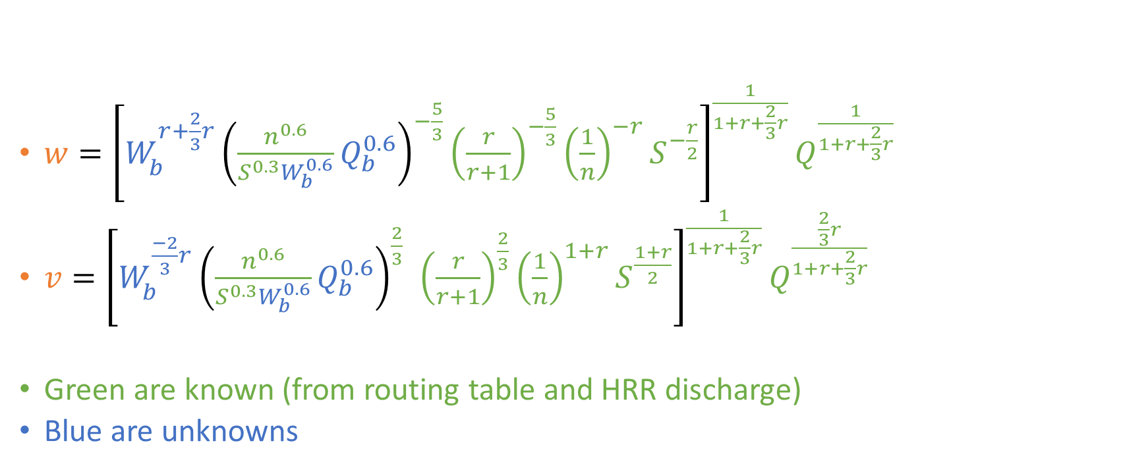
Dingman models after imposing Manning’s equation (and assuming r is known)
$w={\left[W_{b}^{r+\frac{2}{3}r}{\left(\frac{n^{0.6}}{S^{0.3}W_{b}^{0.6}}Q_{b}^{0.6}\right)}_{}^{−\frac{5}{3}}{\left(\frac{r}{r+1}\right)}^{−\frac{5}{3}}{\left(\frac{1}{n}\right)}^{−r}S^{−\frac{r}{2}}\right]}^{\frac{1}{1+r+\frac{2}{3}r}}Q^{\frac{1}{1+r+\frac{2}{3}r}}$
$v={\left[W_{b}^{\frac{−2}{3}r}{\left(\frac{n^{0.6}}{S^{0.3}W_{b}^{0.6}}Q_{b}^{0.6}\right)}_{}^{\frac{2}{3}}{\left(\frac{r}{r+1}\right)}^{\frac{2}{3}}{\left(\frac{1}{n}\right)}^{1+r}S^{\frac{1+r}{2}}\right]}^{\frac{1}{1+r+\frac{2}{3}r}}Q^{\frac{\frac{2}{3}r}{1+r+\frac{2}{3}r}}$
Green are known (from routing table and HRR discharge)
Blue are unknowns

Slide 5
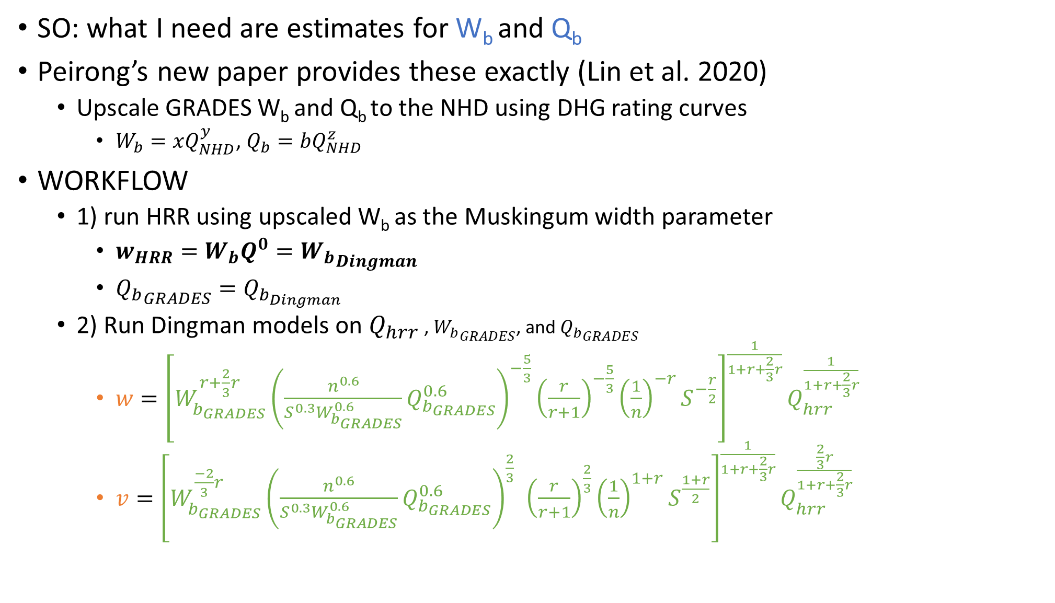
SO: what I need are estimates for W_{b} and Q_{b}
Peirong’s new paper provides these exactly (Lin et al. 2020)
Upscale GRADES W_{b} and Q_{b} to the NHD using DHG rating curves
$W_{b}=xQ_{NHD}^{y}$, $Q_{b}=bQ_{NHD}^{z}$
WORKFLOW
1) run HRR using upscaled W_{b} as the Muskingum width parameter
$w_{HRR}=W_{b}Q^{0}={W_{b}}_{Dingman}$
${Q_{b}}_{GRADES}=Q_{b_{Dingman}}$
2) Run Dingman models on $Q_{hrr}$ , ${W_{b}}_{GRADES}$, and ${Q_{b}}_{GRADES}$
$w={\left[W_{b_{GRADES}}^{r+\frac{2}{3}r}{\left(\frac{n^{0.6}}{S^{0.3}W_{b_{GRADES}}^{0.6}}Q_{b_{GRADES}}^{0.6}\right)}_{}^{−\frac{5}{3}}{\left(\frac{r}{r+1}\right)}^{−\frac{5}{3}}{\left(\frac{1}{n}\right)}^{−r}S^{−\frac{r}{2}}\right]}^{\frac{1}{1+r+\frac{2}{3}r}}Q_{hrr}^{\frac{1}{1+r+\frac{2}{3}r}}$
$v={\left[W_{b_{GRADES}}^{\frac{−2}{3}r}{\left(\frac{n^{0.6}}{S^{0.3}W_{b_{GRADES}}^{0.6}}Q_{b_{GRADES}}^{0.6}\right)}_{}^{\frac{2}{3}}{\left(\frac{r}{r+1}\right)}^{\frac{2}{3}}{\left(\frac{1}{n}\right)}^{1+r}S^{\frac{1+r}{2}}\right]}^{\frac{1}{1+r+\frac{2}{3}r}}Q_{hrr}^{\frac{\frac{2}{3}r}{1+r+\frac{2}{3}r}}$

Slide 6
My initial thought
HRR, via a fixed width, will yield unrealistic depths by definition. However, the total volume of water (Q) should be correct.
Q is accurate, but w, d, v are not….
SO, can we use Dingman models to ‘fix’ scale hydraulics in the context of Q_{hrr} (after imposing some channel shape).

