Slide 1
Remote Sensing the Gas Transfer Velocity
Using NASA SWOT for biogeochemistry

Slide 2
Context
NASA SWOT satellite launches in 2021, observing large rivers every 7-21 days
  Special 1-day sampling over the entire CT mainstem in late 2021…
SO:
  1) Can we remotely sense (RS) gas transfer velocity from SWOT-observable rivers?
  2) More broadly, how much network biogeochemistry will SWOT capture at its limited spatial resolution?
  3) How sensitive are FCO₂ estimates to the CO₂ terms vs. the hydraulics terms?
    Formal sensitivity analysis?

Slide 3
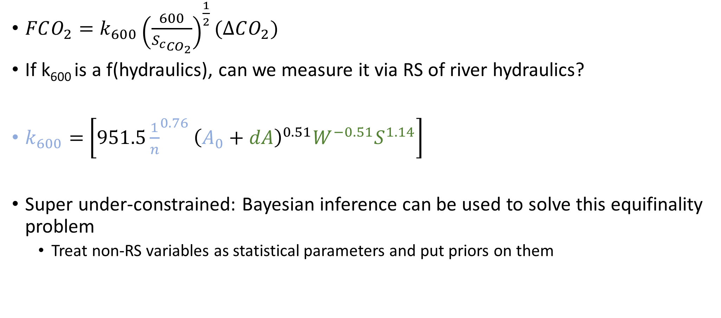
General Idea
$FCO_{2}=k_{600}{\left(\frac{600}{{S_{c}}_{CO_{2}}}\right)}^{\frac{1}{2}}(∆CO_{2})$
If k₆₀₀ is a f(hydraulics), can we measure it via RS of river hydraulics?
$k_{600}=$ $\left[951.5{\frac{1}{n}}^{0.76}{\left(A_{0}+dA\right)}^{0.51}W^{−0.51}S^{1.14}\right]$
Super under-constrained: Bayesian inference can be used to solve this equifinality problem
  Treat non-RS variables as statistical parameters and put priors on them
Raymond et al 2012 + Manning’s equation
Remotely sensible via SWOT
Not remotely sensible

Slide 4
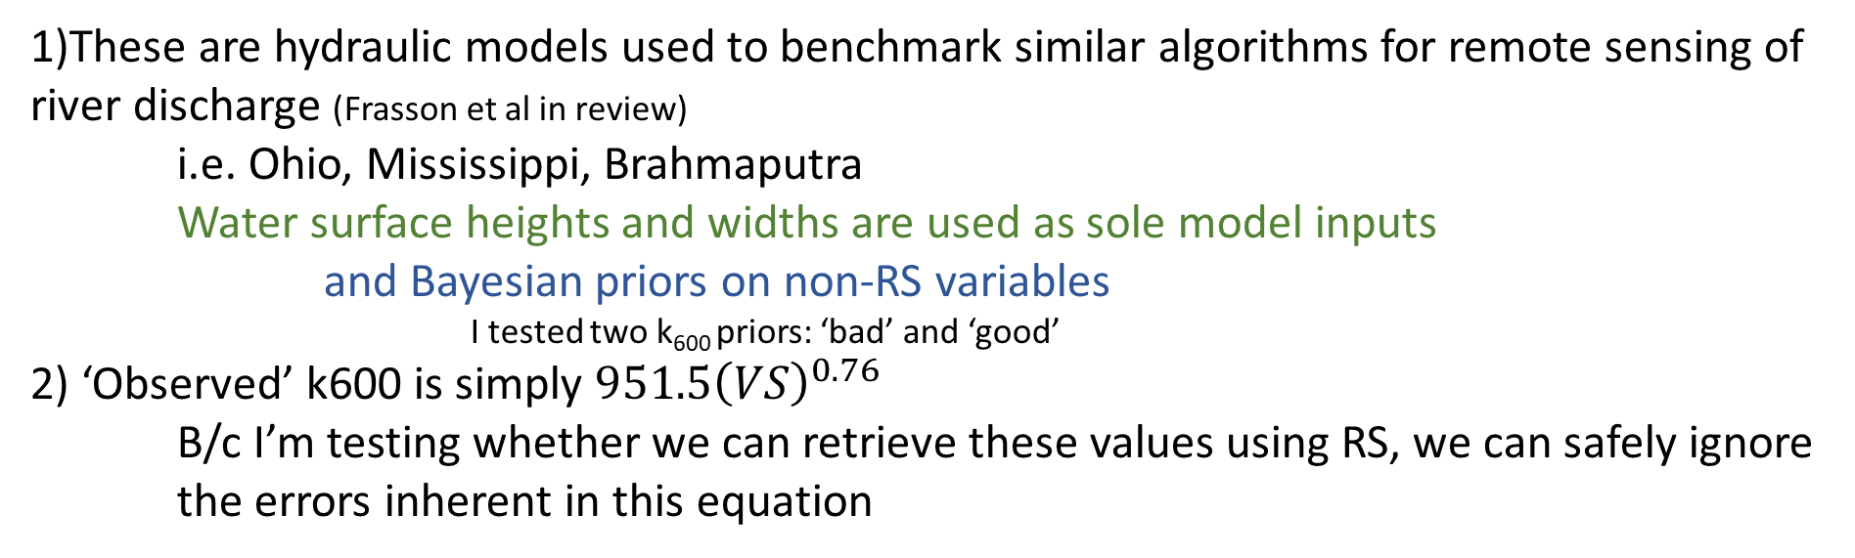
Initial validation on 32 large global rivers
1)These are hydraulic models used to benchmark similar algorithms for remote sensing of river discharge (Frasson et al in review)
i.e. Ohio, Mississippi, Brahmaputra
Water surface heights and widths are used as sole model inputs
and Bayesian priors on non-RS variables
I tested two k₆₀₀ priors: ‘bad’ and ‘good’
2) ‘Observed’ k600 is simply $951.5{\left(VS\right)}^{0.76}$
B/c I’m testing whether we can retrieve these values using RS, we can safely ignore the errors inherent in this equation

Slide 5
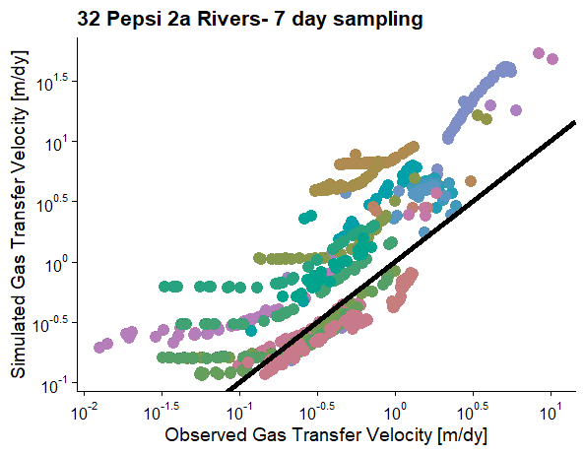
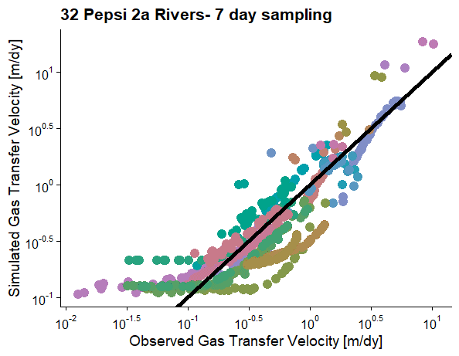
Crappy k600, all priors RS-able
R² 0.68
RMSE 6.85 m/dy
Very-informed k600 prior, all other priors RS-able
R² 0.81
RMSE 0.64 m/dy

