Slide 1
Modeling k600 (gas transfer velocity)
Some crunchier hydraulics ahead….

Slide 2
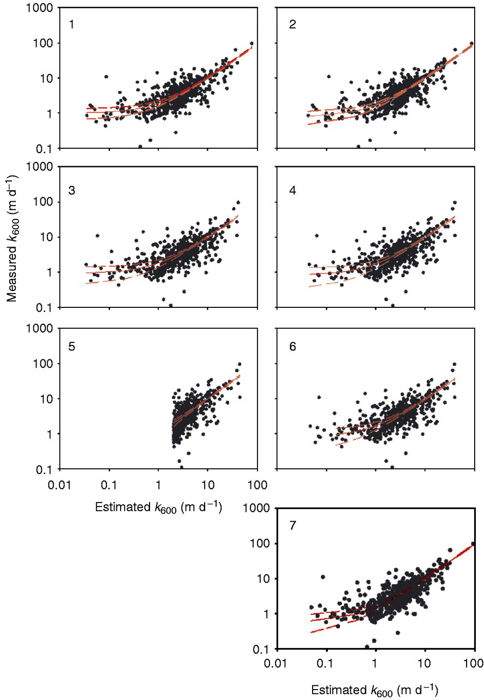
Background on k600 equation
k600 is a f() of water column turbulence and bed turbulence (moreso in small streams)
In general, models work worse in big rivers because there’s little water column mixing like there is in turbulent streams
Raymond et al. (2012) was 1st to scale k600 via turbulence
Turbulent dissipation rate (eD) = gSV
Water column turbulence
Standard model used in the literature
R²: 0.53

Slide 3
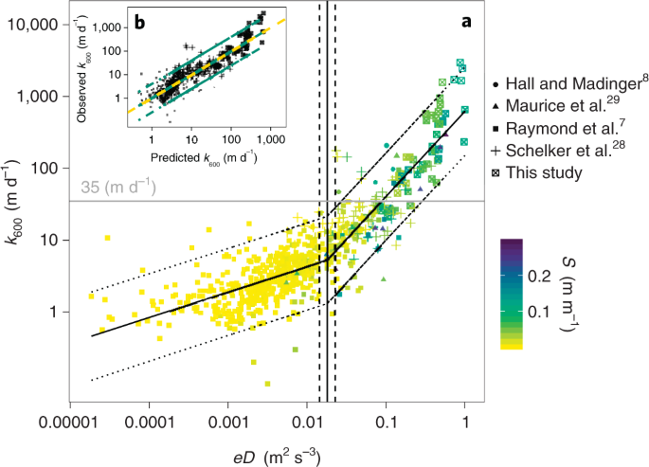
Ulseth et al. (2019)
Combined Raymond 2012 data with newer studies to show two distinct regimes in tuburlence~k600 relationship
But, these two regimes are not remotely sensible (velocity-based)

Slide 4
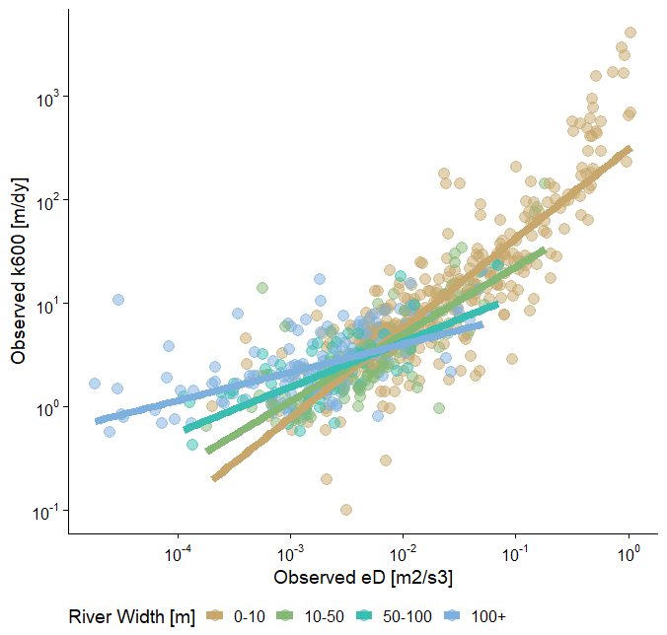
Revisiting k600 equation
So I took all the combined data from Ulseth et al (2019) and modeled k600 using a ‘rule-based’ scaling function
Different scaling functions for different river sizes
river width proxy for river size

Slide 5
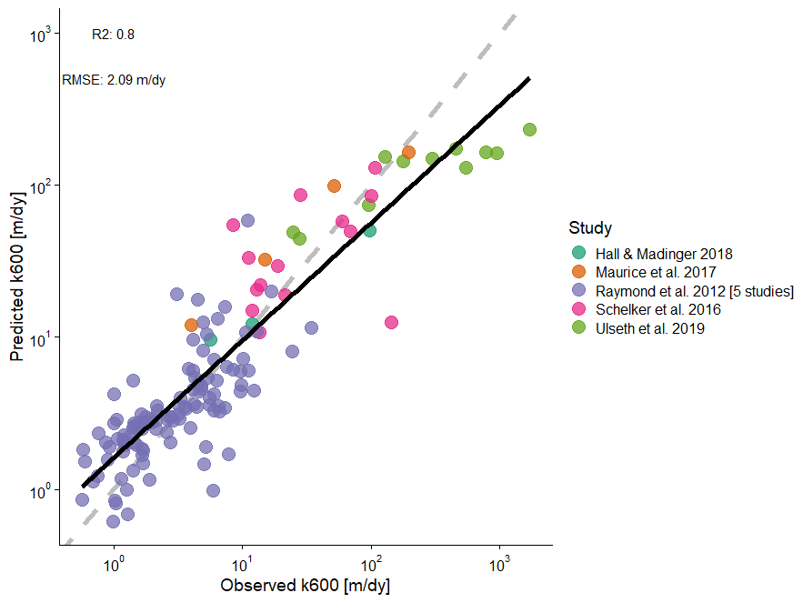
Validation (80/20 split)
Big r2 improvement
Accounts for different physical processes in big vs small rivers
Easily implementable in Bayes model
20% out-of-sample test

