Slide 1
RS of CO2 Evasion

Slide 2
What
Network/global-scale evasion estimates are limited to monthly estimates (Liu et al submitted)
NASA SWOT (2021) will provide river heights/slopes and widths for large rivers every 3-21 (avg. 11) days. During calibration, this will be daily (and over the CT!)
A lot of work has been done to use these data for estimating discharge with no in situ data, generally via Bayesian inference + GRADES.
I think we can do something analogous, using 1) the methods developed for discharge and 2) Shaoda’s results to produce near-daily timeseries of CO2 evasion

Slide 3
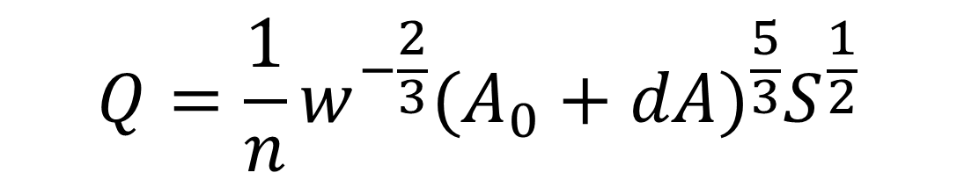

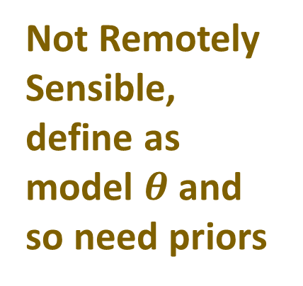
How does Bayesian inference work
to estimate discharge w/ no in situ info?
Priors: initial guesses at terms not RS-able (Q, n, d)
Estimated using training data & proxies, NOT in situ data
$$Q=\frac{1}{n}w^{−\frac{2}{3}}{(A_{0}+dA)}^{\frac{5}{3}}S^{\frac{1}{2}}$$
Not Remotely Sensible, define as model $θ$ and so need priors
Remotely sensible → data
What must Q, n and d be, given w and S observations?
$$P\left(θ | data\right)=\frac{P\left(data | θ\right)P\left(θ\right)}{P\left(data\right)}$$
Notes:
In a Bayesian setting, probability distributions represent not just the likelihood of occurrences, but our current beliefs about A. i.e. we’re pretty sure its near the distribution’s center, but equal likelihood it can be above or below that value.

Slide 4
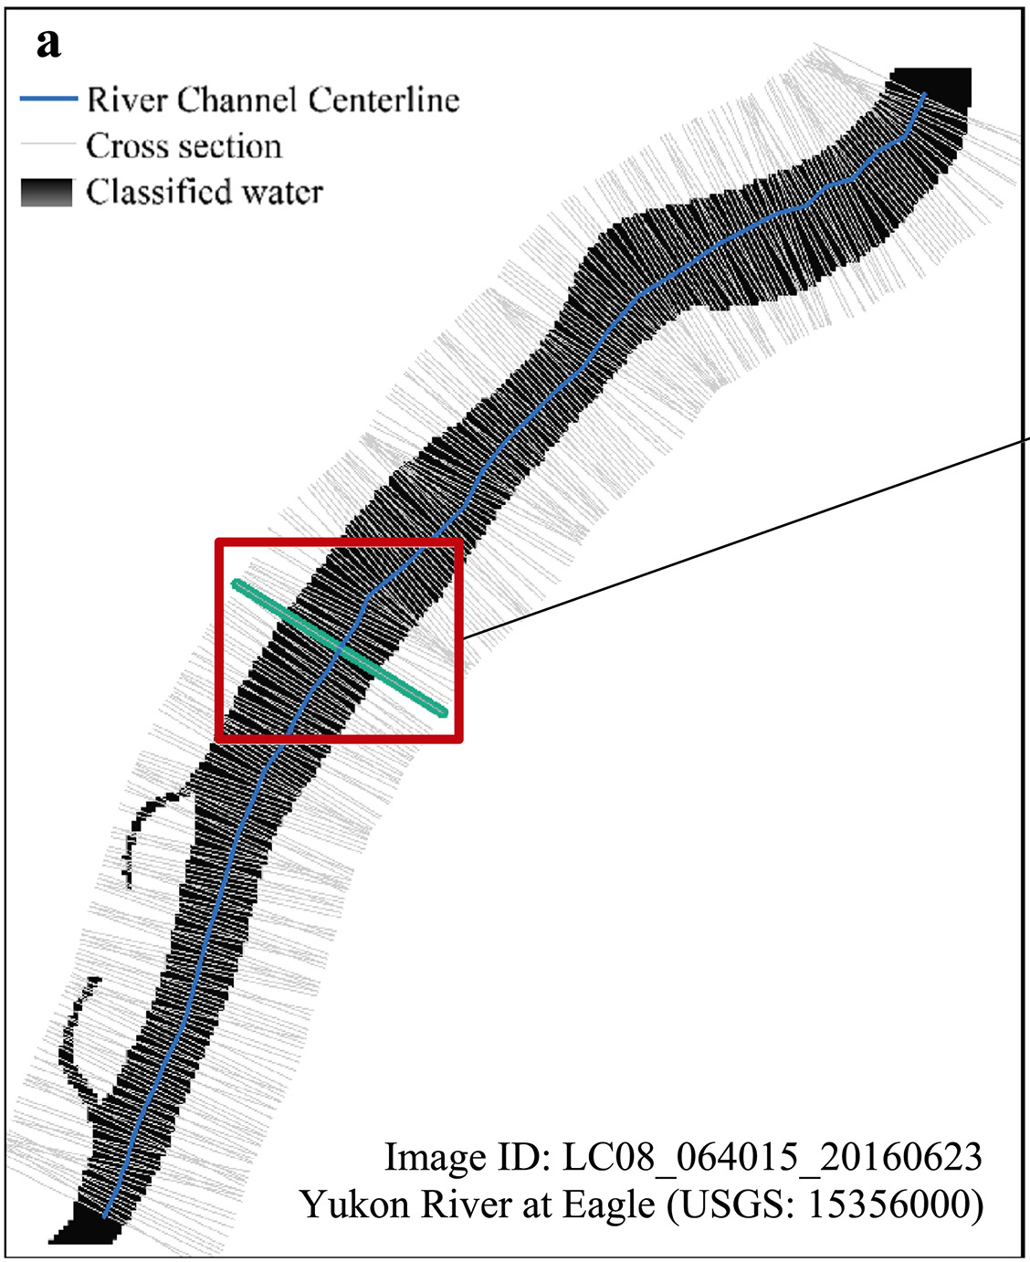
Why mass is conserved over a reach
Flux in
By assuming flux in = flux out over an entire reach, but sampling river width and slope across many xs within that reach, we can reduce the number of priors (Q, n, A0) in the equation relative to the observables (dQ, S, W)
For example:
Say we estimate discharge over a single reach:
3 priors, 3 observables → 1:1 ratio
Say we estimate discharge for a reach, but through 10 xs:
21 priors, 30 observables → 1/1.4 ratio
Say we estimate discharge for a reach, but through 30 xs:
61 priors, 90 observables → 1:1.5 ratio
Flux out
(Feng et al. 2019)

Slide 5
Model
I wanted to see if I could infer CO2 flux from remotely-sensible observations that SWOT will provide
So, I
1) Built a model that does this using Bayesian inference and conservation of mass
2) ‘validated’ on Ohio River in February

Slide 6
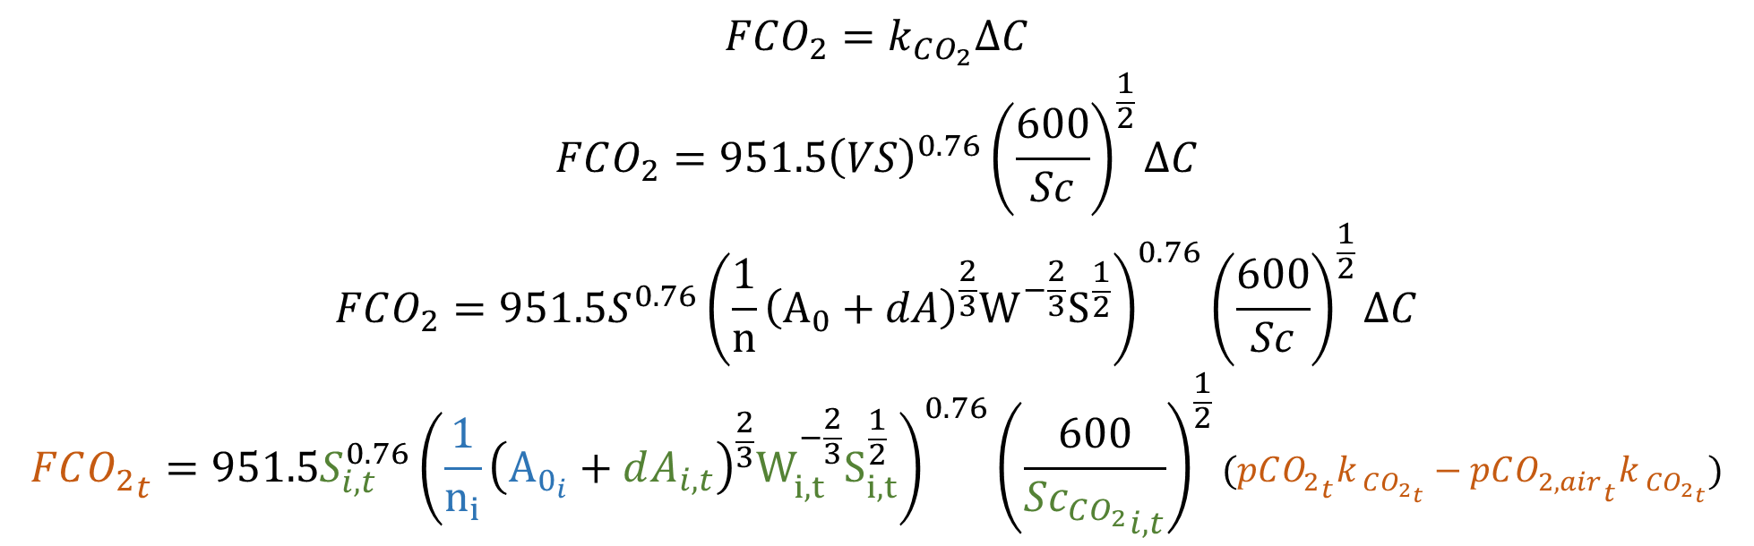
CO2 evasion model
$$FCO_{2}=k_{CO_{2}}ΔC$$
$$FCO_{2}=951.5{\left(VS\right)}^{0.76}{\left(\frac{600}{Sc}\right)}^{\frac{1}{2}}∆C$$
$$FCO_{2}=951.5S^{0.76}{\left(\frac{1}{n}{\left(A_{0}+dA\right)}^{\frac{2}{3}}W^{−\frac{2}{3}}S^{\frac{1}{2}}\right)}^{0.76}{\left(\frac{600}{Sc}\right)}^{\frac{1}{2}}∆C$$
$${FCO_{2}}_{t}=951.5S_{i,t}^{0.76}{\left(\frac{1}{n_{i}}{\left(A_{0_{i}}+dA_{i,t}\right)}^{\frac{2}{3}}W_{i,t}^{−\frac{2}{3}}S_{i,t}^{\frac{1}{2}}\right)}^{0.76}{\left(\frac{600}{S{c_{CO_{2}}}_{i,t}}\right)}^{\frac{1}{2}}(pC{O_{2}}_{t}k_{ C{O_{2}}_{t}}−pC{O_{2, air}}_{t}k_{ C{O_{2}}_{t}})$$
There are two channel priors
There are two CO2 priors
There are four observables
All told, 4 priors and 4i observables
So, ratio of prior to observations is simply i
So more xs → less reliance on priors
Model uncertainty (from Manning’s equation and gas transfer velocity equation) quantified using 1,000 different Monte Carlo runs of 10,000 samples each

Slide 7
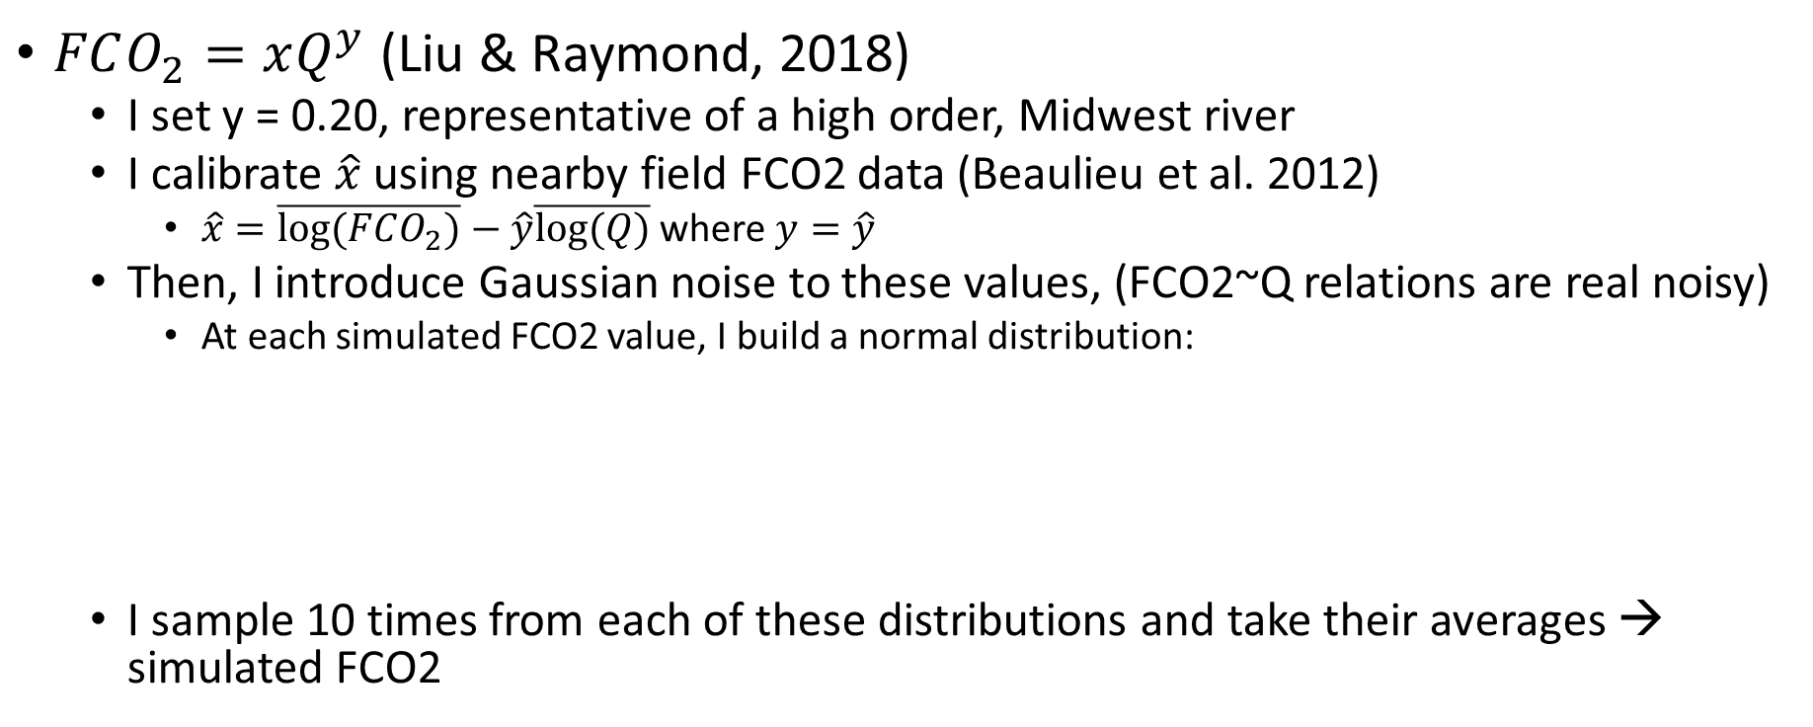
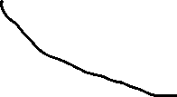
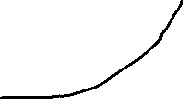
Validation: simulated timeseries of CO2 fluxes
$FCO_{2}=xQ^{y}$ (Liu & Raymond, 2018)
I set y = 0.20, representative of a high order, Midwest river
I calibrate $\hat{x}$ using nearby field FCO2 data (Beaulieu et al. 2012)
$\hat{x}=\overline{log⁡(FCO_{2})}−\hat{y}\overline{log⁡(Q)}$ where $y=\hat{y}$
Then, I introduce Gaussian noise to these values, (FCO2~Q relations are real noisy)
At each simulated FCO2 value, I build a normal distribution:
I sample 10 times from each of these distributions and take their averages → simulated FCO2
Mean = simulated FCO2
sigma = C.V. of 30% (kinda arbitrary...)

Slide 8
5 tests
 | N prior | A0 prior | Flux prior | pCO2 prior | Expected Performance | Required In situ data
Test 1 |  |  |  |  | Perfect | All
Test 2 | Brinkerhoff et al. (in review) | Brinkerhoff et al. (in review) |  |  | Good | CO2
Test 3 (great CO2 priors) | Brinkerhoff et al. (in review) | Brinkerhoff et al. (in review) | Liu et al. (submitted) | Liu et al. (submitted) | Acceptable | None
Test 4 (eh CO2 priors) | Brinkerhoff et al. (in review) | Brinkerhoff et al. (in review) | Liu et al. (submitted) | Liu et al. (submitted) | Biased | None
Test 5 (Mark-style CO2 bounds) | Brinkerhoff et al. (in review) | Brinkerhoff et al. (in review) | Liu et al. (submitted) | Liu et al. (submitted) | Terrible | None
In the weeds:
When pCO2 prior is known (), it is held constant b/c of the way priors must be defined within stan models. But in test 3-4, we actually validate against a simulated timeseries of FCO2 fluxes that are not constant, as would be expected

Slide 9
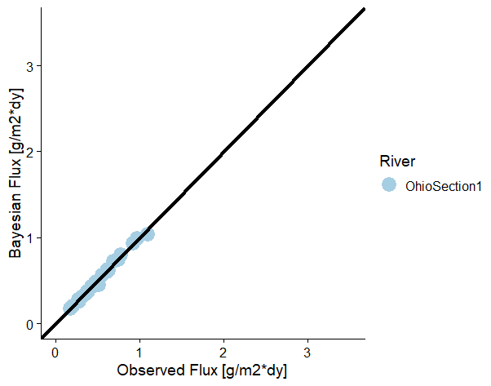
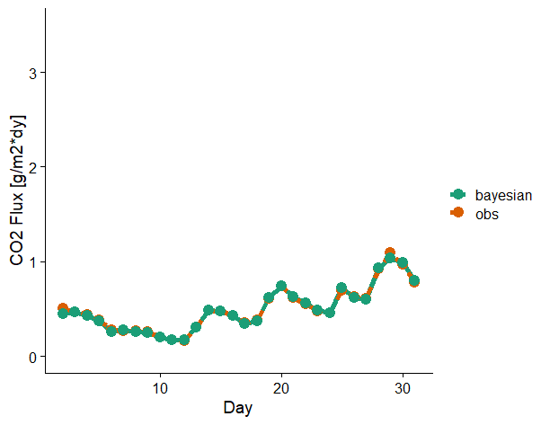
Test 1: ~perfect priors
pCO2 prior: 700 uatm
pCO2 observed: 700 uatm (informed by Beaulieu et al 2012)
This is good these should be functionally identical! Gut check is approved.

Slide 10
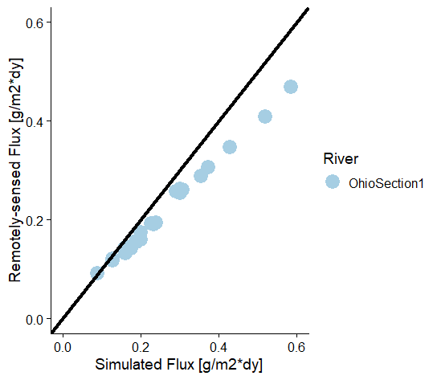
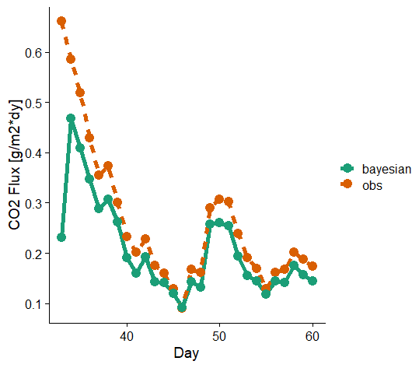
Test 2: ~perfect CO2 priors, global channel priors
pCO2 prior: 700 uatm
pCO2 observed: 700 uatm (informed by Beaulieu et al 2012)

Slide 11
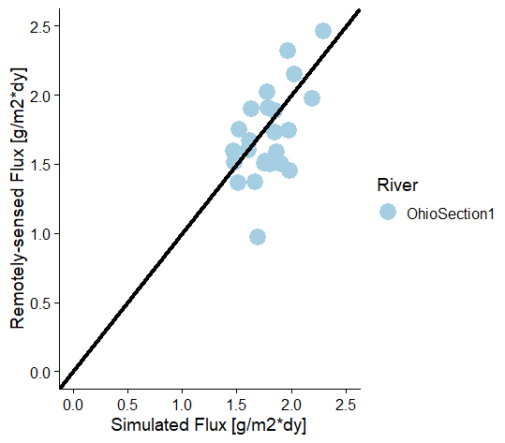
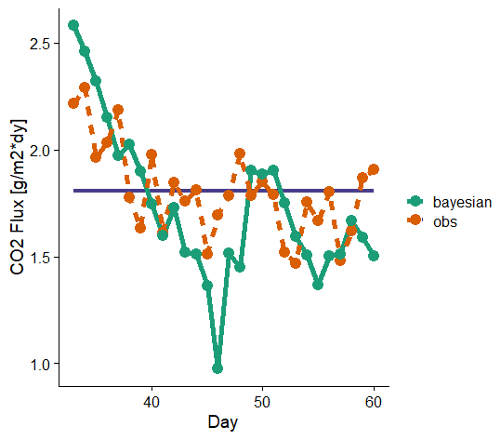
Test 3: all remotely-sensed/global priors (good priors)
F prior (Shaoda
monthly value)

Slide 12
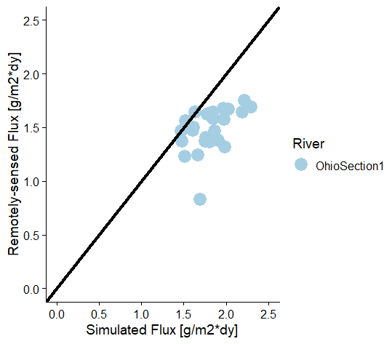
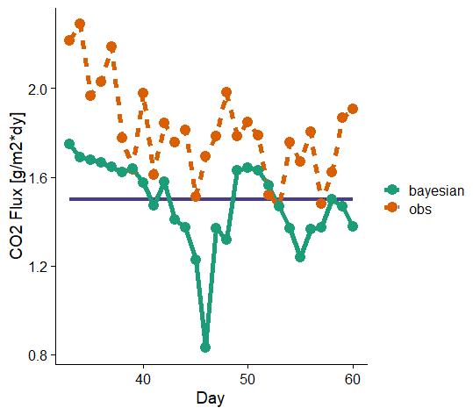
Test 4: all remotely-sensed/global priors (eh priors)
F prior (Shaoda
monthly value)

Slide 13
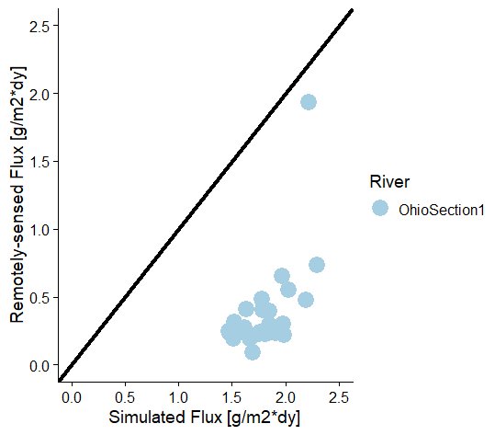
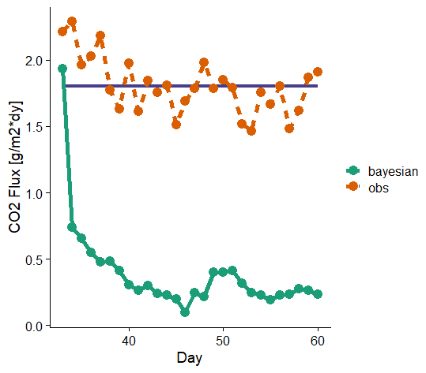
Test 5: all remotely-sensed/global priors (good priors, but wide bounds on CO2)
F prior (Shaoda
monthly value)

