Slide 1
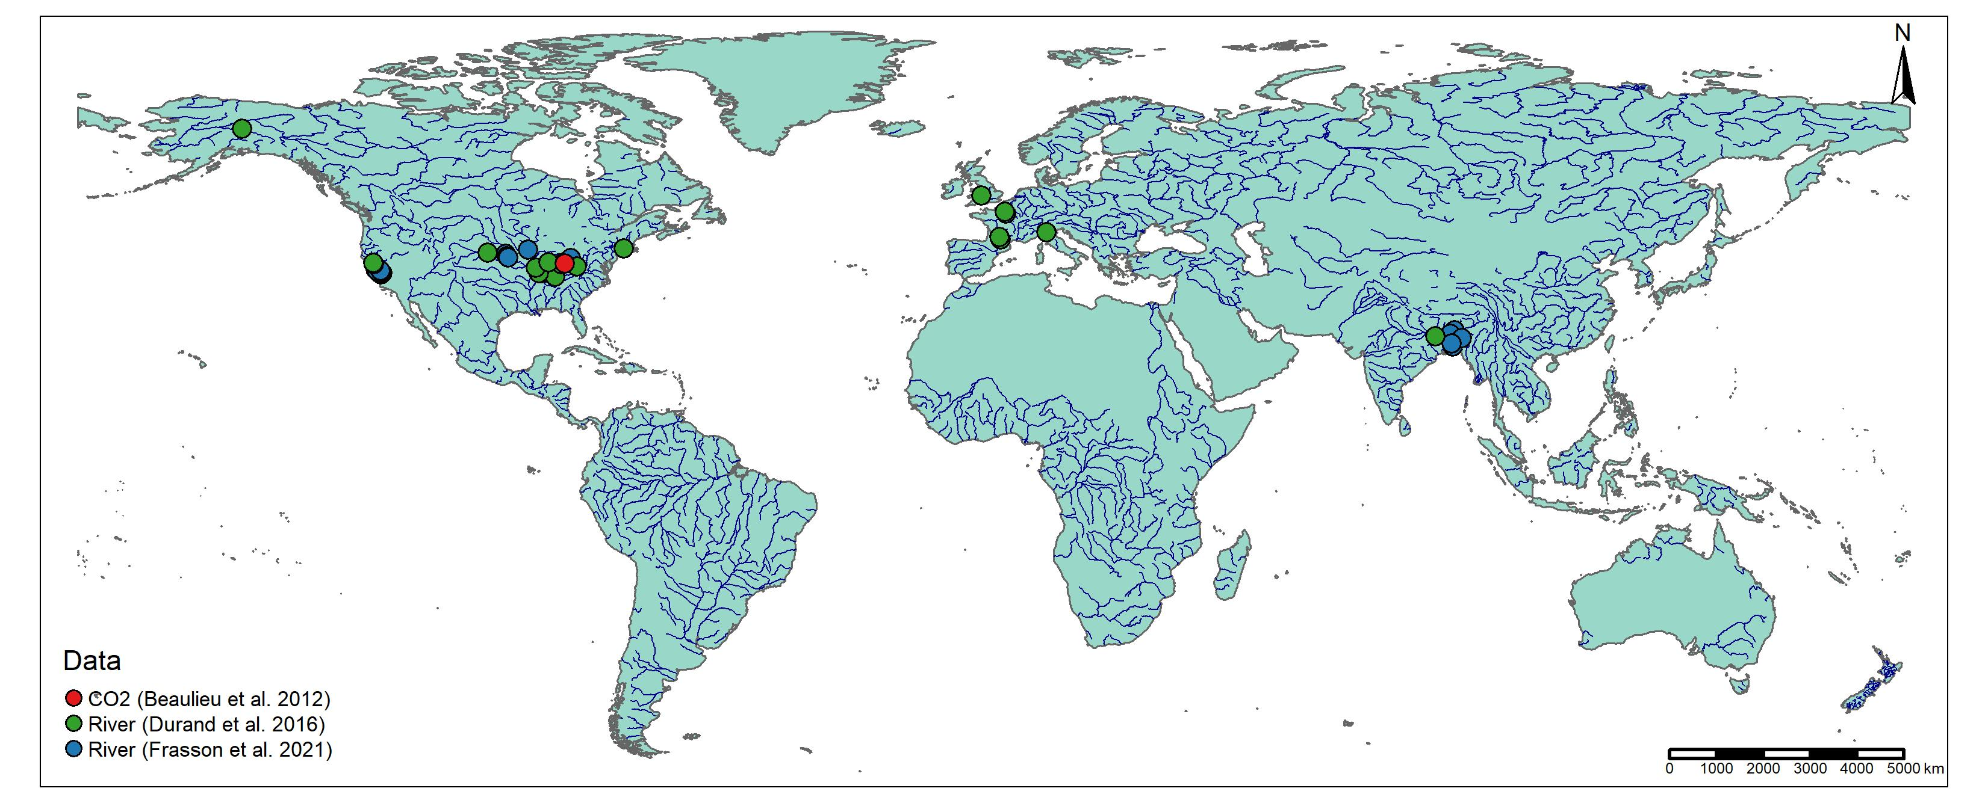
Alaska US (n=1)
Europe (n=7)
Asia (n=6)
California, US (n=14)
Eastern US (n=21)
Notes:
Padma not working, I don’t know why
Kushiyara not really lining up with hydrography

