Slide 2
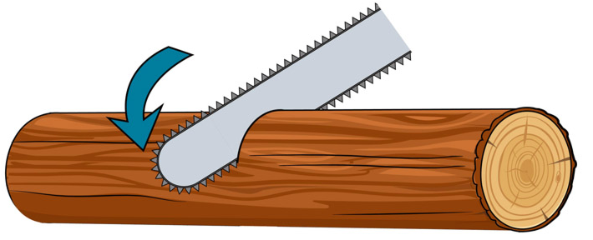
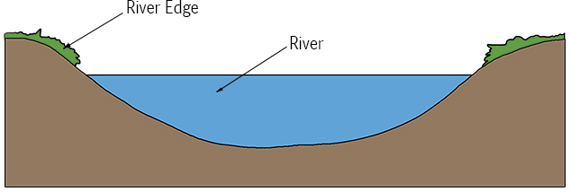
(How I understand the chainsaw model)
Small eddies
Large eddies
Model’s argument: Like a chainsaw blade and it’s teeth cutting a log, small eddies contribute to the actual gas evasion, but they only reach the surface because the large eddies bring them there. So, a multi-scale model is needed [Moog & Jirka, 1999a]
Entire interface
Active zone of gas evasion
Gas evasion
Entire interface

