Slide 1
River surface turbulence in large rivers driven by stream power: implications for remotely sensing gas exchange

Slide 2
Intro
River gas evasion models are limited by poor temporal resolution estimates of k due to mechanistic and methodological uncertainties in gas exchange, particularly from big rivers
Many existing scaling relationships for river k perform appreciably worse in large rivers [Raymond etal 2012; Ulseth et al 2019]
This has been attributed to wind effects [Beauileu etal 2012; Alin et al something] and decreasing bed roughness in flatter channels [Ulseth etal 2019]
Current tools to predict k are fundamentally limited by the resolution and uncertainty in their hydrology inputs
DO inverse models require super high-resolution in situ datasets [Appling etal 2018]
Predictive models require in situ discharge OR hydrology models with their own uncertainties [Liu et al in review]
Moving towards process-based modeling of river gas evasion requires a stronger mechanistic understanding of gas exchange and ways to measure this at high temporal resolution and across huge domains

Slide 3
Key points
Using a simple energy balance, we show in big rivers that turbulence production and dissipation must reduce to stream power and are equal
Meaning there is no additional diffusion of turbulent energy from the bed to the surface and the bed is effectively decoupled from the surface (turbulence-wise)
This allows for scaling of k via shear velocity (production = dissipation). We show that once a river is big enough, these models outperform those based on turbulent dissipation.
Finally, we show that this can all be measured from satellite, where near-daily sampling will allow for unprecedented mapping of river gas exchange

Slide 4



Two turbulence regimes at the river’s surface: background
$G+T_{d}+V_{d}=ε$ [Nezu & Nagawaka 1993]
Bulk TKE production rate [J/kg*s]
Depth-scale diffusion rate of TKE [J/kg*s]
TKE dissipation rate [J/kg*s]
TKE viscous diffusion rate [J/kg*s]
G
$$ε$$
“Energy
Produced”
“Energy Transported from bed”
“Energy
Dissipated”
“Energy Transported viscously”
Td
TAKEAWAY:
This means that G < $ε$ (at the free surface)
Rivers are unique among aquatic environments in that stream power/downslope flow dissipates energy in greater quantities than from bottom friction alone, which is the classical model in lakes and oceans [Moog & Jirka 1999; Raymond etal 2012]
$$ε_{D}≈gSU≫ ε_{s}$$

Slide 5
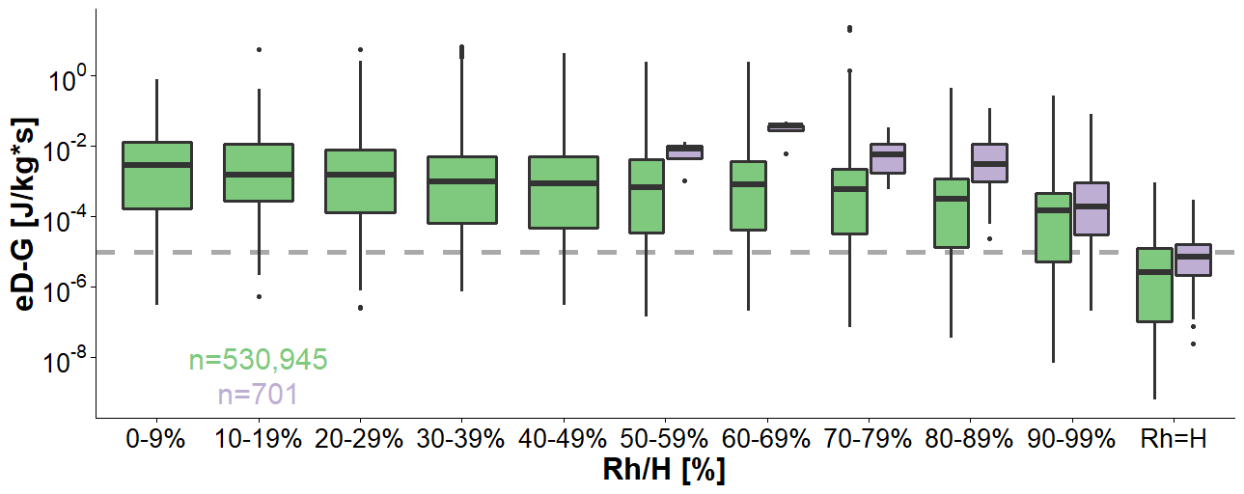

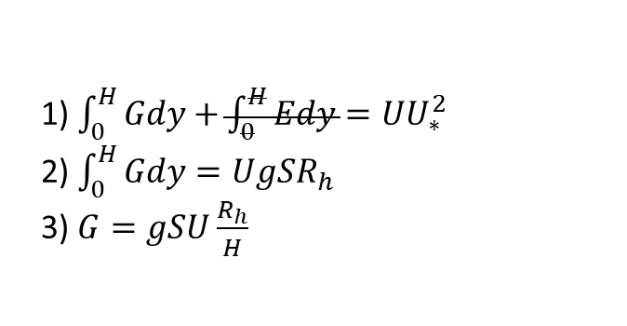
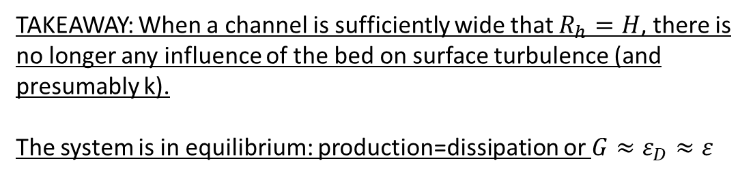
Two turbulence regimes at the river surface
TAKEAWAY: When a channel is sufficiently wide that $R_{h}=H$, there is no longer any influence of the bed on surface turbulence (and presumably k).
The system is in equilibrium: production=dissipation or $G≈ε_{D}≈ε$
1) $\int_{0}^{H}{Gdy}+\int_{0}^{H}{Edy}=UU_{∗}^{2}$
2) $\int_{0}^{H}{Gdy}=UgSR_{h}$
3) $G=gSU\frac{R_{h}}{H}$
[Nezu & Nagawaka 1993]
$${(ε}_{D}=gSU)$$

Slide 6
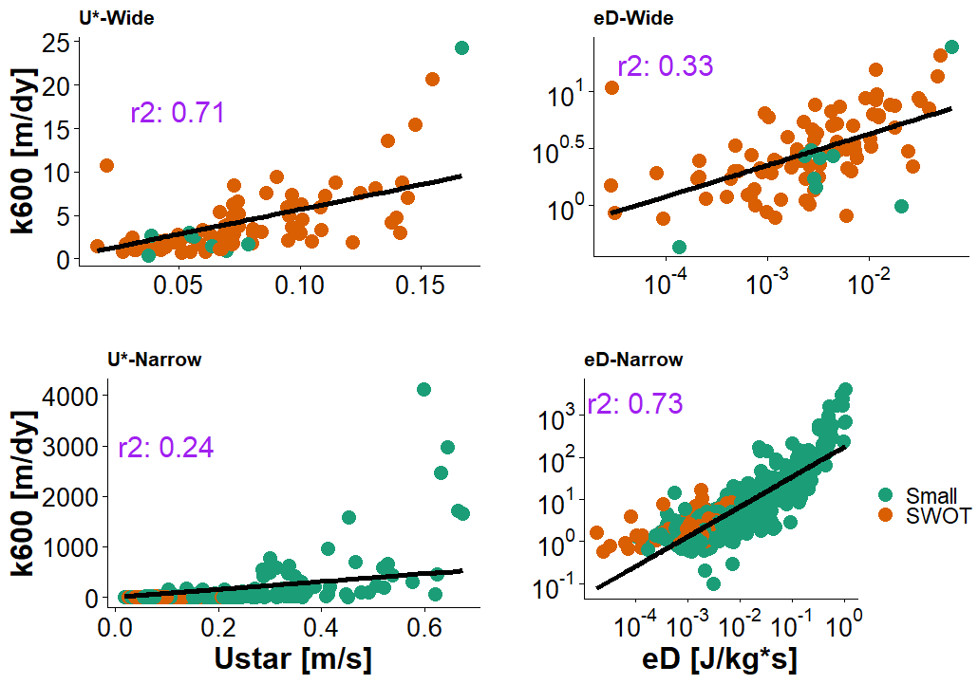
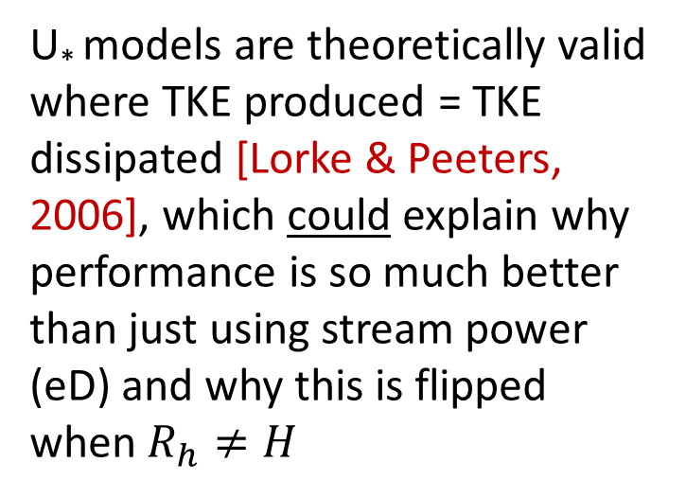




Advancing k scaling in large rivers
$$R_{h}=H$$
$$R_{h}=H$$
U* models are theoretically valid where TKE produced = TKE dissipated [Lorke & Peeters, 2006], which could explain why performance is so much better than just using stream power (eD) and why this is flipped when $R_{h}≠H$
$$R_{h}≠H$$
$$R_{h}≠H$$

Slide 7
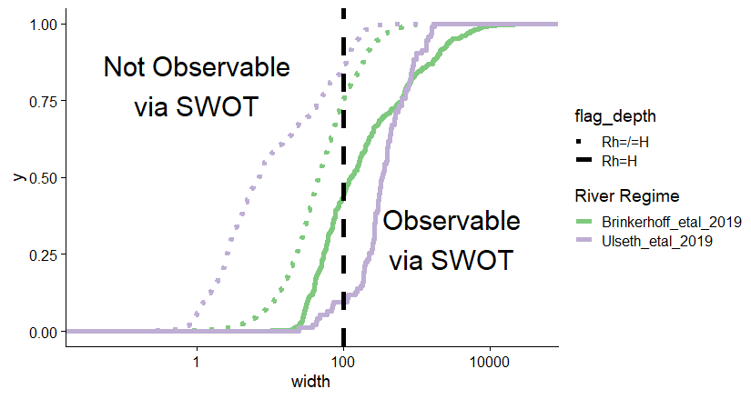
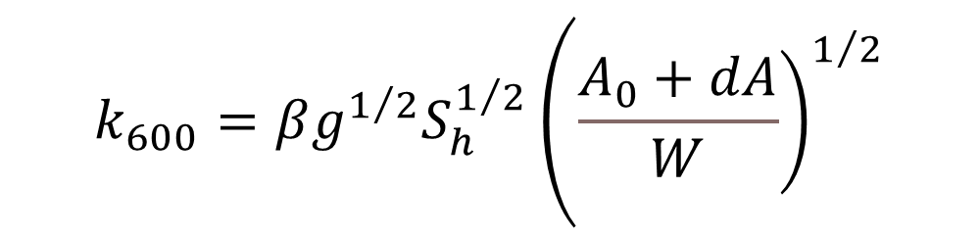
Exploiting this new theory for remote sensing
$$\begin{matrix}k_{600}=βg^{1/2}S_{h}^{1/2}\left({\left.\frac{A_{0}+dA}{W}\right)}^{1/2}\right.\end{matrix}$$
U* is almost entirely remotely sensible from large-scale altimeters like SWOT (unlike eD), opening the opportunity to indirectly remotely sense k with minimal unknowns
The only term in this equation we can’t RS is the unchanging portion of the channel area → Bayesian inference
Rh=H generally when a river is wide enough to be seen by the SWOT satellite

