Slide 1
RSK600 Upscaling

Slide 2
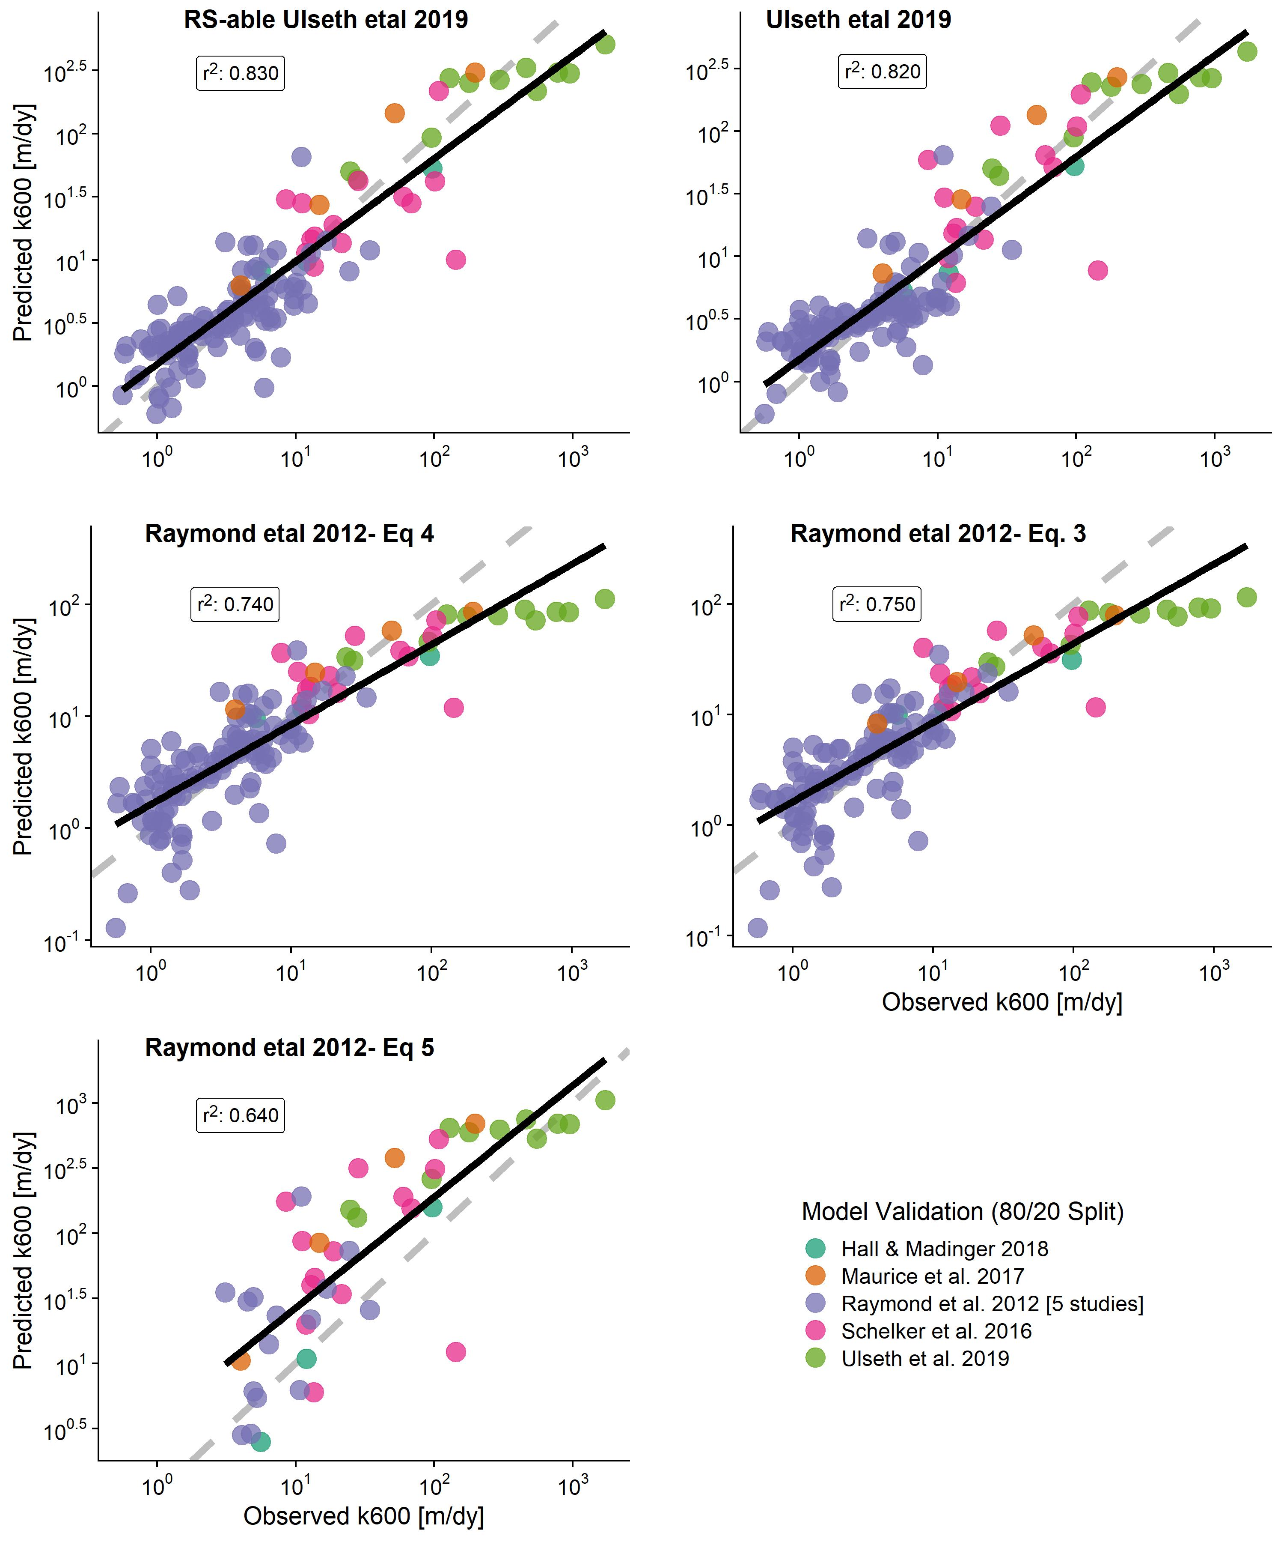
First, I wanted to confirm the scaling model choice
Refit Raymond 2012 models to this expanded dataset
Compare against Ulseth 2019 model and our ‘RS-able’ extension of that model
Note that Raymond eq. 5 is linear and predicts negative values (not plotted) b/c this is not a linear relationship…

Slide 3
I go with the ‘RS-able’ Ulseth model
SO: for validation any deviations from 1:1 are caused by RS of velocity and/or the k600 prior
I found the bias from last week is due to the k600 prior.
I’m now going to show tandem results
A geoBAM style k600 prior
i.e. bin by river size and directly use those PDFs
A Mark style k600 prior
i.e. build simple linear regression using slope + model error

Slide 4
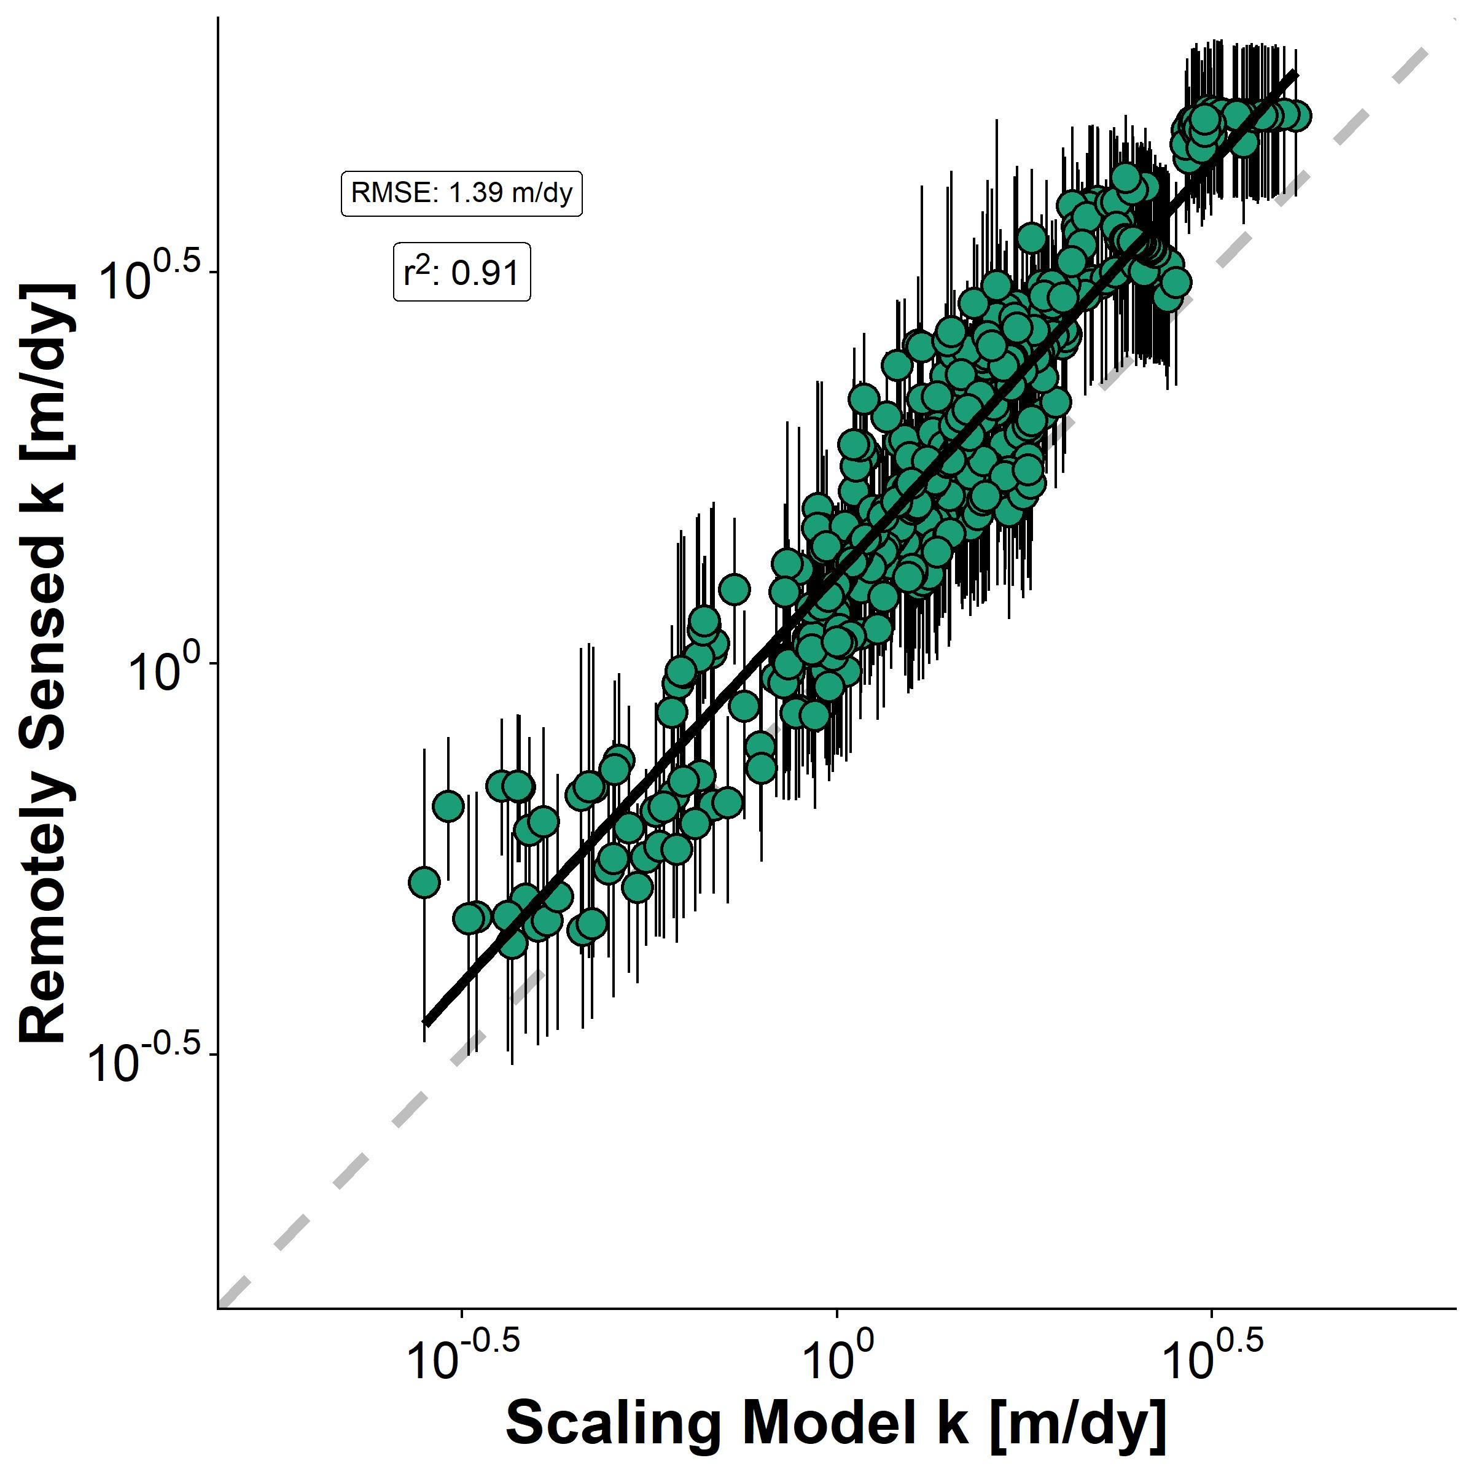
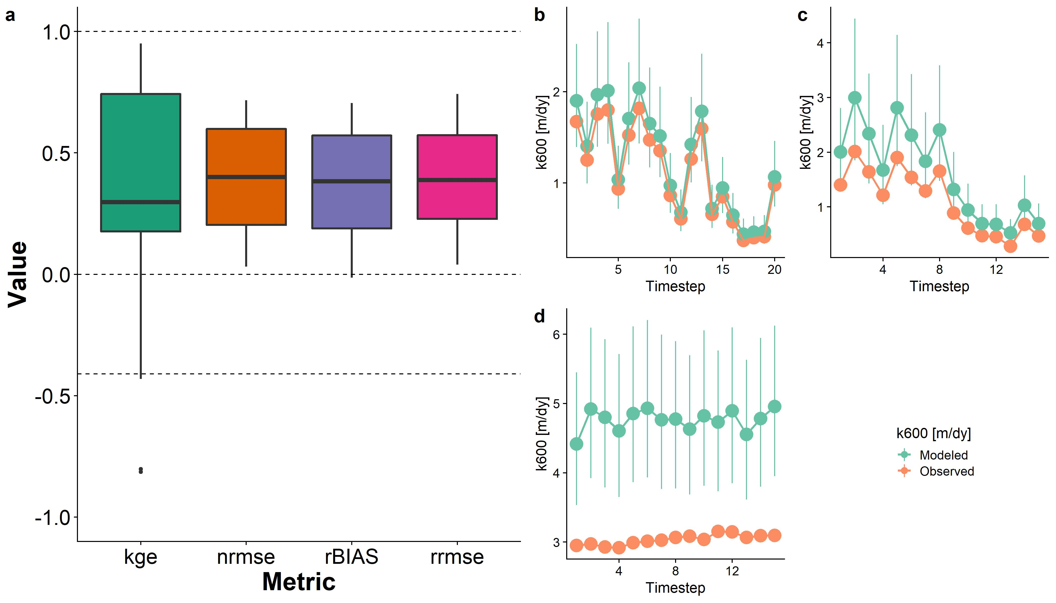
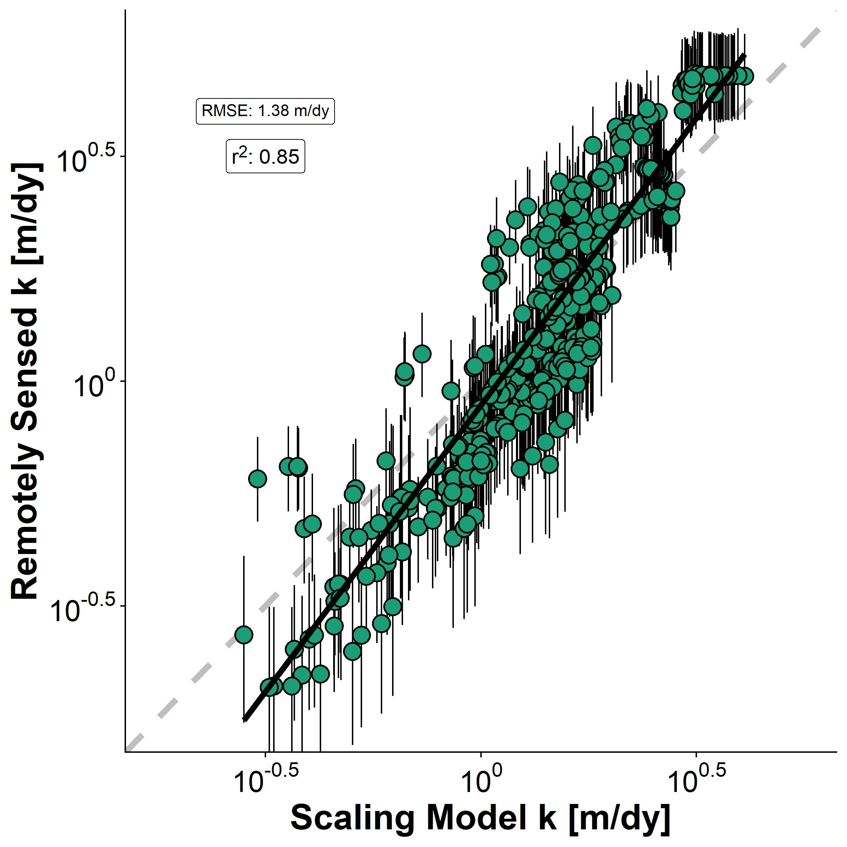
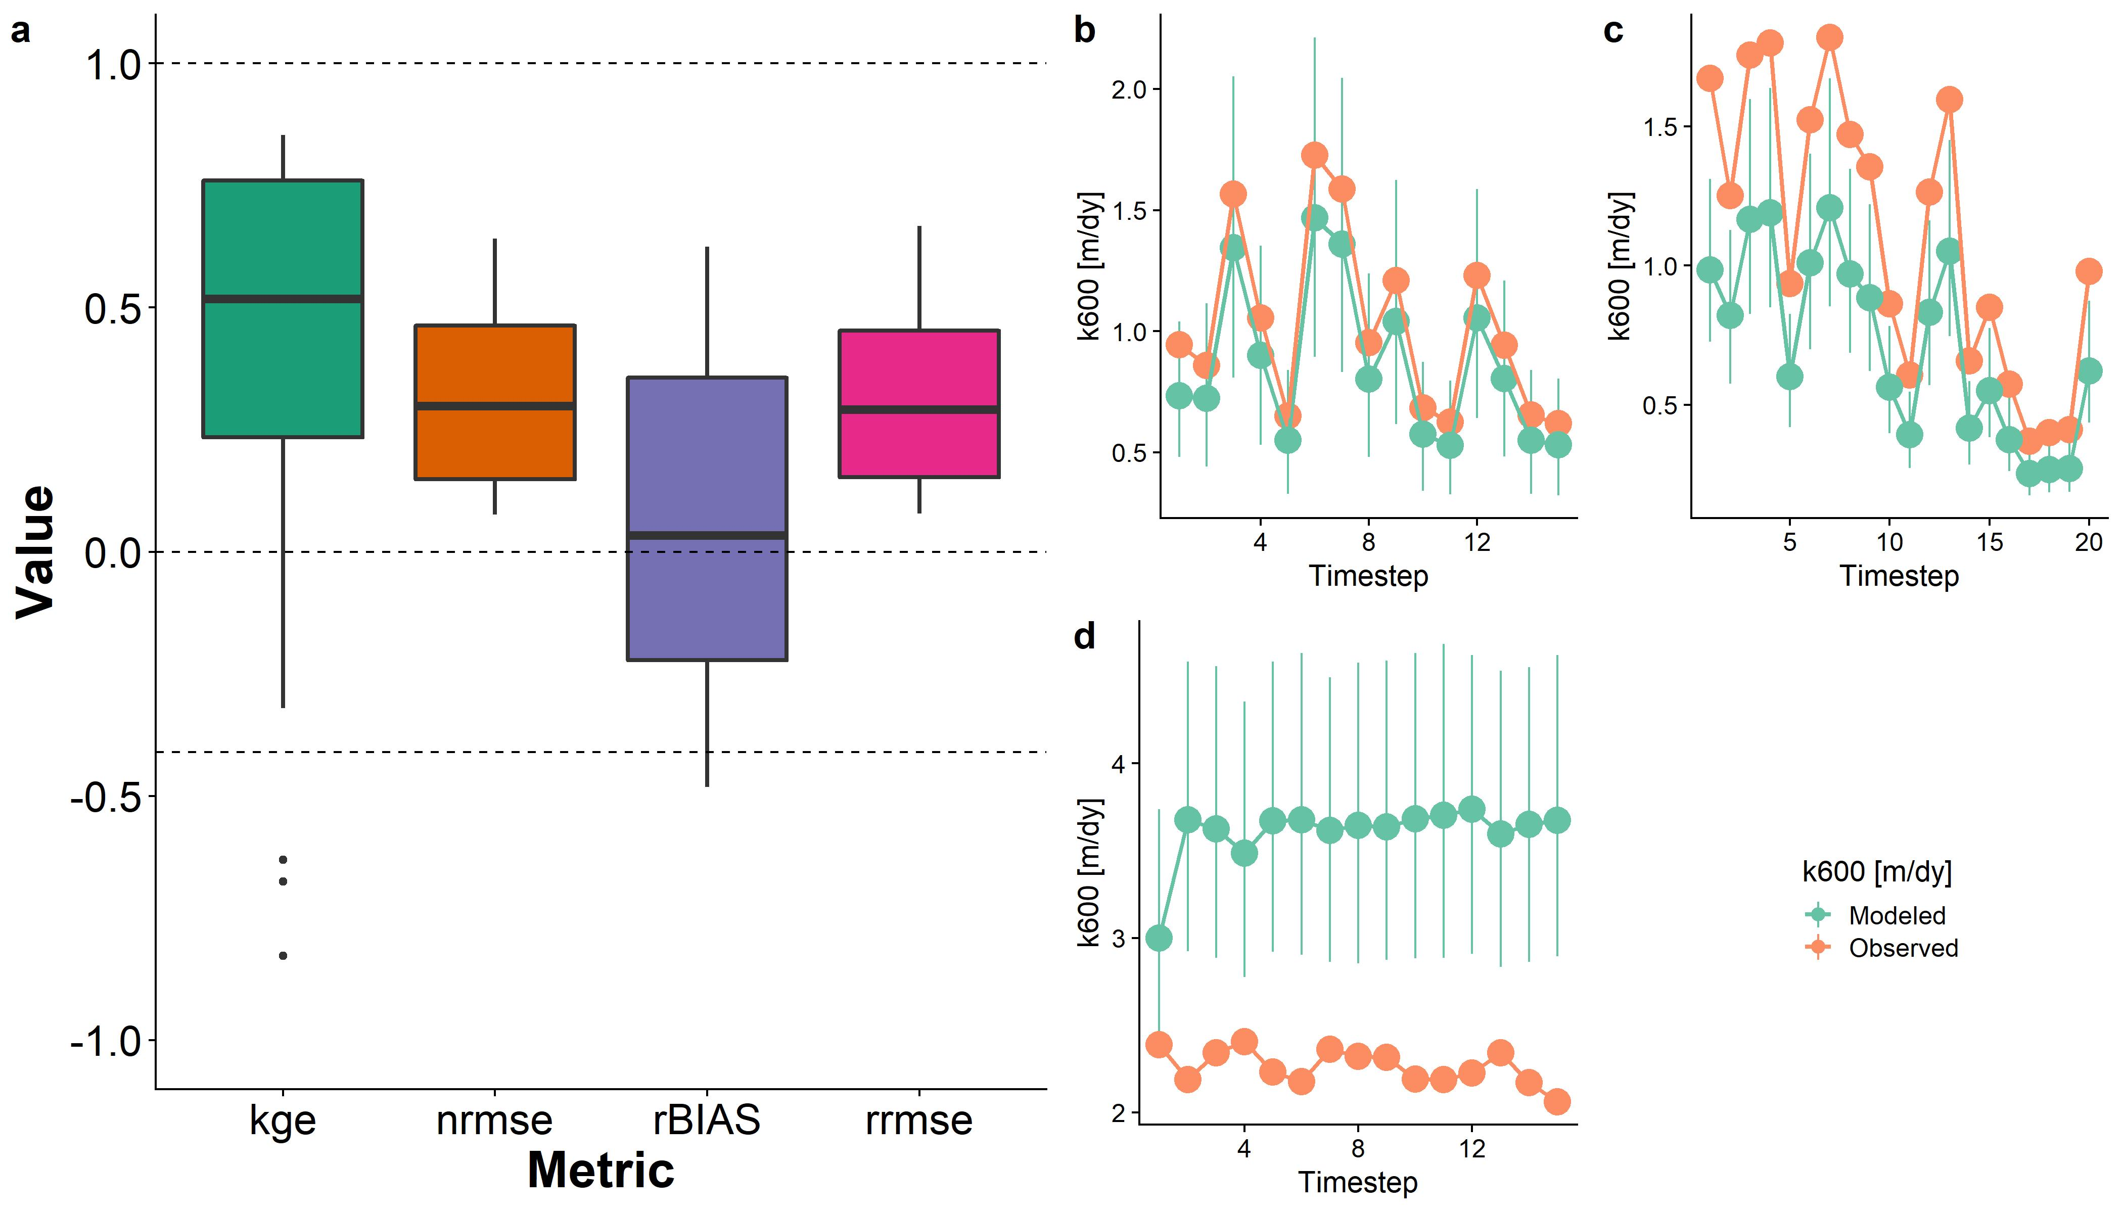
geoBAM style
Mark-style

Slide 5
Flux Implications for 22 SWOT rivers
Took bi-weekly CO2 data for the Ohio River (Beauliu etal 2012) and used it on all rivers as dummy values for a reasonable timeseries
Calculate k_{co2} using 1) BIKER posterior means and 2) ‘RS-able’ ulseth 2019 model
Ignoring the timesteps > 29 for a few rivers as CO2 data is only 29 samples
Calculate two sets of FCO₂ using the different k_{co2}

Slide 6
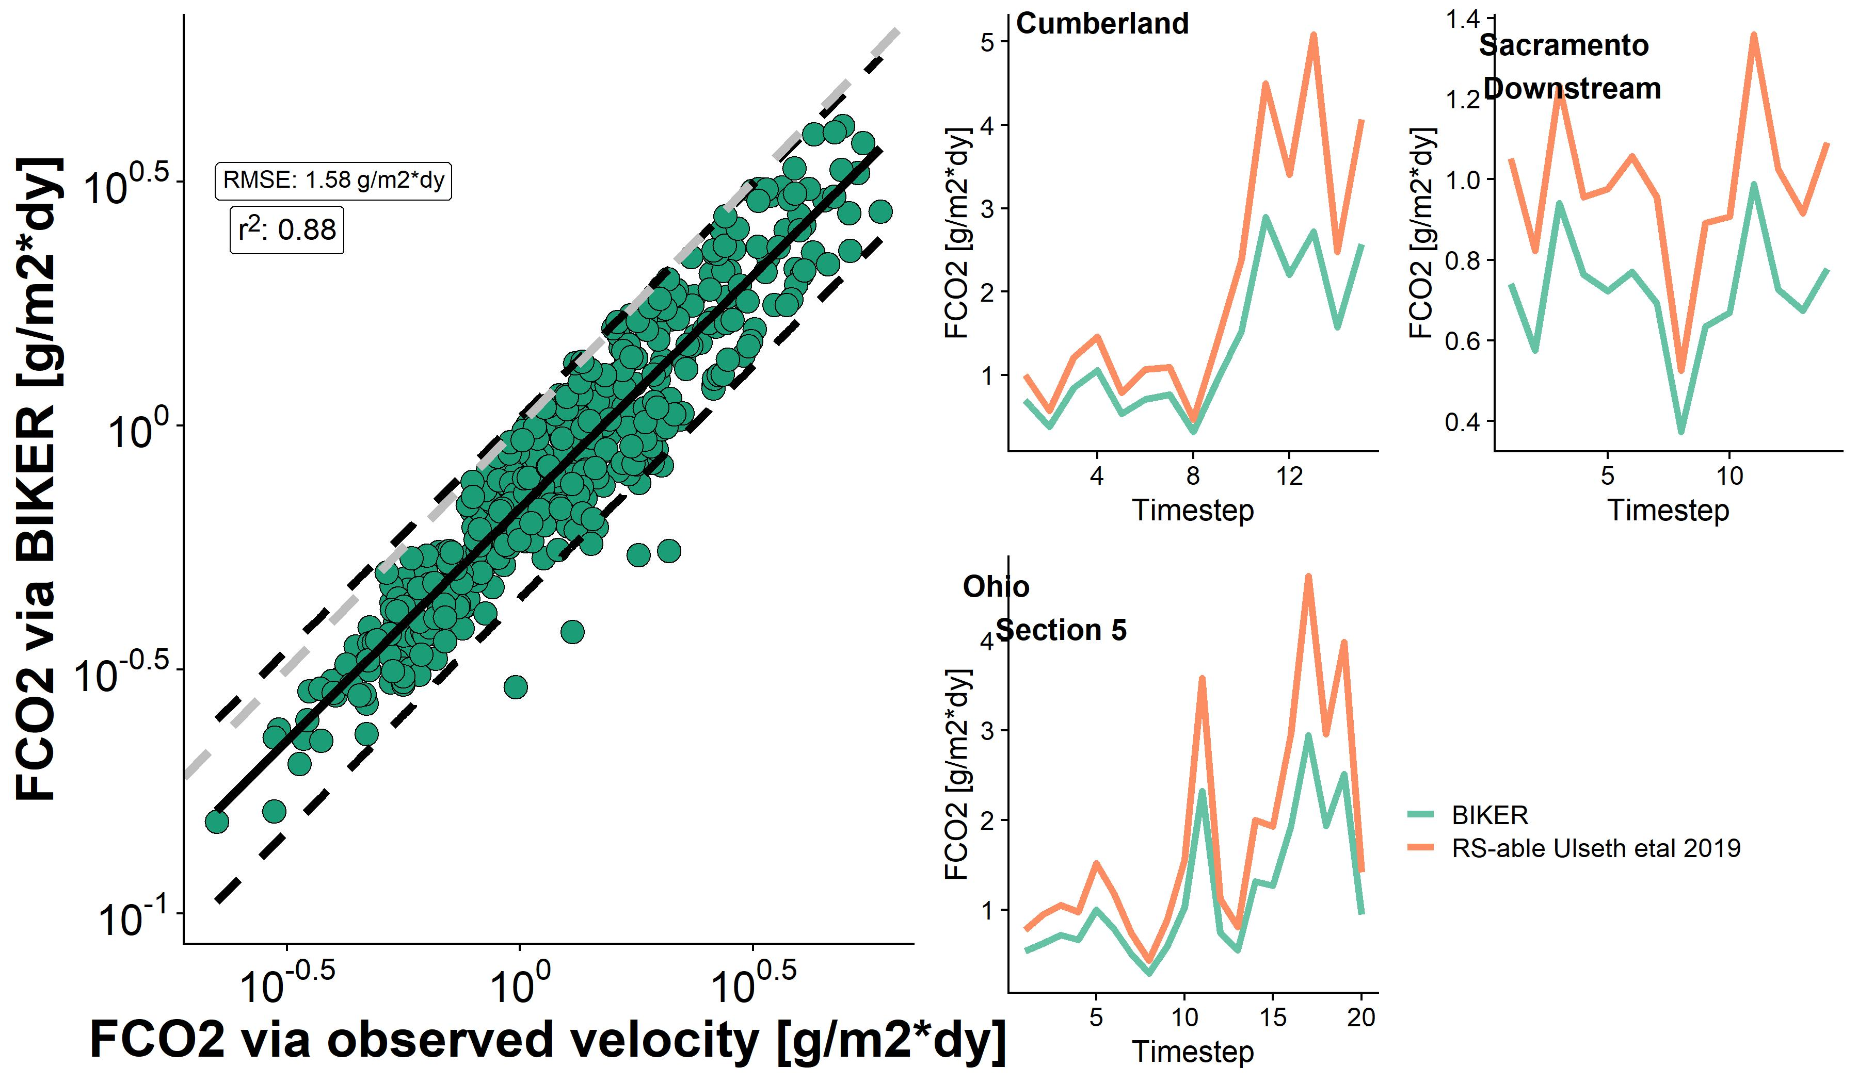
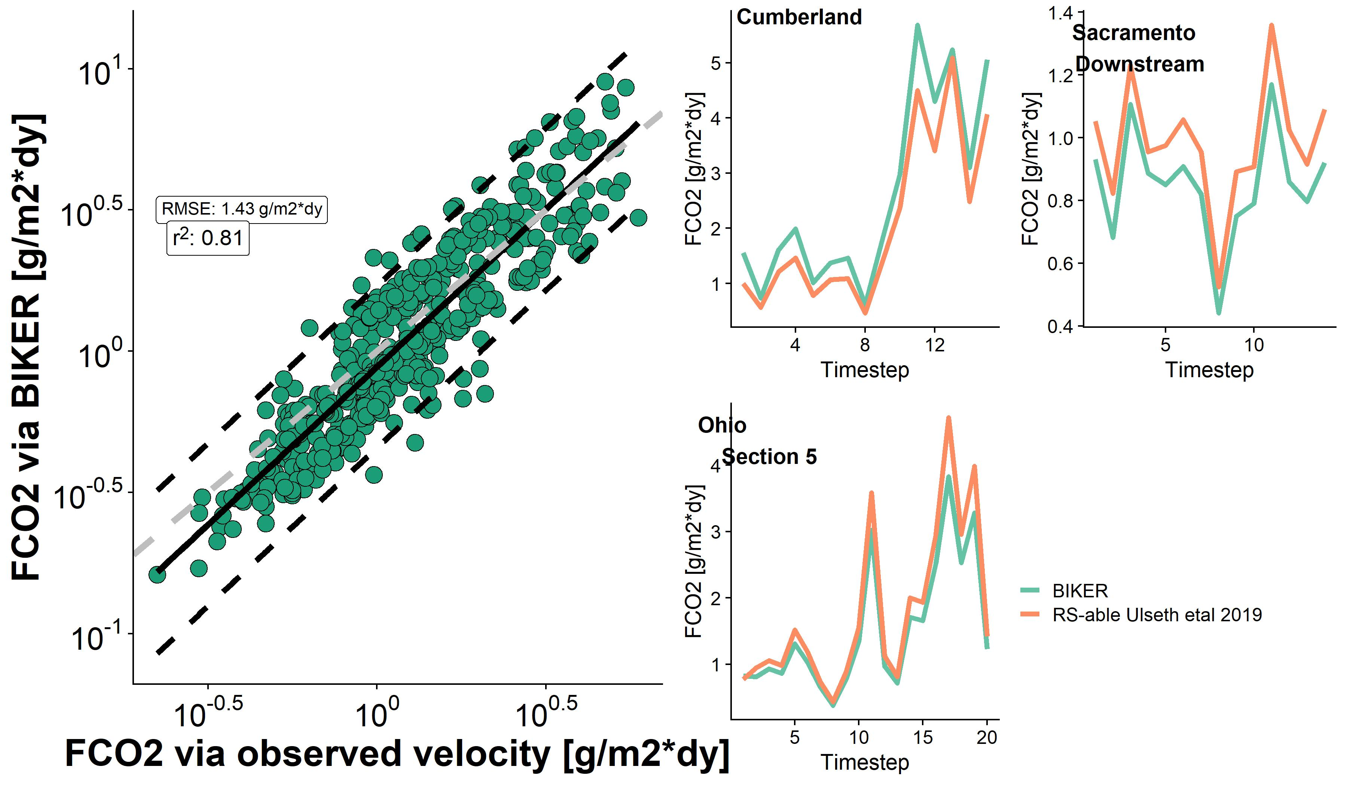
geoBAM style
Smaller PIs and r², but greater bias and RMSE
Mark-style
Larger PIs and r², but lower bias and RMSE

