Slide 1
Is PDF your best option?
Future Sync 2019
Craig Buckler
@craigbuckler
craigbuckler.com
github.com/craigbuckler/html5-export
Notes:
Hello!
My name's Craig Buckler
And I'm a freelance full-stack web developer
A couple of apologies:
This is a talk I gave TechExeter last year which I’ve adapted within the past 24 hours
It’s a bit rough and ready
I apologise that I’m on in the design track
but most of us developers are frustrated designers
Enough about me because you’re not going to see any self-promotion or subliminal advertising in this presentation

Slide 2
HIRE ME!
HIRE ME!
Notes:
I wouldn’t be so vulgar

Slide 3
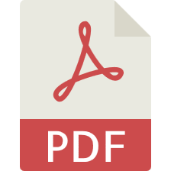
Notes:
So let’s talk about Portable Document Format.
Yeah - fresh tech!
It’s only been around 25 years.
I’ll keep you excited by mentioning Blockchain and AI every few minutes.
Is anyone not familiar with PDFs?
They’re essentially printing instructions sent to a file rather than sent to a printer

Slide 4
What has PDF ever done for us?
any application can create a PDF
preview before saving
read-only
distribution is easy
free reader software for all OSes
works offline
prints perfectly
users expect it
Notes:
That makes very practical.
If an application can print, it can export a PDF
You can print preview to see what it’ll look like
The file is effectively read-only (or near enough)
So it can be sent to others without any security implications
Those people can open it with a PDF reader.
So you don’t need the software which created it.
You can usually read a PDF offline
and print them as well as the original application could
And finally, PDFs are the will of the people.
It’s what they want.
And their decision should never be questioned.

Slide 5
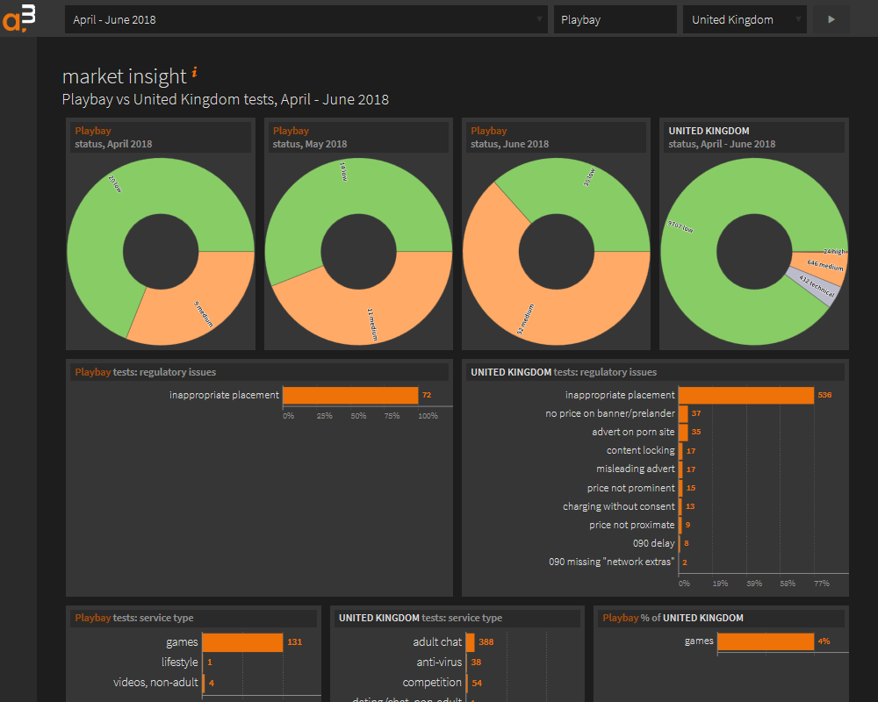
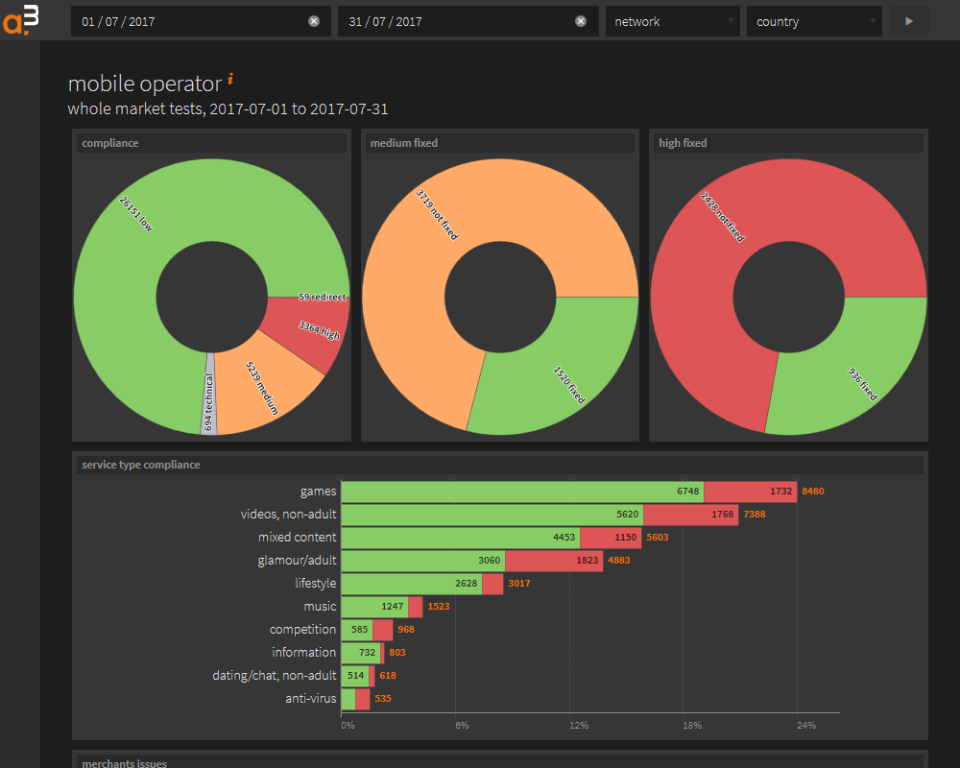
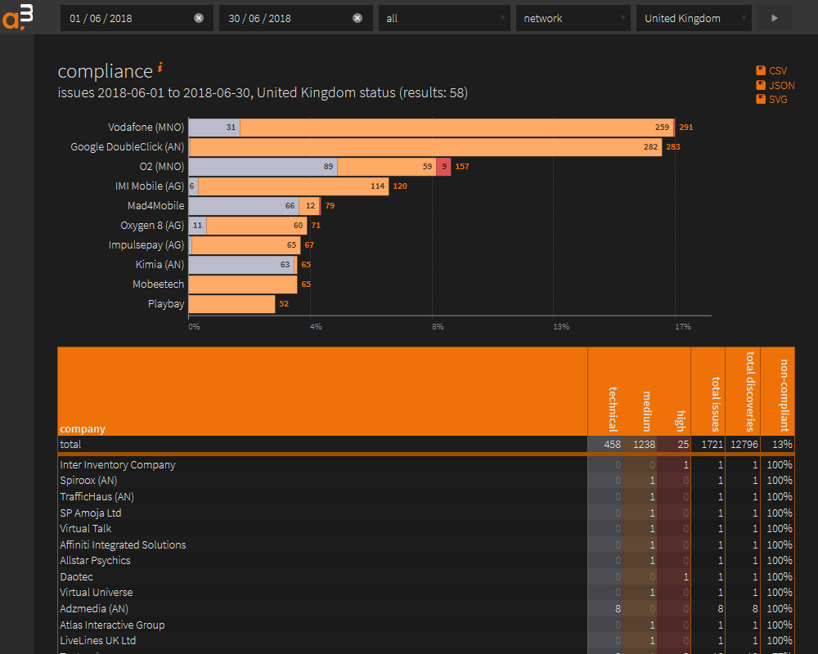
Back story
Notes:
So a little back story to this presentation
I’ve been building a web application for one of my clients
It's nothing revolutionary
They add data and their customers can interact with it
Those customers can run reports and get all sorts of amazing business insights with a few clicks
I was smuggly satisfied with this system

Slide 6


Emailed reports
Notes:
How wrong I was
My client contacted me last year.
They were spending several days every month creating PDF reports which they emailed to customers.
[CLICK]
Why?
Why do that?
Those customers can access all the information any time they like

Slide 7
The reason…
I KNOW NOTHING ABOUT MARKETING
Notes:
The reason was simple:
I don’t understand marketing.
But I’m not a typical user. And nor are any of you.
We’re all curious about technology. And design. And UX.
So if we want to find something out, we go looking for it.
We ask others. We search the web. We go to conferences.
Other people are not like us.
They like to be told what’s good for them.
They don’t want the effort of doing their own research.
They’ve got important jobs and are far too busy.
This report gave them a summary of information which they could read at their convenience
And it reminded them they were getting a useful service even if they didn’t log in every day.
So I had to accept this monthly report worked quite well.
And I knew nothing.

Slide 8
What process was used?
For every client…
Access their web reports.
Take a screenshot.
Paste into PowerPoint.
Edit.
Save as PDF.
Email to client.
Notes:
So my next question: how are you producing these PDFs?
Well, Craig, we access various reports for each customer in the web application.
And then we grab screenshots!
{ What? You don’t download the CSV or SVGs I sweated over? }
No.
We paste screenshots into PowerPoint.
{ PowerPoint? Not Excel or anything practical for analysis? }
No. We like PowerPoint. Our staff understand it.
And it means we can add useful text.
Then we export a PDF.
{ Whatever. But isn’t the quality really bad? }
Yes it’s terrible. The screenshots go all blocky. We often have to zoom the web page and stitch screens together.
Then we email the files.
{ OK. Aren’t those files fairly big? }
Yes. They are. They’re several megabytes in size. That causes problems for some clients.
But rightly or wrongly, this is the process which worked for them.
But I had to make it easier?

Slide 9
Create a PDF from a web app…
METHOD 1
print to PDF
easy
very limited
METHOD 2
PDF creation
flexible
very difficult
Notes:
So there are two main ways of creating a PDF from a browser-based application
The first is what most people use … because you don’t need to really do anything.
You just get a browser to print to a PDF.
There are some CSS printing properties…
…but control is limited.
You can’t make some pages portrait and some landscape, for example.
And it often depends on users to tweak settings. Which they never get right.
The second option is to output a PDF by drawing onto the paper canvas.
This has more flexibly because you're positioning text and lines on paper.
I’m sure you could all write raw PDF code but most developers will grab a library.
But it’s still hard work.
I tried several libraries and results weren’t always great.
Little choice between these two extremes.
And neither is ideal for web applications
So I started to question my life choices

Slide 10

The eureka moment…
Notes:
But I got though that and experienced a rare moment of clarity.
Why was I trying to convert one document format to another?
Am I using PDF because that’s what’s expected?
Is it really the best solution?
These reports are HTML.
Can’t I send people an HTML document instead?
That would be a lot easier to develop.

Slide 11
What has HTML ever done for us?
all OSes have a browser
responsive layout
small file size
text copy/paste
accessibility
open standard
Notes:
And it would also benefit users.
All Operating Systems have a browser so there’s nothing to install
That’s not always the case with PDF readers
HTML documents can be responsive.
They can work on any device whether it’s a smartphone, a PC or TV
PDFs are a fixed paper size: you end up zooming and panning on mobiles
HTML file sizes should be much smaller.
There’s no need to rasterize fonts and images
Copy and paste normally works on HTML documents
That’s not always the case for PDFs or the readers people use
It's accessible
HTML content can be read by screen readers
And we can create HTML for free.
PDF is also an open standard but the software often isn’t

Slide 12
Bring PDF benefits to HTML?
preview before saving
easy distribution
work offline
prints well
read-only(-ish)
users expect it
Notes:
I’d only win this argument is if I could bring the benefits of PDF to HTML.
It couldn’t be more difficult to create or send to others
But it was this last point which caused most concern:
Don’t users expect PDFs?
Let's face it: most users don’t know or care what you’re sending them.
But I had to prove HTML wouldn’t cause problems.
Now there are some options from distant history.
Does anyone remember MHTML?
You’re all too young. Ask your grandparents about 56K modems and surfing the web in the 1990s.
Back then, it’d take almost 30 seconds to download a web page.
So you’d download lots and save them as MHTML files for offline reading.
That freed the telephone line and meant you could eat that week rather than paying BT.
MHTML is: MIME Encapsulation of Aggregate HTML Documents.
It’s effectively HTML email format.
That’s horrible and the format is only native in IE so it wasn’t an option. Thankfully.

Slide 13
Objectives
preview page and download itself
looks like a paged document
printer-friendly
no external assets
no JavaScript in the output
Notes:
This was my plan:
I’d create a web report preview which allowed some simple editing
You could then download a static representation of that page as a single HTML file
That would all happen client side.
It would look like a document.
With PDF-like pages or slides so users weren’t confused.
It would have to print well.
It’d never be better than PDF but would have to be OK.
The exported HTML file had to be viewable offline
I couldn’t use external assets such as fonts
All CSS and images would need to be embedded into the document
Finally, it couldn’t contain JavaScript.
Some systems would flag a security alert so it wasn’t worth the hassle.
Did anyone hear a React developer screaming?
So it doesn’t matter what client side JavaScript you need to create content.
Ultimately, all client-side libraries put HTML on the page.
So we can extract that HTML.
without needing the JavaScript which created it.

Slide 14
Let’s get coding!
Notes:
Over to VS code

Slide 15
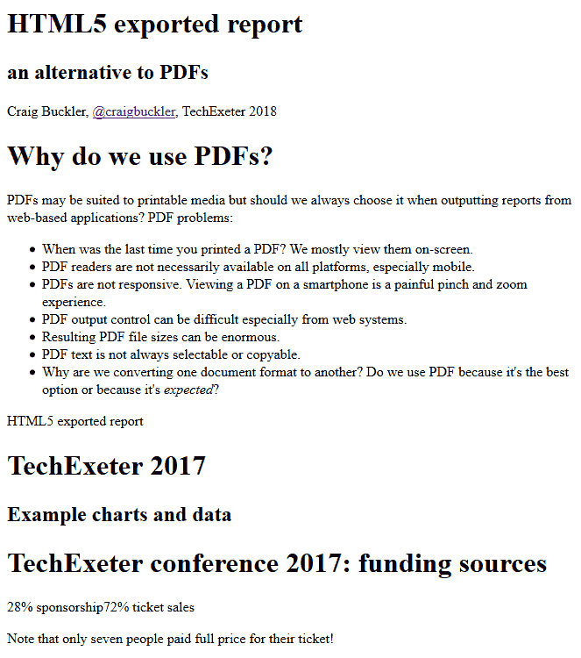
Gmail evil
Notes:
So our static HTML file can now be sent by email or whatever.
But there is a minor hitch.
What do you think Gmail users see when they click an attachment icon in an email and see a preview?
I’ll give you a clue: Gmail opens the file in a new tab so there’s no interface.
[CLICK]
Yep, Google thinks it’s best to treat the document as an HTML email.
It strips all the styles and images.
Actually, it looks OK if you use semantic tags.
You can still read the information.
But some users could think this is the final document.
Now you could fix it using tables and inline styles.
But life’s too short for that sort of nonsense.

Slide 16
Gmail preview fix
<head>
<style>
#exportview {
display: none;
}
</style>
</head>
<main>
<!-- damn you Gmail! -->
<p id="exportview" style="font-size:2em;text-align:center;color:#f00;background-color:#ff0;">THIS DOCUMENT IS NOT DISPLAYING CORRECTLY.<br />PLEASE DOWNLOAD THE FILE THEN OPEN IT IN A WEB BROWSER.</p>
<!-- slide 1 -->
<article></article>
Notes:
I fixed it by adding a styled paragraph at the top of the page.
That gave the reader further instructions.
But the paragraph was removed with display: none if the CSS was parsed correctly.

Slide 17
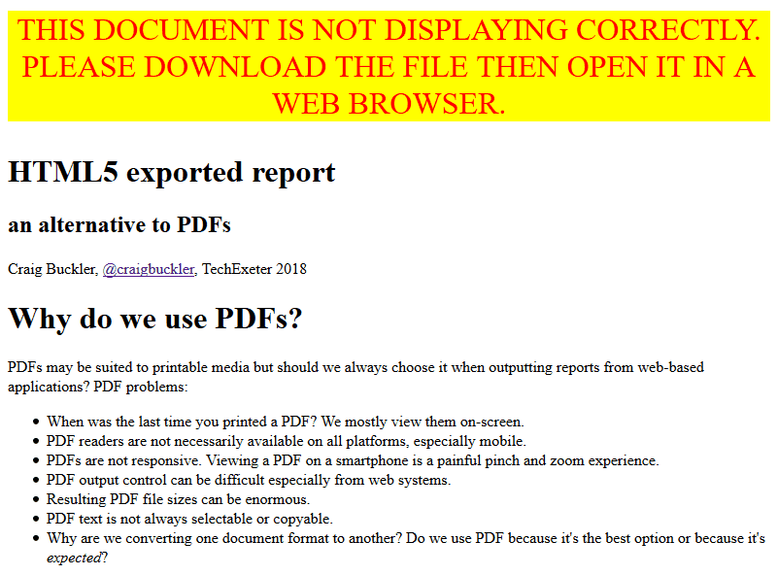
Gmail new preview
Notes:
The result isn’t perfect
But it helps users
Which is more than Google does!

Slide 18
Fin
Future Sync 2019
Craig Buckler
@craigbuckler
craigbuckler.com
github.com/craigbuckler/html5-export
Notes:
That’s it. We have a web report we can create, preview, and edit before downloading a static HTML document.
It can be sent to anyone, and has the benefits of both HTML and PDF.
Some CSS properties I used aren’t great in IE but the document is still readable and prints perfectly.
It's not read-only but neither are PDFs if it comes to it.
The HTML is minified so it’s difficult to edit.
But if you’re worried, I’d suggest generating a hash in the content or the filename so you can prove it’s been tampered with.
User expectations was the biggest unknown
but similar HTML documents have been sent to hundreds of people over the past year.
They had different email systems and browsers but I don’t know of anyone who had a technical problem.
In fact, they love it. Some are actually asking for monthly reports before the end of the month.
Which is clearly bonkers, but that’s users for you.
All the example code is on GitHub.
Feel free to use it as you like.
Or please hire me if you’d like someone else to do it for you!
So yeah, let’s abolish PDF reports from web systems!

