Slide 1
Student Loan Advisor Online
Version 3.0
Wireframe for New Workflow

Slide 2
Step 1 - New Client Data
Upload Data File through Company Admin
Remote Lead Source API POST Request
Direct User Entry

Slide 3
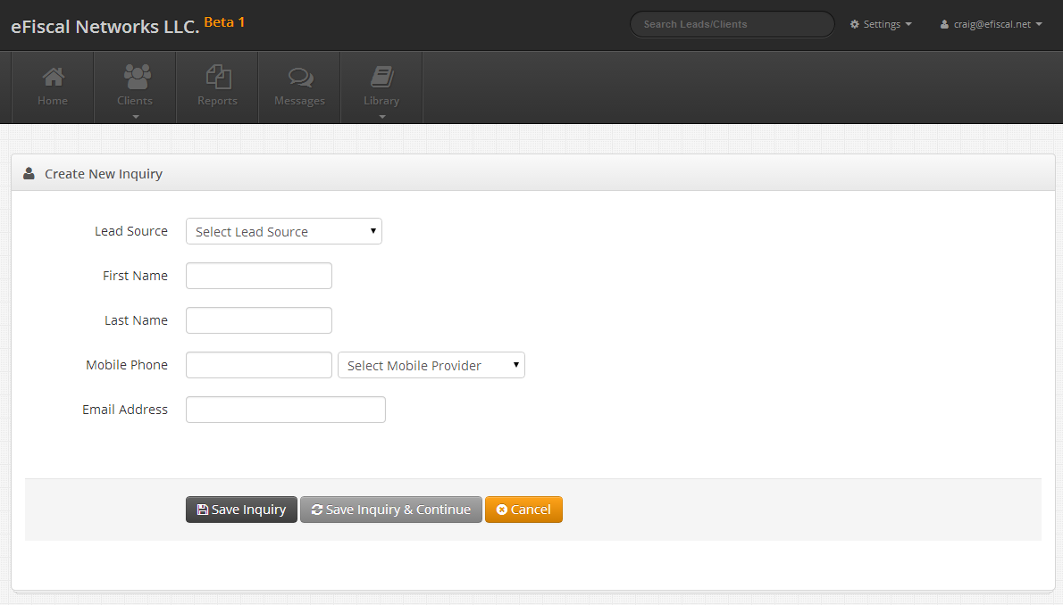
Direct User Entry

Slide 4
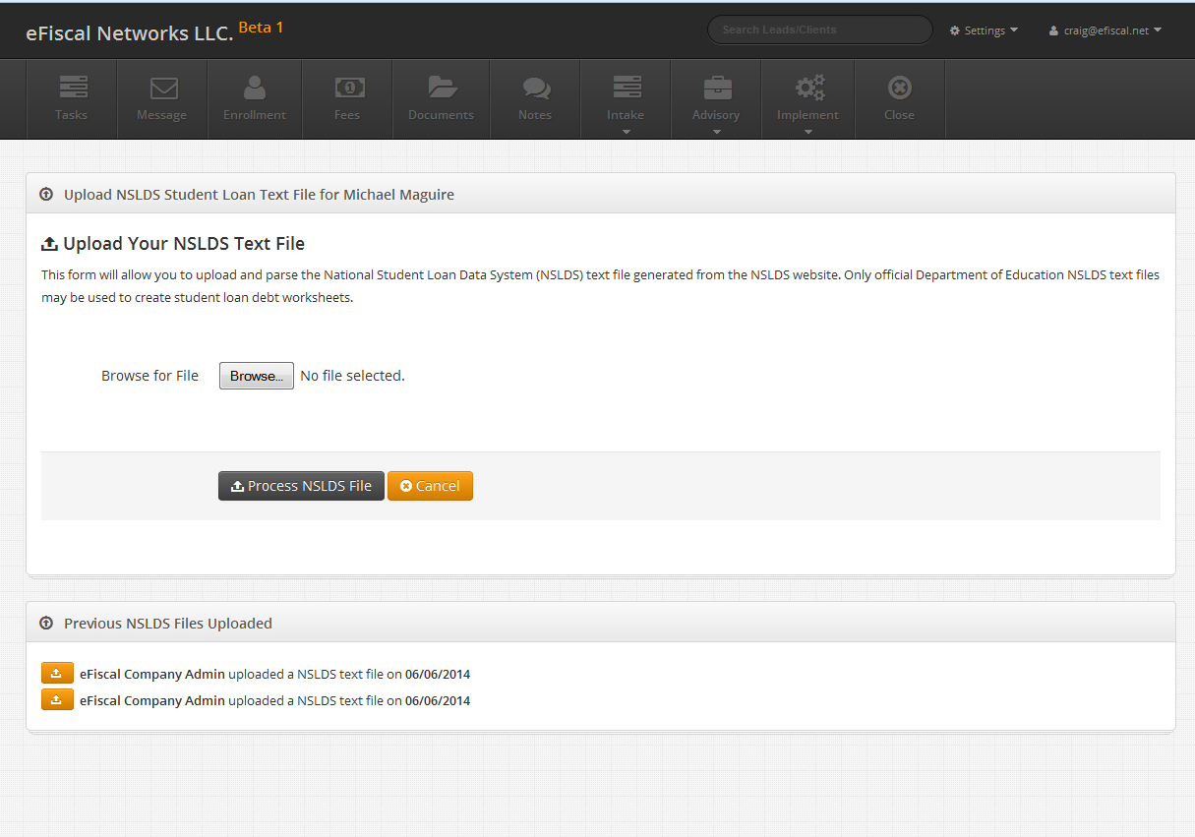
Upload NSLDS

Slide 5
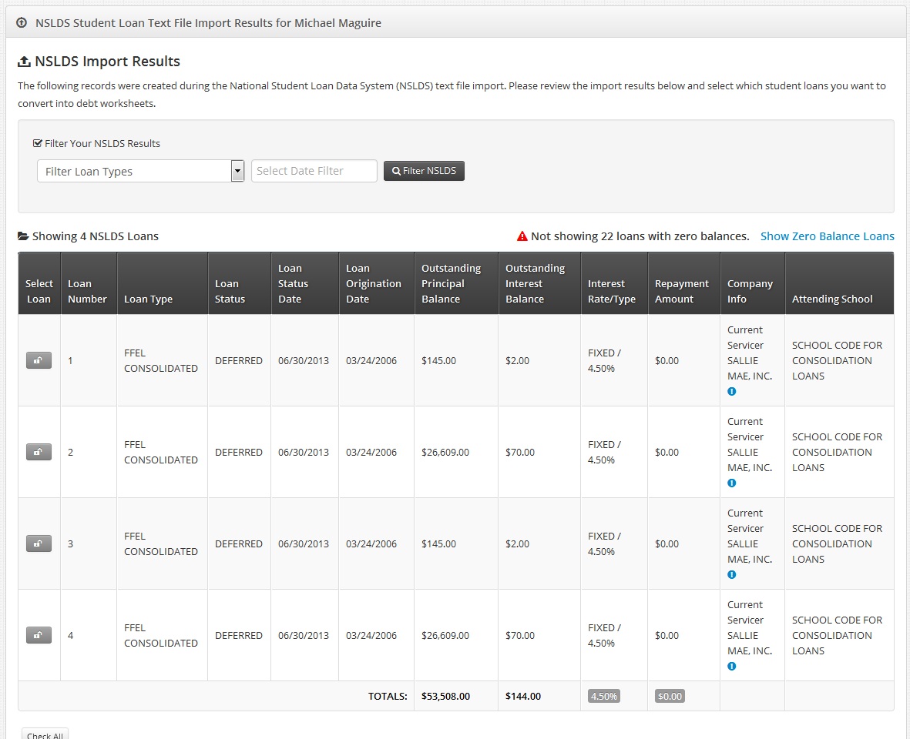
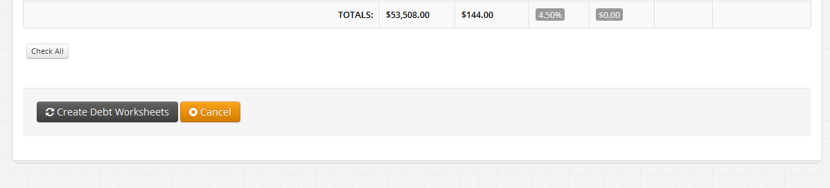
Analyze NSLDS Data
Button to Solution Finder - remember -
no more debt worksheets

Slide 6
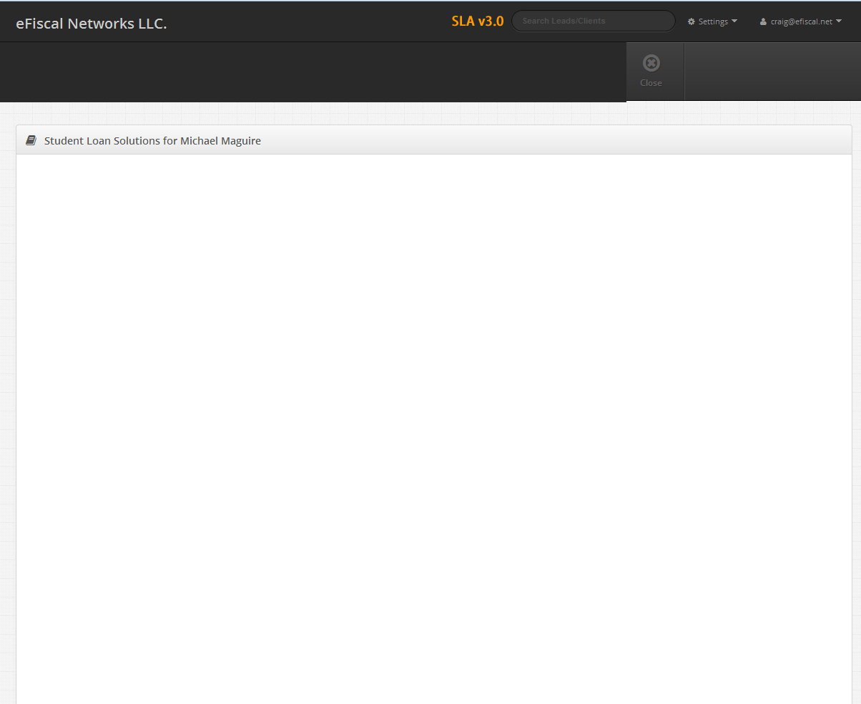
Custom NSLDS Client Survey
Your student loan data file identified several loan types.
Your NDSLS file shows you have a FFEL PLUS GRADUATE loan that originated on 5/14/2004...
Is the loan holder deceased?
• YES
• NO

Slide 7
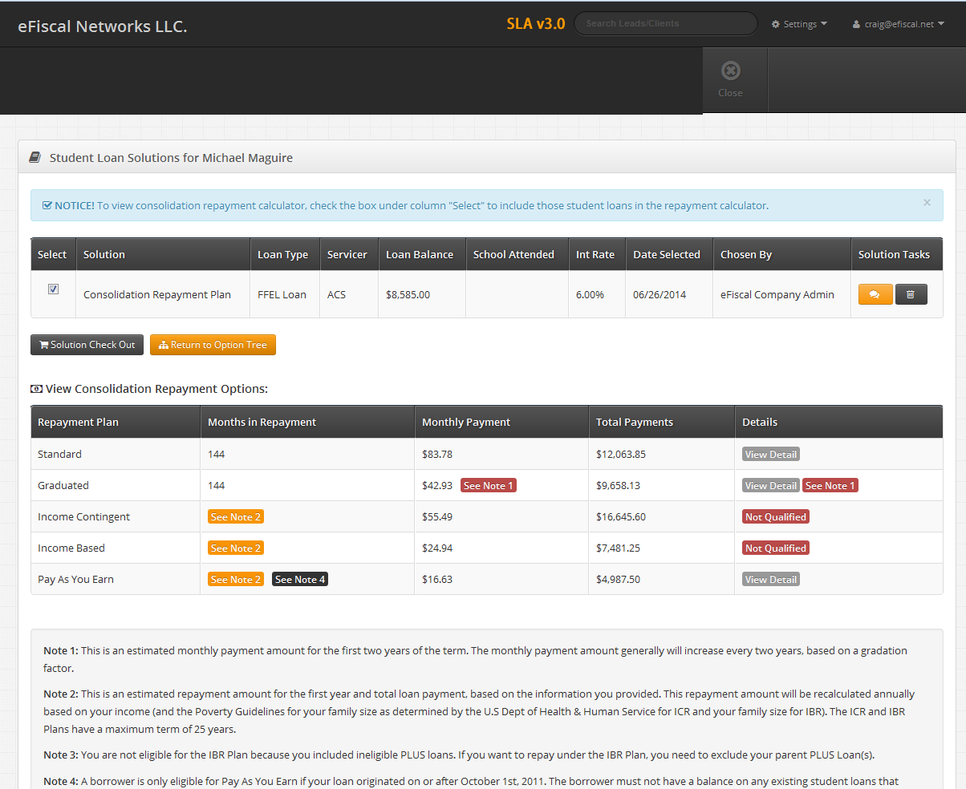
NSLDS Solution Finder

