Slide 1
An Unexpected Journey
My Data Science Pilgrimage by Craig Goldie

Slide 2

{Title Explanation}
Background in… Literature/Philosophy→ MPA→ Spreadsheets→ Data Analysis… [HigherEd, NHS, Utilities, Oil & Gas, Retail Banking]
British Gas… career path?
Aucerna…
Summer 2015…

Slide 3
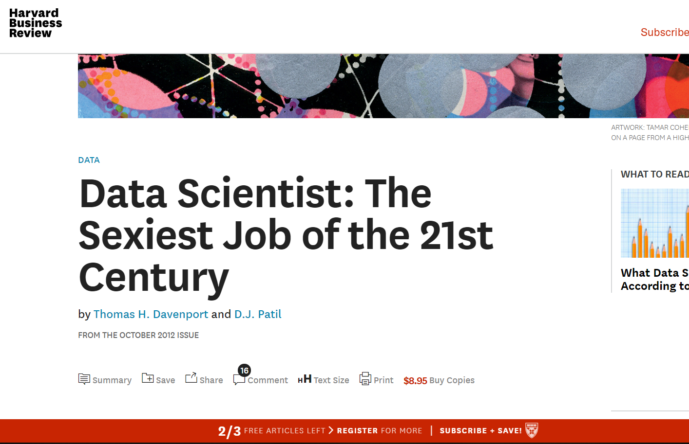
“…we would say the dominant trait among data scientists is an intense curiosity—a desire to go beneath the surface of a problem, find the questions at its heart, and distil them into a very clear set of hypotheses that can be tested”

Slide 4
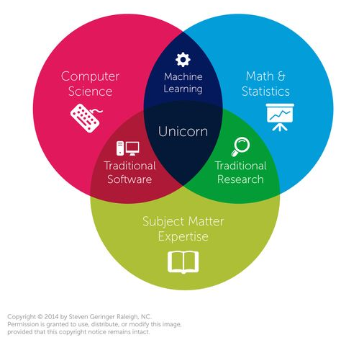

{Data Science: Definition}
2015: Moved to Edinburgh to get back into Analytics

Slide 5
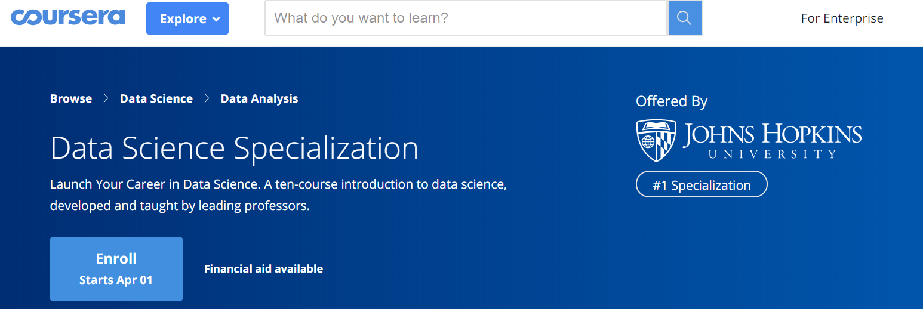
Coursera (2015)
Free, World Class, R-Focused—DS Toolbox, Programming in R, Getting & Cleaning Data, Intro to Machine Learning
introduced me to…

Slide 6
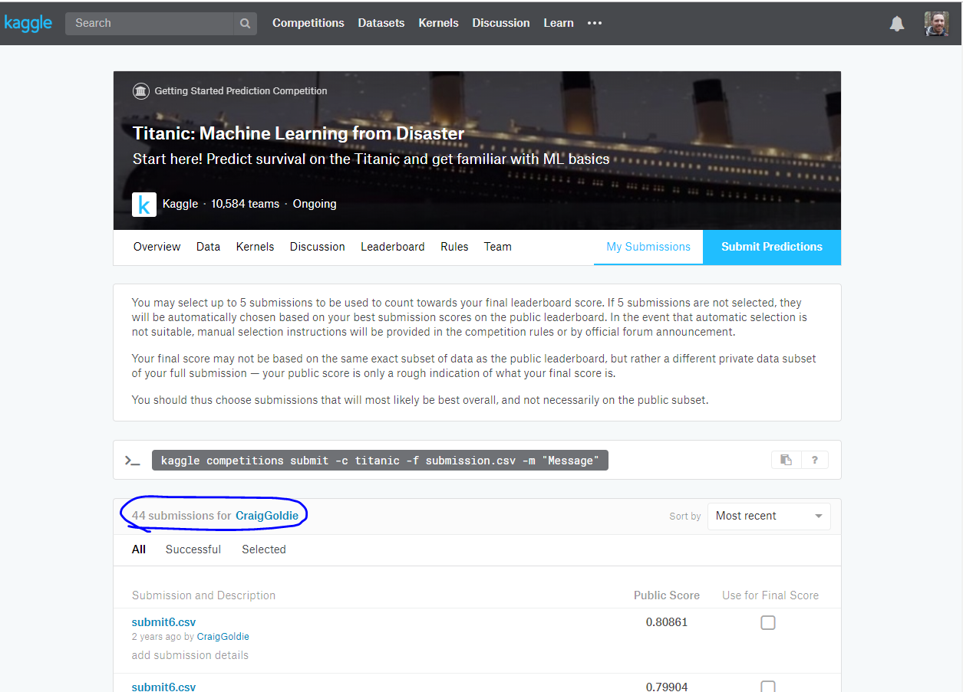
Kaggle (2016)
Single best Predictive Analytics / ML learning resource
Project Based
Kernels
Data Provided
Trevor Stephens Titanic Tutorial

Slide 7
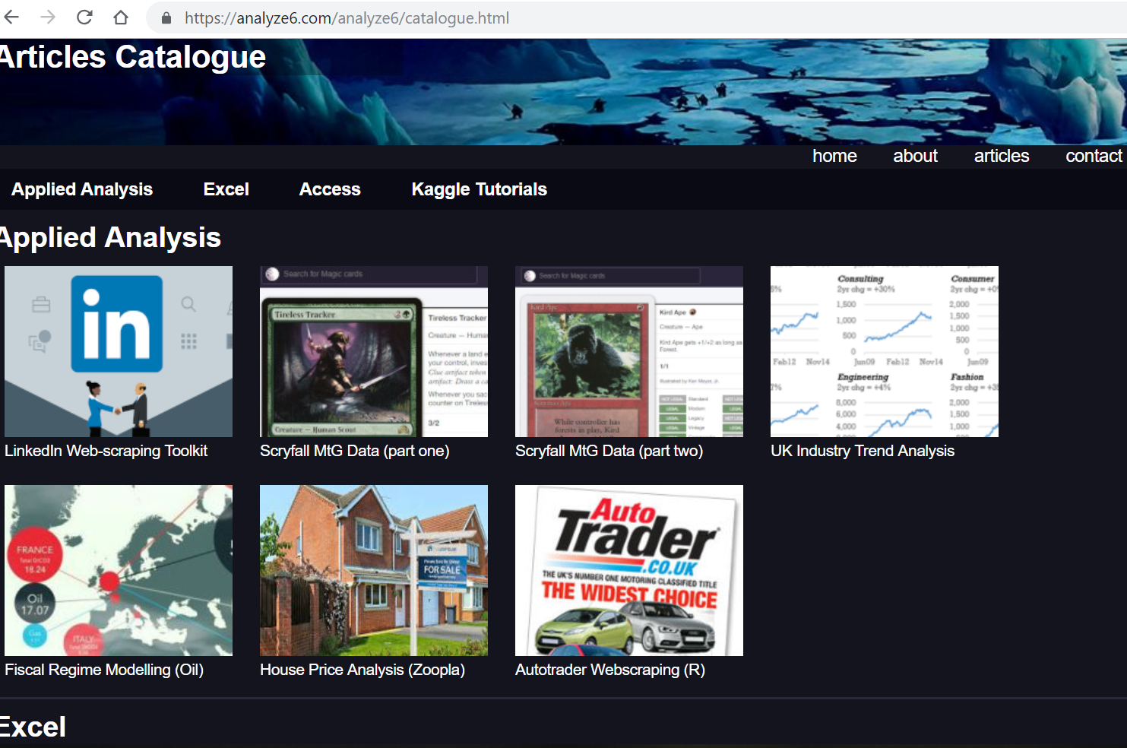
Other Projects
Solve a Problem
Develop Skills
Publish Skills (Website, Github, LinkedIn, etc.)
My Website

Slide 8
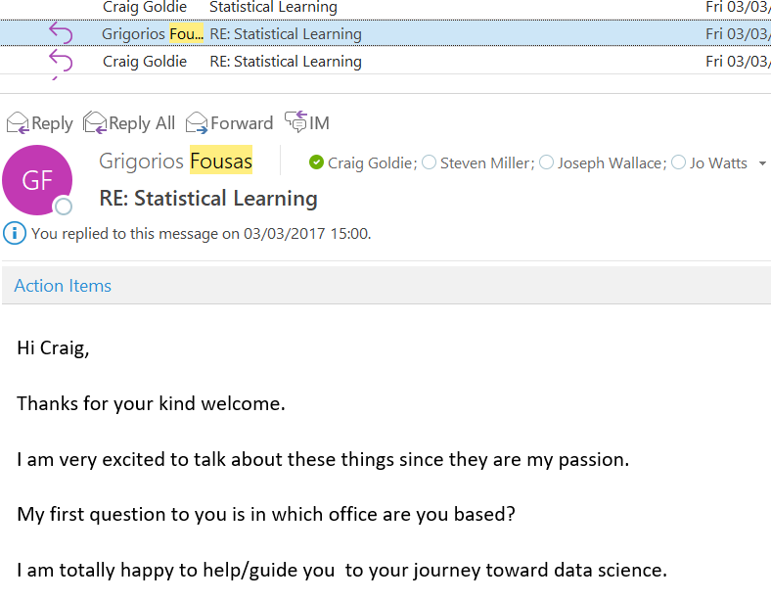
Greg Fousas / Credit Risk (2017)
Reached out to Greg, re: R, Python, and ML help
Greg suggested a Kindle book (read it within a week or so)
Helped me with specific code syntax problems (in R originally)
Directed me to other Kindle book for Python
Talked to Steven/Rachel about Career goals
→Credit Risk Model Monitoring Opportunity

Slide 9
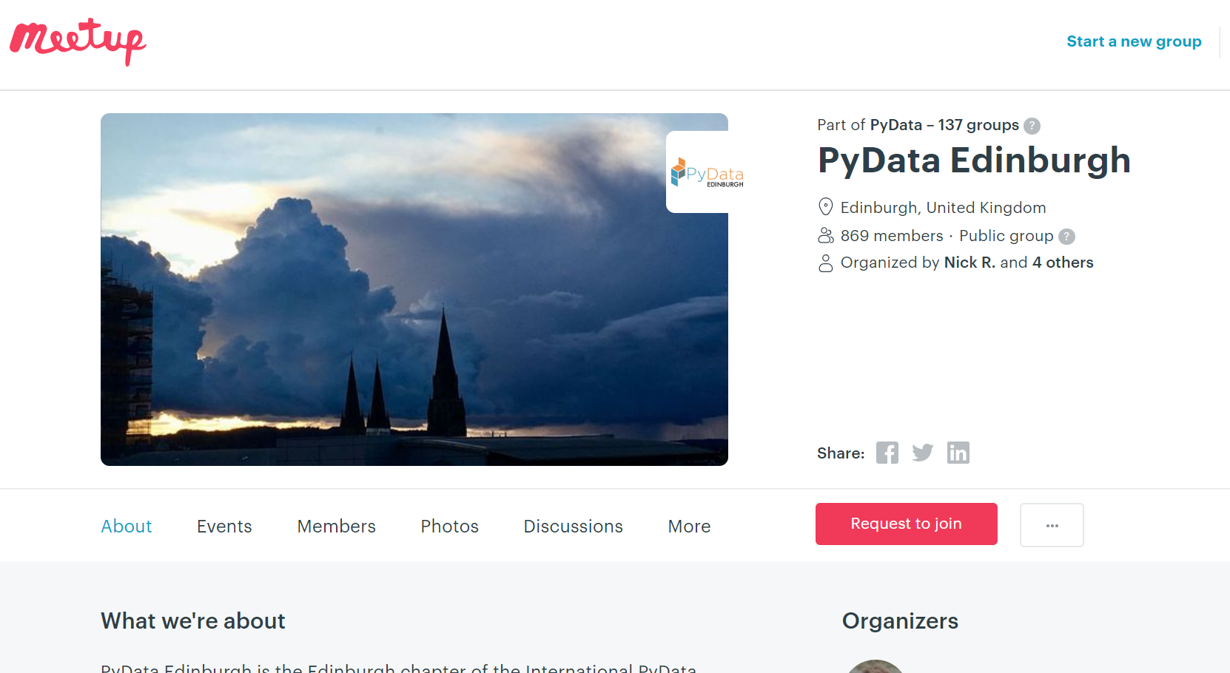
Meetups

Slide 10
Data Science Work (2018)
Opportunity arose to work closely with Greg Fousas for Q1/2 2018
Analytics projects with London Sock Co., Internal Projects, and Shawcor
RBS Financial Modelling Opportunity from Dec 2018
100% Python (well, 2% SAS→98% Python)
Predictive Model Building work

Slide 11
2019+ Trends
Trend to move to Open Source Analytical software (Python is tool of choice)
WHY??
Because its FREE
Because it can do more things
Because its hyped and quality ‘Data Science’ (or aspiring Data Science) people want to use it => better access to talent

Slide 12
Dufrain needs Data Science Skills!!

