Slide 1
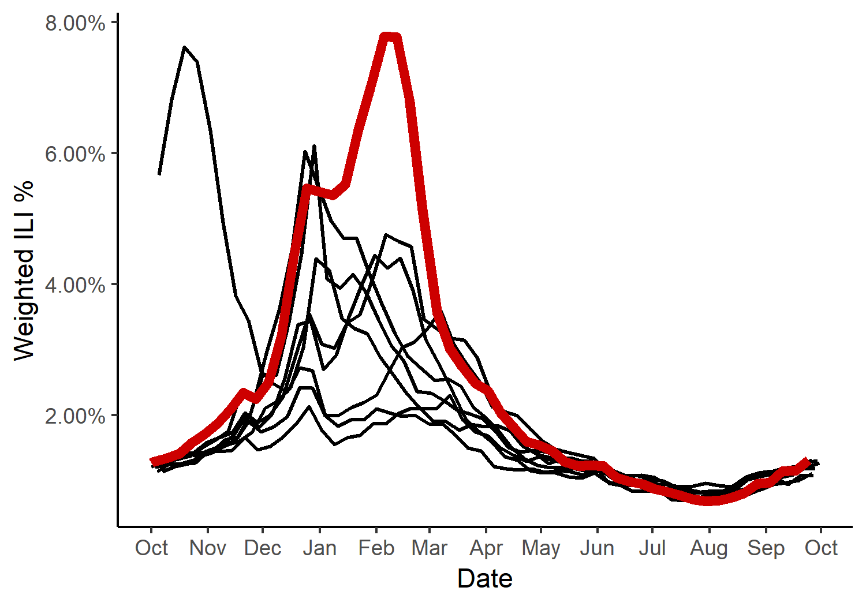
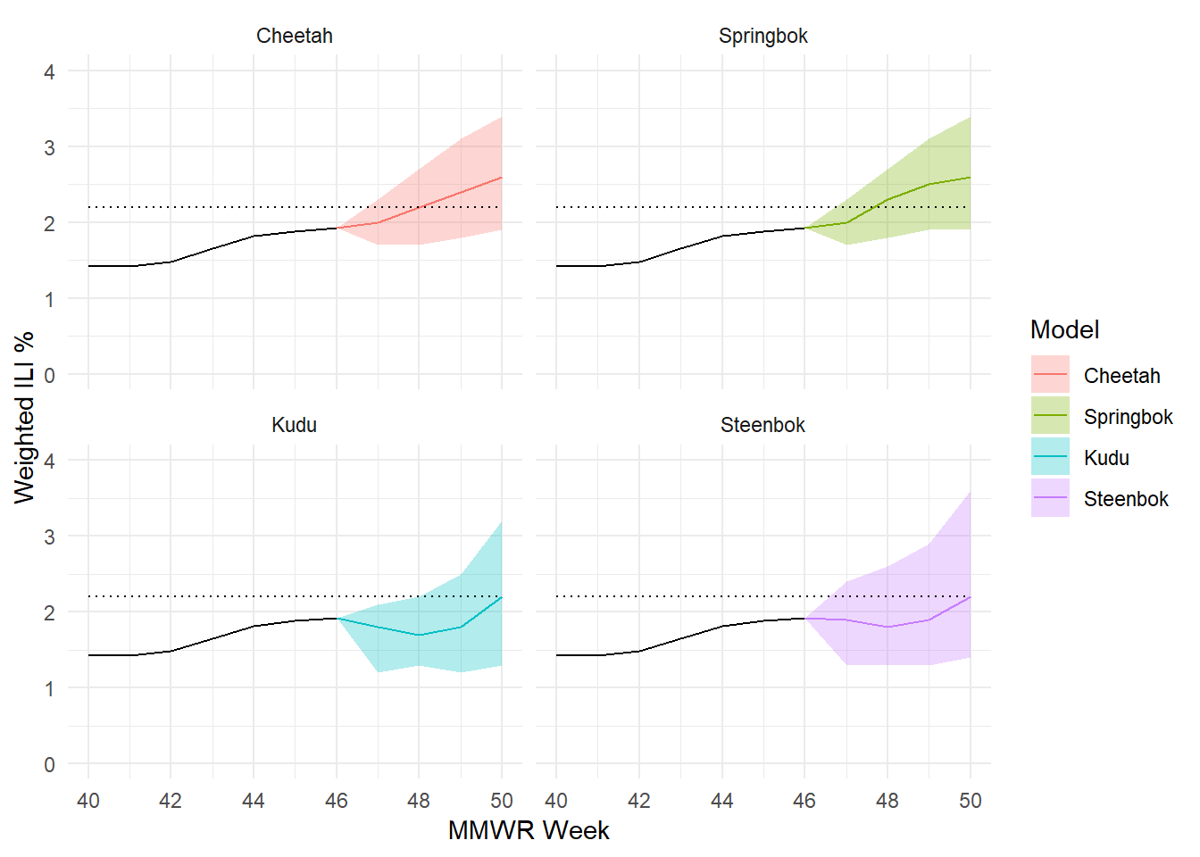
Influenza Forecasting
US CDC runs an annual influenza forecasting competition
Create weekly prospective probabilistic forecasts of influenza activity
Current model: weighted ensemble approach of three components (Cheetah)
Dynamic harmonic regression using Fourier and non-seasonal ARIMA errors, with virus prevalence and Google Trends (Springbok)
Subtype-specific historical trends (Kudu)
General historical trends (Steenbok)
Like to incorporate infection dynamics – current model ignores transmission entirely
Follow along! https://predict.cdc.gov
My models are Protea-Cheetah and Protea-Springbok

