Slide 1

Product Development: Climb On
Loic Maxwell and Craig Young
EE180D Networked Embedded Systems Design

Slide 2
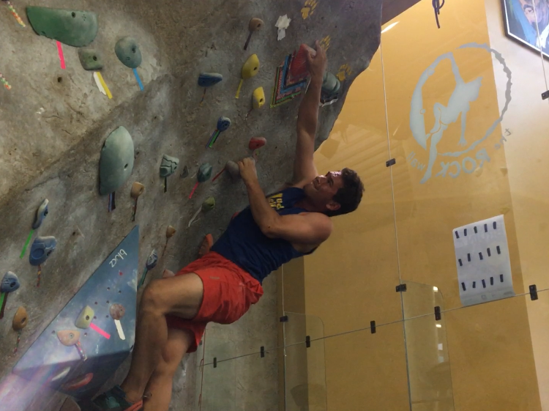
Product Development Mission Background
Rock climbing, both competitive and recreational, is rapidly becoming a popular sport
Our mission was to develop a smart rock climbing trainer system for beginners
Currently no in-depth analytics tools for climbers - only high-level grade tracking
New approach: analyze detailed data about individual movements to improve climbing technique
Notes:
This section is a two viewgraph summary that addresses each of the Heilmeier Questions that appeared in your Design Document
This should include your latest considerations of each question since preparation of the Design Document
Each team member should be prepared to answer and discuss each question
However, due to time constraints, we will very rapidly present these one or two slides in less than 2 minutes and then focus on the technical information that follows.

Slide 3
Product Development Mission Background - 2
Users: beginner rock climbers (huge community)
Techniques could improve enough to be used by professional competitive climbers similar to advanced sport analytics
Midterm exam: classification of a single move
Final exam: classification of several moves within a complete climb
Notes:
This section is a two viewgraph summary that addresses each of the Heilmeier Questions that appeared in your Design Document
This should include your latest considerations of each question since preparation of the Design Document
Each team member should be prepared to answer and discuss each question
However, due to time constraints, we will very rapidly present these one or two slides in less than 2 minutes and then focus on the technical information that follows.

Slide 4
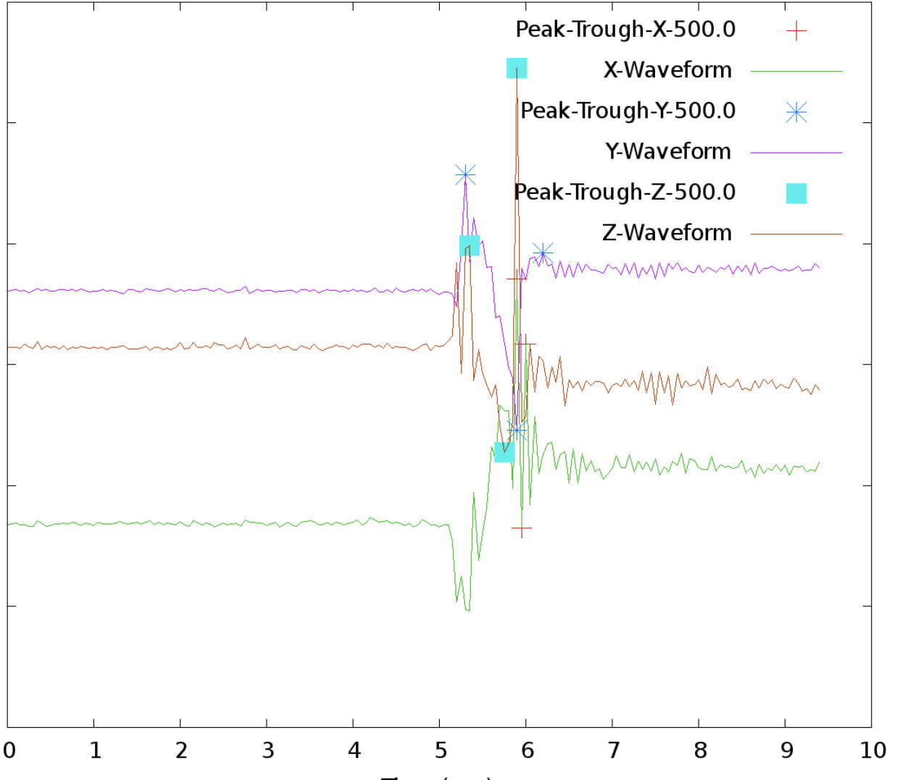
Design Overview: Technical Challenges
Available sensor data: 3D accelerometer and gyroscope
Challenges
Determine metrics to accurately classify quality of climbing moves
Extract features from 3D accelerometer data
Notes:
Detailed Problem Statement
This section should summarize the nature of the design constraints and challenges you have recognized in delivering your product mission
This section may include two slides.
Again, however, due to time constraints, we will rapidly present these slides in one or two minutes and then focus on the technical information that follows.

Slide 5
System Implementation: Complete Description
Metrics used to determine quality of climbing moves:
Smoothness - quality of movement during actual move
Arrival stability - minimize shaking and movement directly following arrival onto next hold
Notes:
This describes your system implementation progress
This contains specific details
This also contains data acquired as applicable to your product development mission at this time
This section may include two or more slides

Slide 6
System Implementation: Complete Description - 2
Tools Used:
ST Micro SensorTile - accelerometer hooked to user’s wrists
TI BeagleBone Green - development and data processing
Project written using C code and shell scripts - about 20 separate files
acquire_data.c - used to collect data for training
process_data.c - used to extract features using the following:
process_shaking.h (arrival stability metric)
process_timing.h (smoothness metric)
Notes:
This describes your system implementation progress
This contains specific details
This also contains data acquired as applicable to your product development mission at this time
This section may include two or more slides

Slide 7
System Implementation: Complete Description - 3
Development Process
Collected training data
Extracted features
Created training file
Trained Neural Network
Tested and made confusion matrix
Developed executable main program for system demonstration
Notes:
This describes your system implementation progress
This contains specific details
This also contains data acquired as applicable to your product development mission at this time
This section may include two or more slides

Slide 8
Testing and Verification: Complete System
Testing and Verification Plan
Collect 40 data sets, 10 for each classification
Train Neural Network using this data
Collect 20 more data sets, 5 for each classification
Test Neural Network using this data and create confusion matrix
If results unsatisfactory, adjust Neural Network layers
Additional training and testing as necessary
Notes:
Test and Verification Plan
The test plan describes your performance test approach
This section may include as many slides as required to fully describe results for your complete system. Not all slides may be presented depending on timing.

Slide 9
System Demonstration
Video Link: https://www.facebook.com/craig.young.526/videos/2169082456442075/
Notes:
The system demonstration should include a video capture
The system demonstration should also include data that validates your progress
Actual system demonstration is encouraged and can occur at the end of the Finals session

Slide 10
Testing Confusion Matrix
 | Predicted
Actual |  | Smooth/ Stable | Smooth/Unstable | Not Smooth/ Stable | Not Smooth/ Unstable
 | Smooth/Stable | 5 | 0 | 0 | 0
 | Smooth/Unstable | 1 | 4 | 0 | 0
 | Not Smooth/Stable | 0 | 0 | 5 | 0
 | Not Smooth/Unstable | 0 | 0 | 0 | 5

Slide 11
Final System Mission Progress Report
Important Advances and Accomplishments
Successfully implemented a climbing move classification system based on new feature extraction methods
“climb_on” end user demonstration program that combines data collection and classification
Ventured into the climbing motion analysis industry
Notes:
Describe the final system mission progress for Quarter 2 relative to your initial goals
Note that each group has identified important advances that are unique and were planned to be completed in Quarter 2. These include, for example, new hardware and software systems, new classifier algorithms, additional system components, and others.
Describe innovative development objectives and deliverables for Quarter 2. This may include as many slides as needed.

Slide 12
Final System Development
Approach
Since we seldom had overlapping schedules, we made sure to optimize our collaborative work time to ensure that we maximized our efficiency.
We each took the lead on one feature to extract, allowing us to develop during our own time
Used lab time to overcome roadblocks and lay out a template for the following week’s work
Spent a few hours every 2-3 weeks collecting more data to further test our system

Slide 13
Final System Development
Starting the Quarter vs. Now
Transition from directness metric to stability metric → challenging to extract features
Current system works for individual climbing moves rather than an entire climb

Slide 14
Team and Responsibilities - Loic
Wrote code to collect and save climbing waveform data
Operated data acquisition code during collection phase
Researched and developed feature extraction for arrival stability climbing metric
Wrote code to analyze data files and create NN training file
Wrote testing program to create confusion matrix

Slide 15

Team and Responsibilities - Craig
Researched and developed feature extraction for smoothness climbing metric
Wrote code to generate graphs of 3D waveform data
Collected data as climber
Wrote code to execute feature extraction methods on multiple files for training
Wrote main user interaction code
Acted as model for presentation video

Slide 16
Resources and References
All climbing footages and data captured (with permission from employees) at UCLA John Wooden Center Rock Wall
Code libraries used include
Liquid DSP: http://liquidsdr.org/
FANN: http://leenissen.dk/fann/wp/
GNU Plot: http://www.gnuplot.info/
All under direction and with permission from Professor William Kaiser for EE 180D class
Songs used in video: “Derezzed” - Daft Punk
Notes:
Please list specific resources and references that you have found to be helpful here.
These slides will not be presented, but should be included.

Slide 17
Conclusion: Future Development Opportunities
This project has huge implications for the future of data analytics within rock climbing, which is rapidly growing as a sport and recreational activity
Movement analytics is a multi-billion dollar industry in popular sports such as baseball
Climb On could be improved enough to fill the unclaimed niche of movement analytics in rock climbing - for professionals and beginners
Movement analytics in climbing will most likely become a multi-million dollar industry within 20 years

