Slide 1
The Goal:
Predict how long it takes an epoxy to cure at a given temperature.

Slide 2
The Problem:
Can’t test it directly.

Slide 3
The Problem:
In the process of heating the sample to the target temperature,
The cure advances at intermediate temperatures.

Slide 4
The Solution:
“Isoconversional” techniques.

Slide 5
Isoconversional:
The rate that the cure progresses depends only on:
The current temperature and
The current degree of cure
(0% - 100%)

Slide 6
The Plan:
Heat the epoxy at a controlled temperature ramp.
Record the temperature and information about cure.

Slide 7
The Data:
The following slides show pre-processing of the data.

Slide 8
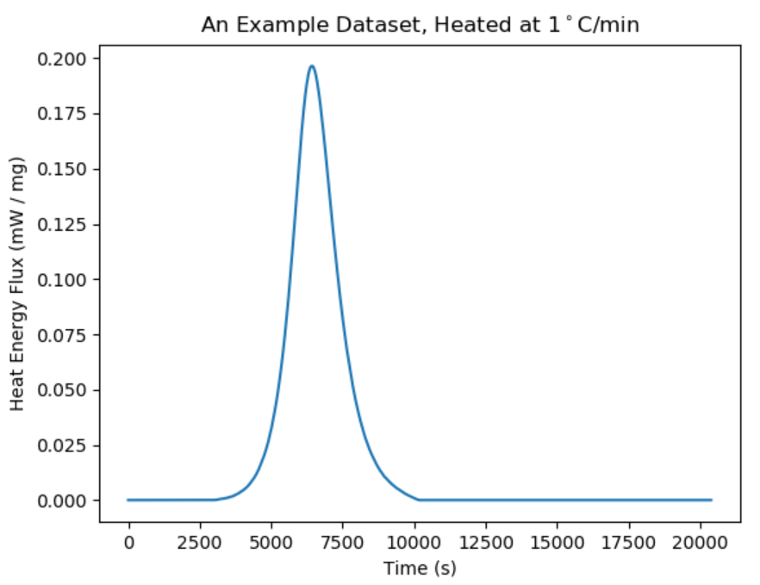
As the epoxy cures, it gives off heat.

Slide 9
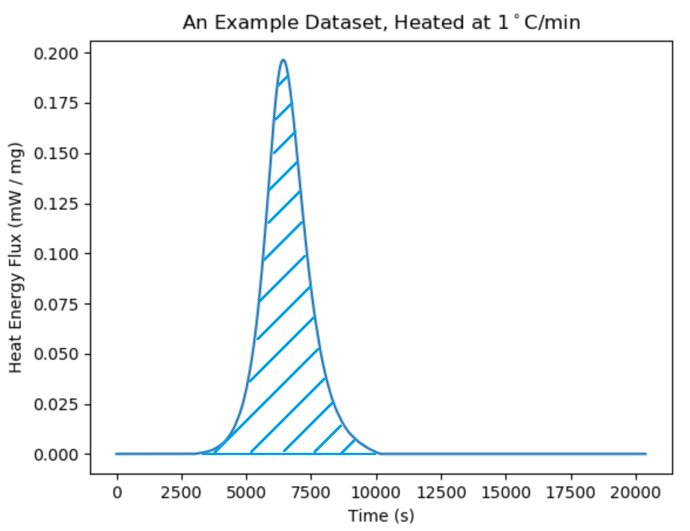
The blue hatched region is total amount of heat energy given off.

Slide 10
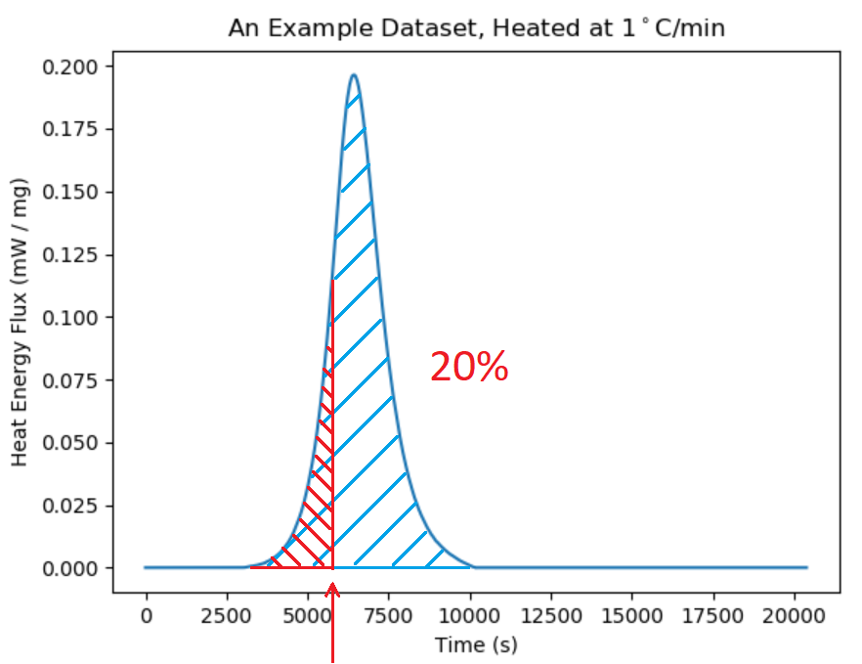
At the time marked by the red arrow, 20% of the total heat energy has been given off.

Slide 11
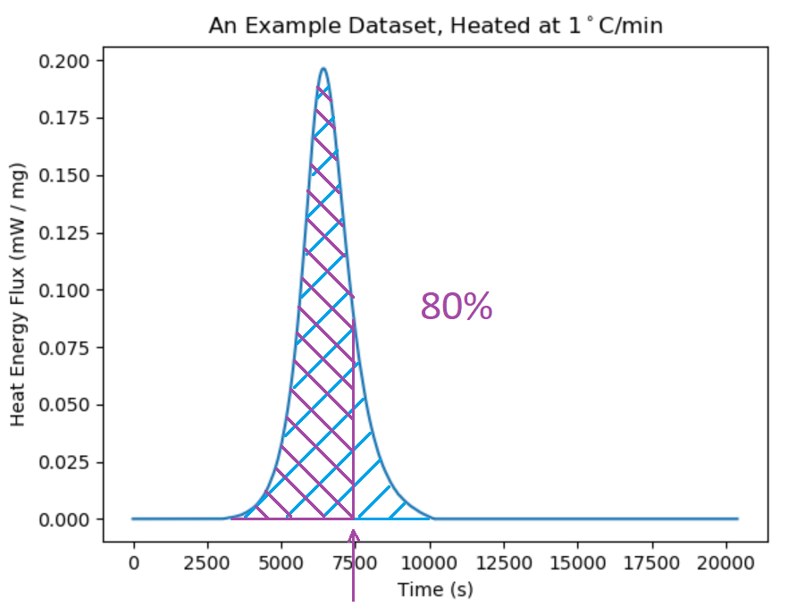
At the time marked by the purple arrow, 80% of the total heat energy has been given off.

Slide 12
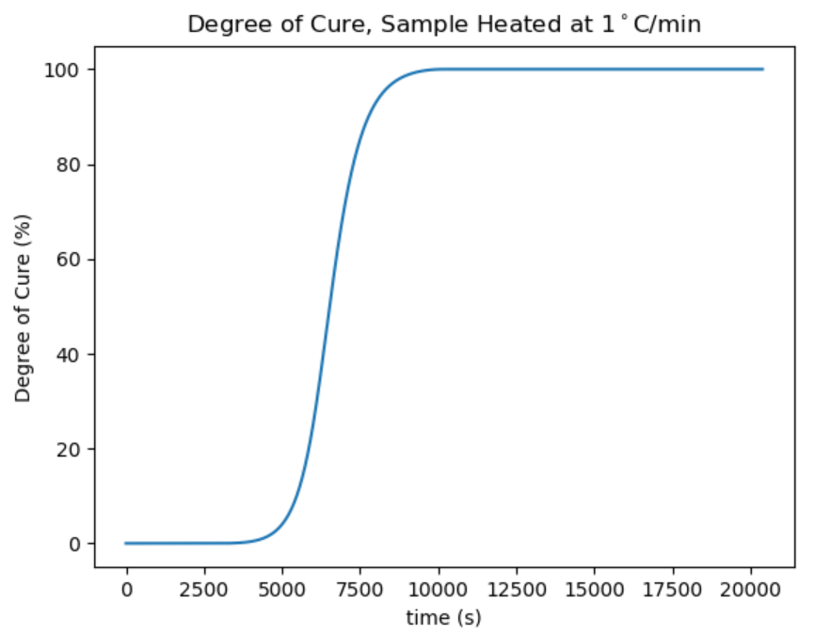
We define our degree of cure as the portion of heat given off.

Slide 13
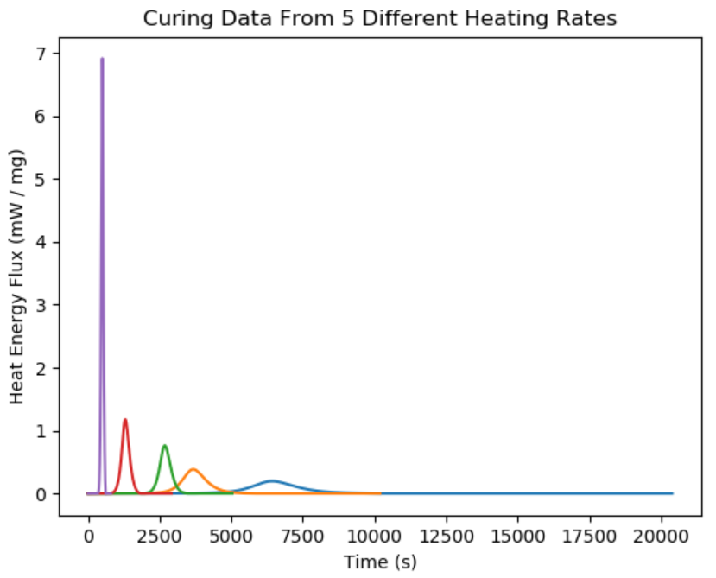
Repeating this study with various heating rates…

Slide 14
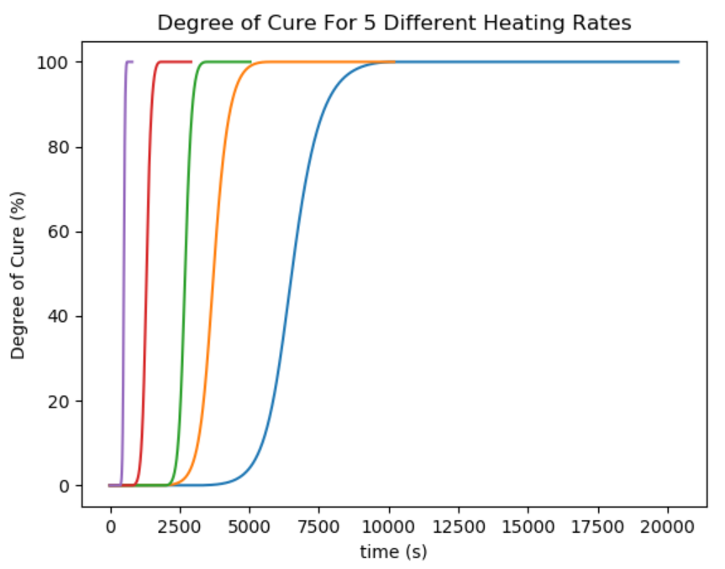
…gives us a breadth of data to use for our predictions.

Slide 15
The Math:
At the end of the day, we want the time it takes to reach a degree of cure.

Slide 16

The Math:
(Please forgive the calculus)

Slide 17

The Math:
Gas constant
Temperature and time from experimental data
Time to reach α
Isothermal temperature
For prediction
Something else altogether… we need to calculate this.

Slide 18

The Math:
We’ll calculate E_{α} by minimizing this cost function. (Find the value of E_{α} for which φ has the lowest value.)

Slide 19
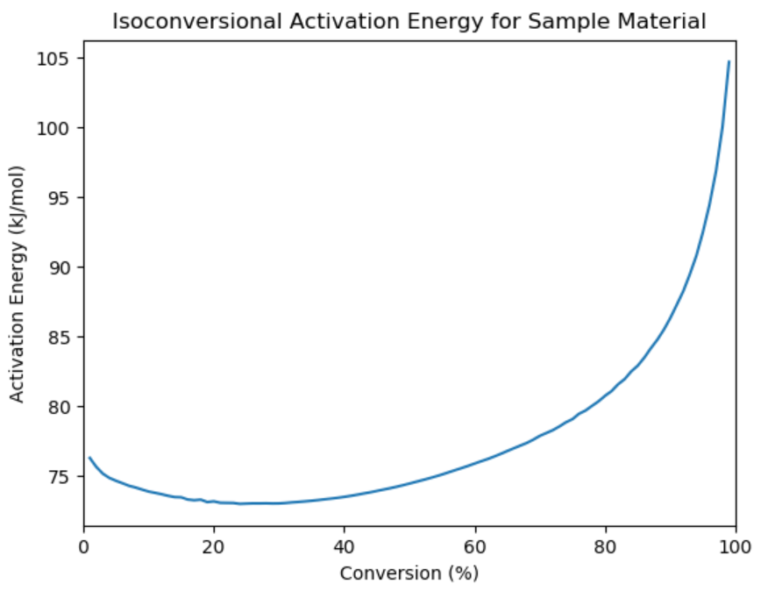
E_{α} is out “Activation Energy”. It varies with degree of cure.

Slide 20
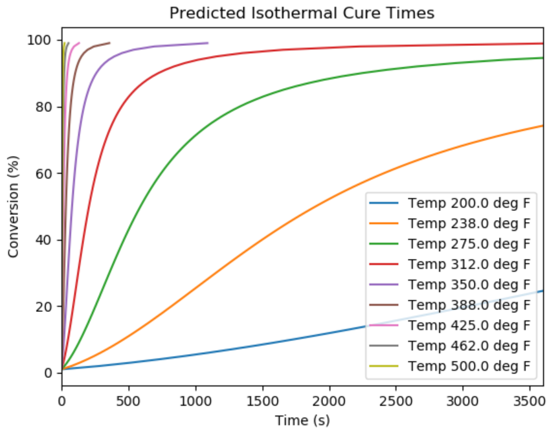
Now we can predict cure time for any isothermal temperature!

Slide 21
Validation:
…but is it right?

Slide 22
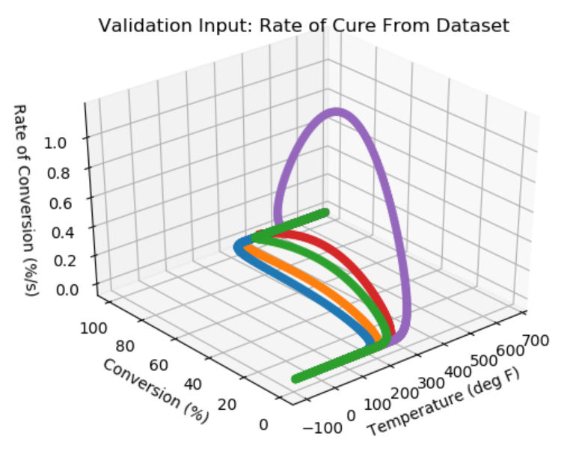
This is data from the experimental runs.

Slide 23
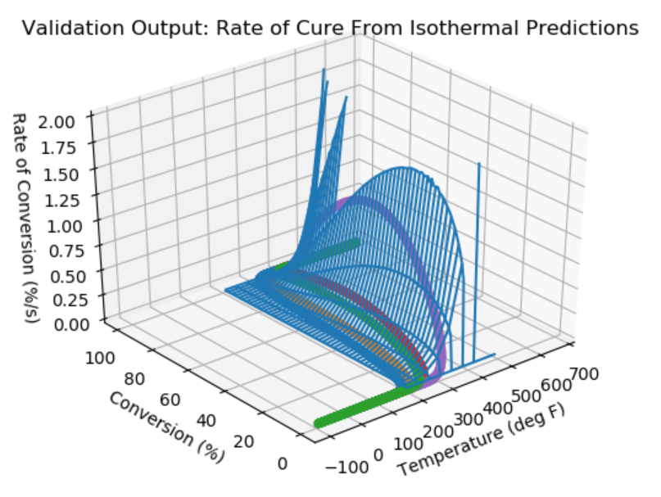
Now with predicted results on top.
It looks good!

Slide 24
Reference:
Sbirrazzuoli, Nicolas, et al. "Integral, differential and advanced isoconversional methods: complex mechanisms and isothermal predicted conversion–time curves." Chemometrics and Intelligent Laboratory Systems 96.2 (2009): 219-226.

Slide 25
Questions?
?
?
?
?
?

