Slide 1
The Goal:
Predict how long it takes an epoxy to cure at a given temperature.

Slide 2
The Problem:
Can’t test it directly.

Slide 3
The Problem:
In the process of heating the sample to the target temperature,
The cure advances at intermediate temperatures.

Slide 4
The Solution:
“Isoconversional” techniques.

Slide 5
Isoconversional:
The rate that the cure progresses depends only on:
The current temperature and
The current degree of cure
(0% - 100%)

Slide 6
The Plan:
Heat the epoxy at a controlled temperature ramp.
Record the temperature and information about cure.

Slide 7
The Data:
The following slides show pre-processing of the data.

Slide 8
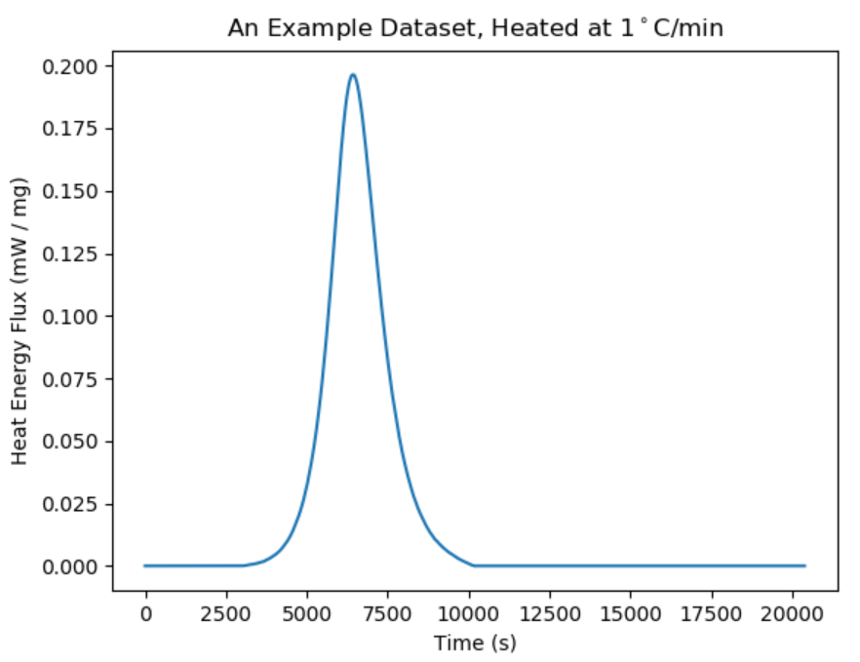
As the epoxy cures, it gives off heat.

Slide 9
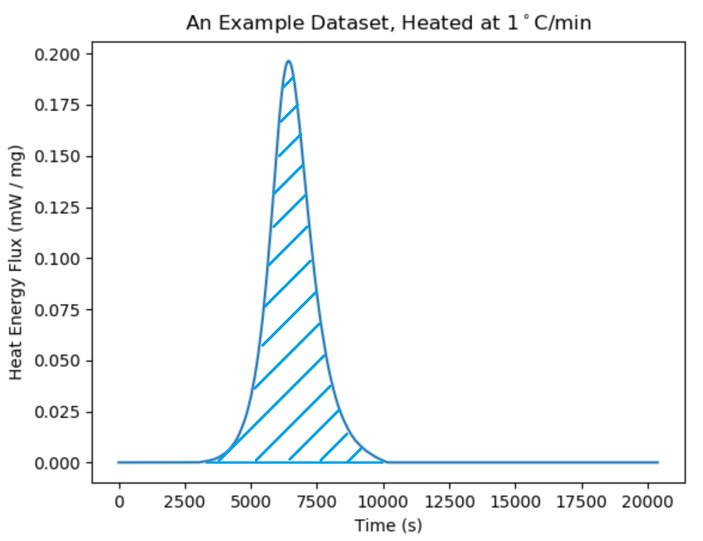
The blue hatched region is total amount of heat energy given off.

Slide 10
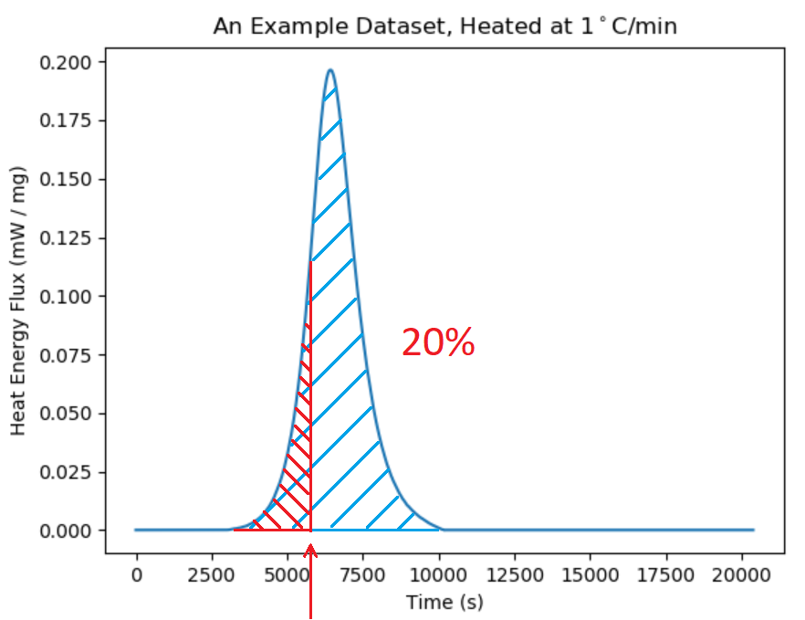
At the time marked by the red arrow, 20% of the total heat energy has been given off.

Slide 11
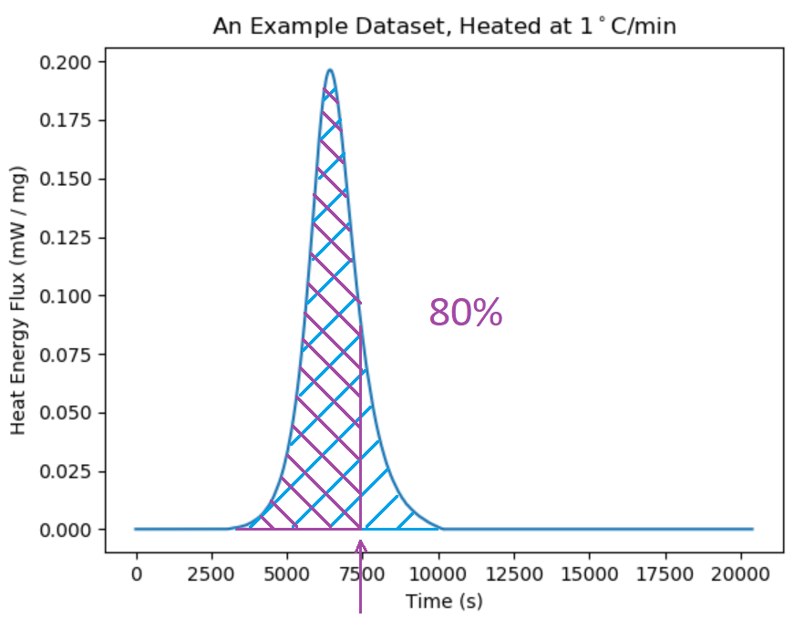
At the time marked by the purple arrow, 80% of the total heat energy has been given off.

Slide 12
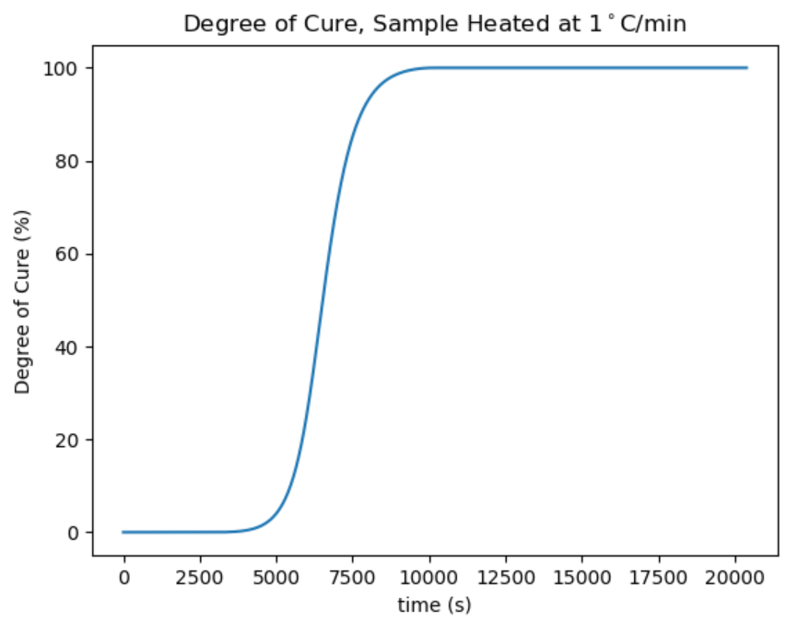
We define our degree of cure as the portion of heat given off.

Slide 13
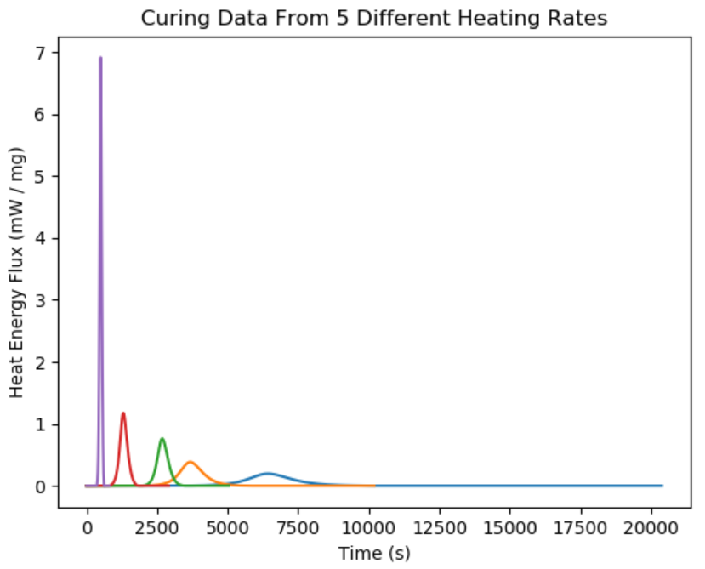
Repeating this study with various heating rates…

Slide 14
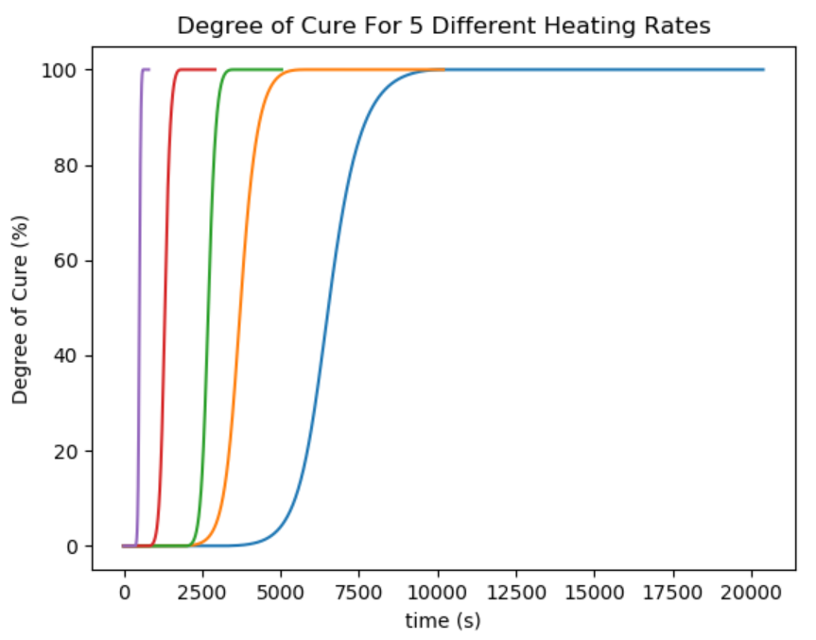
…gives us a breadth of data to use for our predictions.

Slide 15
The Math:

