Slide 1
Ansible
Presented by Craig Maloney
http://decafbad.net

Slide 2

https://flic.kr/p/9iQD1E

Slide 3
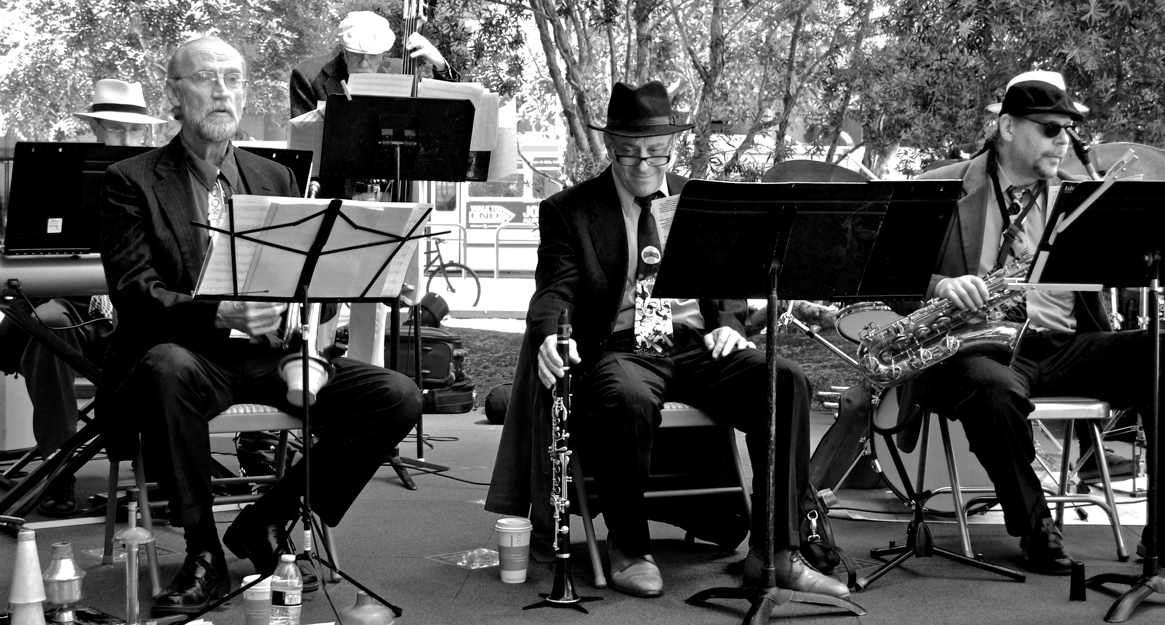
https://flic.kr/p/os3JHY

