Slide 1

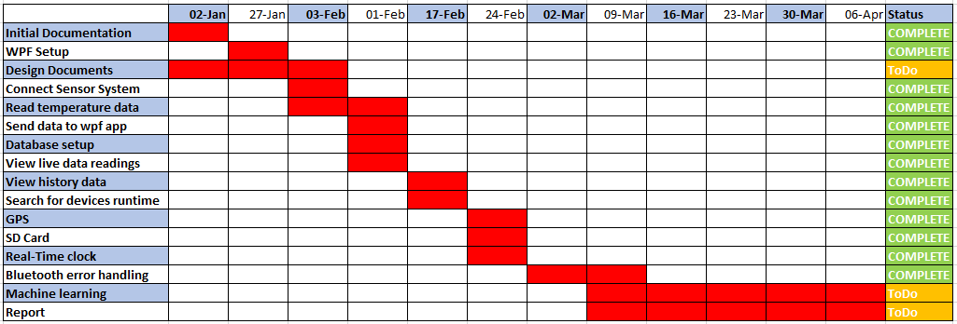
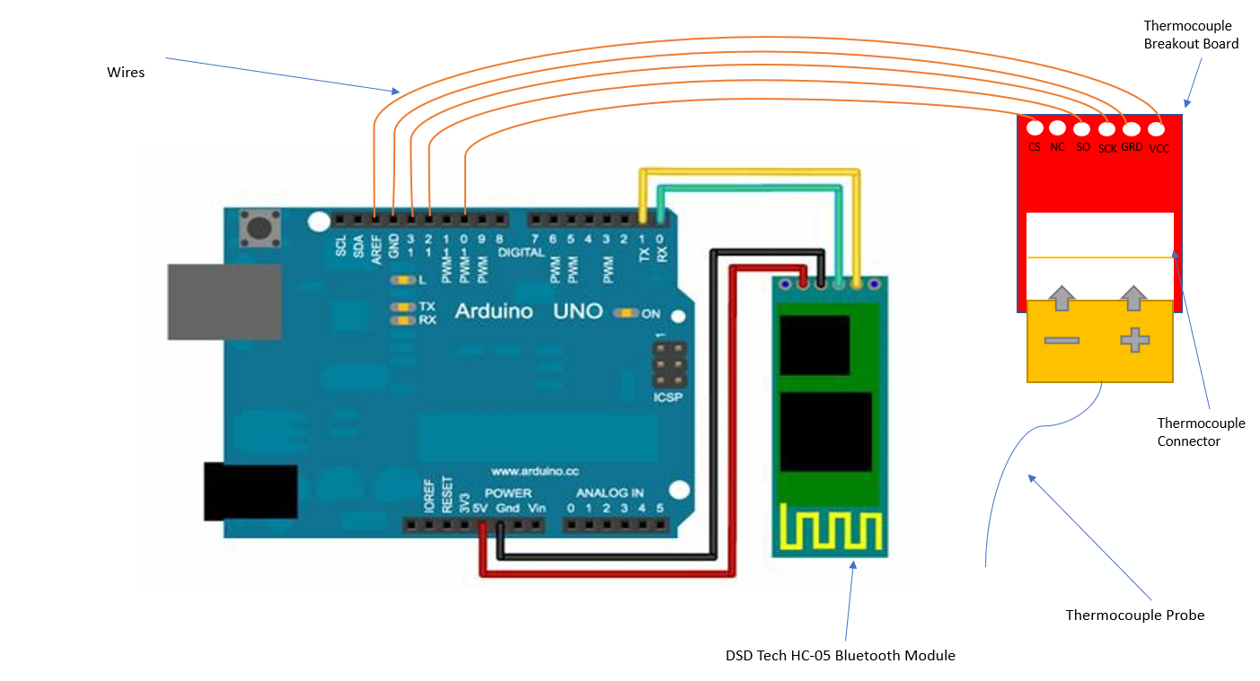
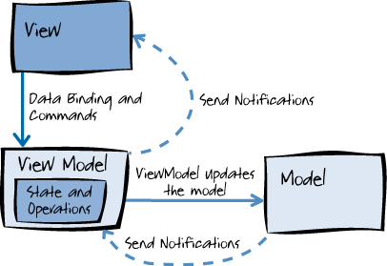
IoT Sensor System to Record The Temperature and Location for Ladles Used In Metallurgy
Craig Martin – Q5031372 BSc Computer Science
Scope
Objectives
Research & Analysis
Constraints & Problems
My project is to create an Arduino sensor system that can record the temperature and GPS location each second.
Each Arduino in the sensor system will communicate with a nearby windows device to display and store the information in a Windows Presentation Foundation (WPF) application using Bluetooth.
Material Processing Institute are a company in Teesside that create meatal castings and require this solution to improve their metal making process.
My objective is to create a system capable of the following:
Record Current Environmental Temperatures
Record Current GPS Location
Communicate with nearby Windows device using Bluetooth
Store the data locally on the sensor if the Bluetooth connection fails
Display the sensor information on a WPF application
Store the data in a SQL database
The world is becoming more dependent upon computers and sensors to tell us real- time data. It is predicted that in 2020, the number of smart devices will exceed 38.5 billion.
The reasoning for using Arduino’s is because they are very cheap, and their parts are easily configurable and replaceable (What is Arduino).
A Type-K Thermocouple will be used to record the temperature, a similar implementation was found which I will base my project on.
A problem that I have identified is running multiple Serial Peripheral Interfaces (SPI) devices from one Arduino. An SPI device is a communication method used between devices for fast transmission. The SPI devices I am using in the project require pins twelve and thirteen on the Arduino, therefore I must devise a method for the devices to be able to share these pins.
Another aspect that will be challenging will be recording data if the Bluetooth signal fails, as the Arduino has a small, limited memory.
Project Timeline
The initial project timeline can be seen below, the majority of the application has already been completed and I am ahead of schedule. More features are being considered and added to compensate for the additional time remaining.
Some current tasks being developed are:
Adding GPS
Storing the data on a Micro SD card if the Bluetooth connection fails
Investigating machine learning and SSRS reports
Project Design
Throughout the project, I aim to use the Agile methodology as it is widely used in the industry. The work will be split into weekly sections with a sprint review each week.
The WPF application will be structured the Model-View-ViewModel architecture pattern. The pattern allows for code separate leading to stronger, more reusable code (The Model-View-ViewModel Pattern, 2018).
Hardware & Software
Arduino Sensor
Hardware required:
2 x Arduino Uno
2 x DSD Tech HC-05 Bluetooth
2 x Type K Thermocouple
2 x DS3231 Date Time
2 x GPS Shield 1.1
2 x Breadboard
1 x Windows Laptop
Software required:
Visual Studio 2019
Arduino IDE
SQL Management
Studio
Sends environmental data
WPF APP
Sends data for storage
SQL Database

