Slide 1
Writing with reStructuredText and Sphinx
Kevin Putnam

Slide 2
Tools
Required
Visual Studio Code with reStructuredText extension
Optional
Windows Subsystem for Linux v1
Ubuntu 20.04
Python 3.6 or better (included with Ubuntu 20.04)
Sphinx (install with pip)
Pandoc

Slide 3
Installing the reStructuredText extension for VS Code
Click View>Extensions (Ctrl-shift-x)
Type “restructuredtext” in the search field that appears at the top of list of installed extensions (It should say “Search Extensions in Marketplace”).
In the list of extensions, find “reStructuredText” by LeXtudio Inc. It should be at the top of the list.
Click the small blue “Install” button. Alternatively, click on the extension in the list and the full description of the extension should appear as a tab in the editor. There will be another “Install” button in the header area.

Slide 4
reStructuredText
reST is a simple and extensible open-source markup language that is easy for humans to read.
It is intended to be converted into other formats including HTML.
The reStructuredText specification is defined in Docutils.

Slide 5
Getting started with reStructuredText
Key concepts:
Built-in markup – headers, bullets, definition lists, etc.
Directives – adds new kinds of blocks and can sometimes be nested.
Roles – adds inline snippets.
Indentation – like Python it helps define blocks and the depth must match exactly.
Ways to convert reStructuredText to HTML:
Docutils: rst2html.py input.rst output.html
Pandoc: pandoc -f rst -t html input.rst > output.html
Sphinx: to be covered later in the presentation.
Automatically in GitHub and GitLab
https://raw.githubusercontent.com/intelkevinputnam/tech-writing-school/main/ktp-adv.rst

Slide 6
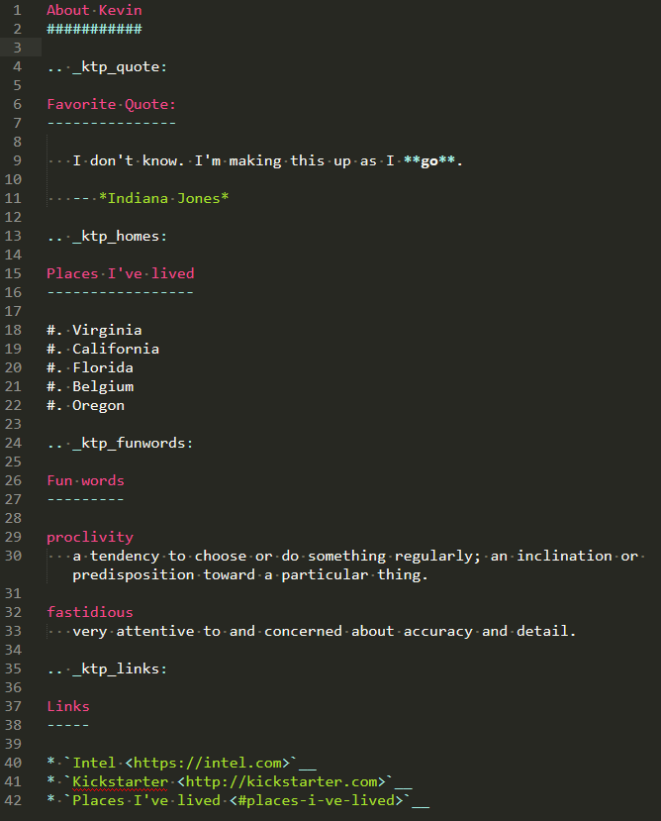
Built-in markup
1
6
7
Headers
Lists
Definition lists
Reference targets (make unique)
Links
Block quote
Bold/Italic
4
2
1
3
2
5

Slide 7
Roles – inline
Literal - : ``text`` or :literal:`text`
Code - :code:``
Math - :math:``
Emphasis - :emphasis:``
Strong - :strong:``
Subscript/Superscript - :sub:`` or :sup:``
Syntax:
The role name is between colons.
The content is between backticks.

Slide 8
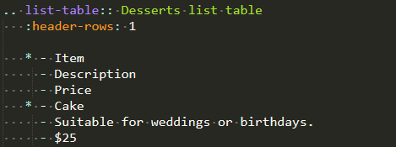
Directives – block (can sometimes be nested)
Internal table of contents - .. contents::
List Table - .. list-table::
Notes, Warnings, and Cautions - .. note:: or .. warning:: or .. caution::
Images and Figures - .. image:: or .. figure::
Code blocks - .. code:: or .. code-block::
Syntax:
1
Argument
Option
Indent must match
3
2

Slide 9
Create your own version
Use the example file (ktp-adv.rst) as a template to share some information about yourself.
Rename the file using your initials or your name.
Send it to me via email. Don’t forget to send your image file too, if you used one.

Slide 10
Sphinx
Sphinx is an open-source documentation generation framework that uses reStructureText as its source.
It was originally developed to create documentation for the Python programming language and is written in Python.
It can combine any number of reST files into a single document set. Sphinx markup is a superset of reStructuredText, defining new directives and roles.
Sphinx makes it easy to customize the look and feel of the static HTML output.

Slide 11
Sphinx basics
The .. toctree:: directive is the most important element of a Sphinx project. Every reST file must be referenced by a toctree.
Link to any reference target using the :ref: role no matter what file it is in (this is why they should be unique).
Only two files are required (the 3rd is optional):
conf.py – configuration information for the Sphinx project.
index.rst – top level file with primary toctree.
Makefile/make.bat – are included to make building easier.
Build the docs:
Using make: make html
sphinx-build -b html . _build/html

Slide 12
Takeaways
Most of reST is defined in Docutils.
Sphinx combines reST files to create a hierarchical document.
Sphinx also defines a superset of reST.
Configure your Sphinx project in the conf.py.

